Slide 1
Revising Trigonometry

Slide 2
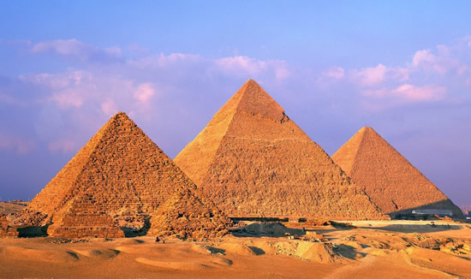

Slide 3
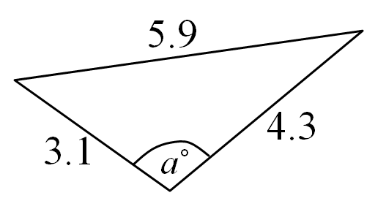
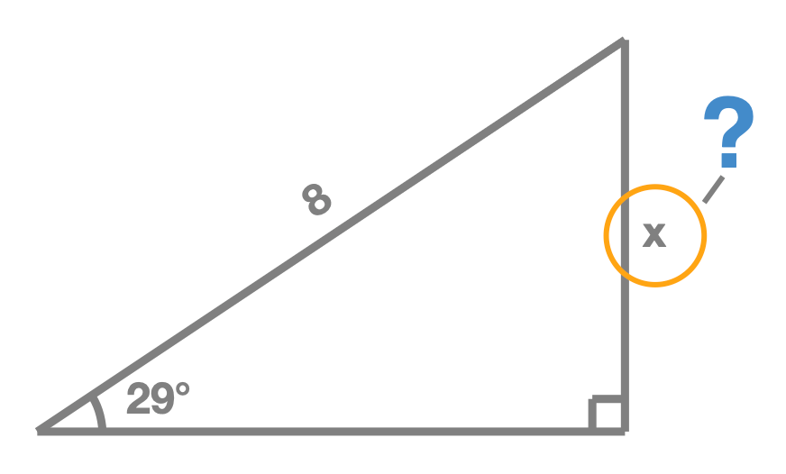
Every Trigonometry question involves…?
Angles | Sides

Slide 4
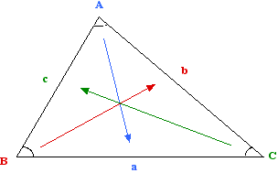
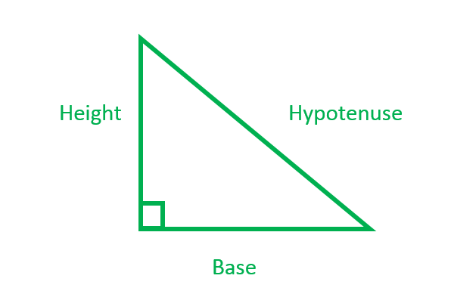
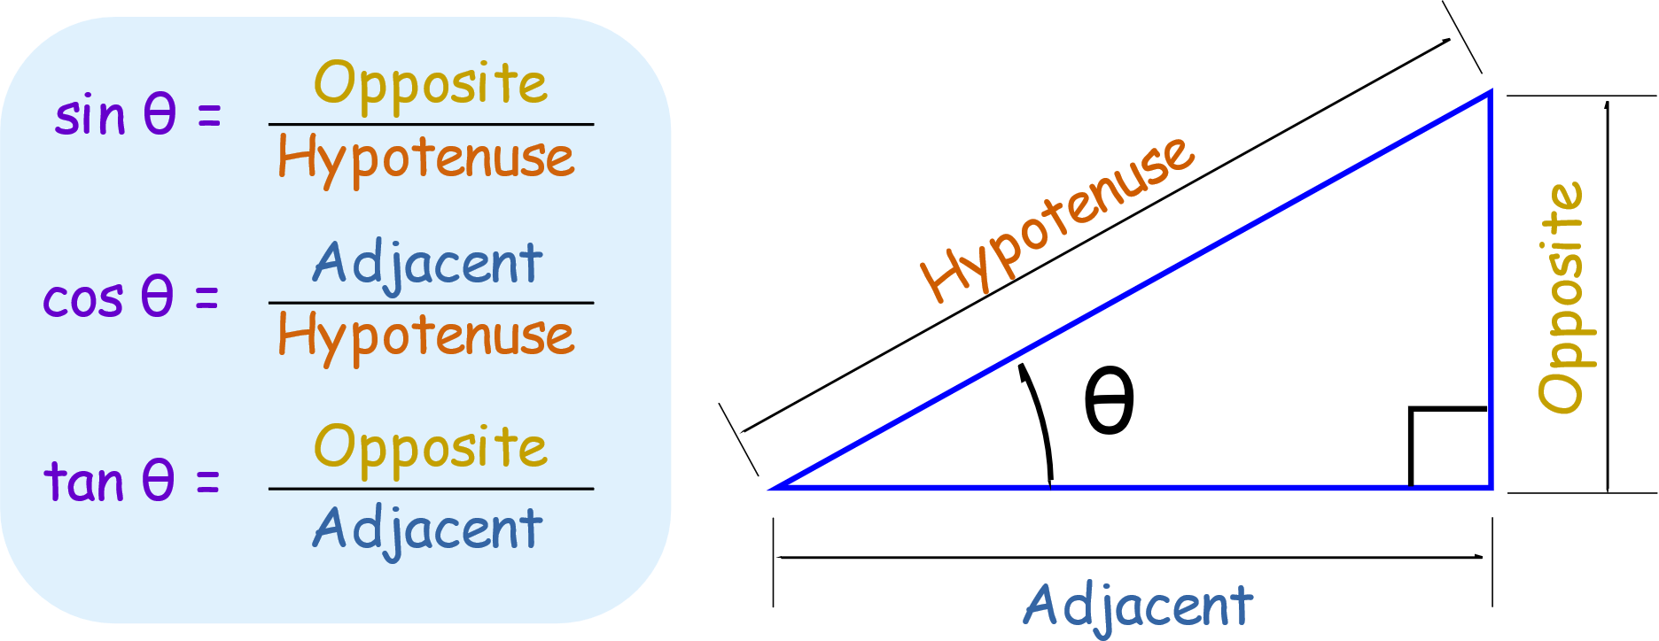
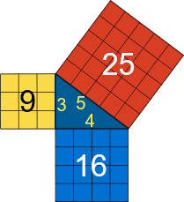


HOW YOU ANSWER TRIGONOMETRY QUESTIONS DEPENDS ON THE TYPE OF TRIANGLE
Non Right-Angled | Right-Angled
Sine Rule
Cosine Rule

Slide 6
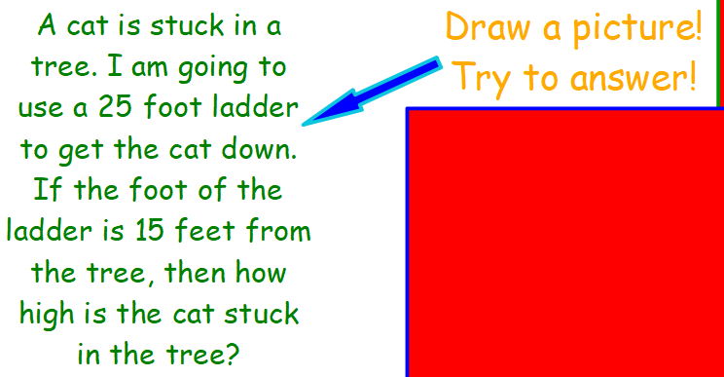

Revision question 1

Slide 7
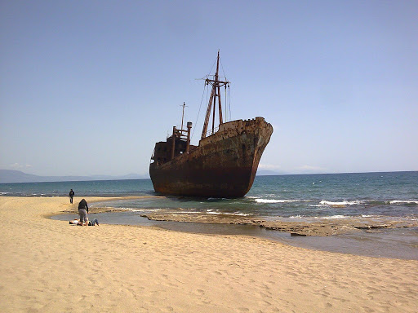
Revision question 2
James and Rachel are standing at the beach, 10 metres apart. James and Rachel both see a ship in the water.
The angle between James’ spot on the coastline and the ship is 35 degrees. The angle between Rachel’s spot on the coastline and the ship is 45 degrees.
How far away is the ship from James?

Slide 8
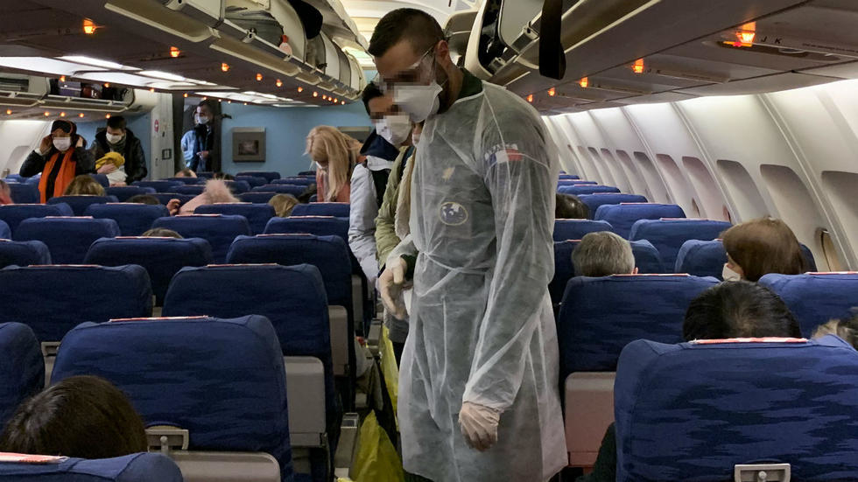
Revision question 3
A plane has flown 20 miles north of its departure airport, Airport A.
The pilot discovers that a passenger may be infected with the Coronavirus.
It has to emergency land at Emergency Airport B, 15 miles away, 63 degrees to the South East.
After it lands at Airport B, how far will the plane have to travel to get back to Airport A?

