Slide 1
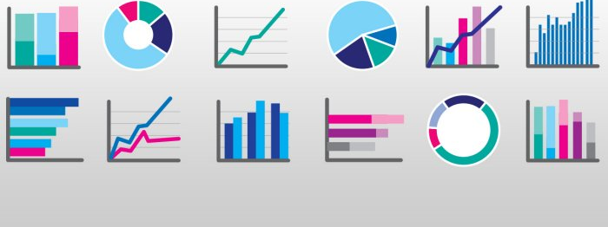
Re- Introduction to Statistics

Slide 2
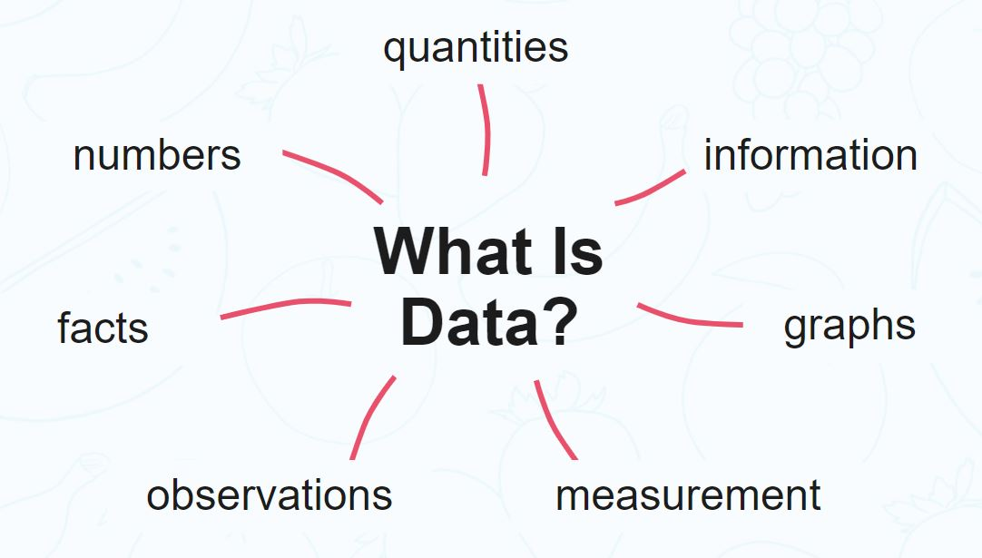

Slide 3







Uses of data?

Slide 4
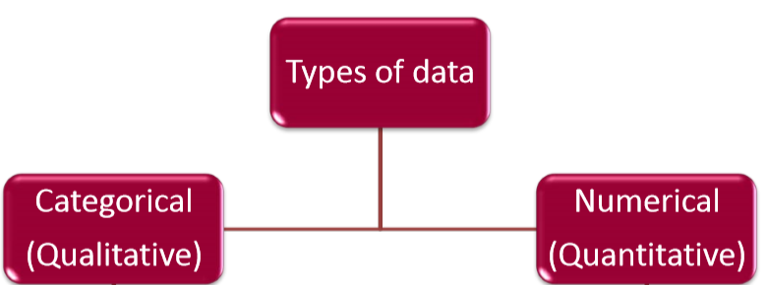

Slide 5
Qualitative Data | Quantitative Data
Deals with descriptions. | Deals with numbers.
Data can be observed but not measured. | Data which can be measured.
Colours, textures, smells, tastes, appearance, opinions, etc. | Length, height, area, volume, weight, speed, time, temperature, sound levels, cost, ages etc.
Qualitative -> Quality | Quantitative -> Quantity

Slide 6
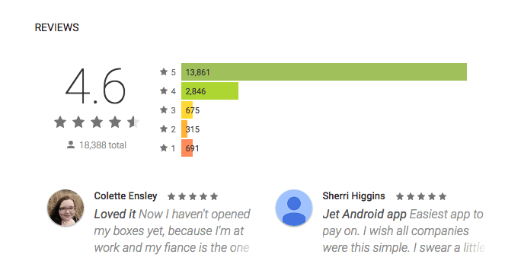
Qualitative and Quantitative Data

Slide 7
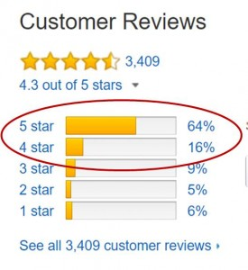
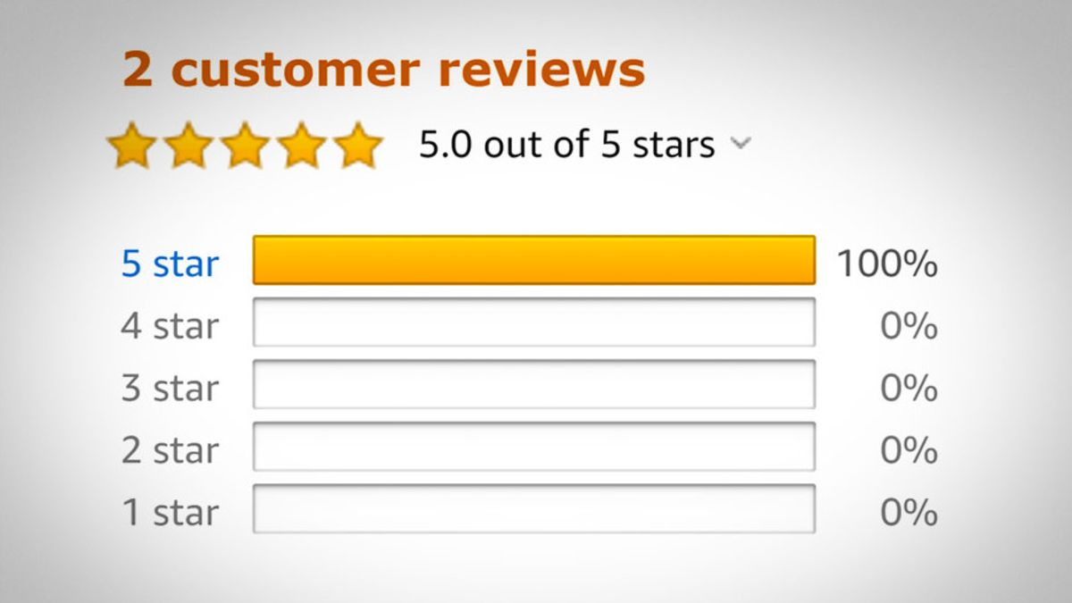
Accuracy of Data

Slide 8
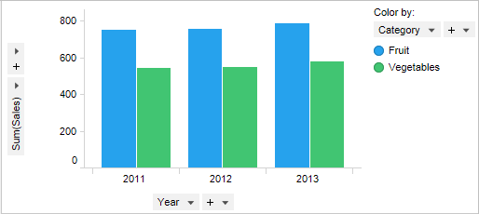
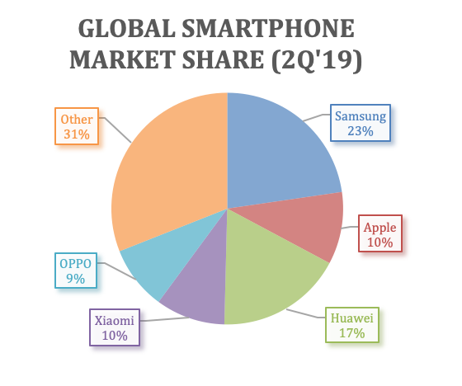
Visualising and Analysing Data

Slide 9
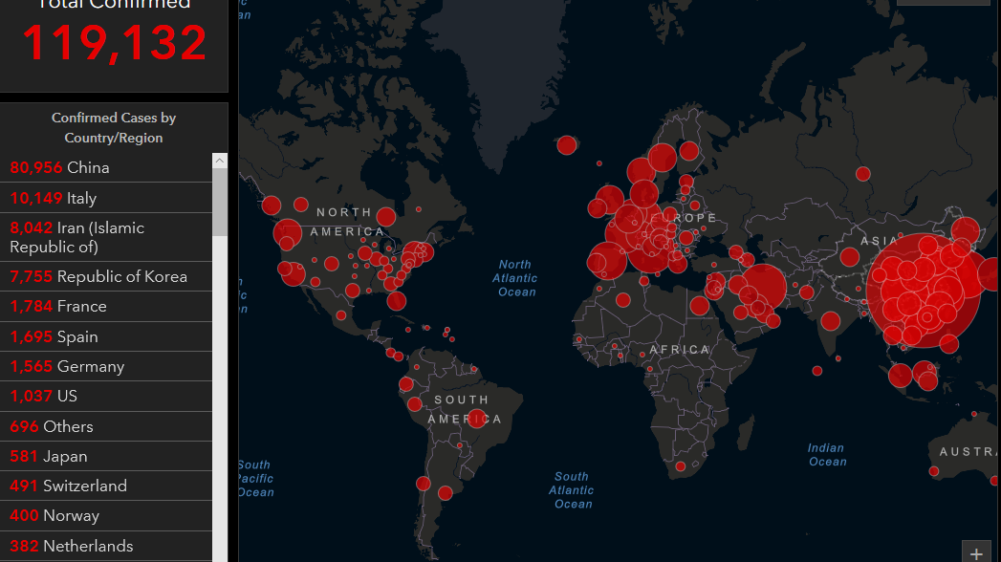

Slide 10
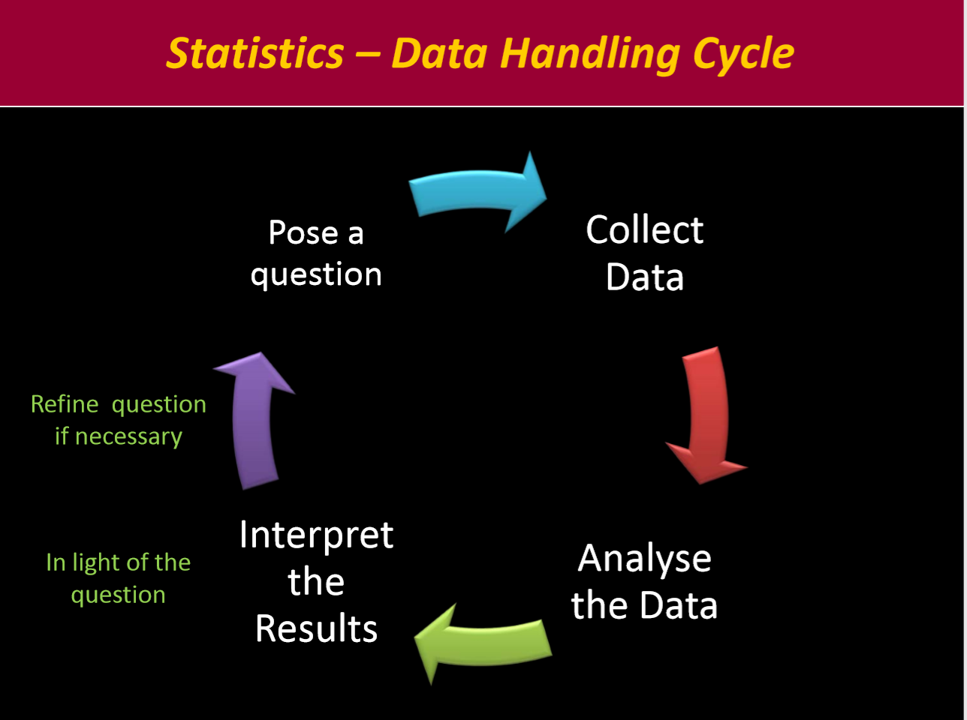

Slide 11
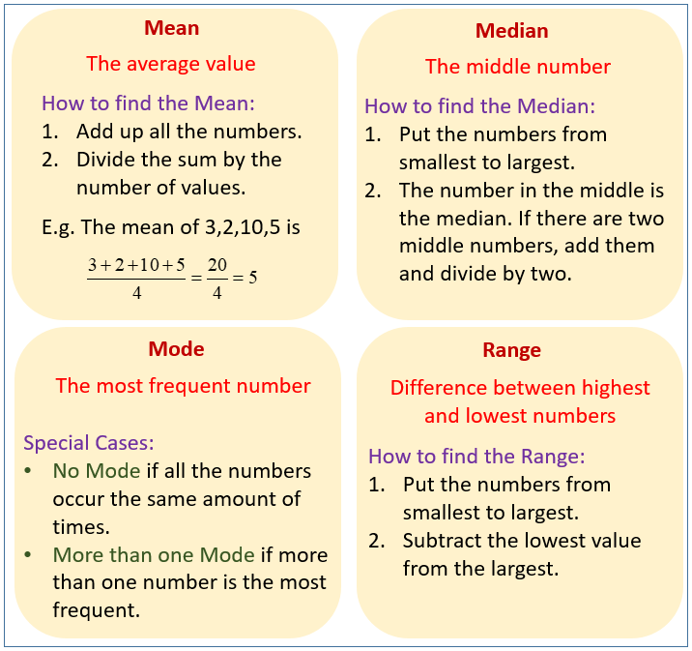
Analysing Data

