Slide 1
Complex Numbers
An Introduction

Slide 2
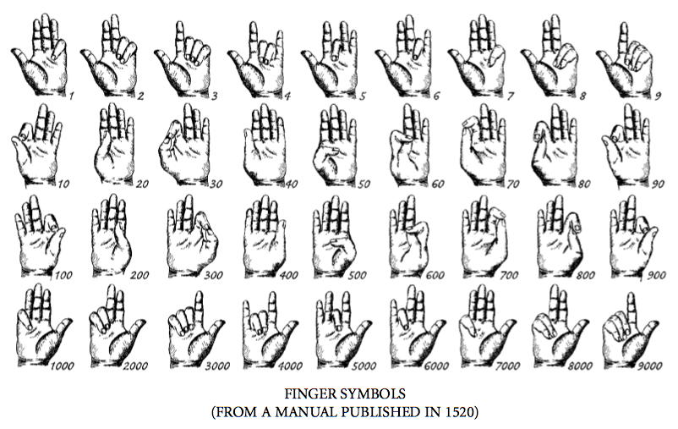
How high can you count with your hands?

Slide 3
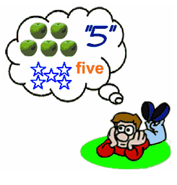
What are Numbers? e.g Five?

Slide 4
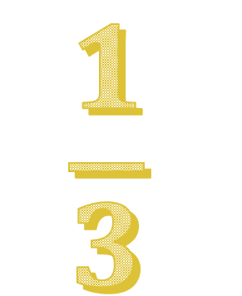
Different Types of Numbers?
-5
-4.657
137
0.32
$$\frac{1}{3}$$
1869004181

Slide 5
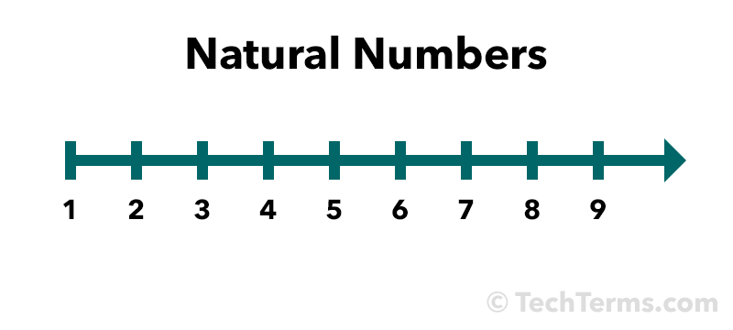
N = Natural Numbers

Slide 6
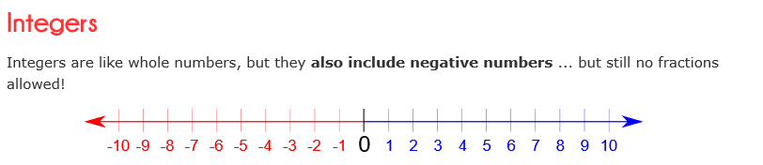

Z = Integers

Slide 7

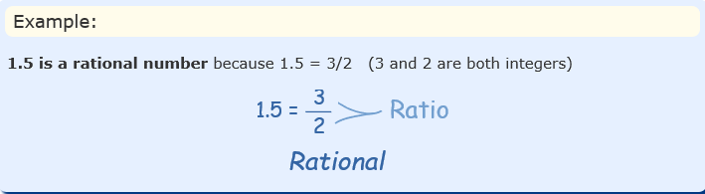

Q = Rational Numbers
0.62 $\frac{−16}{27}$ 3.2 $\frac{5}{8}$

Slide 8

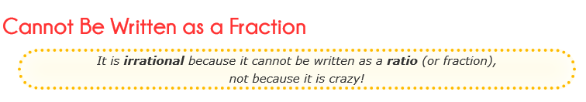
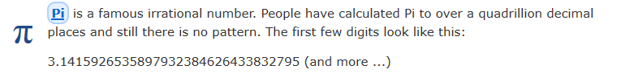
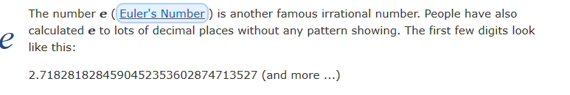
Irrational Numbers

Slide 9
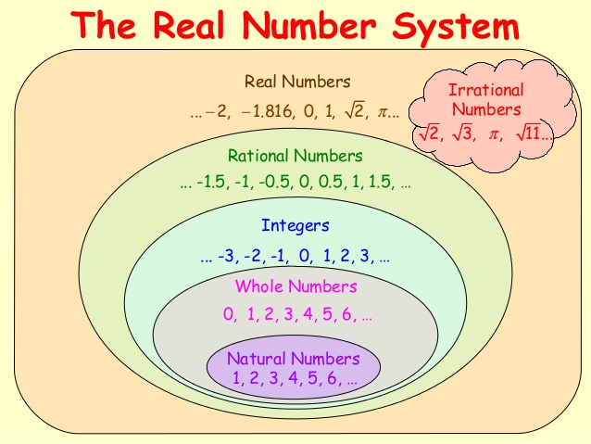

Slide 10
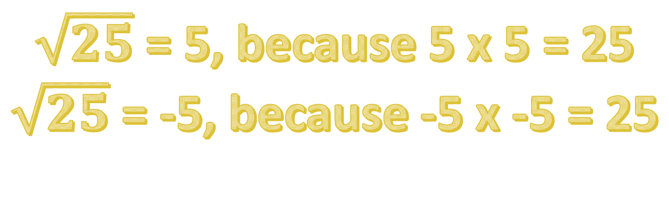
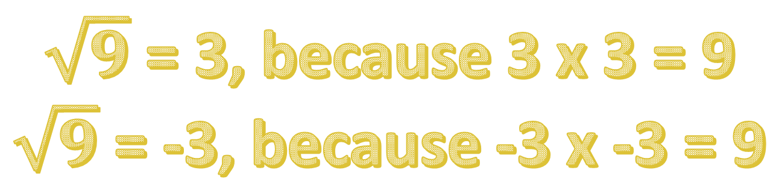
Investigating numbers that aren’t Real
$\sqrt{9}$ = 3, because 3 x 3 = 9
$\sqrt{9}$ = -3, because -3 x -3 = 9
$\sqrt{25}$ = 5, because 5 x 5 = 25
$\sqrt{25}$ = -5, because -5 x -5 = 25

Slide 11

Investigating numbers that aren’t Real
$\sqrt{−1}$ = ?
No answer, because you can’t get the square root of a negative number. So we call it an imaginary number.

Slide 12
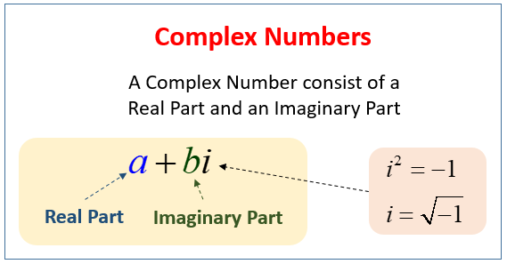
Complex Numbers

Slide 13



Complex Numbers
$$3−i$$
$$7+2i$$
8 $+ 4i 3i$

Slide 14

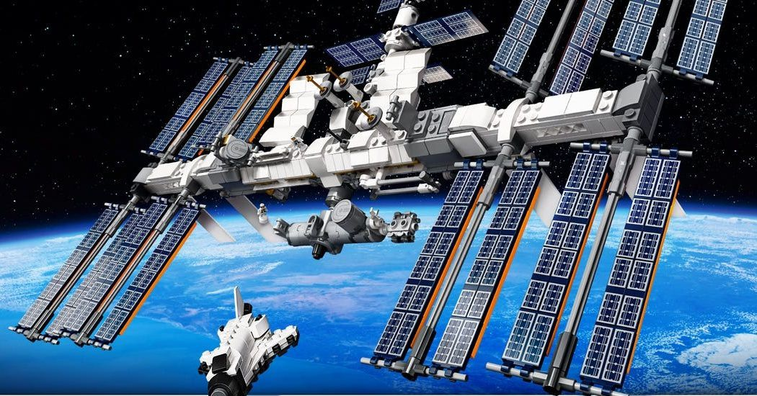

We need Complex Numbers for:

