Slide 1
The Complex conjugate
complex numbers

Slide 2
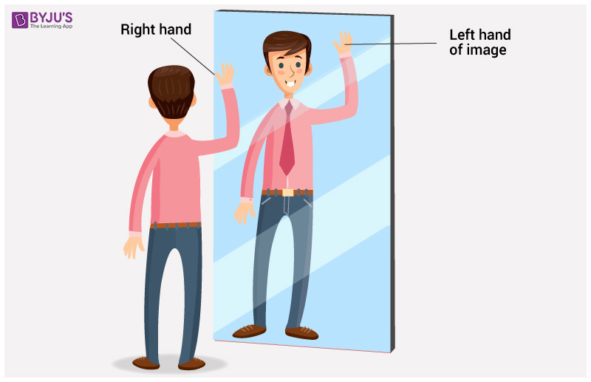
What is a Reflection?

Slide 3
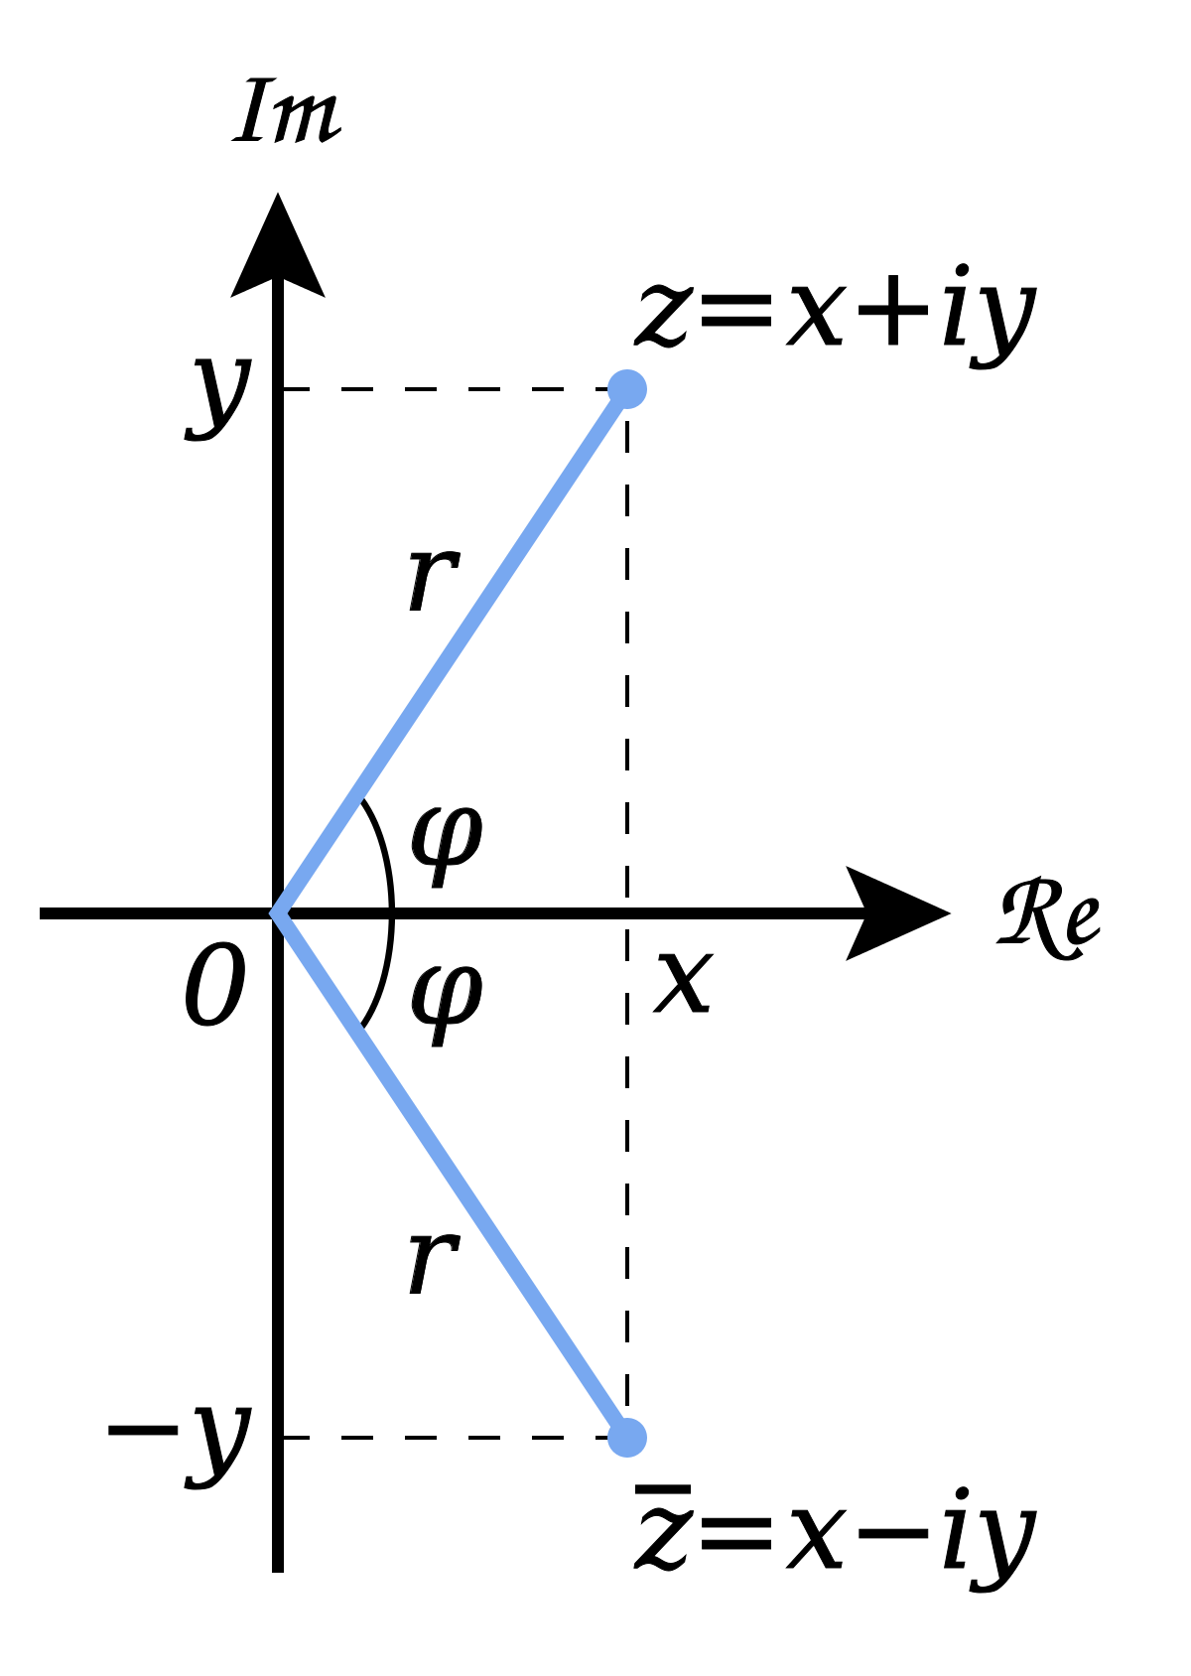
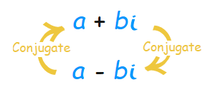
The Complex Conjugate
Every Complex number has a conjugate pair:
This is its reflection over the Real axis.
To calculate a conjugate you change the sign of the Imaginary part.

Slide 4
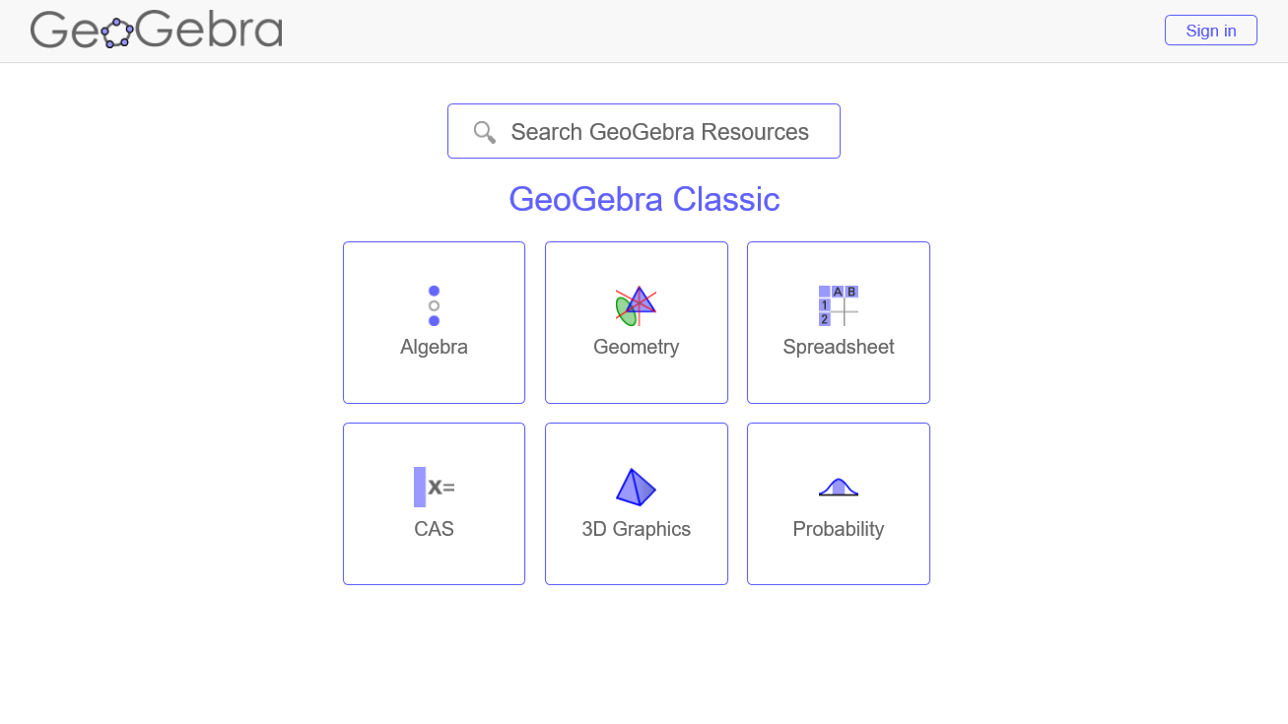

Slide 5
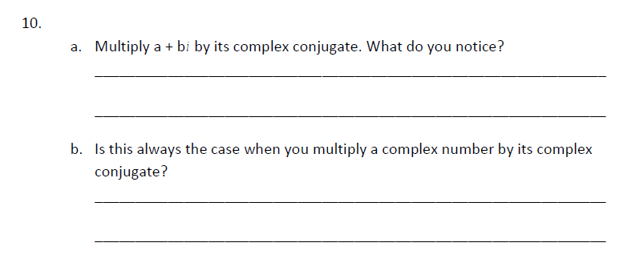
“…what about dividing a Complex number by another Complex number?”
This feature of complex conjugate is very useful for division:

