Slide 1
Operations: division
Complex numbers

Slide 2

Why haven’t we divided yet?

Slide 3
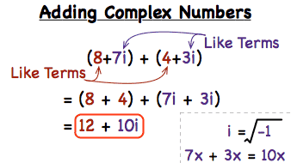
Addition

Slide 4
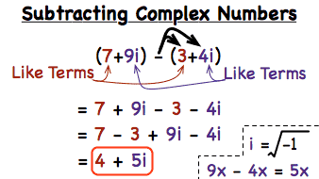
Subtraction

Slide 5
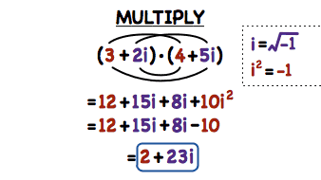
Multiplication

Slide 6
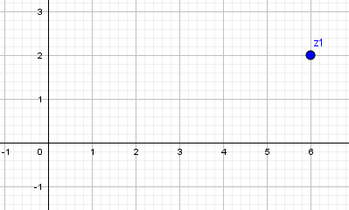
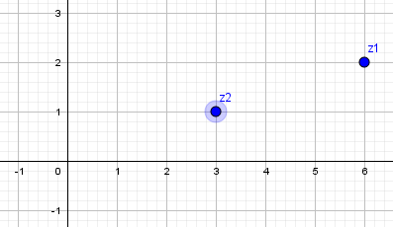
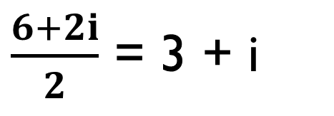
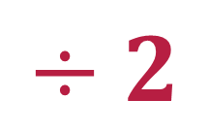
Division by 2
$$÷2$$
$\frac{6+2i}{2}$ = 3 + i
6 + 2i

Slide 7
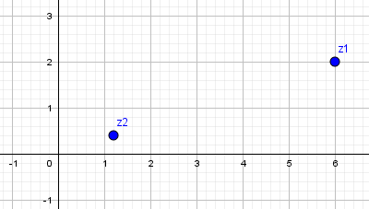
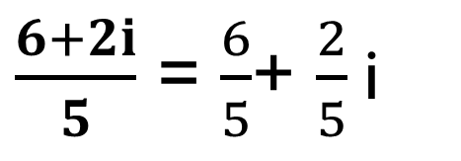
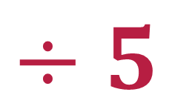
Division by 5
$$÷5$$
$\frac{6+2i}{5}$ = $\frac{6}{5}$+ $\frac{2}{5}$i
6 + 2i

Slide 8
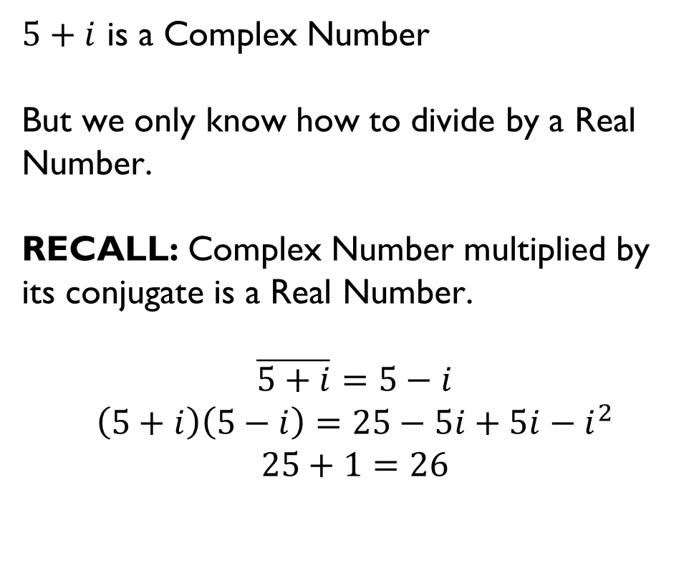
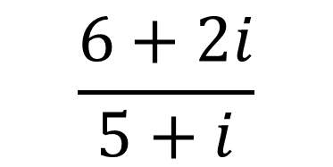
DIVIDE BY ANOTHER COMPLEX NUMBER
$5+i$ is a Complex Number
But we only know how to divide by a Real Number.
RECALL: Complex Number multiplied by its conjugate is a Real Number.
$$\overline{5+i}=5−i$$
$$\left(5+i\right)\left(5−i\right)=25−5i+5i−i^{2}$$
$$25+1=26$$
$$\frac{6+2i}{5+i}$$

Slide 9

DIVIDE BY ANOTHER COMPLEX NUMBER
We will have to multiply both the denominator and numerator by the conjugate.
$$\frac{(6+2i)}{(5+i)}x\frac{(5−i)}{(5−i)}$$
$$\frac{30−6i+10i−10i^{2}}{26}$$
$$\frac{30+4i−10(−1)}{26}$$
$$\frac{40+4i}{26}=\frac{20}{13}+\frac{2}{13}i$$
$$\frac{6+2i}{5+i}$$

