Slide 1
COMPLEX ROOTS OF QUADRATIC EQUATIONS
Complex numbers

Slide 2
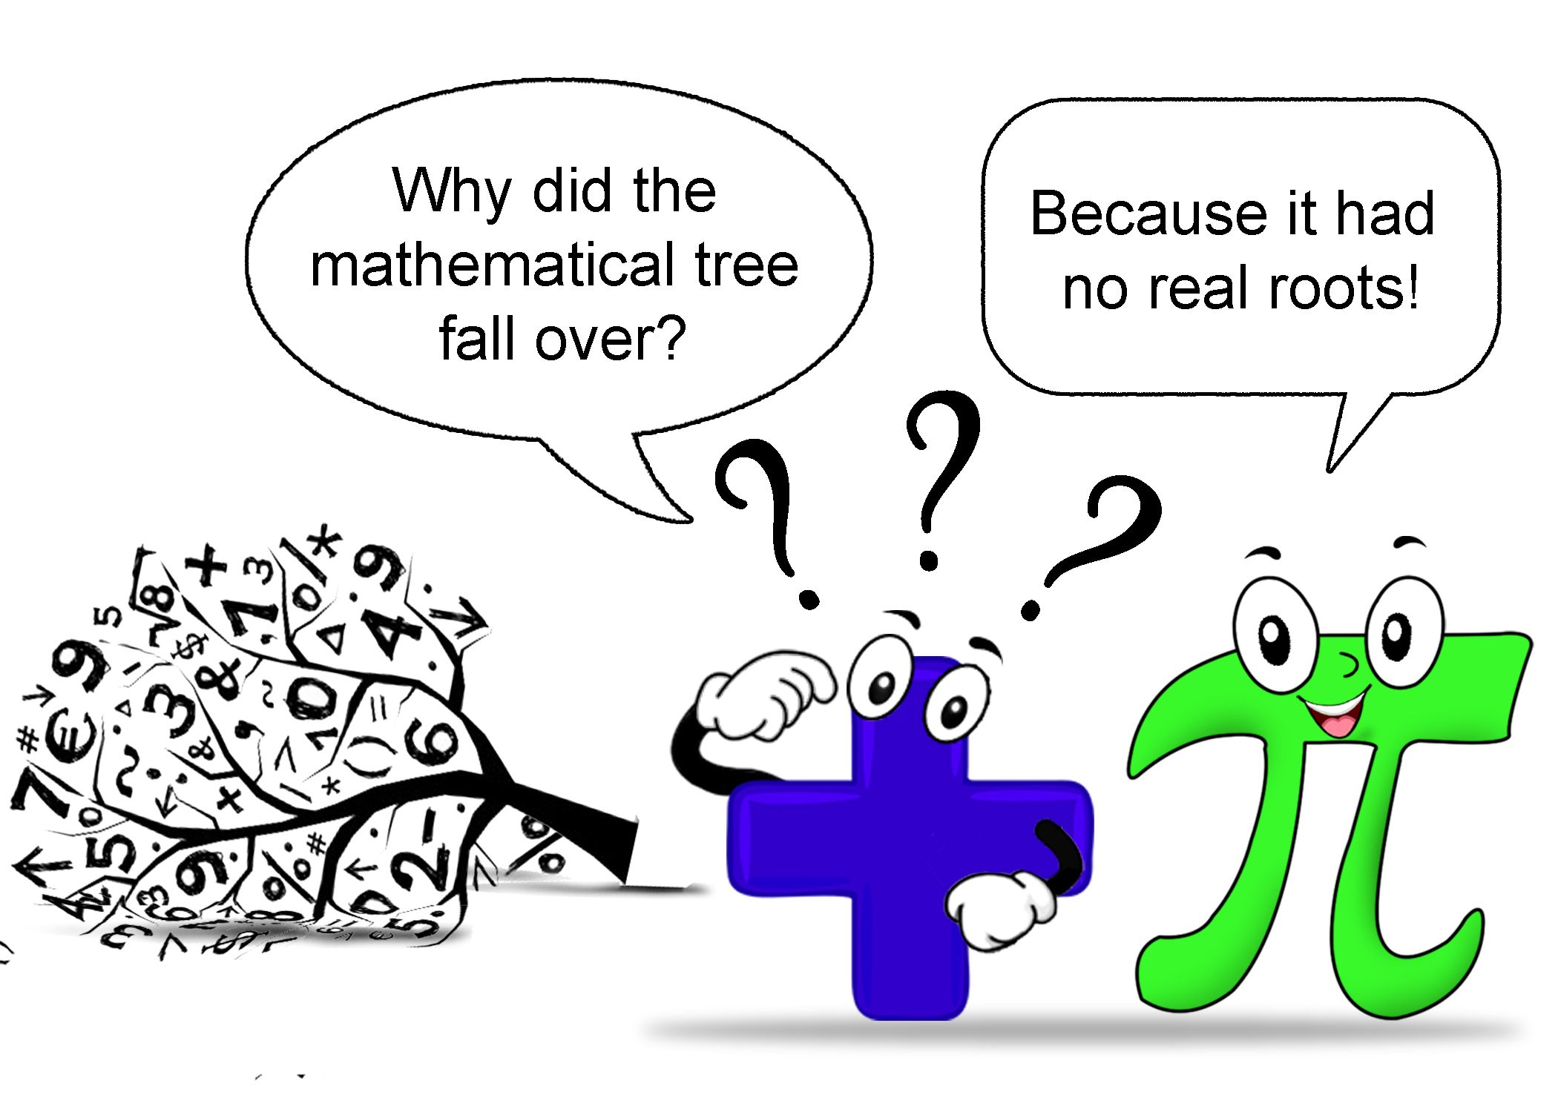
What are roots?

Slide 3
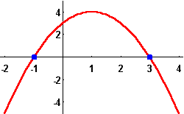
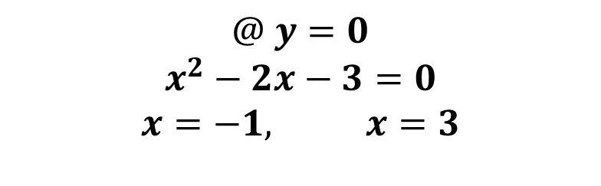
Real Roots
$$@ y=0$$
$$x^{2}−2x−3=0$$
$$x=−1, x=3$$

Slide 4
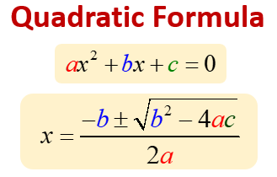
Calculating Roots

Slide 5
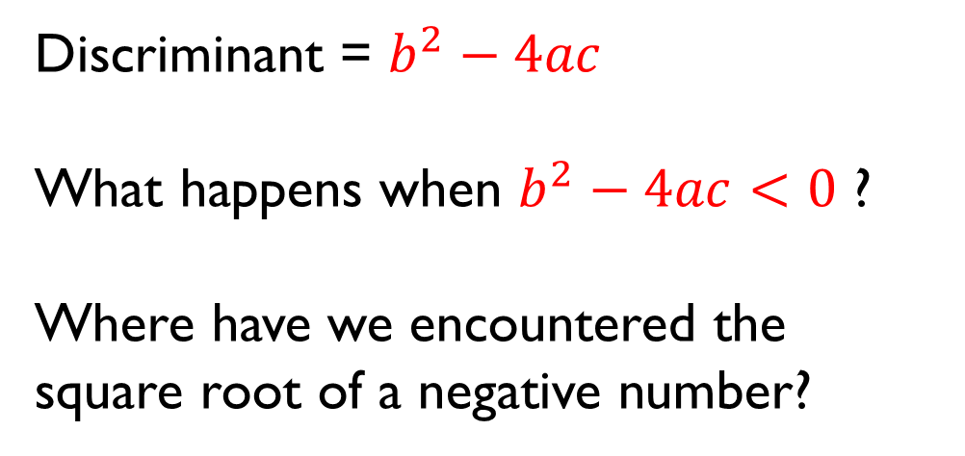
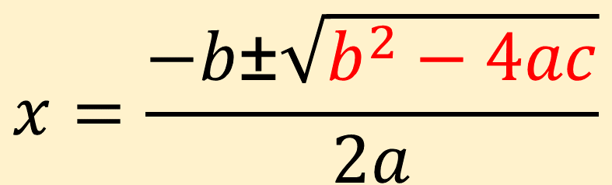
$$x=\frac{−b\text{±}\sqrt{b^{2}−4ac}}{2a}$$
Discriminant = $b^{2}−4ac$
What happens when $b^{2}−4ac<0$ ?
Where have we encountered the square root of a negative number?

Slide 6
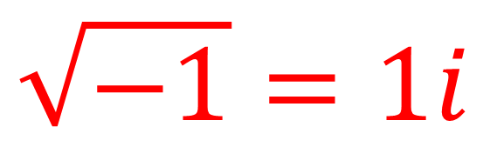
$$\sqrt{−1}=1i$$
$$\sqrt{−9}=\left(\sqrt{9} \right)\left(\sqrt{−1}\right)=\left(\sqrt{9}\right)\left(i\right)=3i$$
$$\sqrt{−25}=\left(\sqrt{25} \right)\left(\sqrt{−1}\right)=\left(\sqrt{25}\right)\left(i\right)=5i$$

Slide 7


Slide 8
