Slide 1
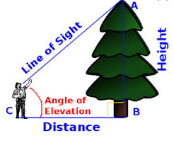
Triangles in Real Life

Slide 2
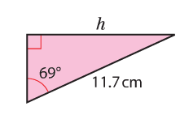
Trigonometry
SOH-CAH-TOA

Slide 3

Labelling Triangles
Before we even consider using trigonometry to solve problems, we need to know how to label right-angled triangles.
This is the hypotenuse. It is the longest side and always opposite the right angle
This is called the opposite. It is opposite the labelled angle.
H
O
A
The is called the adjacent. It is next to the angle.

Slide 4
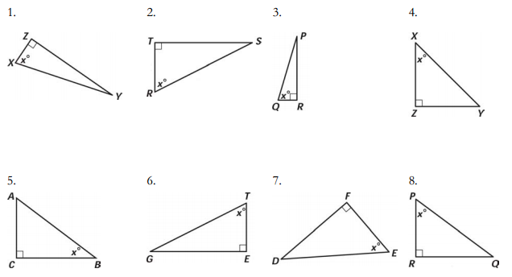



Label the following triangles…

Slide 5
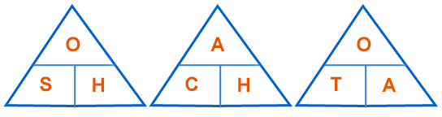
SOH-CAH-TOA
When we are faced with a trigonometry problem in a right-angled triangle, you need to remember…
SOH-CAH-TOA
This is the SINE triangle
This is the TANGENT triangle
These triangles allow us to easily remember each formula.
This is the COSINE triangle

Slide 6




Which rule do we use?
Every time you are faced with a trigonometry question, you will need to decide which rule you are using.
Do we use Sine, Cosine or Tan?
H
$$x$$
O
$$35°$$
A
$$12cm$$
We would be using the Tan rule.

Slide 7



Which rule do we use?
Do we use Sine, Cosine or Tan?
H
$$12cm$$
O
$$35°$$
A
$$x$$
We would be using the Cosine rule.

Slide 8



Which rule do we use?
Do we use Sine, Cosine or Tan?
H
O
$$12cm$$
$$5cm$$
$$x°$$
A
We would be using the Sine rule.

Slide 9

Using the triangles
The “Cover Up” Method
You simply cover up what you are looking for
If we using the Sine rule and we are looking for the Opposite, we cover up the opposite.
$$Opposite=sin\left(x\right)×hypotenuse$$

Slide 10

Using the triangles
The “Cover Up” Method
You simply cover up what you are looking for
If we using the Coine rule and we are looking for the Hypotenuse, we cover up the opposite.
$$Hypotenuse= \frac{adjacent}{cos(x)}$$

Slide 11

Using the triangles
The “Cover Up” Method
You simply cover up what you are looking for
If we are using the Tan rule and looking for the angle, we cover up tan.
$$Tan(x)= \frac{opposite}{adj}$$

Slide 12
SOH-CAH-TOA
Finding lengths in right-angled triangles

Slide 13






Find the length of x in the following triangle
Label the triangle
H
$$x$$
Decide which rule to use.
O
Use the cover-up method
$$35°$$
$$Opposite=tan\left(x\right)×adjacent$$
A
$$12cm$$
Substitute in your values
$$Opposite=tan\left(35\right)×12$$
$$Opposite=8.4cm$$

Slide 14
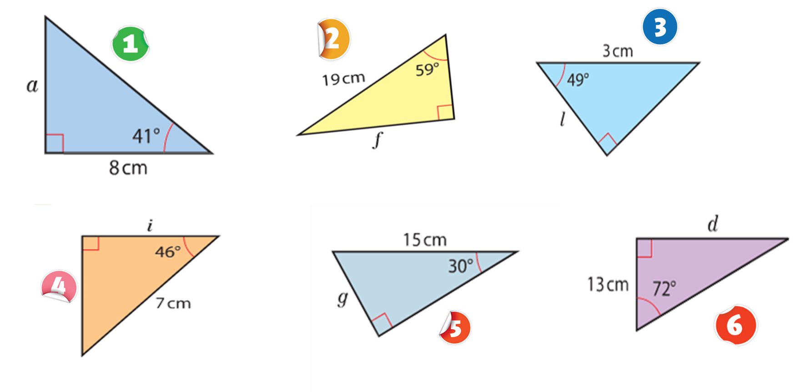
Independent Task - SOHCAHTOA

Slide 15
SOH-CAH-TOA
Finding angles in right-angled triangles

Slide 16





Find the angle x in the following triangle
Label the triangle
H
$$7cm$$
Decide which rule to use.
O
Use the cover-up method
$$x°$$
$$tan\left(x\right)= \frac{opposite}{adjacent}$$
A
$$12cm$$
Substitute in your values
$$tan\left(x\right)= \frac{7}{12}$$
$$\tan^{−1}\left(\frac{7}{12}\right)=30°$$

Slide 17

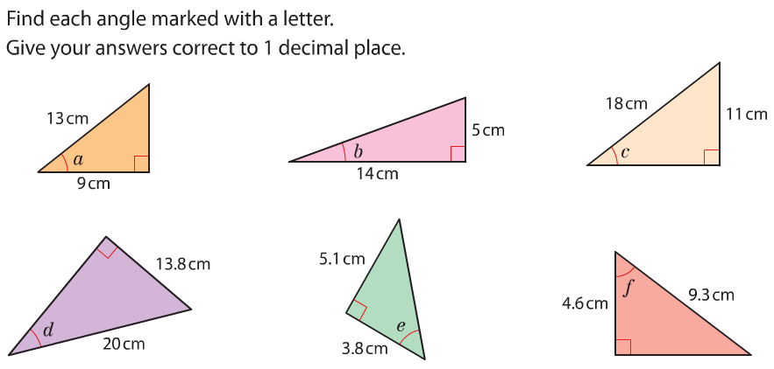





Independent Task - SOHCAHTOA

Slide 18
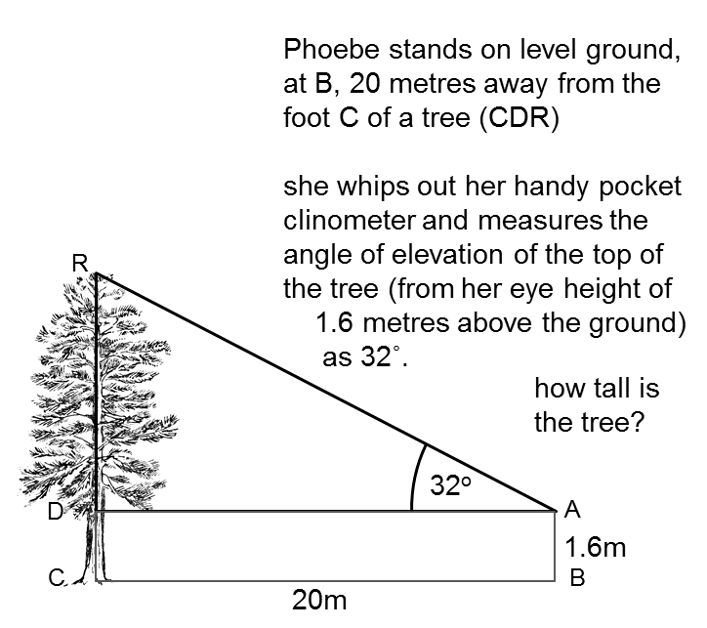






Stretch and Challenge
H
O
$$32°$$
A
$$20m$$
$$Opposite=tan\left(32\right)×20$$
$$Opposite=12.5m$$
$$Height of tree=12.5+1.6$$
$$=14.1m$$

