Slide 1
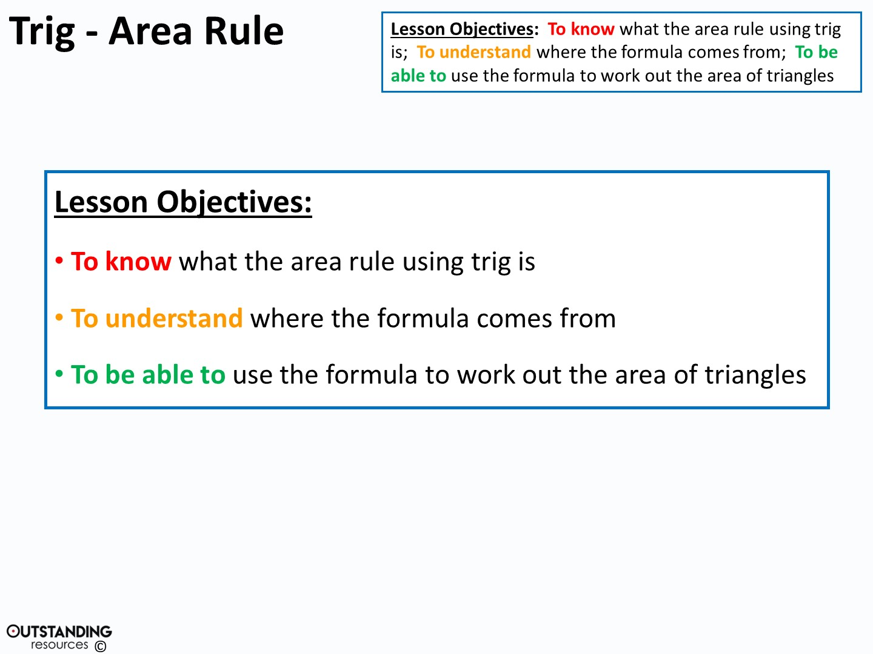

Slide 2
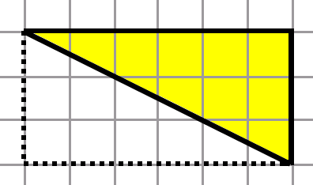
What do we know about Area from Right-angles Triangles?

Slide 3
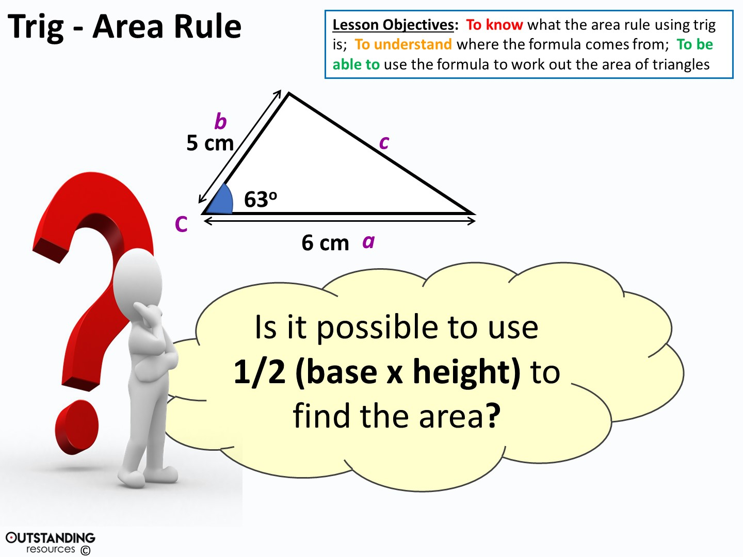
Notes:
Clipart – Questions Clipart #29226: taken from - http://clipartix.com/questions-clipart-image-29226/

Slide 4
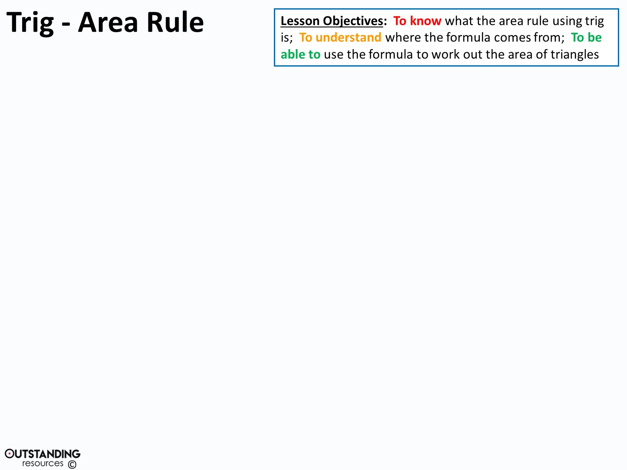
B
a
Area of a triangle
= ½(bh)
c
h
A
C
P
b
In triangle PBC, Sin C =
(xa) h = a sin C (xa)
Substituting this into ½bh gives:
Area = ½ ab.SinC

Slide 5
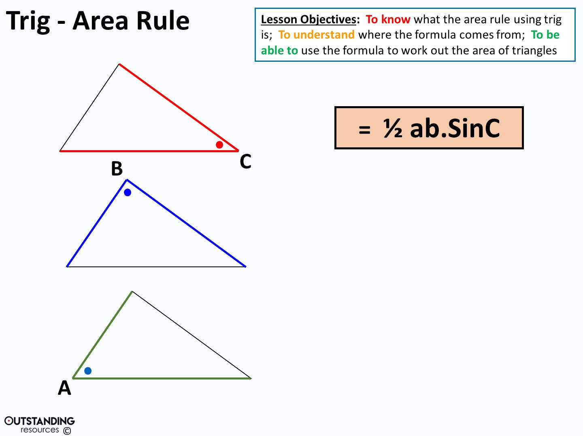
= ½ ac.SinB
= ½ bc.SinA
Notes:
NOTE: However you label the triangle it is ALWAYS the angle and the two sides that make that angle

Slide 6
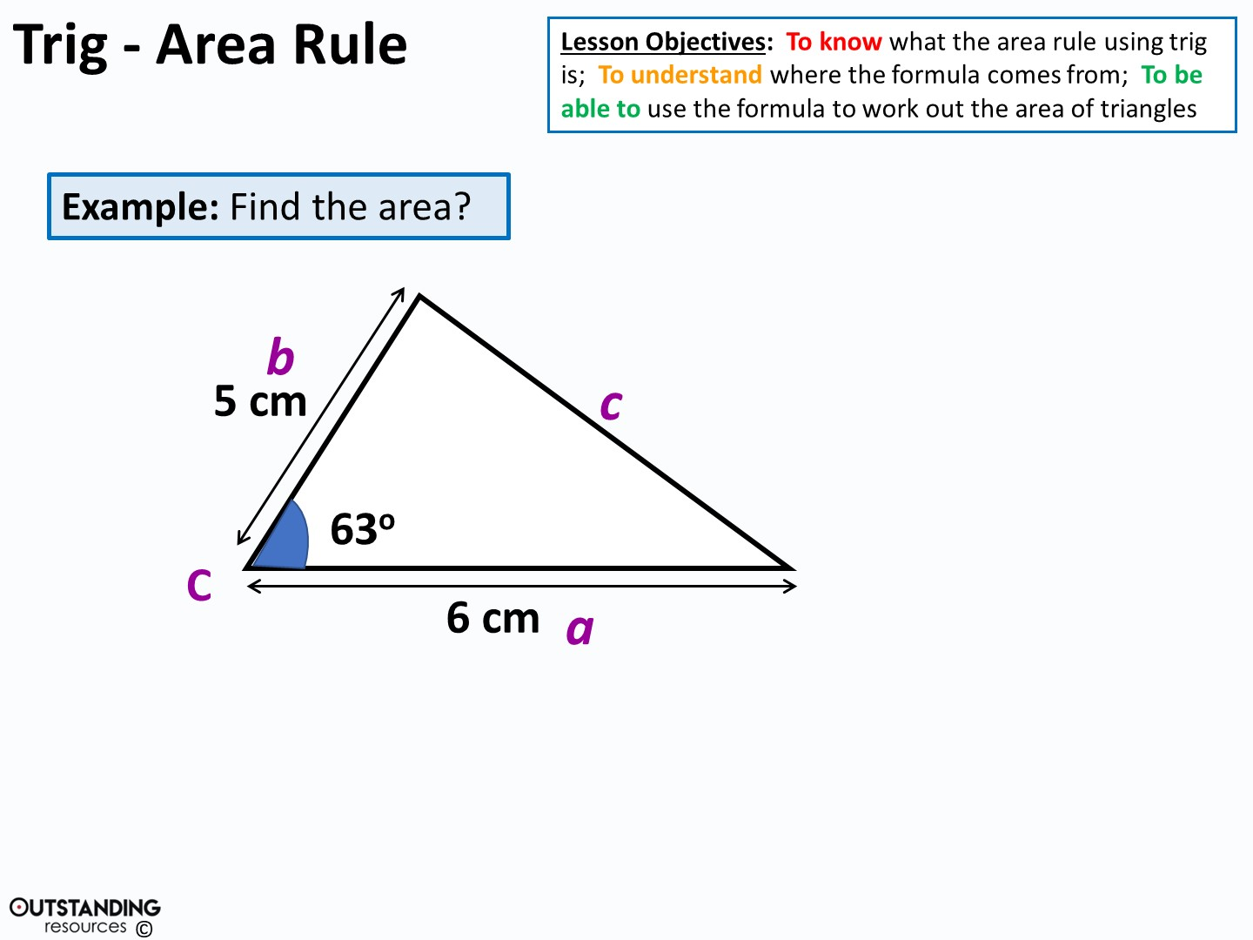
Area = ½ x 5 x 6 x sin 63º
= 13.4 cm²

Slide 7
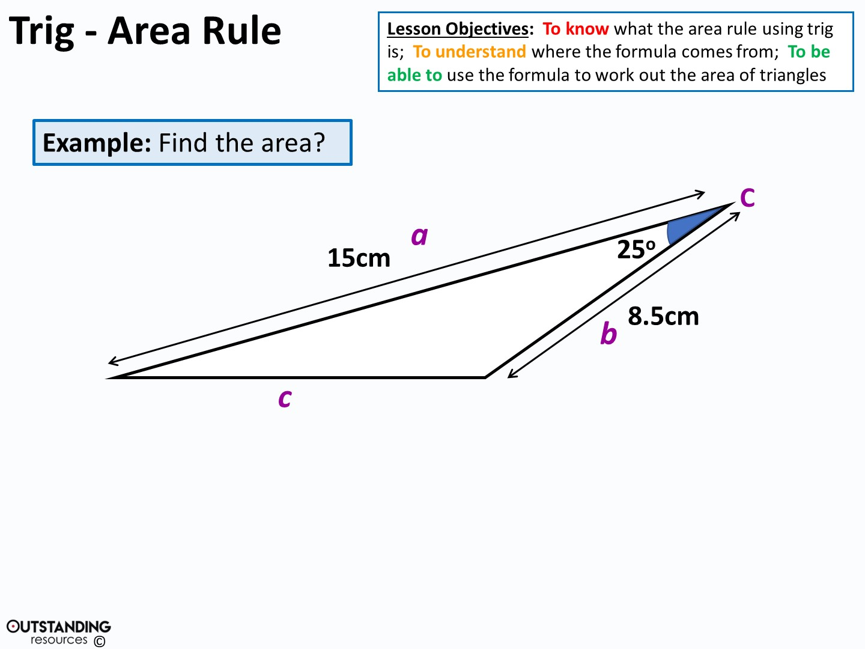
Area = ½ x 15 x 8.5 x sin 25º
= 26.9 cm²

Slide 8
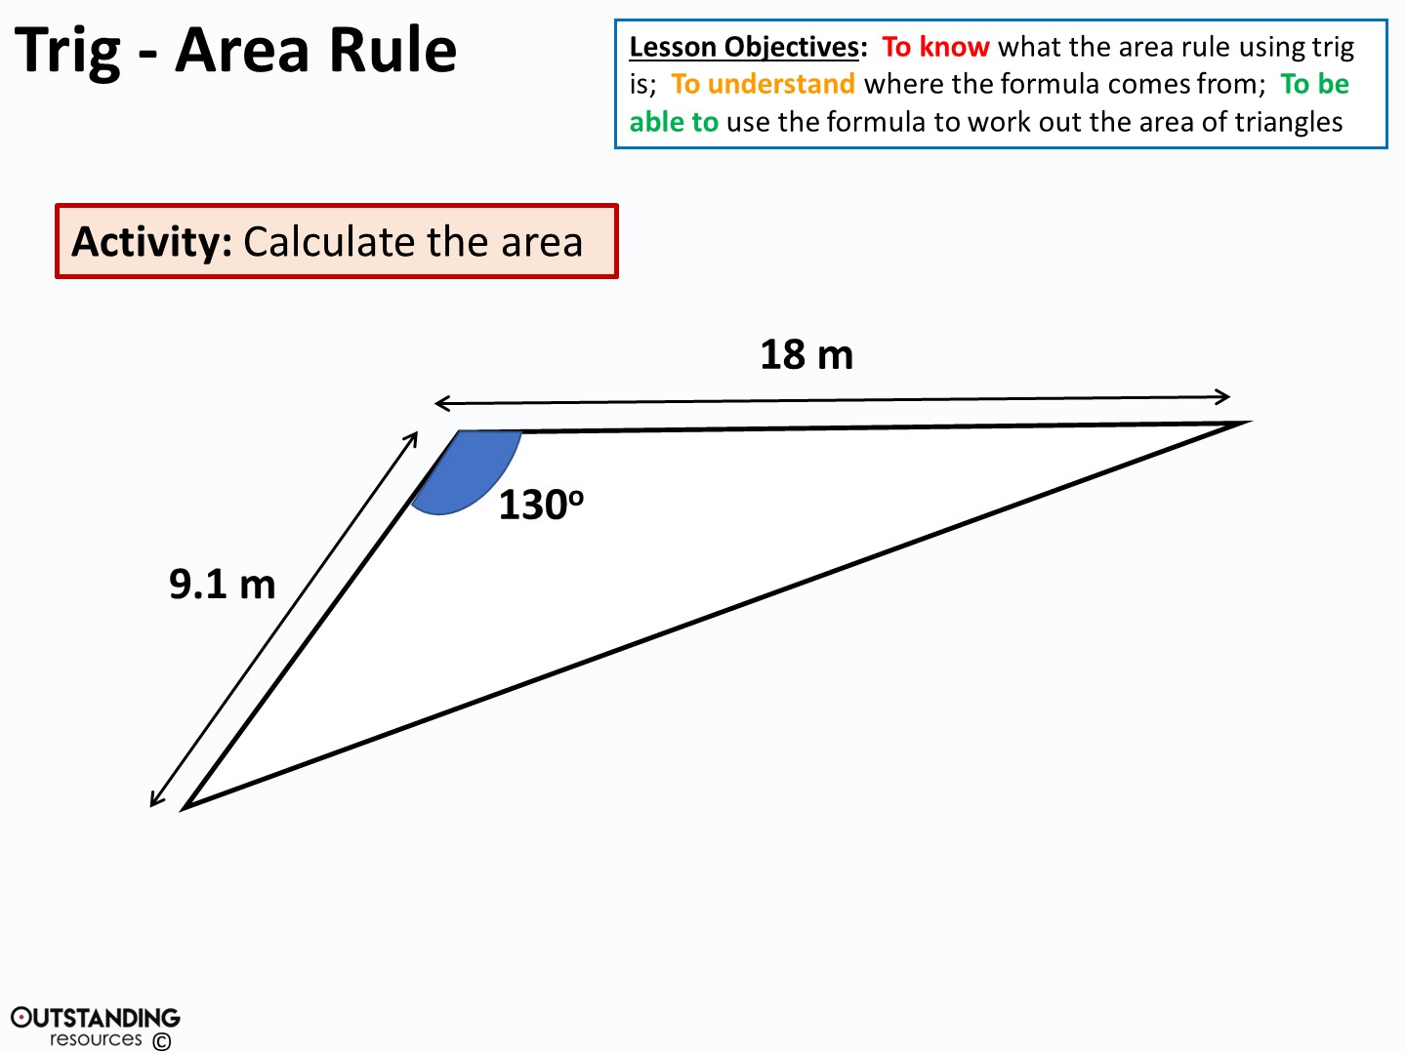
Area = ½ x 9.1 x 18 x sin130º
= 62.7 m²

Slide 9
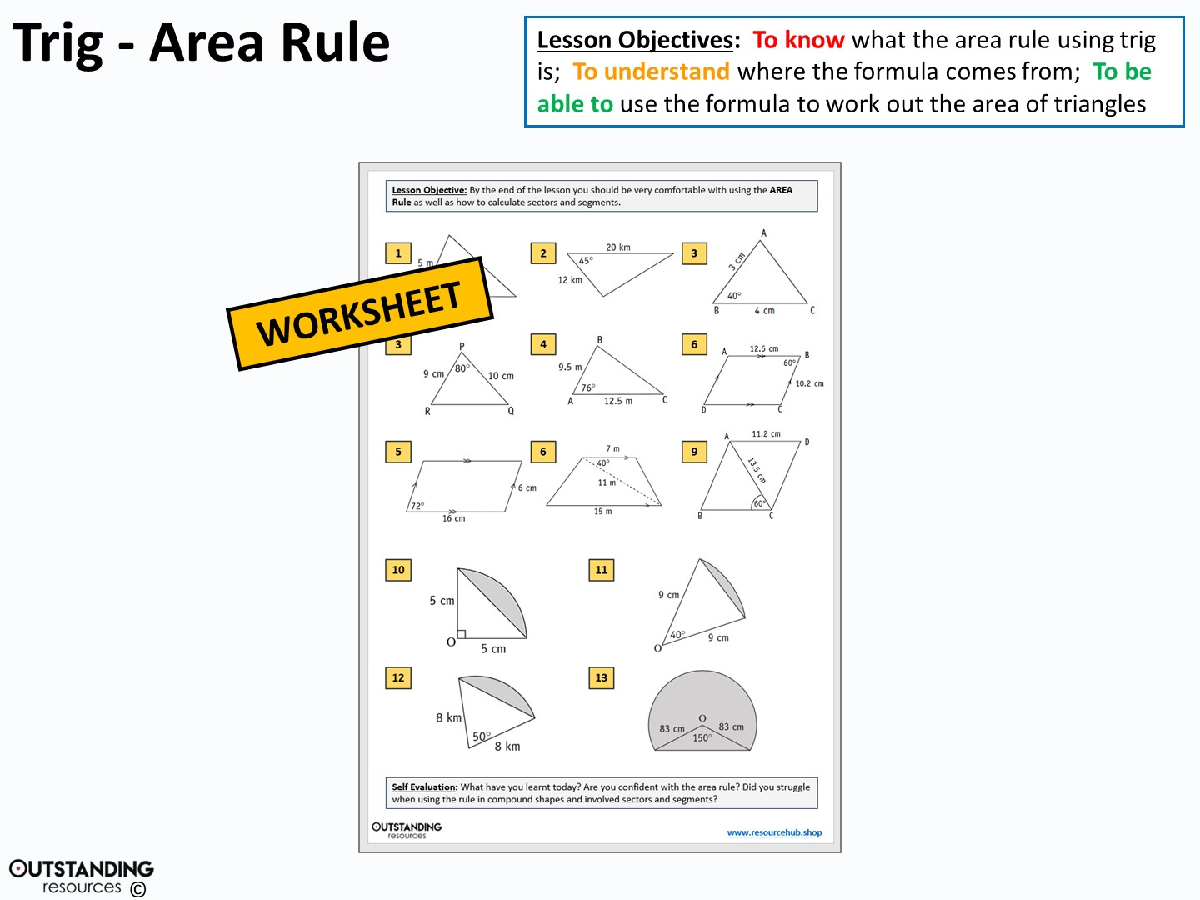

Slide 10
