Slide 1
Decimals: Rounding

Slide 2
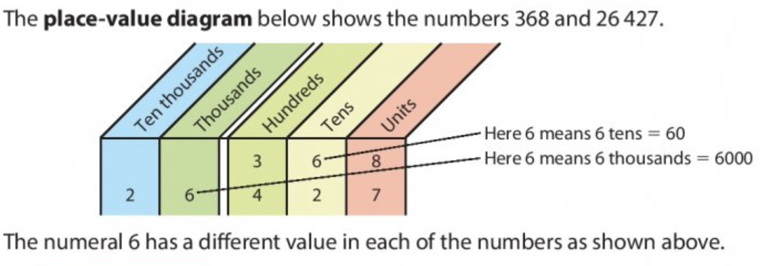
What is place-value?

Slide 3
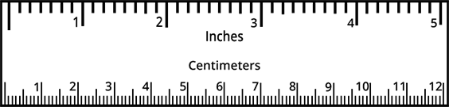
What is this? What is it used for?

Slide 4
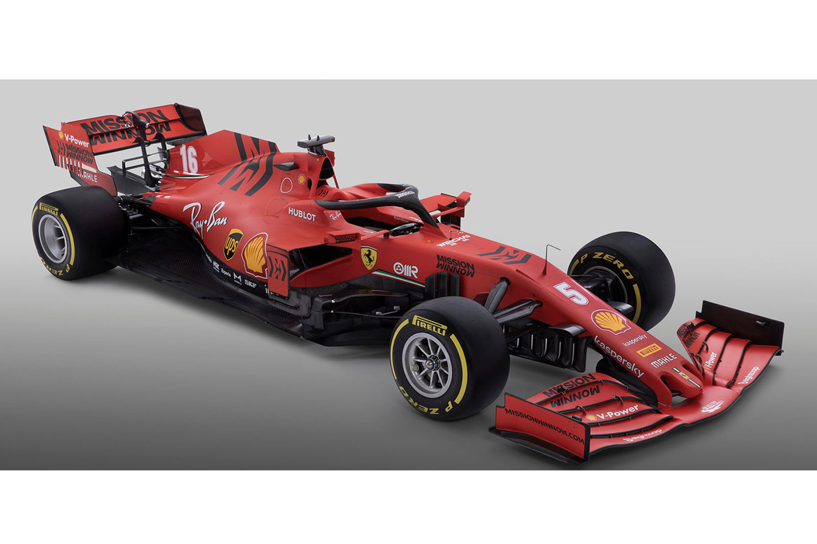
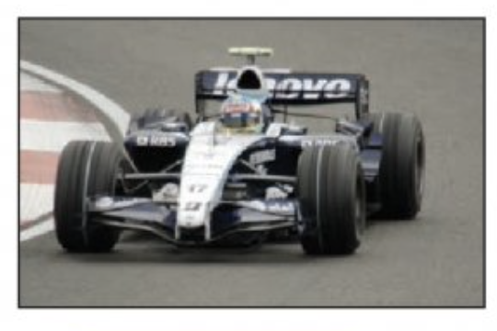
Time it takes to race around a track.
54.653 seconds
57 seconds

Slide 5
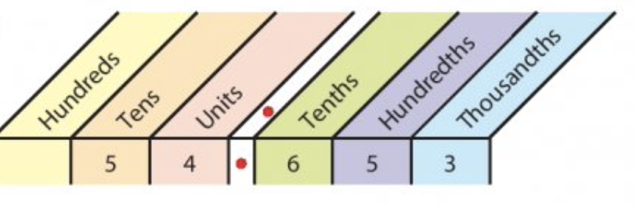
54
54.1
54.2
54.3
54.4
54.5
54.6
54.7
54.8
54.9
55

Slide 6
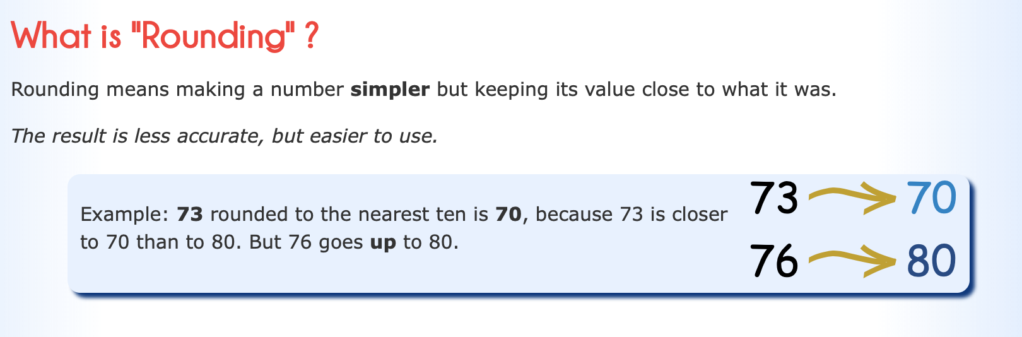

Slide 7
Round to the nearest whole number.
.
Tens
Units
Tenths
.
4
7
5
4
4.1
4.2
4.3
4.4
4.5
4.6
4.7
4.8
4.9
5

Slide 8
Round to the nearest whole number.
.
Tens
Units
Tenths
.
7
3
7
7
7.1
7.2
7.3
7.4
7.5
7.6
7.7
7.8
7.9
8

Slide 9
Round to the nearest whole number.
.
Tens
Units
Tenths
.
1
4
5
15
14
14.1
14.2
14.3
14.4
14.5
14.6
14.7
14.8
14.9
15

Slide 10
Round to the nearest whole number.
.
Tens
Units
Tenths
.
6
6
1
66
66
66.1
66.2
66.3
66.4
66.5
66.6
66.7
66.8
66.9
67

Slide 11
Round these lengths to the nearest centimetre.
8.8 cm ->
9 cm
9.1 cm ->
9 cm
18.2 cm ->
18 cm
13.9 cm ->
14 cm

Slide 12
Round to the nearest whole number.
.
Units
Tenths
Hundredths
.
7
1
9
7
7
7.1
7.2
7.3
7.4
7.5
7.6
7.7
7.8
7.9
8

Slide 13
Round to the nearest whole number.
.
Tens
Units
Tenths
Hundredths
.
2
4
7
7
25
24
24.1
24.2
24.3
24.4
24.5
24.6
24.7
24.8
24.9
25

Slide 14
Round these lengths to the nearest metre.
8.83 m ->
9 m
9.19 m ->
9 m
26.28 m ->
26 m
14.94 m ->
15 m

Slide 15
.
Round to 1 decimal place.
Tens
Units
Tenths
Hundredths
Thousandths
.
1
8
5
1.9

Slide 16
.
Round to 1 decimal place.
Tens
Units
Tenths
Hundredths
Thousandths
.
1
5
6
3
15.6

Slide 17
.
Round to 1 decimal place.
Tens
Units
Tenths
Hundredths
Thousandths
.
0
7
8
0.8

Slide 18
.
Round to 1 decimal place.
Tens
Units
Tenths
Hundredths
Thousandths
.
9
5
2
9.5

Slide 19
.
Round to 1 decimal place.
Tens
Units
Tenths
Hundredths
Thousandths
.
4
5
6
9
4.6

Slide 20
.
Round to 1 decimal place.
Tens
Units
Tenths
Hundredths
Thousandths
.
2
3
0
5
2.3

Slide 21
.
Round to the nearest 10c.
€10
€1
10c
1c
.
€
9
4
6
€9.50

Slide 22
.
Round to the nearest 10c.
€10
€1
10c
1c
.
€
1
4
7
3
€14.70

Slide 23
.
Round to the nearest 10c.
€10
€1
10c
1c
.
€
8
8
2
€8.80

Slide 24
.
Round to the nearest 10c.
€10
€1
10c
1c
.
€
6
5
9
€6.60

