Slide 2
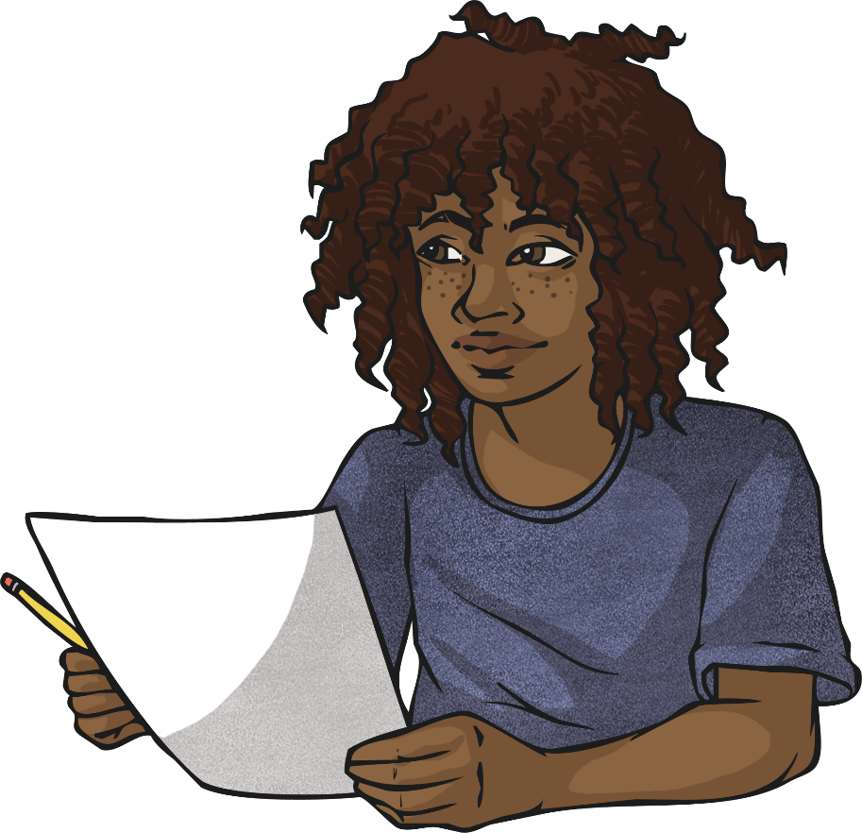
Place Value
When adding and subtracting decimals, it is important to understand the place value of the numbers.
With 11 + 1.1 the numbers both have 2 digits, however only one digit in each number has the same place value.
11 + 1.1 ≠ 2.2 or 22
11 + 1.1 = 12.1

Slide 3
Right or Wrong?
Here are some calculations involving decimals. Which have the correct answer? Where the answer is incorrect, can you explain what mistakes have been made?
23 + 2.3 = 25.3
38 + 3.8 = 38.38
5.6 + 5.6 = 10.12
correct
incorrect 38 + 3.8 = 41.8
incorrect 5 + 5 = 10, 6 + 6 = 12, but 0.6 + 0.6 = 1.2, so 5.6 + 5.6 = 11.2
Show Answers
Hide Answers

Slide 4
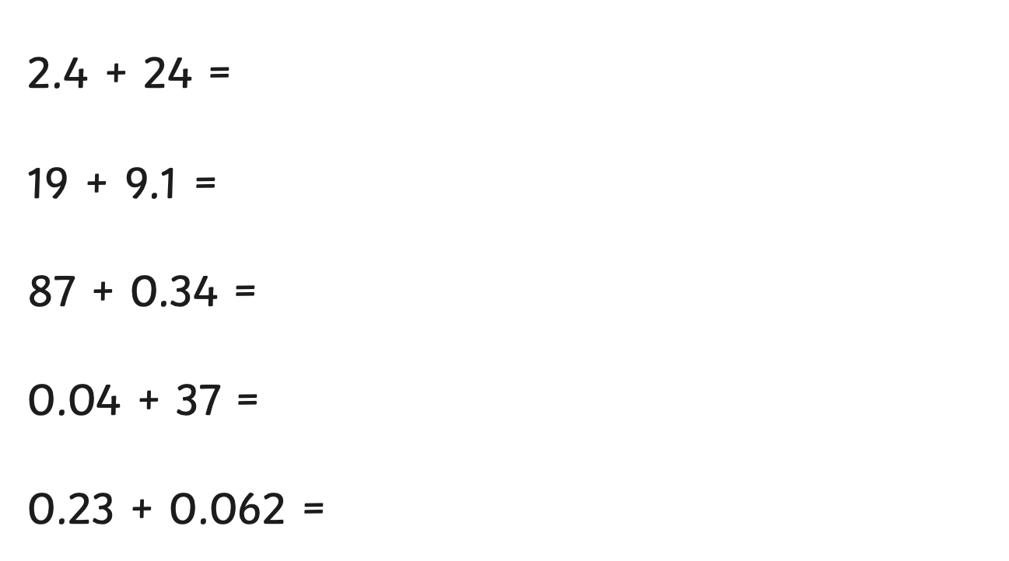
Mental Practice
Calculate the answers to these in your head or in your copy:
26.4
28.1
87.34
37.04
0.292
Show Answers
Hide Answers

Slide 5
Correct?
Which calculation is correct? Explain why.
345.6
345.6
+ 49.24
+ 49.24
The matching place values and decimal point are lined up.
The matching place values and decimal point are not lined up.
✔
x
Show Answers
Hide Answers

Slide 6

Formal Methods
Complete these calculations using a formal written method.
38.29
799
2.08
+ 451.7
+ 8.54
+ 34.7
489.99
807.54
36.78
Show Answers
Hide Answers

Slide 7
Using 0’s
Sometimes it is helpful to place a 0 where a digit is not given.
345.6
345.60
+ 49.24
+ 49.24
It is more useful with subtraction.
345.6
345.60
- 49.24
- 49.24

Slide 8
Adding
345.6
+ 49.24
. 4
1
345.6
+ 49.24
.84
345.6
+ 49.24
4.84
1
1
345.6
+ 49.24
94.84
345.6
+ 49.24
394.84
Place the decimal in the correct position in the answer section. Start by adding the smallest value together.
0 hundredths + 4 hundredths = 4 hundredths
5 ones + 9 ones = 14 ones
Place the 1 ten into the tens column and the 4 in the ones column in the answer section.
1 ten + 4 tens + 4 tens = 9 tens
3 hundreds + 0 hundreds= 3 hundreds
6 tenths + 2 tenths= 8 tenths
Remember to place the answers within the correct columns in the answer section.

Slide 9
Quick Practise
349.84
293.04
348.14
+ 397.16
+ 517.59
+ 364.57
747.00
810.63
712.71
Show Answers
Hide Answers

Slide 10
Subtracting
5
5
3
5
2
3
5
2
3
5
1
1
1
1
1
1
1
1
1
1
345.60
- 49.24
. 6
345.60
- 49.24
.36
345.60
- 49.24
6.36
345.60
- 49.24
96.36
345.60
- 49.24
296.36
Start by subtracting the smallest value. In this example, this is the hundredths column.
0 – 4 hundredths. This cannot be done therefore we exchange a tenth for 10 hundredths and regroup these. 10 + 0 = 10 hundredths.
10 hundredths – 4 hundredths = 6 hundredths.
5 ones – 9 ones. This cannot be done so we exchange 1 ten for 10 ones and regroup these into the ones column: 10 ones + 5 ones = 15 ones.
15 ones – 9 ones = 6 ones.
3 tens - 4 tens. This cannot be done, therefore we exchange 1 hundred for 10 tens and regroup these into the tens column: 10 tens + 3 tens = 13 tens.
13 tens – 4 tens = 9 tens
5 tenths - 2 tenths = 3 tenths
2 hundreds - 0 hundreds = 2 hundreds
Remember to place the answers within the correct columns in the answer section.

Slide 11
Quick Practise
343.7
587.14
348.75
- 121.5
- 249.56
- 124.94
222.2
337.58
223.81
Show Answers
Hide Answers

Slide 12
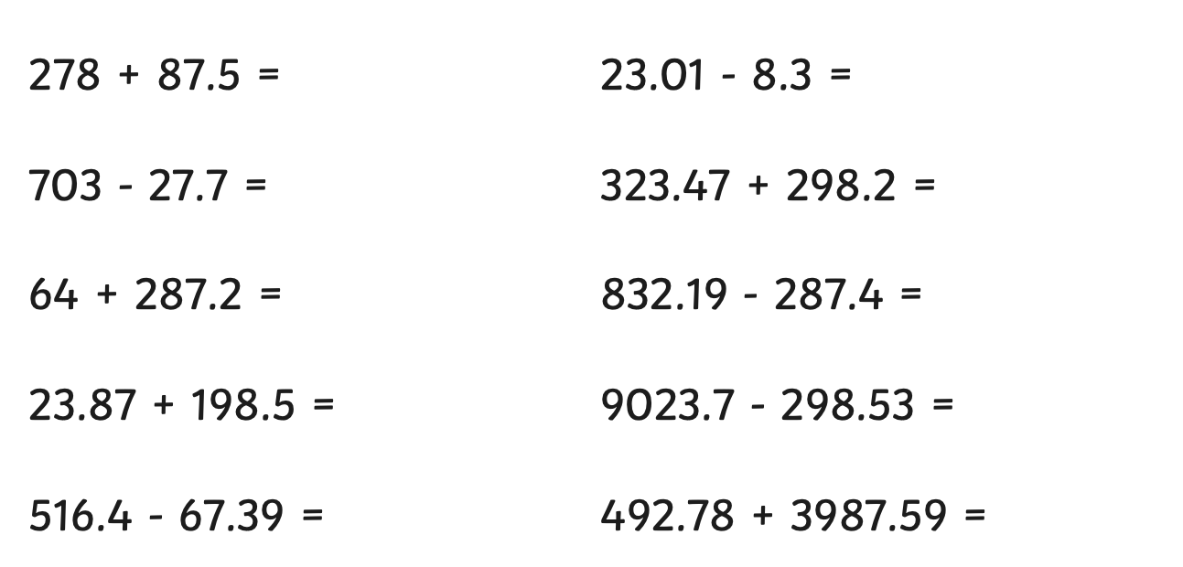
Formal Practice
Calculate the answers to these using a formal method:
365.5
14.71
675.3
621.67
351.2
544.79
222.37
8725.17
449.01
4480.37
Show Answers
Hide Answers

