Slide 2

How to Play
Click on a present to reveal a question. Think carefully about the question and share your answer. Once you have worked out the answer, click on the box once to check your answer.
Click again to reveal a part of the picture!

Slide 3
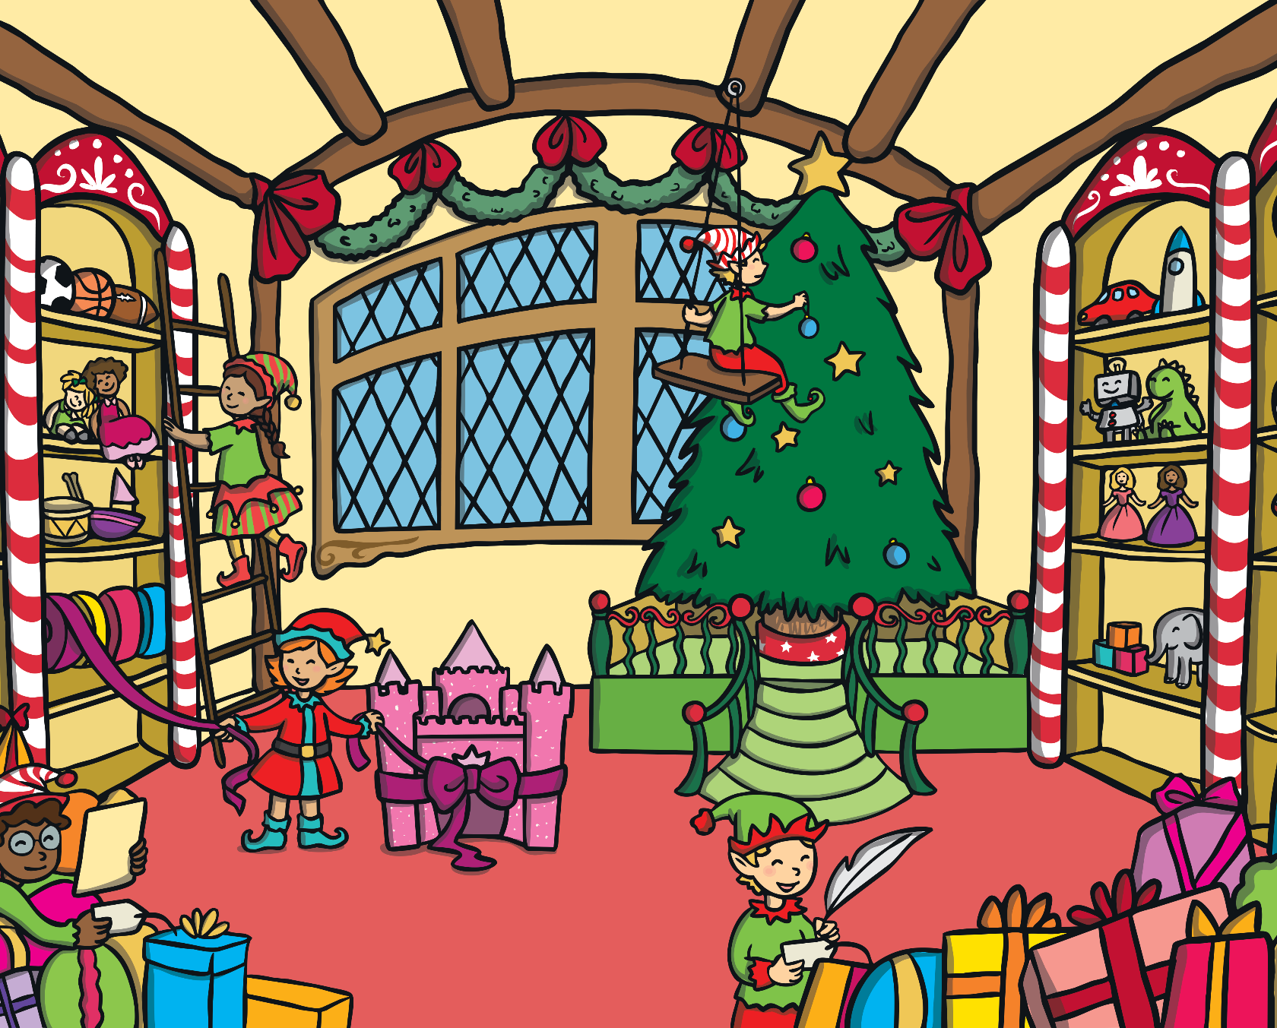








Slide 4
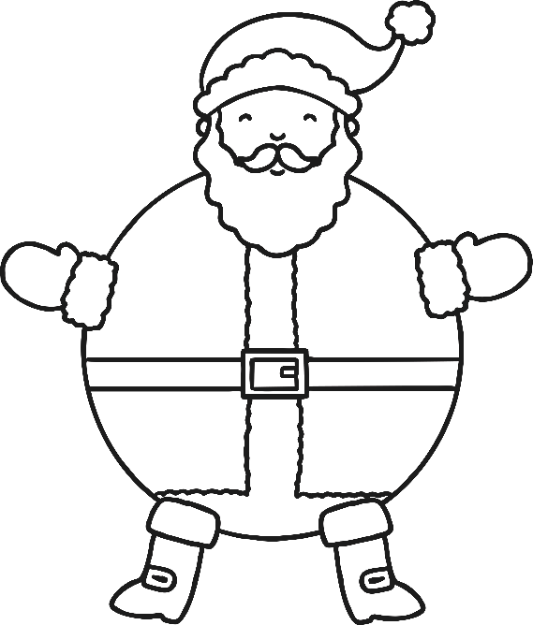
Can you find the missing number bond to make the number on
Santa’s tummy?
5
3
15
4
8
2
8
19
10
Choose Another Question
Show Answers

Slide 5

Which crackers do you need to pull to score:
a) 8 points
b) 7 Points
1
2
3
4
5
6
There are different possibilities, e.g.
a) 8 points = 5 + 3
b) 7 points = 1 + 2 + 4
Choose Another Question
Show Answer

Slide 6

Which different coins could you use to pay for two mince pies?
5p
5p
There are different possibilities, e.g. 5p + 2p + 2p + 1p.
Choose Another Question
Show Answer

Slide 7
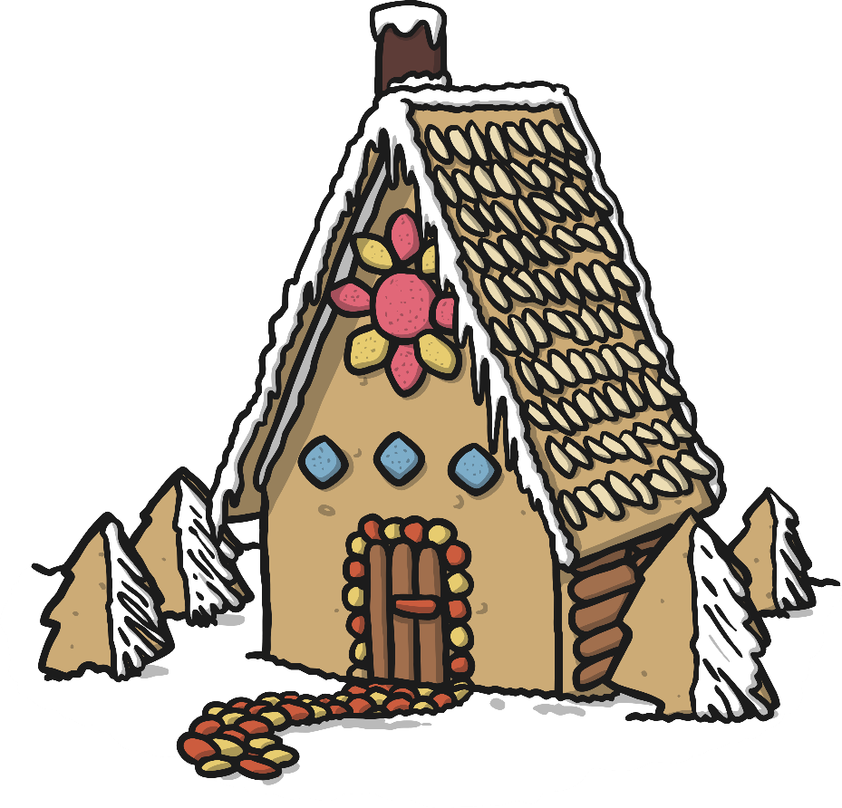
Carlos was making a gingerbread house. He had fifty pieces altogether, but he was hungry.
If he ate one piece, how many would be left?
49
Choose Another Question
Show Answer

Slide 8
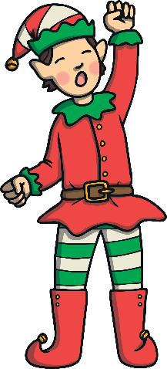

The elves have got themselves in a pickle counting presents.
Use the number line to show them how to find the number in the number sentences.
1
+
9
=
10
10
-
6
=
4
0
1
2
3
4
5
6
7
8
9
10
11
12
13
14
15
Choose Another Question
Show Answer

Slide 9





We often give presents to our friends and family at Christmas. Here are some wrapped presents.
Look at the shapes. What could they be?
cuboid, sphere, cube, triangular prism, cylinder
Choose Another Question
Show Answer

Slide 10

Phoebe was counting down the seconds to when the Christmas carol concert was going to start. She started with, “90 seconds…”. Can you carry on the countdown for the next five numbers?
89, 88, 87, 86, 85
Choose Another Question
Show Answer

Slide 11

Five of the reindeer had a race. They finished in this order. Rudolph, Comet, Donner, Cupid and Dasher. Who came fourth?
Cupid
Choose Another Question
Show Answer

Slide 12

Work out the number sentence below. Then, draw a picture to represent the number sentence. Challenge yourself to turn the number sentence into a Christmas word problem.
1 + 12 =
13
0
1
2
3
4
5
6
7
8
9
10
11
12
13
14
15
16
17
18
19
20
21
22
Choose Another Question
Show Answer

Slide 13

Father Christmas has one present left to deliver but the label has fallen off. It belongs to an odd number house between the numbers 20 and 40.
Which houses could it belong to?
21, 23, 25, 27, 29, 31, 33, 35, 37, 39
Choose Another Question
Show Answer

Slide 14

Add up the baubles on the Christmas trees.
10
Choose Another Question
Show Answer

Slide 15

The Christmas trees were in groups of five at the Christmas market.
Sue counted eight groups of them. How many Christmas trees were there?
40
Choose Another Question
Show Answer

Slide 16
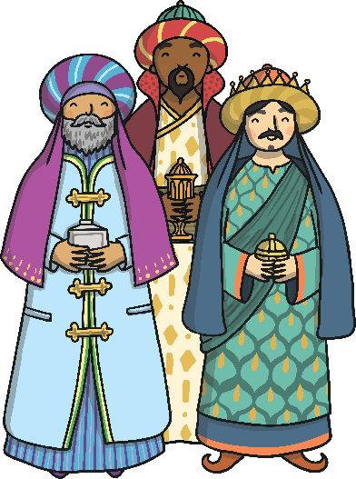
The Wise Men followed a star to find baby Jesus.
How many triangles can you find in this star?
10
Choose Another Question
Show Answer

Slide 17



Which present is the odd one out? Explain your answer.
There are lots of answers, including 15 as it is an odd number, 20 as it isn’t a multiple of 3, etc.
Choose Another Question
Show Answer

Slide 18




Which of these baubles will tessellate?
(Tessellate means joins together without any gaps!)
Explain your answers.
Triangles, square and hexagons are all tessellating shapes.
Circles will not tessellate.
Choose Another Question
Show Answer

Slide 19

What would the next bauble be in this sequence?
2
4
6
8
10
Choose Another Question
Show Answer

Slide 20

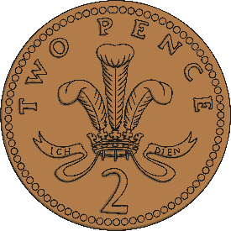
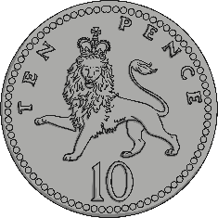
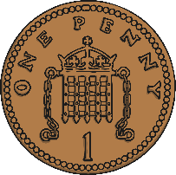
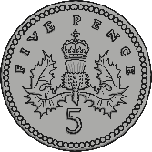
A candy cane costs less than 20p. How much could the candy cane cost if you paid with exactly 3 coins?
1p
2p
10p
5p
There are different possibilities, e.g. 1p + 1p + 1p (3p), 1p + 1p + 2p (4p).
Choose Another Question
Show Answer

Slide 21



The elves have been putting the presents onto the sleigh.
There are three presents left to put on.
What order could they put them on the sleigh?
How many different ways can you find?
Blue Red Yellow, Blue Yellow Red, Red Blue Yellow, Red Yellow Blue, Yellow Red Blue or Yellow Blue Red.
Choose Another Question
Show Answer

Slide 22


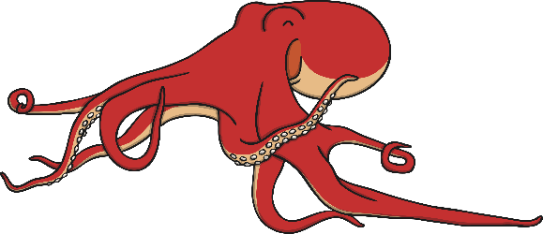
The elves have been busy making toys in the workshop. They have made:
robots
rocking horses
octopuses
If you could only see 20 legs which toys might you be looking at?
10× robots, 1 horse + 8 robots, 2 horses + 6 robots, 3 horses + 4 robots, 4 horses + 2 robots, 5 horses, 1 horse + 2 octopuses, 3 horses + 1 octopus, 2 octopuses + 2 robots.
Choose Another Question
Show Answer

Slide 23




Can you write your own Christmas code for a friend to try?
=
10
7
×
=
70
=
5
4
×
=
20
=
2
5
×
=
10
Choose Another Question
Show Answer

