Slide 1
Algebra: Inequalities

Slide 2
What is an inequality?
An inequality is like an equation, but instead of an equals sign (=) it has one of these signs:
< : less than
≤ : less than or equal to
> : greater than
≥ : greater than or equal to

Slide 3

13 > 3
9 < 21
4 > 1
-2 < 2
10 > -6

Slide 4
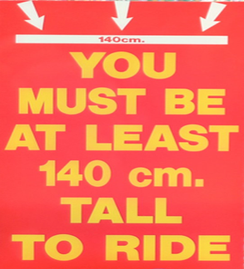



Real World Examples of Inequalities

Slide 5



Solution of an Inequality
$x$ ∈ N
$x$ ∈ Z
$x$ ∈ R
∈ = ‘an element of’
= part of that group

Slide 6




If $x$ is a natural number, we can write $x$ ∈ N.
Natural Numbers (N):
A natural number is any positive whole number.
N = {1, 2, 3, 4, ...}
As natural numbers are whole numbers, to graph them on a number line we use solid dots.
Integers (Z):
An integer is any whole number: positive, negative or zero.
Z = {... , –3, –2, –1, 0, 1, 2, 3, ...}
As integers are also whole numbers, to graph them on a number line we use solid dots.
Real Numbers (R):
A real number is any number that can be plotted on a number line.
In order to show real numbers on the number line we use solid continuous shading.
<
≤
>
≥
If $x$ is a real number, we can write $x$ ∈ R.
If$x$is an integer, we can write $x$ ∈ Z.

Slide 7
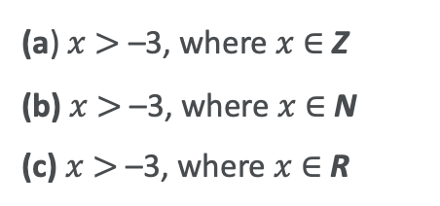
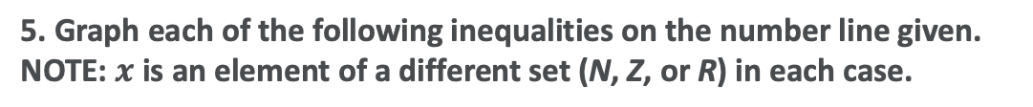
5. Graph each of the following inequalities on the number line given. NOTE: $x$ is an element of a different set (N, Z, or R) in each case.
(a) $x$ $>$–3, where $x$ ∈ Z
(b) $x$ $>$–3, where $x$ ∈ N
(c) $x$ $>$ –3, where $x$∈ R
−4
−3
−2
−1
0
1
2
3
(a)
−4
−3
−2
−1
0
1
2
3
(b)
−4
−3
−2
−1
0
1
2
3
(c)

Slide 8
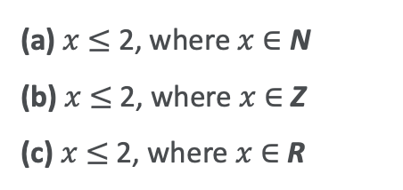
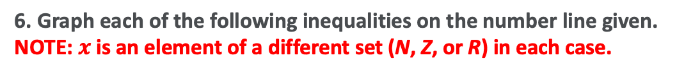
6. Graph each of the following inequalities on the number line given. NOTE: $x$ is an element of a different set (N, Z, or R) in each case.
(a) $x$ $≤$2, where $x$ ∈ N
(b) $x$ $≤$2, where $x$ ∈ Z
(c) $x$ $≤$ 2, where $x$∈ R
−4
−3
−2
−1
0
1
2
3
(a)
−4
−3
−2
−1
0
1
2
3
(b)
−4
−3
−2
−1
0
1
2
3
(c)

Slide 9
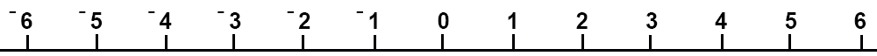
Which inequality is shown on the number line?
A
B
C
D

Slide 10
Which inequality is shown on the number line?
A
B
C
D

Slide 11
Which inequality is shown on the number line?
A
B
C
D

Slide 12
Which inequality is shown on the number line?
A
B
C
D

Slide 13
Which inequality is shown on the number line?
A
B
C
D

Slide 14
Which inequality is shown on the number line?
A
B
C
D

Slide 15

7. Solve the inequality 2x - 4 ≤ 6, where $x$ ∈ N

Slide 16
8. Solve the inequality $5x − 3 ≥ 12 , where$ $x$∈ R

Slide 17
What we Learnt Today
Important symbols: <, >, ≤, ≥ and ∈
Rules for graphing inequalities on the number line: Dots for Natural Numbers and Integers Continuous line for Real Numbers (because it includes all the fractions and decimals in between the whole numbers)
Solving inequalities like how we solve equations: Change side, change sign
Will practice solving more inequalities tomorrow…
… before a test on Friday.

