Slide 1
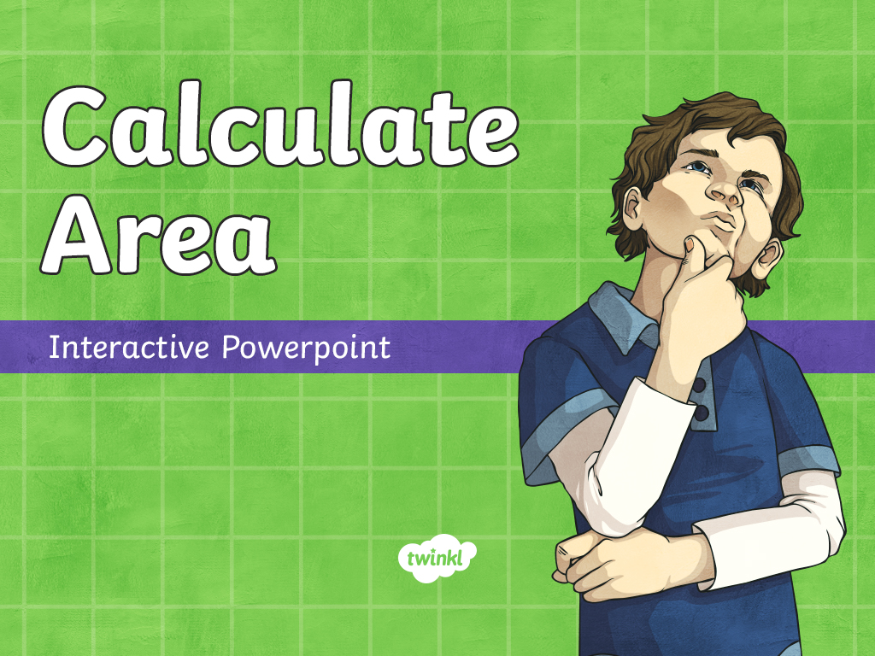

Slide 2
Aim
I am learning to find the area of a shape.

Slide 3
Area
Area is the amount of space inside a given shape.
Area
We measure area in square centimetres - cm².

Slide 4
cm²
1cm²
Imagine each of these squares is 1cm × 1cm.
That means the area of each little square is 1cm². (Just like the blue square!)
32cm²
Can you find the area of the green rectangle by counting the squares?
Can you find the area of the pink shape?
15cm²

Slide 5
Strange Shapes
Some shapes are difficult to count exactly because they don’t fill up whole squares. The easy way to remember is to count the whole squares first. Add any squares which fill half or more and ignore the squares which cover less than half the square.
1cm²
Have a go at finding the area of these 2 shapes. Share your ideas with the class.

Slide 6
Estimating
Because we didn’t know the exact area for the two previous sides, we made a guess. This is called an estimate. We didn't just randomly guess, though; we used our knowledge and skills and made an educated guess.
1cm²

Slide 7
Estimate
1cm²
Can you estimate the area of this shape?
Check the area by counting the squares.

Slide 8
Estimate
1cm²
Can you estimate the area of this shape?
Check the area by counting the squares.

Slide 9
Estimate
1cm²
Can you estimate the area of this shape?
Check the area by counting the squares.

Slide 10
Estimate
1cm²
Can you estimate the area of this shape?
Check the area by counting the squares.

Slide 11
Calculate Area
with grid lines
no grid lines

Slide 12
Area measures the surface inside a shape. Click on the width and the length to add them to the calculation. Then multiply the width and length to find the area of the shape.
7cm
3cm
Show
answer
Next
?cm
21cm²
7cm × 3cm =
?cm
Menu

Slide 13
Area measures the surface inside a shape. Click on the width and the length to add them to the calculation. Then multiply the width and length to find the area of the shape.
5cm
4cm
Show
answer
Next
?cm
?cm
20cm²
5cm × 4cm =
Menu

Slide 14
Area measures the surface inside a shape. Click on the width and the length to add them to the calculation. Then multiply the width and length to find the area of the shape.
9cm
1cm
Show
answer
Next
?cm
9cm²
9cm × 1cm =
?cm
Menu

Slide 15
Area measures the surface inside a shape. Click on the width and the length to add them to the calculation. Then multiply the width and length to find the area of the shape.
4cm
2cm
Show
answer
Next
?cm
8cm²
4cm × 2cm =
?cm
Menu

Slide 16
Area measures the surface inside a shape. Click on the width and the length to add them to the calculation. Then multiply the width and length to find the area of the shape.
6cm
2cm
Show
answer
Next
?cm
?cm
12cm²
6cm × 2cm =
Menu

Slide 17
Area measures the surface inside a shape. Click on the width and the length to add them to the calculation. Then multiply the width and length to find the area of the shape.
9cm
5cm
Show
answer
Next
?cm
45cm²
9cm × 5cm =
?cm
Menu

Slide 18
Area measures the surface inside a shape. Click on the width and the length to add them to the calculation. Then multiply the width and length to find the area of the shape.
8cm
2cm
Show
answer
Next
?cm
16cm²
8cm × 2cm =
?cm
Menu

Slide 19
Area measures the surface inside a shape. Click on the width and the length to add them to the calculation. Then multiply the width and length to find the area of the shape.
4cm
6cm
Show
answer
Next
?cm
?cm
24cm²
4cm × 6cm =
Menu

Slide 20
Area measures the surface inside a shape. Click on the width and the length to add them to the calculation. Then multiply the width and length to find the area of the shape.
9cm
3cm
Show
answer
Next
?cm
?cm
9cm × 3cm =
27cm²
Menu

Slide 21
Area measures the surface inside a shape. Click on the width and the length to add them to the calculation. Then multiply the width and length to find the area of the shape.
11cm
7cm
Show
answer
Next
?cm
?cm
11cm × 7cm =
77cm²
Menu

Slide 22
Area measures the surface inside a shape. Click on the width and the length to add them to the calculation. Then multiply the width and length to find the area of the shape.
5cm
6cm
Show
answer
Next
?cm
?cm
30cm²
5cm × 6cm =
Menu

Slide 23
Area measures the surface inside a shape. Click on the width and the length to add them to the calculation. Then multiply the width and length to find the area of the shape.
2cm
2cm
Show
answer
Next
?cm
?cm
4cm²
2cm × 2cm =
Menu

Slide 24
Area measures the surface inside a shape. Click on the width and the length to add them to the calculation. Then multiply the width and length to find the area of the shape.
6cm
6cm
Show
answer
Next
?cm
36cm²
6cm × 6cm =
?cm
Menu

Slide 25
Area measures the surface inside a shape. Click on the width and the length to add them to the calculation. Then multiply the width and length to find the area of the shape.
1cm
1cm
Show
answer
Next
?cm
?cm
1cm²
1cm × 1cm =
Menu

Slide 26
Area measures the surface inside a shape. Click on the width and the length to add them to the calculation. Then multiply the width and length to find the area of the shape.
4cm
4cm
Show
answer
?cm
Menu
4cm × 4cm =
?cm
16cm²

Slide 27
Area measures the surface inside a shape. Click on the width and the length to add them to the calculation. Then multiply the width and length to find the area of the shape.
7cm
3cm
Show
answer
Next
?cm
21cm²
7cm × 3cm =
?cm
Menu

Slide 28
Area measures the surface inside a shape. Click on the width and the length to add them to the calculation. Then multiply the width and length to find the area of the shape.
5cm
4cm
Show
answer
Next
?cm
?cm
20cm²
5cm × 4cm =
Menu

Slide 29
Area measures the surface inside a shape. Click on the width and the length to add them to the calculation. Then multiply the width and length to find the area of the shape.
9cm
1cm
Show
answer
Next
?cm
9cm²
9cm × 1cm =
?cm
Menu

Slide 30
Area measures the surface inside a shape. Click on the width and the length to add them to the calculation. Then multiply the width and length to find the area of the shape.
4cm
2cm
Show
answer
Next
?cm
8cm²
4cm × 2cm =
?cm
Menu

Slide 31
Area measures the surface inside a shape. Click on the width and the length to add them to the calculation. Then multiply the width and length to find the area of the shape.
6cm
2cm
Show
answer
Next
?cm
?cm
12cm²
6cm × 2cm =
Menu

Slide 32
Area measures the surface inside a shape. Click on the width and the length to add them to the calculation. Then multiply the width and length to find the area of the shape.
9cm
5cm
Show
answer
Next
?cm
45cm²
9cm × 5cm =
?cm
Menu

Slide 33
Area measures the surface inside a shape. Click on the width and the length to add them to the calculation. Then multiply the width and length to find the area of the shape.
8cm
2cm
Show
answer
Next
?cm
16cm²
8cm × 2cm =
?cm
Menu

Slide 34
Area measures the surface inside a shape. Click on the width and the length to add them to the calculation. Then multiply the width and length to find the area of the shape.
4cm
6cm
Show
answer
Next
?cm
?cm
24cm²
4cm × 6cm =
Menu

Slide 35
Area measures the surface inside a shape. Click on the width and the length to add them to the calculation. Then multiply the width and length to find the area of the shape.
9cm
3cm
Show
answer
Next
?cm
?cm
9cm × 3cm =
27cm²
Menu

Slide 36
Area measures the surface inside a shape. Click on the width and the length to add them to the calculation. Then multiply the width and length to find the area of the shape.
11cm
7cm
Show
answer
Next
?cm
?cm
11cm × 7cm =
77cm²
Menu

Slide 37
Area measures the surface inside a shape. Click on the width and the length to add them to the calculation. Then multiply the width and length to find the area of the shape.
5cm
6cm
Show
answer
Next
?cm
?cm
30cm²
5cm × 6cm =
Menu

Slide 38
Area measures the surface inside a shape. Click on the width and the length to add them to the calculation. Then multiply the width and length to find the area of the shape.
2cm
2cm
Show
answer
Next
?cm
?cm
4cm²
2cm × 2cm =
Menu

Slide 39
Area measures the surface inside a shape. Click on the width and the length to add them to the calculation. Then multiply the width and length to find the area of the shape.
6cm
6cm
Show
answer
Next
?cm
36cm²
6cm × 6cm =
?cm
Menu

Slide 40
Area measures the surface inside a shape. Click on the width and the length to add them to the calculation. Then multiply the width and length to find the area of the shape.
1cm
1cm
Show
answer
Next
?cm
?cm
1cm²
1cm × 1cm =
Menu

Slide 41
Area measures the surface inside a shape. Click on the width and the length to add them to the calculation. Then multiply the width and length to find the area of the shape.
4cm
4cm
Show
answer
?cm
Menu
4cm × 4cm =
?cm
16cm²

