Slide 1
Statistics 5th Year Maths 14th September 2020

Slide 2
What are Statistics?
By asking specific questions, gathering data,
processing and presenting this data, Statistics help us make sense of the world.

Slide 3
The Data Handling Cycle
Specifying the question
Collecting Data
Processing and presenting the data
Interpreting the data (to answer the question)
3

Slide 4
Specifying the Question
Example:
“Do you agree that you get too much homework?”
What’s wrong with this question?
Leading

Slide 5
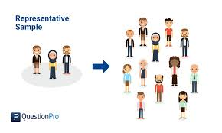
Collecting Data
It’s important to gather data from a representative sample.
Primary Data | Secondary Data
Gathering data yourself. Examples: Surveys, questionnaires, experiments | Data already collected by someone else. Examples: Books, internet.

Slide 6
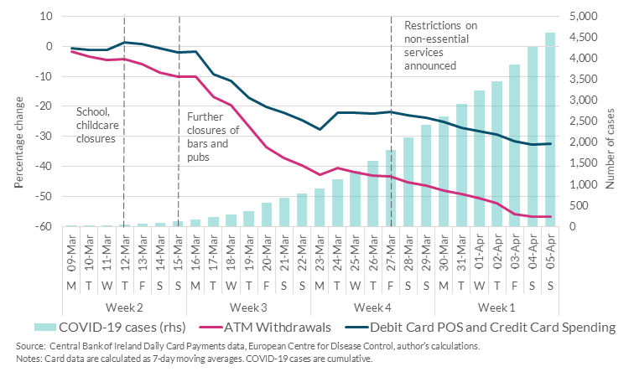

Slide 7
Processing and presenting the data
One way of processing data is finding different…
Averages
An average tries to represent the full set of data by a single value.

Slide 8
Averages
Median | Mode | Mean
The middle number… when the data is ordered from smallest to largest. | The most common number found in a set of data.
18, 3, 16, 10, 11, 18, 16, 21, 15
3, 10, 11, 15, 16, 16, 18, 18, 21

Slide 9
Exercise 7D
Find the mode of each of the following sets of data.
3, 4, 1, 2, 4, 5, 1, 3, 4, 1, 3, 1
4, 7, 5, 6, 5, 8, 5, 7, 5, 7, 5, 7, 6
5, 6, 7, 5, 6, 7, 5, 7, 6, 6
Red, blue, green, black, green, black, white, green, red, black, black
A, B, A, C, B, A, C, B, B, B, C, A, C, A, A

Slide 10
(i) 3, 4, 1, 2, 4, 5, 1, 3, 4, 1, 3, 1
Numbers | 1 | 2 | 3 | 4 | 5
Count | 4 | 1 | 3 | 3 | 1
Mode?
1

Slide 11
(ii) 4, 7, 5, 6, 5, 8, 5, 7, 5, 7, 5, 7, 6
Numbers | 4 | 5 | 6 | 7 | 8
Count | 1 | 5 | 2 | 3 | 2
Mode?
5

Slide 12
(iii) 5, 6, 7, 5, 6, 7, 5, 7, 6, 6
Numbers | 5 | 6 | 7
Count | 3 | 4 | 3
Mode?
6

Slide 13
(iv) Red, blue, green, black, green, black, white, green, red, black, black
Colours | Black | Blue | Green | Red | White
Count | 4 | 1 | 3 | 2 | 1
Mode?
Black

Slide 14
(v) A, B, A, C, B, A, C, B, B, B, C, A, C, A, A
Letters | A | B | C
Count | 6 | 5 | 4
Mode?
C

Slide 15
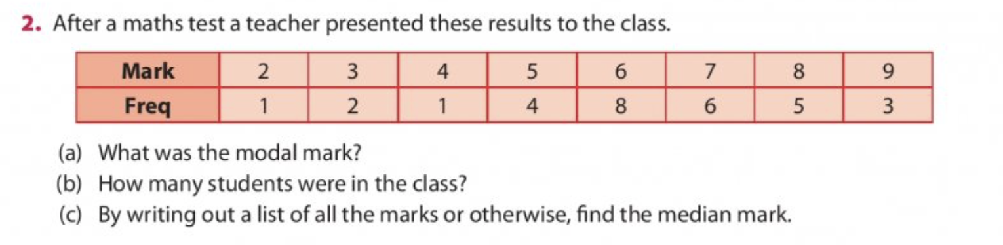
Modal mark – mode – most common – highest frequency? 6
Students in class total? 1 + 2 + 1 + 4 + 8 + 6 + 5 + 3 = 30
Median – middle – after arranged from smallest to biggest
2, 3, 3, 4, 5, 5, 5, 5, 6, 6, 6, 6, 6, 6, 6, 6, 7, 7, 7, 7, 7, 7, 8, 8, 8, 8, 8, 9, 9, 9
6, 6
Median: 6

Slide 16
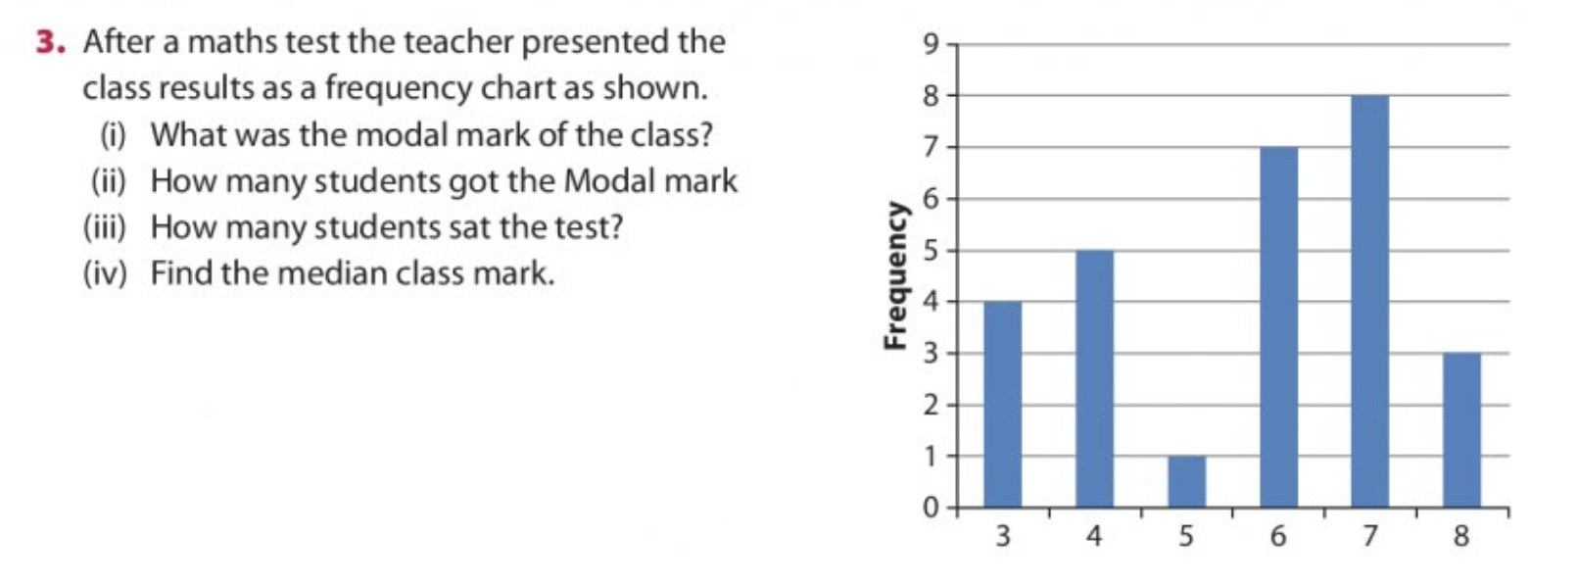
Modal mark – mode – most common – highest frequency? 7
Frequency of mark 7? 8
4 + 5 + 1 + 7 + 8 + 3 = 28
Median – middle – after arranged from smallest to biggest:
3, 3, 3, 3, 4, 4, 4, 4, 4, 5, 6, 6, 6, 6, 6, 6, 6, 7, 7, 7, 7, 7, 7, 7, 7, 8, 8, 8
6, 6 => Median = 6

Slide 17
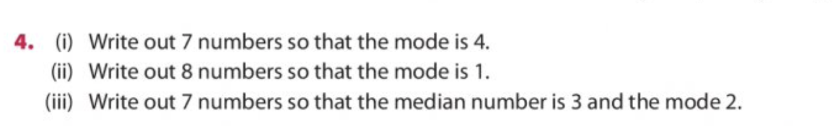
1, 1, 3, 4, 4, 4, 5
1 , 1, 1, 1, 2, 3, 4, 4
1, 2, 2, 3, 4, 5, 6

Slide 18
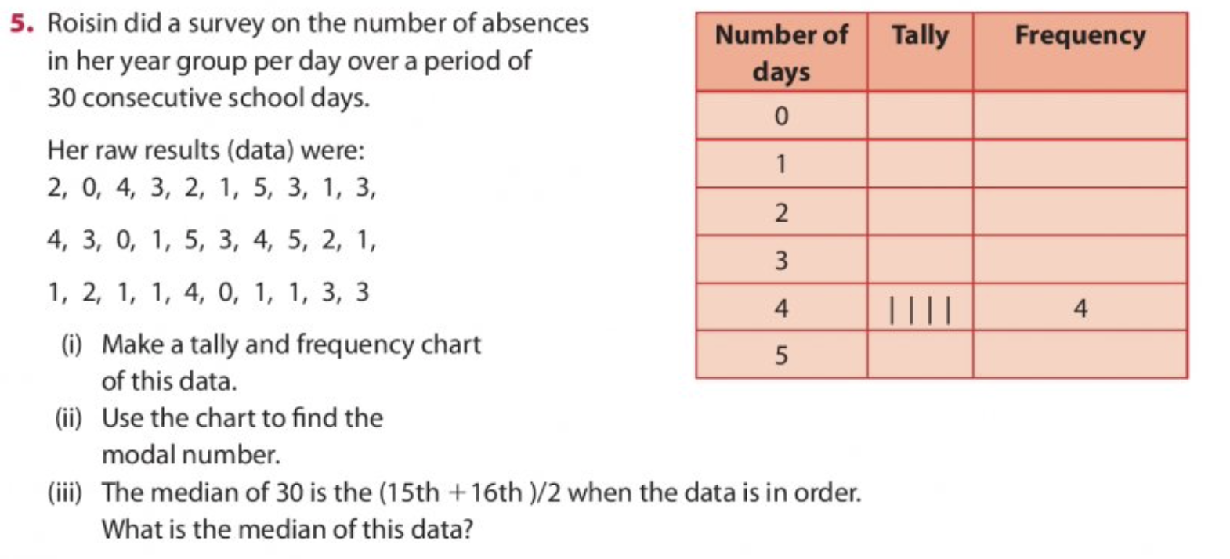

Slide 19
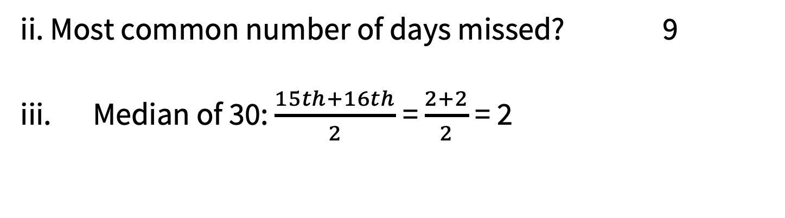
Number of days | Tally | Frequency
0 | | | | | 3
1 | | | | | | | | | | | 9
2 | | | | | | 4
3 | | | | | | | | 6
4 | | | | | | 4
5 | | | | 2
15th and 16th = 2
ii. Most common number of days missed? 9
iii. Median of 30: $\frac{15th+16th}{2}$= $\frac{2+2}{2}$= 2

Slide 20
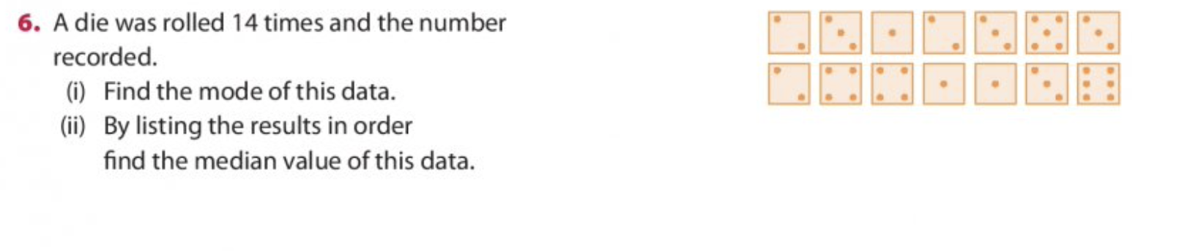
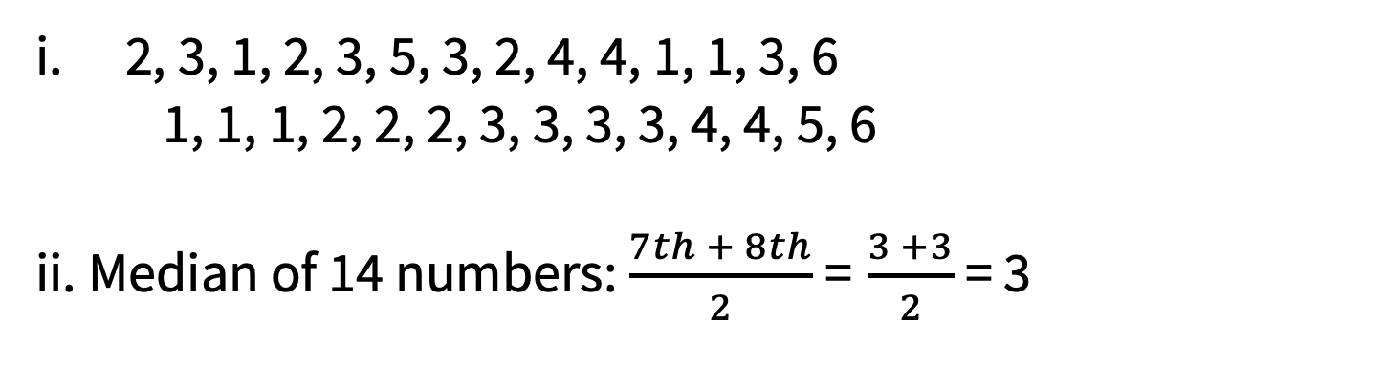
2, 3, 1, 2, 3, 5, 3, 2, 4, 4, 1, 1, 3, 6
1, 1, 1, 2, 2, 2, 3, 3, 3, 3, 4, 4, 5, 6
ii. Median of 14 numbers: $\frac{7th + 8th}{2}$= $\frac{3 +3}{2}$ = 3

Slide 21
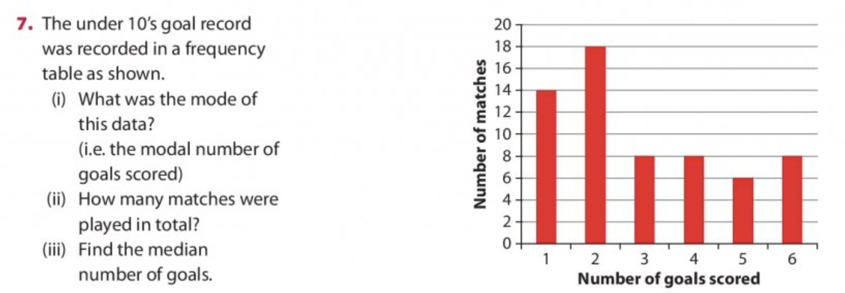
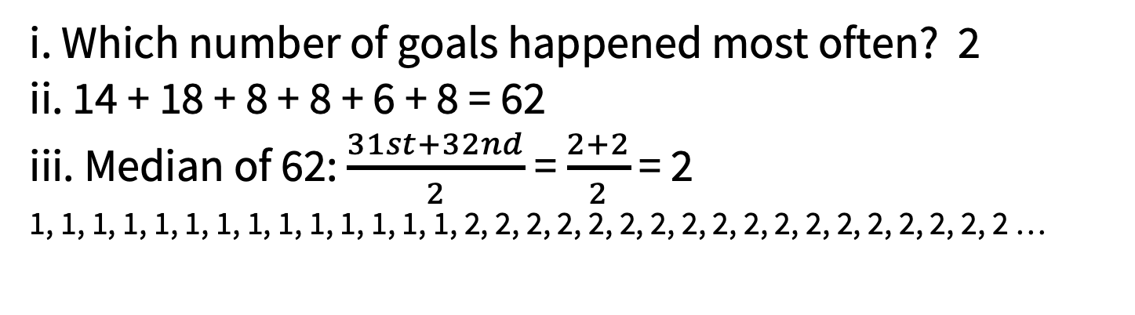
i. Which number of goals happened most often? 2
ii. 14 + 18 + 8 + 8 + 6 + 8 = 62
iii. Median of 62: $\frac{31st+32nd}{2}$= $\frac{2+2}{2}$ = 2
1, 1, 1, 1, 1, 1, 1, 1, 1, 1, 1, 1, 1, 1, 2, 2, 2, 2, 2, 2, 2, 2, 2, 2, 2, 2, 2, 2, 2, 2, 2, 2 …

Slide 22
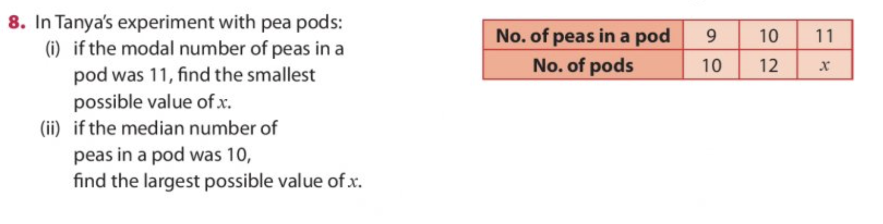
For 11 peas in a pod to be the most common, it must be more common than 9-pea and 10-pea pods.
Mode: 13
ii. If median is 10 it has to be the middle number.
Largest value of x: 21

