Slide 1
Length, Area and Volume:
Surface Area of 3D Figures
5C, Tuesday 18/11/20

Slide 2
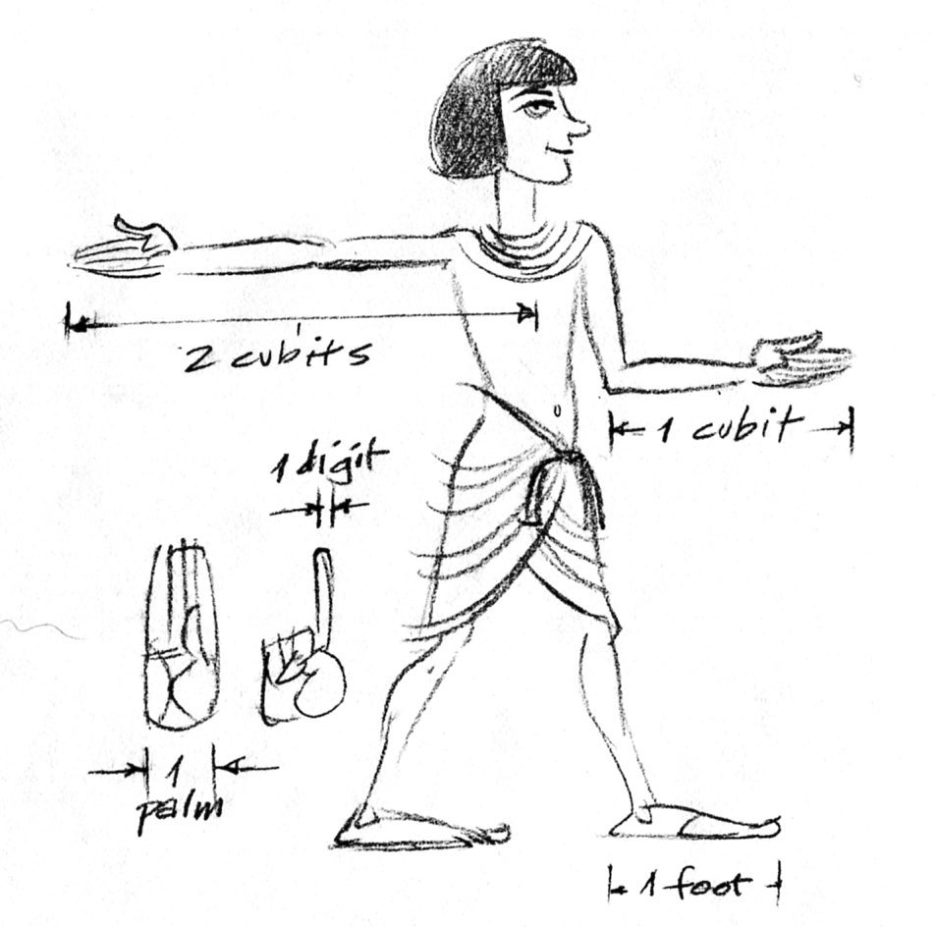
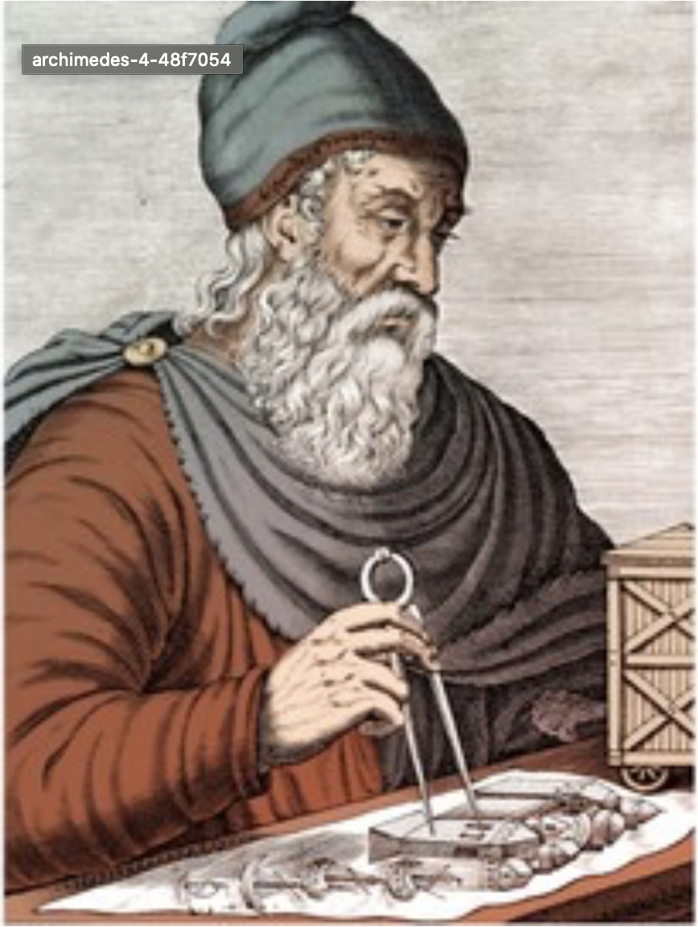
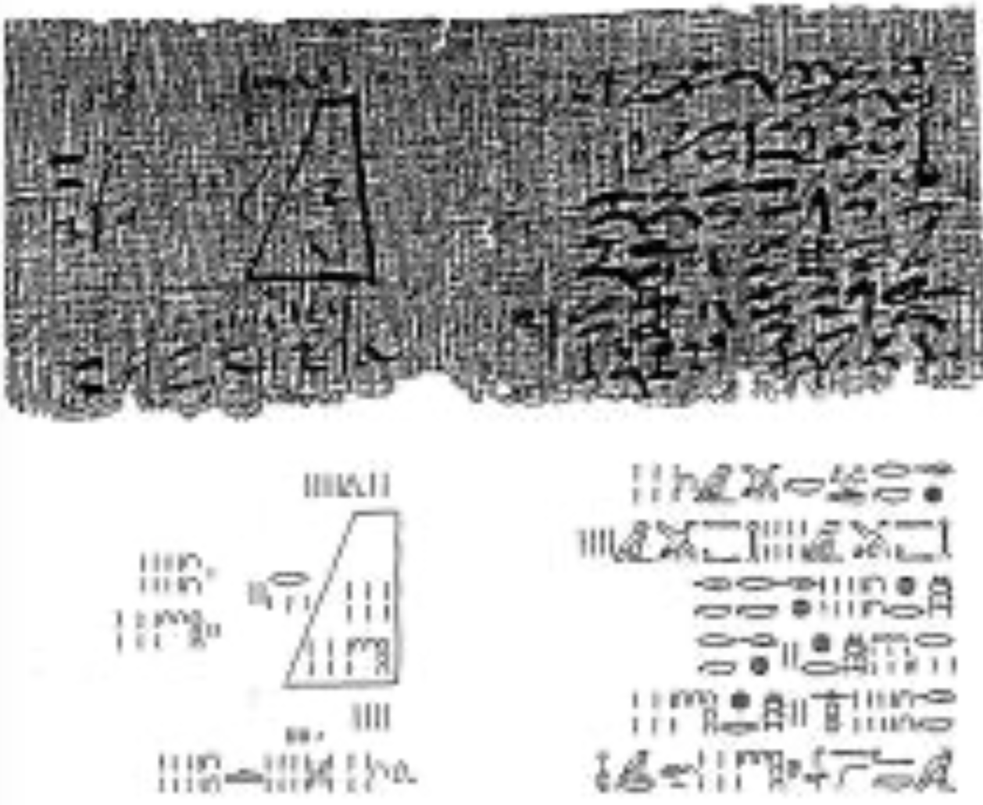
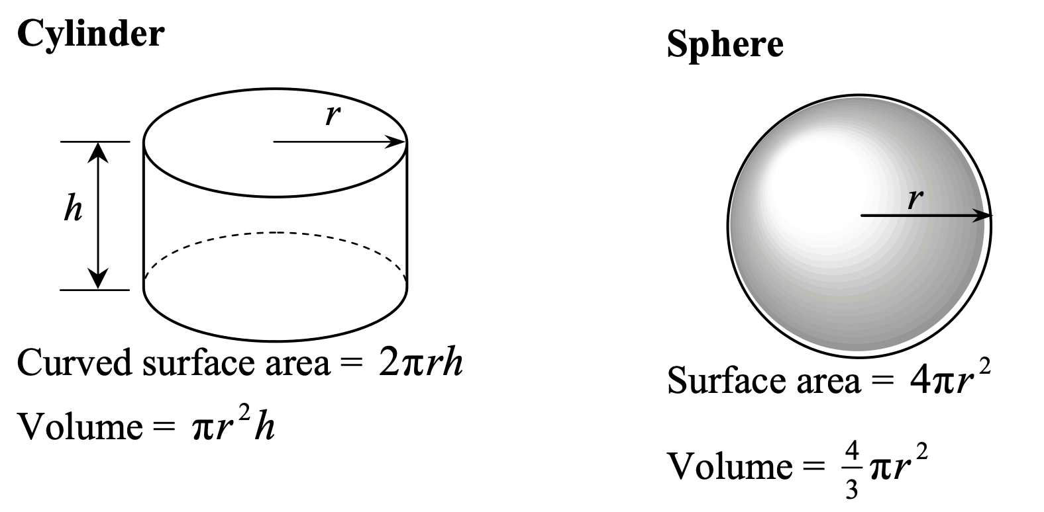
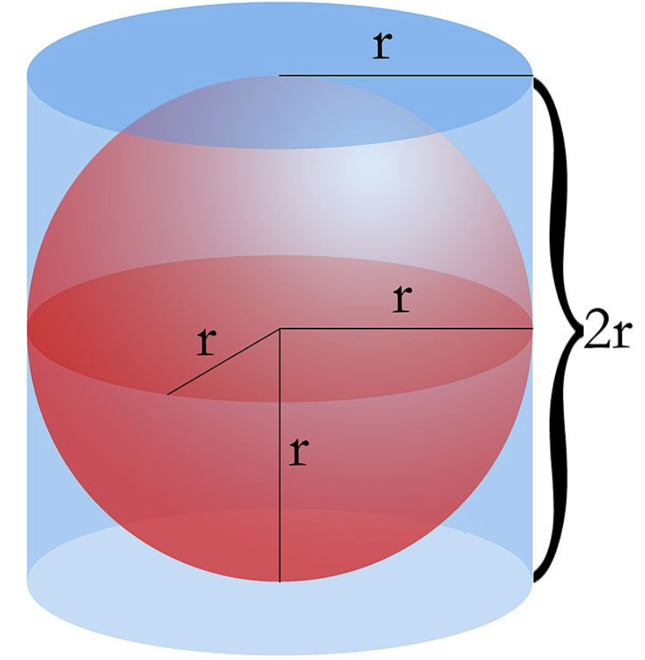
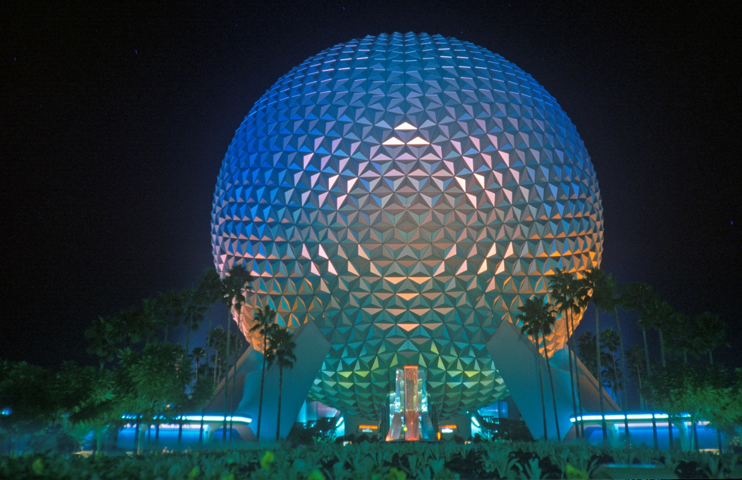
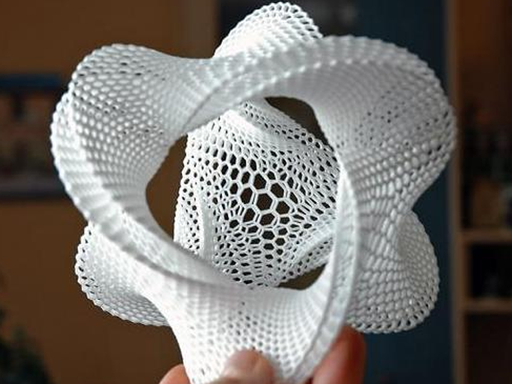
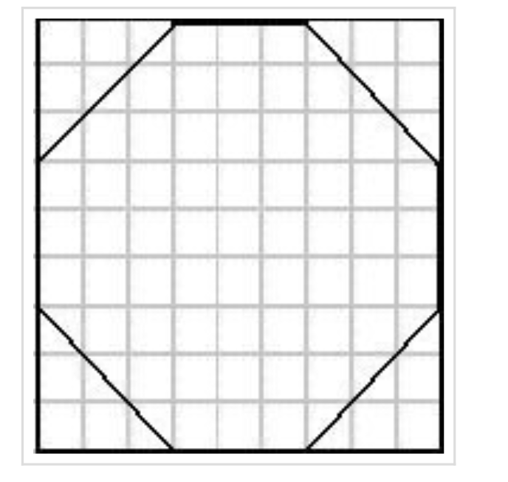
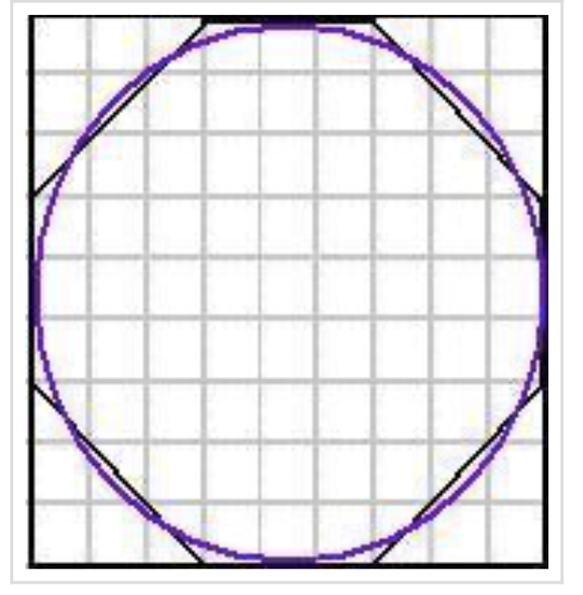
History of Area and Volume
Egyptians (~2000 B.C.) | Greeks (~250 B.C.) | Today (2020)

Slide 3
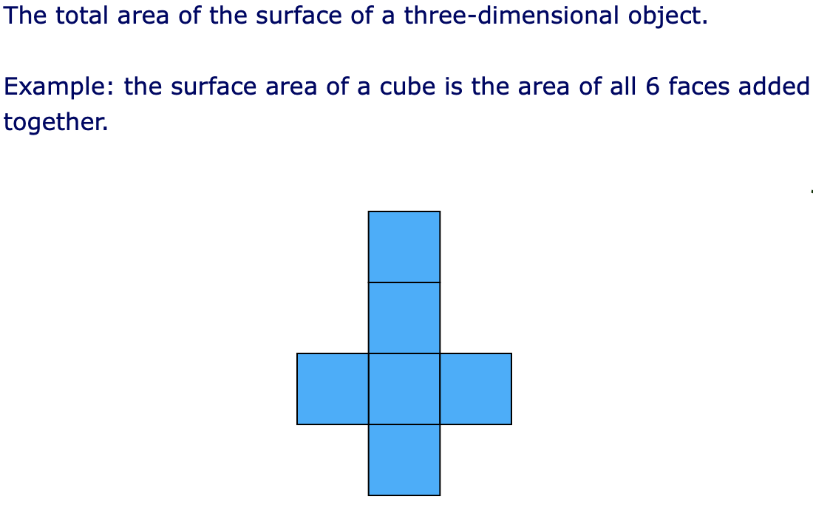
Surface Area and the Net of Objects
What is the surface area of an object?

Slide 4
What is a net of an object?
A net is a flat shape that can be folded to make a 3-dimensional object.
We use nets to:
help us visualise all the sides of an object
help us calculate the surface area of an object

Slide 5
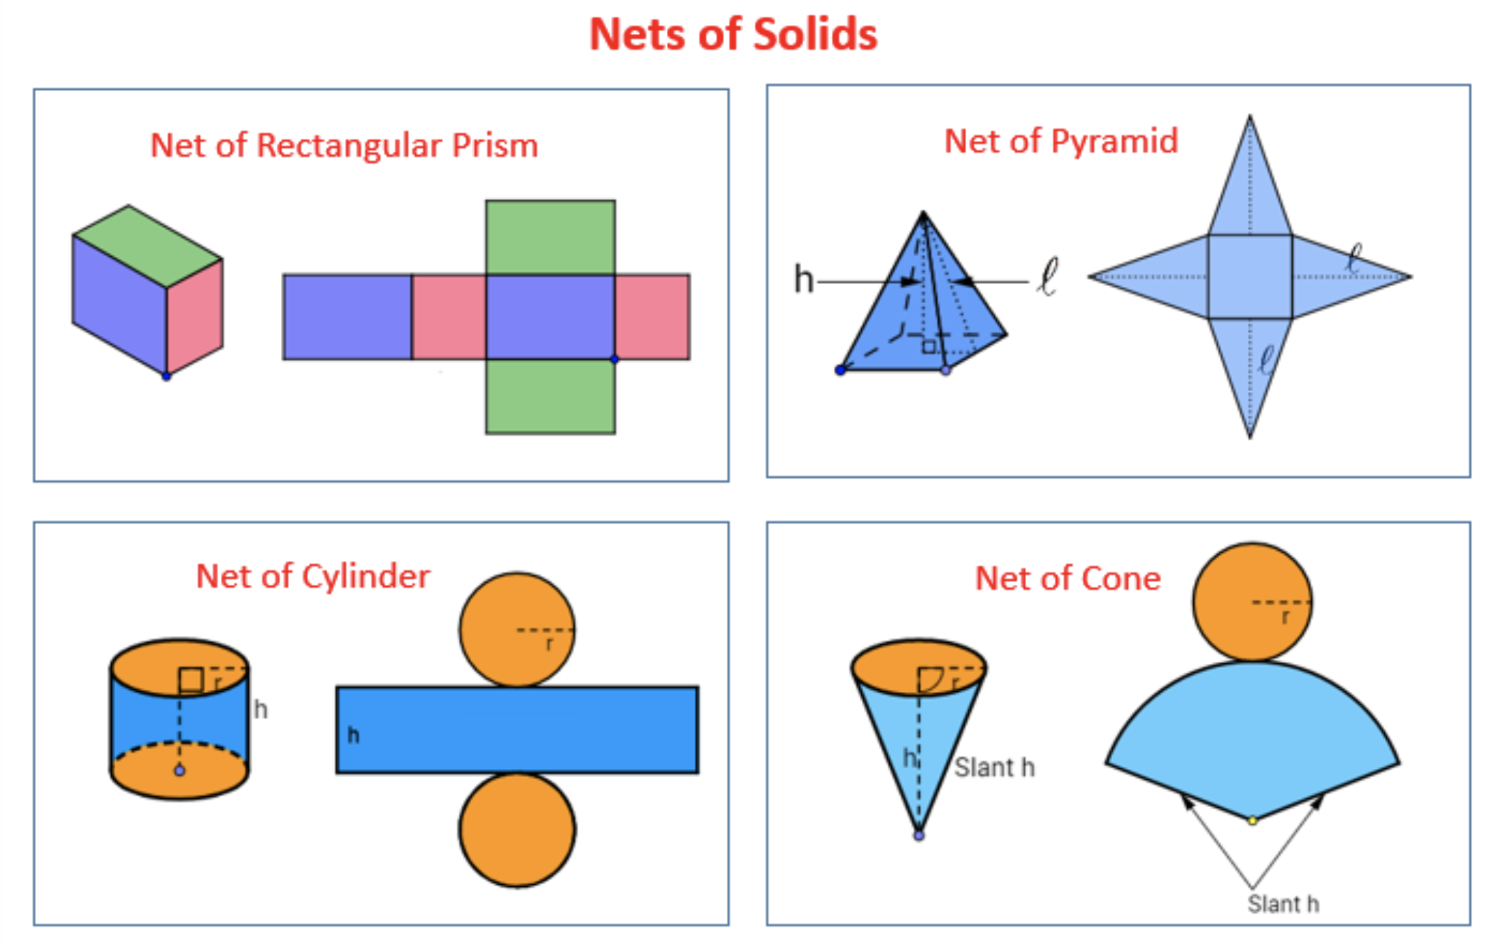

Slide 6
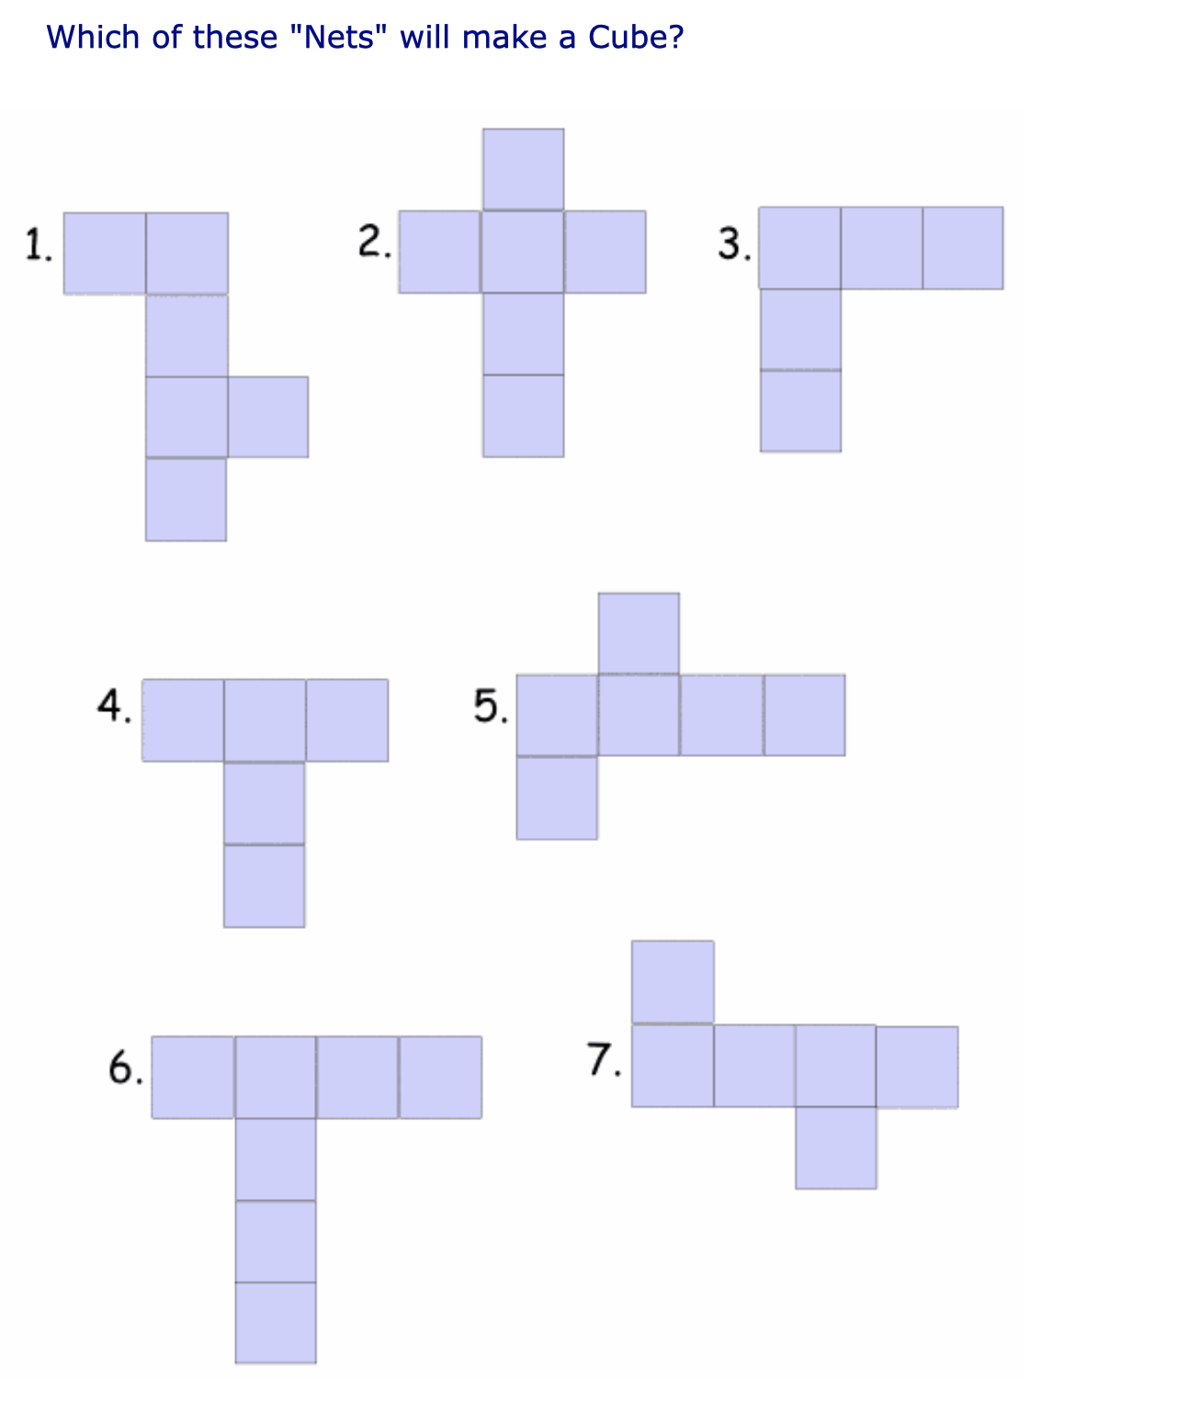
Worksheet: Section A
The Net of a Cube
Which of these nets will make a cube?

Slide 7
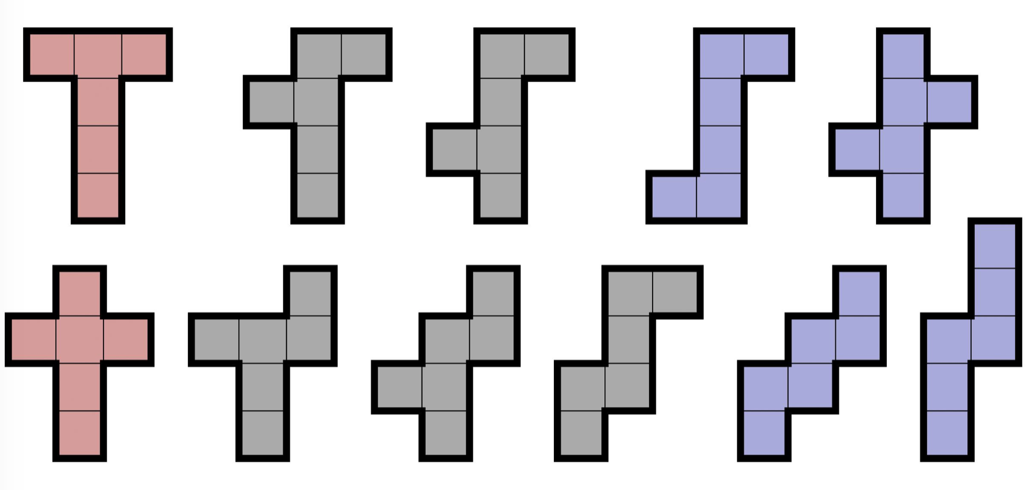
The 11 Nets of a Cube

Slide 8
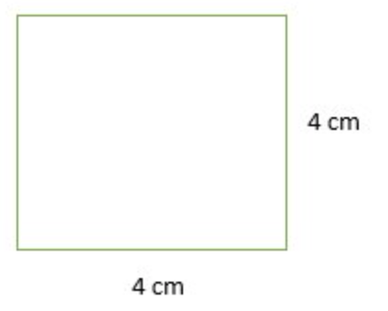
Worksheet: Section B
Investigate the net of a cube

Slide 9
The Net of a Cylinder

Slide 10
Worksheet: Section C
Investigate the net of a cylinder

Slide 11
Recap:
Maths knowledge is built over thousands of years thanks to humans communicating and learning from each other.
Our ability to quickly calculate the area and volume of shapes build on our ancestors’ knowledge.
Nets are flat shapes that can be folded into 3D objects
There are 11 different shaped nets for a cube.
In the net of a cylinder, the length of the rectangular side is the same as the circumference of the circular side: 2 * π * r
We calculate the surface area by calculate the area of each individual side, and adding them

