Slide 1
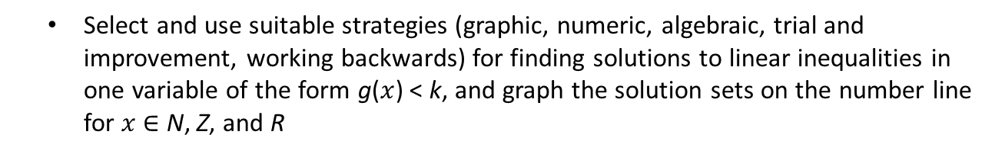
Chapter 22: Algebra: Solving Linear Inequalities
22
Select and use suitable strategies (graphic, numeric, algebraic, trial and improvement, working backwards) for finding solutions to linear inequalities in one variable of the form g($x$) < k, and graph the solution sets on the number line for $x$ ∈ N, Z, and R

Slide 2
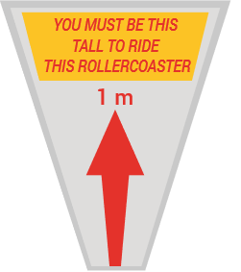
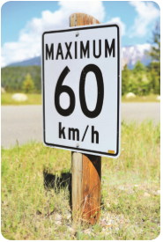

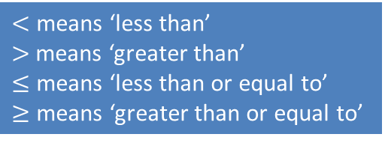


Inequalities
Each diagram shows an example of an inequality.
You must be at least 1 m tall to be able to ride this rollercoaster:
Height $≥$1 m.
Vehicles must travel at a speed less than or equal to 60 km/hr:
Speed $≤$60 km/hr.
$<$ means ‘less than’ $>$means ‘greater than’
$≤$ means ‘less than or equal to’
$≥$ means ‘greater than or equal to’
Using the number line, state if the inequalities below are true or false.
(a) 3$>$1 (b) −4$<$3 (c) –2 $>2$
−4
−3
−2
−1
0
1
2
3
(a) True as 3 is to the right of 1.
(b) True as −4 is to the left of 3.
(c) False as –2 is to the left of 2.

Slide 3




Number Systems
Natural Numbers (N):
A natural number is any positive whole number.
The set of natural numbers is denoted by N: N = {1, 2, 3, 4, ...}
As natural numbers are whole numbers, to graph them on a number line we use shaded dots.
If $x$ is a natural number, we can write $x$ ∈ N.
Integers (Z):
An integer is any whole number: positive, negative or zero.
The set of integers is denoted by the letter Z: Z = {... , –3, –2, –1, 0, 1, 2, 3, ...}
As integers are also whole numbers, to graph them on a number line we use shaded dots.
If$x$is an integer, we can write $x$ ∈ Z.
Real Numbers (R):
A real number is any number that can be plotted on a number line.
In order to show real numbers on the number line we use solid continuous shading.
If $x$ is a real number, we can write $x$ ∈ R.

Slide 4

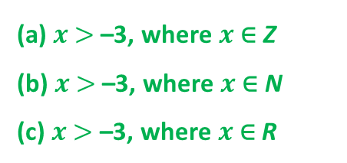
Graphing Inequalities
Graph each of the following inequalities on the number line given. NOTE: $x$ is an element of a different set (N, Z, or R) in each case.
(a) $x$ $>$–3, where $x$ ∈ Z
(b) $x$ $>$–3, where $x$ ∈ N
(c) $x$ $>$ –3, where $x$∈ R
(a)
−4
−3
−2
−1
0
1
2
3
−4
−3
−2
−1
0
1
2
3
(b)
−4
−3
−2
−1
0
1
2
3
(c)

Slide 5

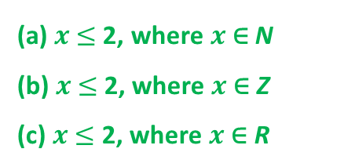
Graphing Inequalities
Graph each of the following inequalities on the number line given. NOTE: $x$ is an element of a different set (N, Z, or R) in each case.
(a) $x$ $≤$2, where $x$ ∈ N
(b) $x$ $≤$2, where $x$ ∈ Z
(c) $x$ $≤$ 2, where $x$∈ R
−4
−3
−2
−1
0
1
2
3
(a)
−4
−3
−2
−1
0
1
2
3
(b)
(c)
−4
−3
−2
−1
0
1
2
3

Slide 6
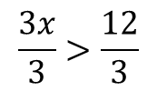




Solving Linear Inequalities
Solve the inequality 3$x$ − 5 $>$ 7,$x$∈ N.
We solve linear inequalities using the same rules we learned for solving linear equations.
$$3x−5>7$$
$3x−5+5>7+5$ Adding 5 to both sides.
$$3x>12$$
$$\frac{3x}{3}>\frac{12}{3}$$
Dividing both sides by 3.
$$∴x>4, x \text{∈ }\text{N}\text{.}$$
This is the solution set of the inequality.

Slide 7
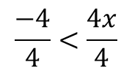






Solving Linear Inequalities
Solve $5−4x<9$, $x$ ∈ R and show the solution set on a number line.
$$5−4x<9$$
$5<9+4x$ Adding 4$x$ to both sides.
$5−9<4x$ Subtract 9 from both sides.
$$−4<4x$$
$$\frac{−4}{4}<\frac{4x}{4}$$
Dividing both sides by 4.
$$∴−1<x, x \text{∈ }\text{R}\text{.}$$
Then $x>1.$
We then graph this solution set on a number line.
Remember that x ∈ R.
−2
−1
0
1
2
3
4
5

