Slide 1
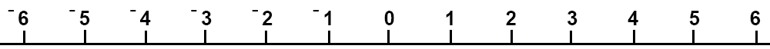
Which inequality is shown on the number line?
A
B
C
D

Slide 2
Which inequality is shown on the number line?
A
B
C
D

Slide 3
Which inequality is shown on the number line?
A
B
C
D

Slide 4
Which inequality is shown on the number line?
A
B
C
D

Slide 5
Which inequality is shown on the number line?
A
B
C
D

Slide 6
Which inequality is shown on the number line?
A
B
C
D

Slide 7
Which inequality is shown on the number line?
A
B
C
D

Slide 8
Which inequality is shown on the number line?
A
B
C
D

