Slide 1


Linear Inequalities
WALT:
WILF:
Solve simple inequalities, representing the solution on a number line
Grade 5
Is the answer to:
Is the answer to:
Is the answer to:
Represent:
-2 < x < 4
on a number line
Solve this inequality
Solve this inequality
Grade 3
Grade 4/5
Grade 5/6
Eliminate Simultaneous Variable
Keywords

Slide 2



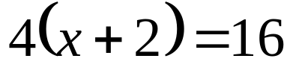
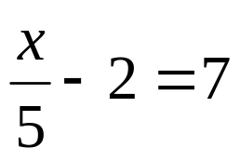
Linear Inequalities
Starter:
Solve these equations.
1
2
3
4
5

Slide 3



Linear Inequalities
Definition:
An inequality tells you about two quantities that are unequal.
You can solve an inequality like you can solve an equation.
-2
-2
÷3
÷3
0
1
2
3
4
5
6

Slide 4




Linear Inequalities
Representing Inequalities on a number line:
You can show the solution of an inequality on a number line, for example
2
3
4
5
6
7
8
2
3
4
5
6
7
8
2
3
4
5
6
7
8
2
3
4
5
6
7
8

Slide 5
Exercise 1:
1
List the set of integers that satisfy each inequality
a
–2 < x ≤ 1
b
–2 ≤ x < 4
c
–3 < x < 3
-1, 0, 1
-2,-1,0,1,2,3
-2,-1,0,1,2
d
–3 ≤ x < 2
e
–1 < x ≤ 4
f
–2 ≤ x ≤ 4
-3,-2,-1,0,1
0,1,2,3,4
-2,-1,0,1,2,3,4
2
Represent the following inequalities on a number line
a
x ≤ 3
b
x > 2
c
x < 0
-5
-4
-3
-2
-1
0
1
2
3
4
5
6
-5
-4
-3
-2
-1
0
1
2
3
4
5
6
-5
-4
-3
-2
-1
0
1
2
3
4
5
6
c
–2 < x ≤ 1
d
–2 ≤ x < 4
e
–3 < x < 3
-5
-4
-3
-2
-1
0
1
2
3
4
5
6
-5
-4
-3
-2
-1
0
1
2
3
4
5
6
-5
-4
-3
-2
-1
0
1
2
3
4
5
6
f
–3 ≤ x < 2
g
–1 < x ≤ 4
h
–2 ≤ x ≤ 4
-5
-4
-3
-2
-1
0
1
2
3
4
5
6
-5
-4
-3
-2
-1
0
1
2
3
4
5
6
-5
-4
-3
-2
-1
0
1
2
3
4
5
6

Slide 6












Inequalities
Solving inequalities:
Solve these inequalities and represent the solutions on a number line.
-2x
-2x
÷4
÷4
-7
-7
+5
+5
Change sign
÷2
÷2
÷2
÷2
So
Change sign
6
7
8
9
10
11
12
-5
-4
-3
-1
1
-2
0
1
2
3
4
5
5
6

Slide 7








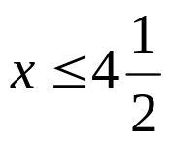
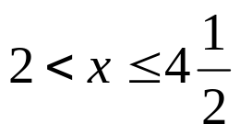
Linear Inequalities
Solving inequalities:
Treat as two separate inequalities
Expand
Expand
-x
-x
+2
+2
+2
+2
÷2
÷ 2

Slide 8

















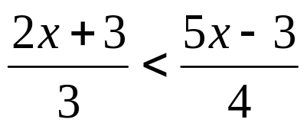
Exercise 2:
Solve the equalities.
a
b
c
x ≤ 2
x > 1
x > -4
d
e
f
x ≥ 2
x ≥ -4
x > -3
g
h
i
x ≤ 3
x < -4
x ≥ 1
j
k
l
x < 4
x ≤ 0
x < -3
m
n
o
x > -4¹/₃
2 ≤ x < 6
-1 ≤ x < 3
p
q
r
-12 < x < -4
-1 ≤ x < 6
x > 3

Slide 9
Linear Inequalities
WALT:
WILF:
Solve simple inequalities, representing the solution on a number line
Grade 5
Is the answer to:
Is the answer to:
Is the answer to:
Represent:
-2 < x < 4
on a number line
Solve this inequality
Solve this inequality
Grade 3
Grade 4/5
Grade 5/6
Eliminate Simultaneous Variable
Keywords

