Slide 1
Sketching Graphs
WALT:
WILF:
Sketch quadratic graphs
Grade 8
Is the answer to:
Is the answer to:
Is the answer to:
Factorise:
x² + 11x + 30
Complete the square for
x² – 14x + 5
Sketch the graph for
y = x² – 14x + 5
Grade 6
Grade 7
Grade 8
Factorise Turning point Minimum Maximum
Completing the square Quadratic Formula
Y-intercept X-intercept Solve
Keywords

Slide 2
Sketching Graphs
Starter:
1
Factorise the following quadratics
a
x² + 5x + 6
b
x² - 5x - 36
c
2x² + 16x + 24
d
x² - 25
(x + 3)(x + 2)
(x + 9)(x – 4)
(2x + 12)(x + 2)
(x + 5)(x – 5)
2
Write these functions in the form (x + p)² + q Completing the square
a
x² – 6x + 13
b
x² + 4x + 6
c
2x² – 20x + 3
d
x² – x – 5
(x + 3)(x + 2)
(x + 9)(x – 4)
(2x + 12)(x + 2)
(x + 5)(x – 5)
3
Use the quadratic formula to work to find the solutions for
a
x² + 8x + 5 = 0
b
3x² + 6x – 3 = 0
c
5 – 4x – 2x² = 0
d
x² + 3x = 4
-7.32 or -0.683
-2.41 or 0.414
-2.87 or 0.871
-4 or 1

Slide 3
Sketching Graphs
Introduction:
y
y = x²
Positive quadratics are U shaped.
x
y
Negative quadratics are n shaped.
x
y = -x²

Slide 4
Sketching Graphs
Introduction:
y
X-intercept
Find this by setting y = 0
x
Y-intercept
Find this by setting x = 0
Turning Point
Find the turning point by completing the square

Slide 5









Sketching Graphs
Example 1:
Sketch the graph y = x² + 5x + 6
U shaped because it is positive
Do this by completing the square
Y intercept = 6
Find the X intercept by setting y = 0 and solving the equation
The min point occurs when x = -2.5
Therefore y = -0.25
and
y
X intercept = -2 and -3
(0,6)
Because the quadratic is positive we find the minimum turning point
(-3,0)
(-2,0)
x
(-2.5,-0.25)

Slide 6








Sketching Graphs
Example 2:
Sketch the graph y = x² – 10x
U shaped because it is positive
Do this by completing the square
Y intercept = 0
Find the X intercept by setting y = 0 and solving the equation
The min point occurs when x = 5
Therefore y = -25
and
y
X intercept = 0 and 10
Because the quadratic is positive we find the minimum turning point
(0,0)
(10,0)
x
(5,-25)

Slide 7




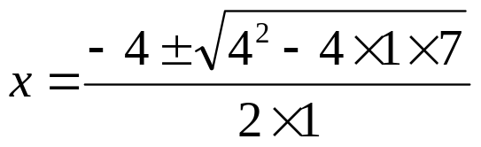
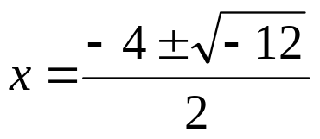
Sketching Graphs
Example 3:
Sketch the graph y = x² + 4x + 7
U shaped because it is positive
Do this by completing the square
Y intercept = 7
Find the X intercept by setting y = 0 and solving the equation
The min point occurs when x = -2
Therefore y = 3
y
(0,7)
Can’t square root a negative number therefore it does not intercept the x axis
(-2,3)
Because the quadratic is positive we find the minimum turning point
x

Slide 8




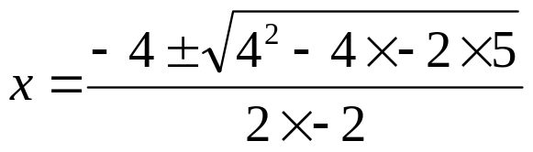


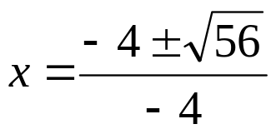


Sketching Graphs
Example 4:
Sketch the graph y = 5 + 4x -2x²
n shaped because it is negative
Do this by completing the square
Y intercept = 5
Find the X intercept by setting y = 0 and solving the equation
The max point occurs when x = 1
Therefore y = 7
y
(1,7)
x
and
(0,5)
X intercept = -0.871 and 2.87
(-0.871,0)
(2.87,0)
Because the quadratic is negative we find the maximum turning point

Slide 9
Sketching Graphs
Exercise:
Sketch the graphs of these quadratic functions.
a
y = x² + 2x - 5
b
y = x² + 10x + 23
c
y = x² – 5x + 4
Positive U
Y-intercept = (0,-5)
X-intercept =
(-3.4,0)&(1.4,0)
Turning Point = (-1,6)
Positive U
Y-intercept = (0,23)
X-intercept =
(-6.4,0)&(-3.6,0)
Turning Point = (-5,-2)
Positive U
Y-intercept = (0,4)
X-intercept =
(1,0)&(4,0)
TP = (2.5,-2.25)
d
y = -x² - 7x - 12
e
y = x² – x - 3
f
y = x² + 12x + 5
Negative n
Y-intercept = (0,-12)
X-intercept =
(-4,0)&(-3,0)
TP = (-3.5,0.25)
Positive U
Y-intercept = (0,-3)
X-intercept =
(-1.3,0)&(2.3,0)
TP = (0.5,-3.25)
Positive U
Y-intercept = (0,5)
X-intercept =
(-11.6,0)&(-0.4,0)
TP = (-6,-31)
g
y = 3x² + 6x - 15
h
y = 4 + 8x – 2x²
i
y = 6 – 6x – 3x²
Positive U
Y-intercept = (0,-15)
X-intercept =
(-3.4,0)&(1.4,0)
TP = (-1,18)
Negative n
Y-intercept = (0,4)
X-intercept =
(-0.4,0)&(4.4,0)
TP = (2,12)
Negative n
Y-intercept = (0,6)
X-intercept =
(-2.7,0)&(0.7,0)
TP = (-1,9)

Slide 10
Sketching Graphs
WALT:
WILF:
Sketch quadratic graphs
Grade 8
Is the answer to:
Is the answer to:
Is the answer to:
Factorise:
x² + 11x + 30
Complete the square for
x² – 14x + 5
Sketch the graph for
y = x² – 14x + 5
Grade 6
Grade 7
Grade 8
Factorise Turning point Minimum Maximum
Completing the square Quadratic Formula
Y-intercept X-intercept Solve
Keywords

