Slide 1
Quadratic Inequalities
WALT:
WILF:
Solve quadratic inequalities with the help of sketching the graphs
Grade 8
Is the answer to:
Is the answer to:
Is the answer to:
Write the inequality that is represent in the number line below
Solve the equation
0 = x² - 8x + 16
Solve the quadratic inequality
X² + 21 < 10x
-5
-4
-3
-2
-1
0
1
2
3
4
5
6
Grade 4
Grade 6
Grade 8
Factorise Quadratic Formula Inequality
X-intercept Solve Sketch
Keywords

Slide 2
Quadratic Inequalities
Starter:
1
Write the inequalities that is represent in the number lines below
a
b
4
x
6
4
6
-5
-4
-3
-2
-1
0
1
2
3
5
-5
-4
-3
-2
-1
0
1
2
3
5
x
x ≤ 1
x > -2
c
d
4
x
6
4
6
-5
-4
-3
-2
-1
0
1
2
3
5
-5
-4
-3
-2
-1
0
1
2
3
5
x
-3 < x ≤ 5
-4 < x < 0
e
f
4
x
6
4
6
-5
-4
-3
-2
-1
0
1
2
3
5
-5
-4
-3
-2
-1
0
1
2
3
5
x
x ≤ -1 and x ≥ 3
x ≤ 3 and x ≥ 4

Slide 3
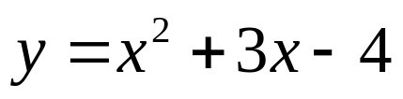







Quadratic Inequalities
Example 1:
1
Solve the inequality x² + 3x - 4 < 0
To solve a quadratic inequality you should complete a quick sketch of the function
Now do a quick sketch of the function.
y
We can factorise this function.
(1,0)
x
(-4,0)
Set y = 0
Because it is < 0 we shade in under the x axis. Therefore ...
and
The x intercept is at (-4,0) and (1,0)

Slide 4
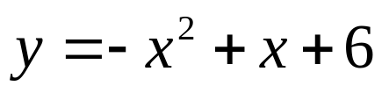
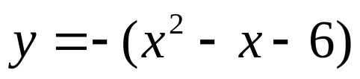







Quadratic Inequalities
Example 2:
1
Solve the inequality -x² + x + 6 ≥ 0
To solve a quadratic inequality you should complete a quick sketch of the function
Now do a quick sketch of the function.
y
x
We can factorise this function.
(-2,0)
(3,0)
Set y = 0
Because it is ≥ 0 we shade in above the x axis. Therefore ...
and
The x intercept is at (-2,0) and (3,0)

Slide 5









Quadratic Inequalities
Exercise:
1
Solve these inequalities, in each case sketch a graph
a
b
c
-4 < x < 3
x ≤ -3 and x ≥ 5
x = 3
d
e
f
-3 < x < 1
x ≤ -5/2 and x ≥ 1
x < -4 and x > 4
g
h
i
-3 < x < 2
-6 < x < -1
-2 < x < 5

Slide 6
Quadratic Inequalities
WALT:
WILF:
Solve quadratic inequalities with the help of sketching the graphs
Grade 8
Is the answer to:
Is the answer to:
Is the answer to:
Write the inequality that is represent in the number line below
Solve the equation
0 = x² - 8x + 16
Solve the quadratic inequality
X² + 21 < 10x
-5
-4
-3
-2
-1
0
1
2
3
4
5
6
Grade 4
Grade 6
Grade 8
Factorise Quadratic Formula Inequality
X-intercept Solve Sketch
Keywords

