Slide 3
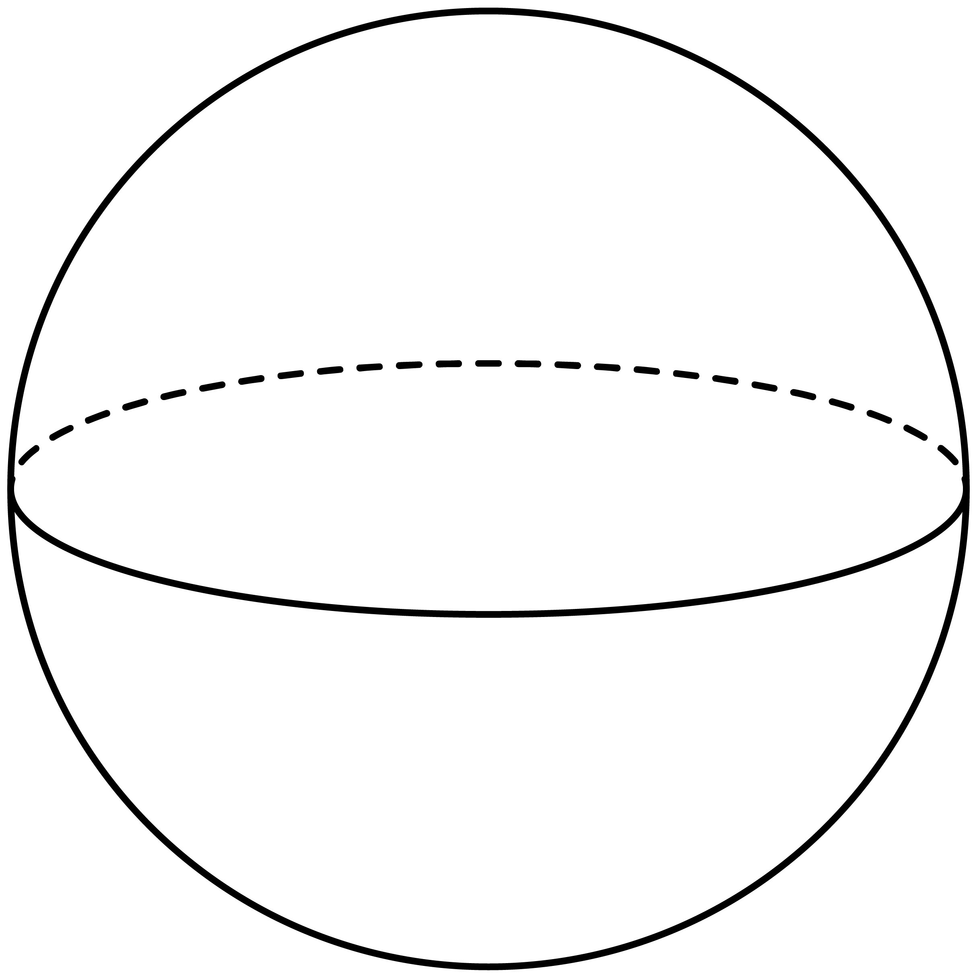
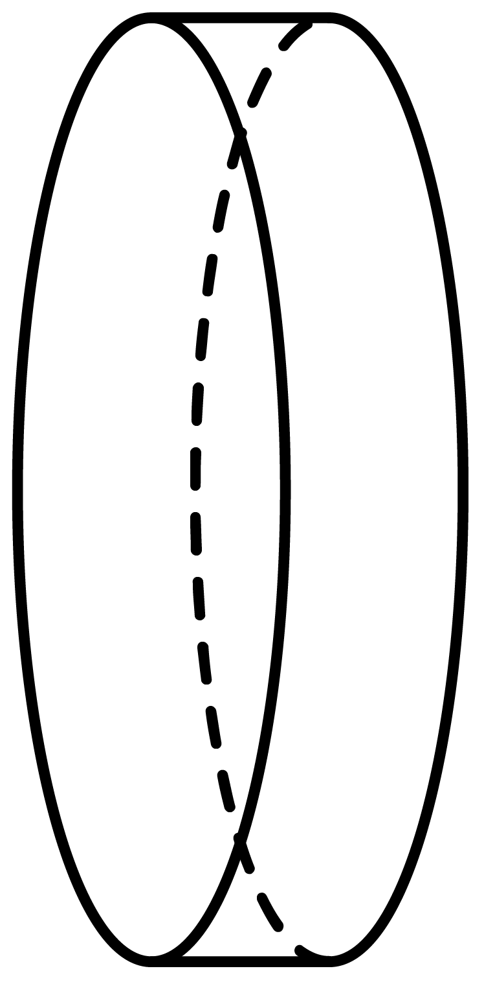




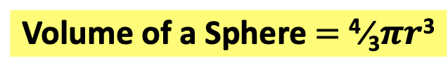



Volume of a Sphere $=$ ⁴⁄₃$πr$³
Ex1
Find the volume of the sphere below.
Ex2
Which of the following shapes has the largest volume?
Solution
Solution
3cm
6cm
11cm
The sphere has the largest volume.
2cm
Volume $=$ ⁴⁄₃ $×$ $π$ $×$ 3³
Sphere $=$ ⁴⁄₃ $×$ $π$ $×$ 6³
Cylinder $=$ $π$ $×$ 11² $×$ 2
Volume $=$ 36$π$cm³
Volume $=$ 113.1cm³
Sphere $=$ 288$π$cm³
Cylinder $=$ 242$π$cm³

Slide 4
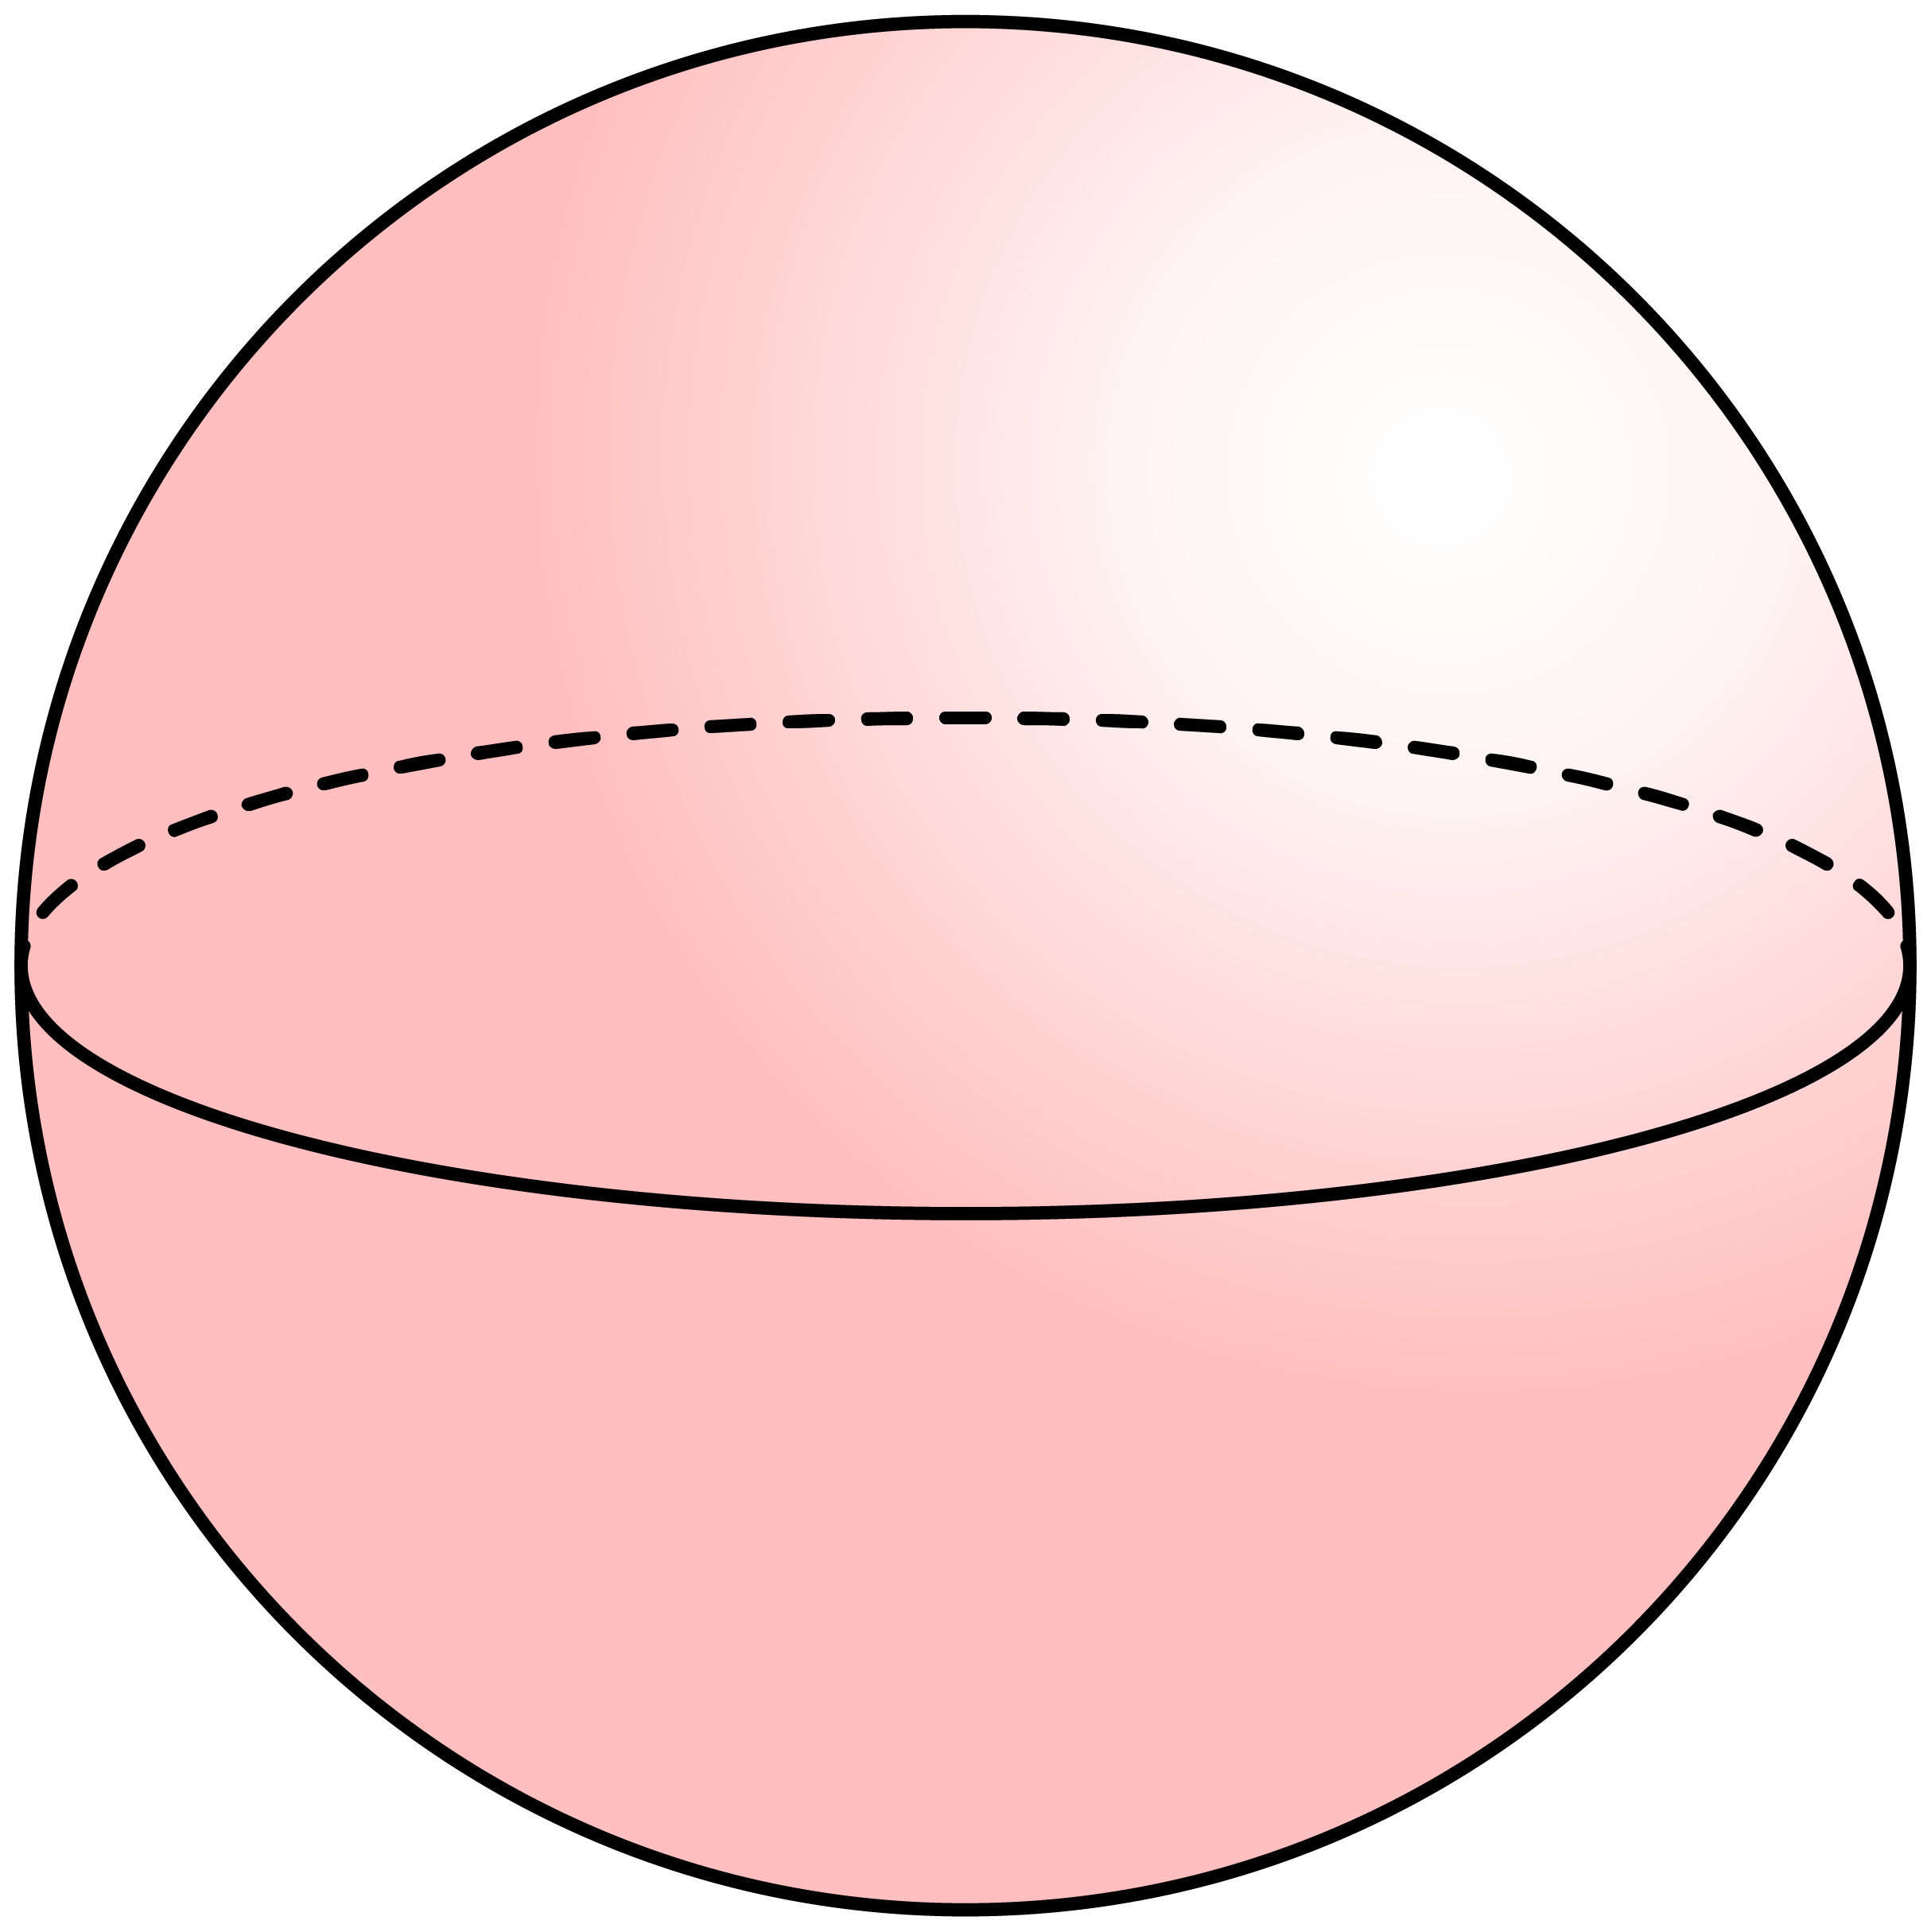
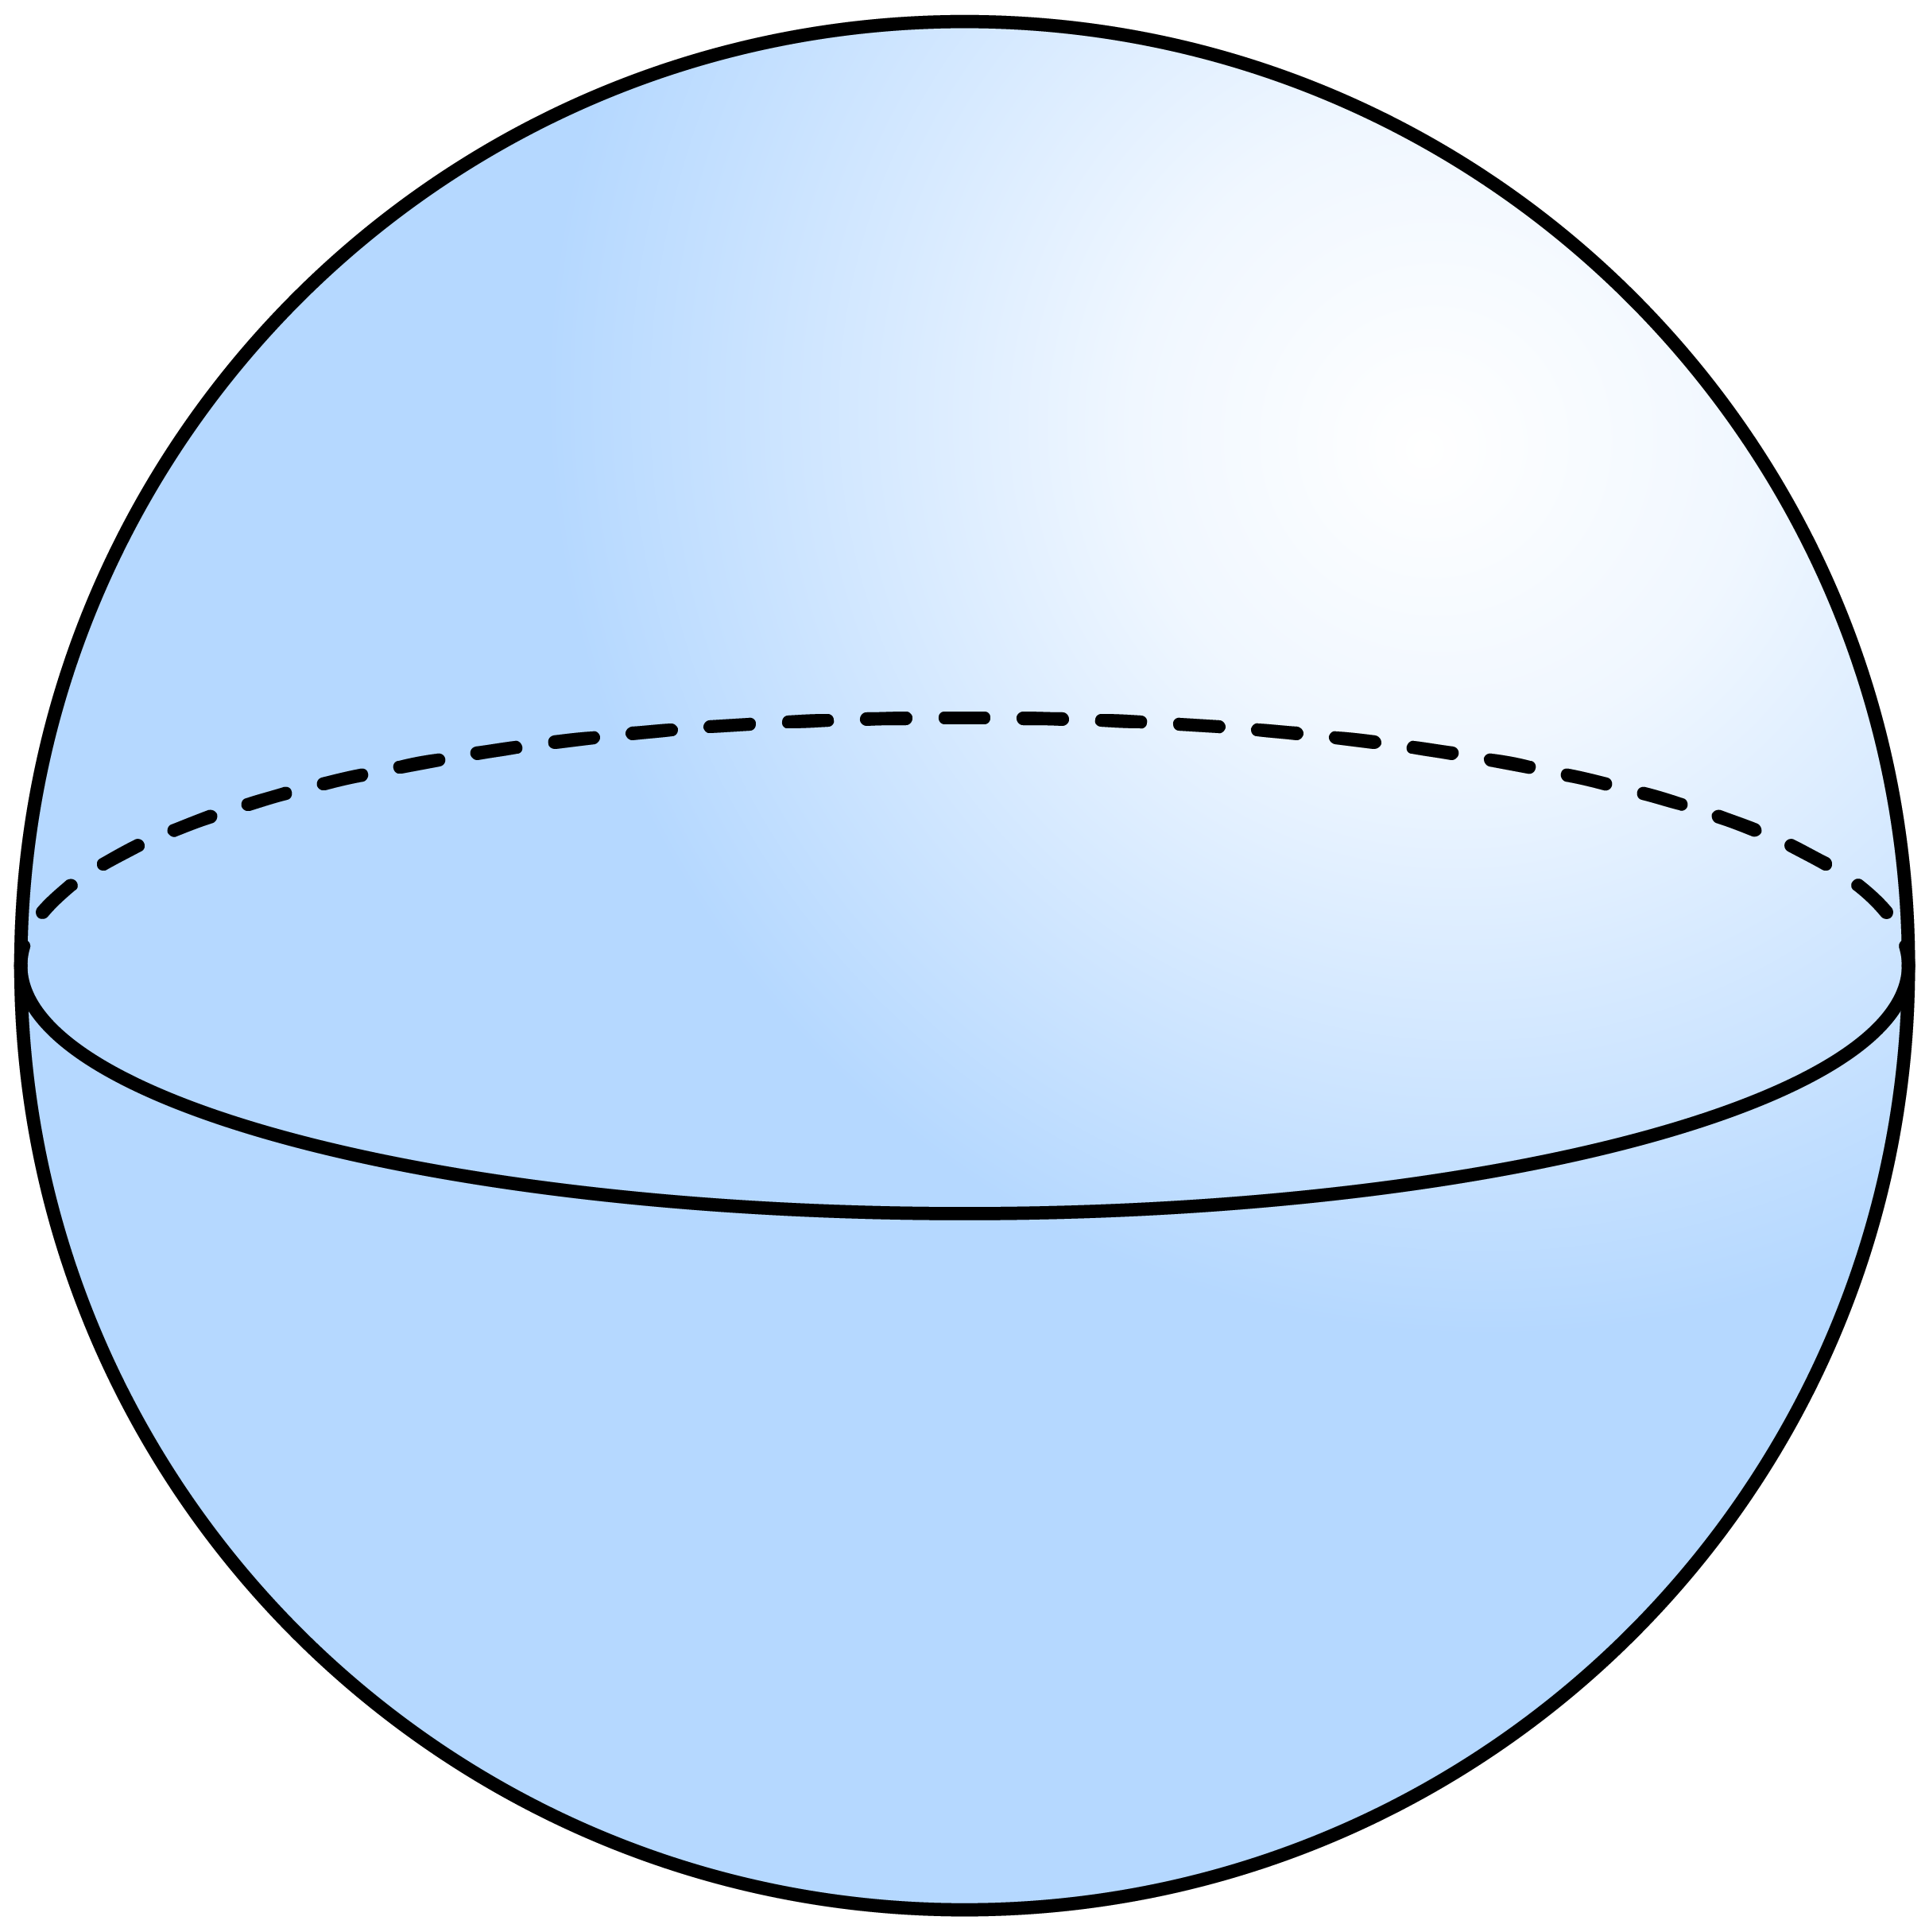
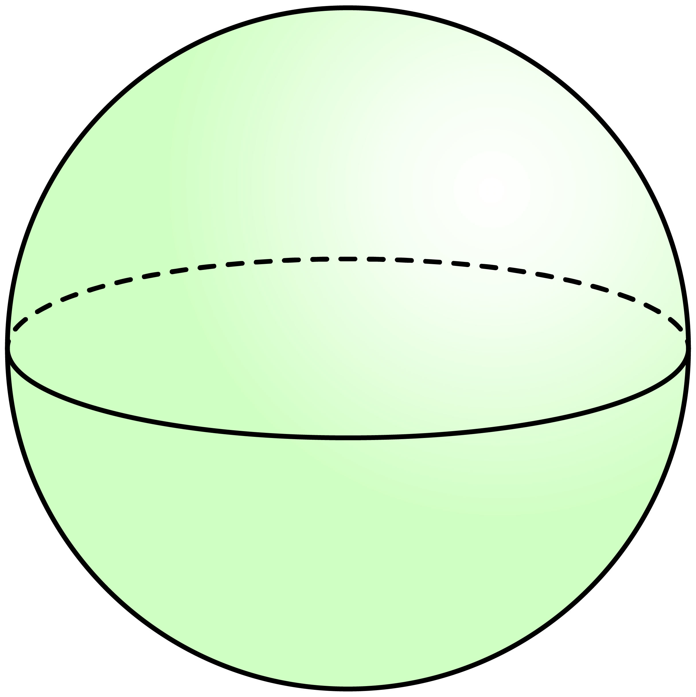
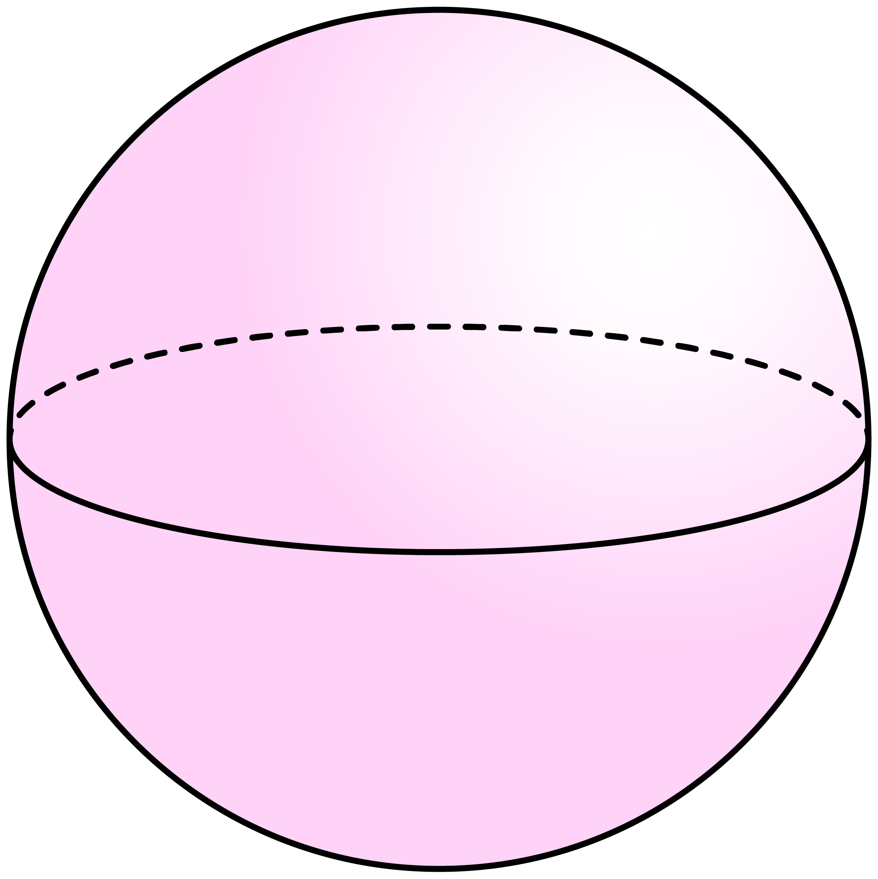
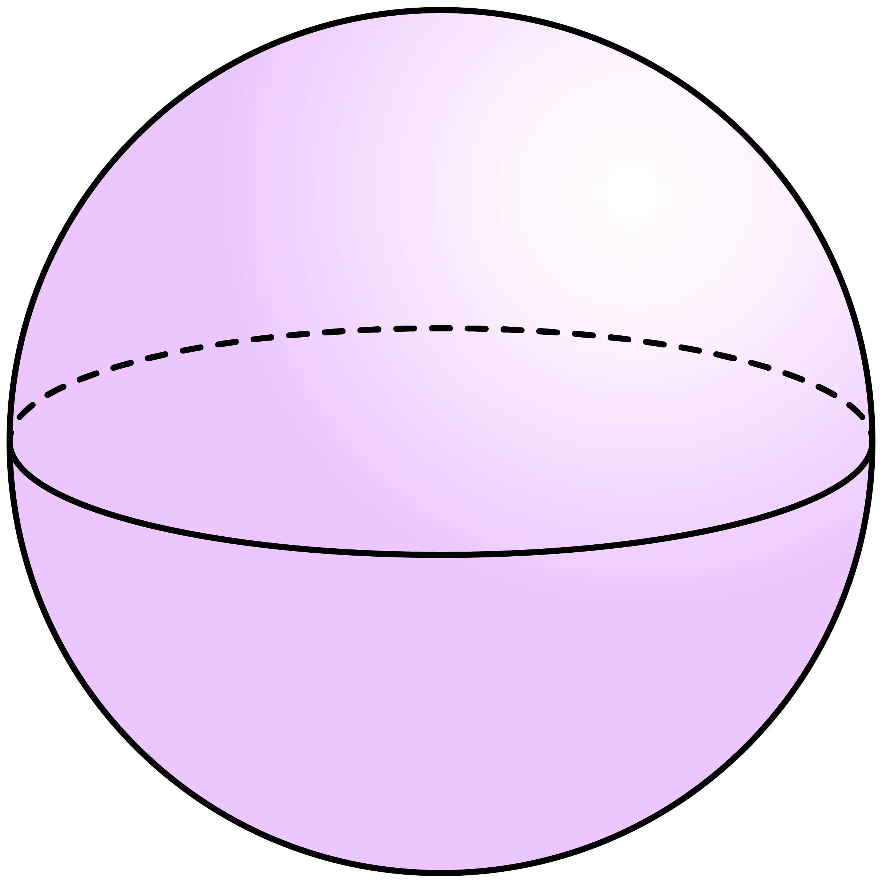
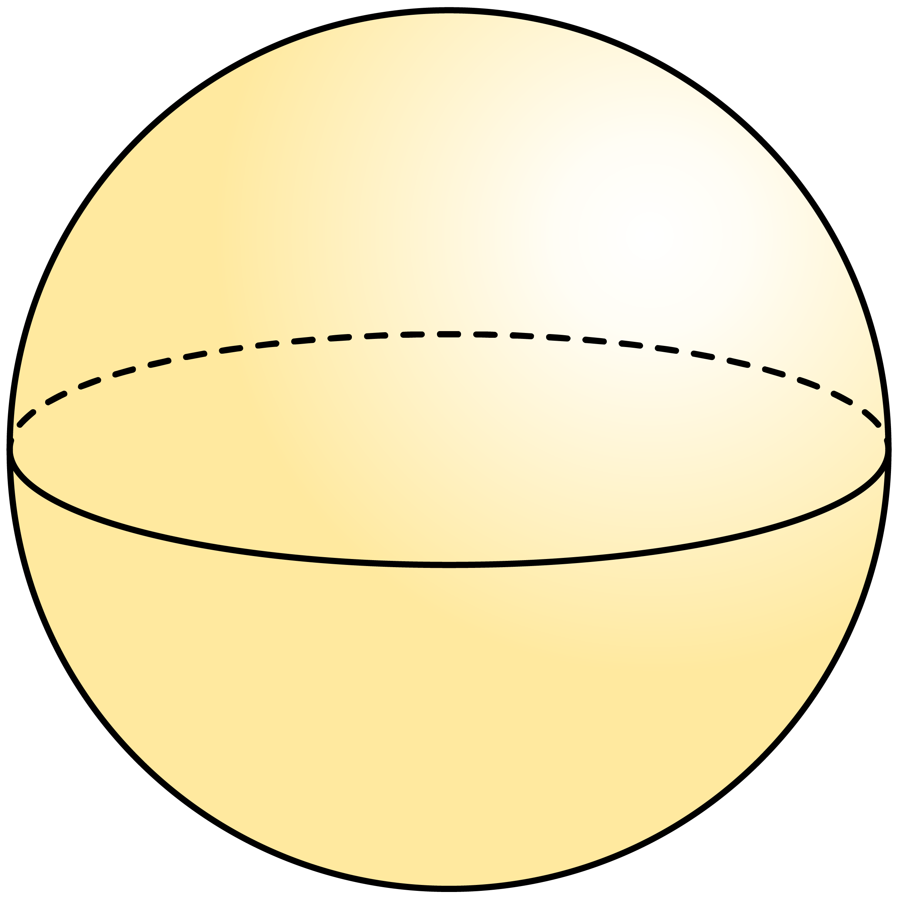
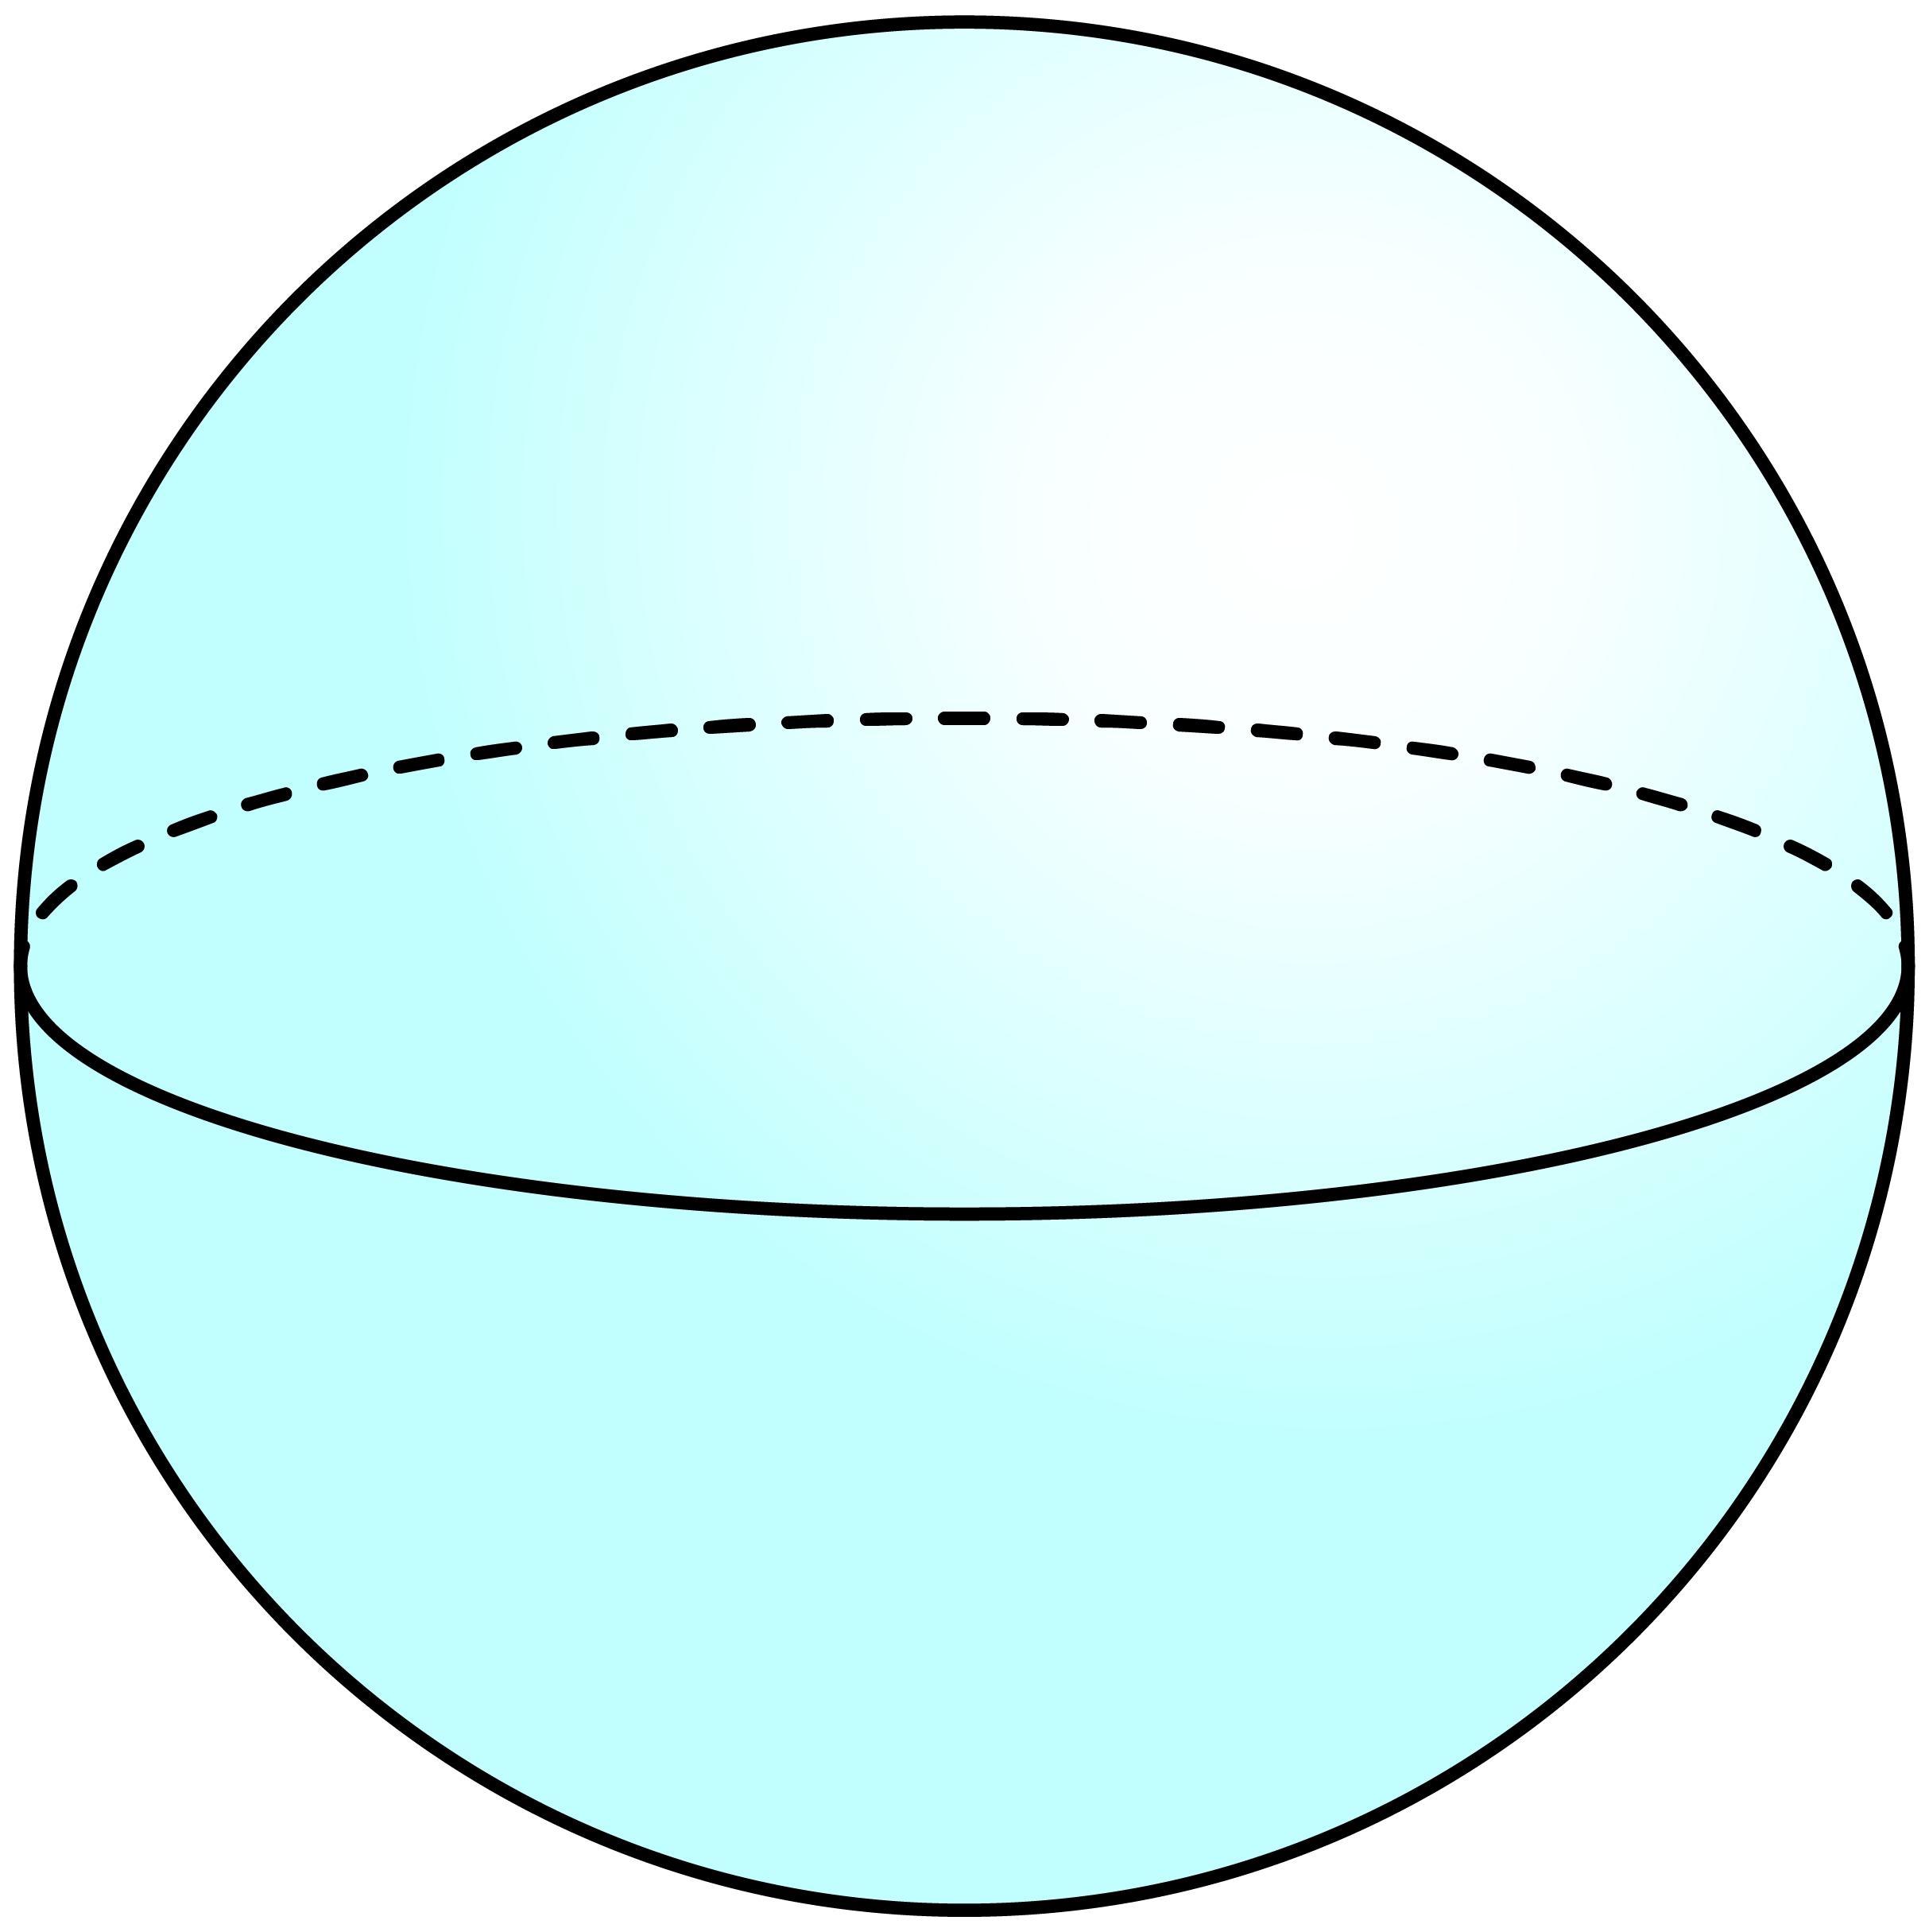
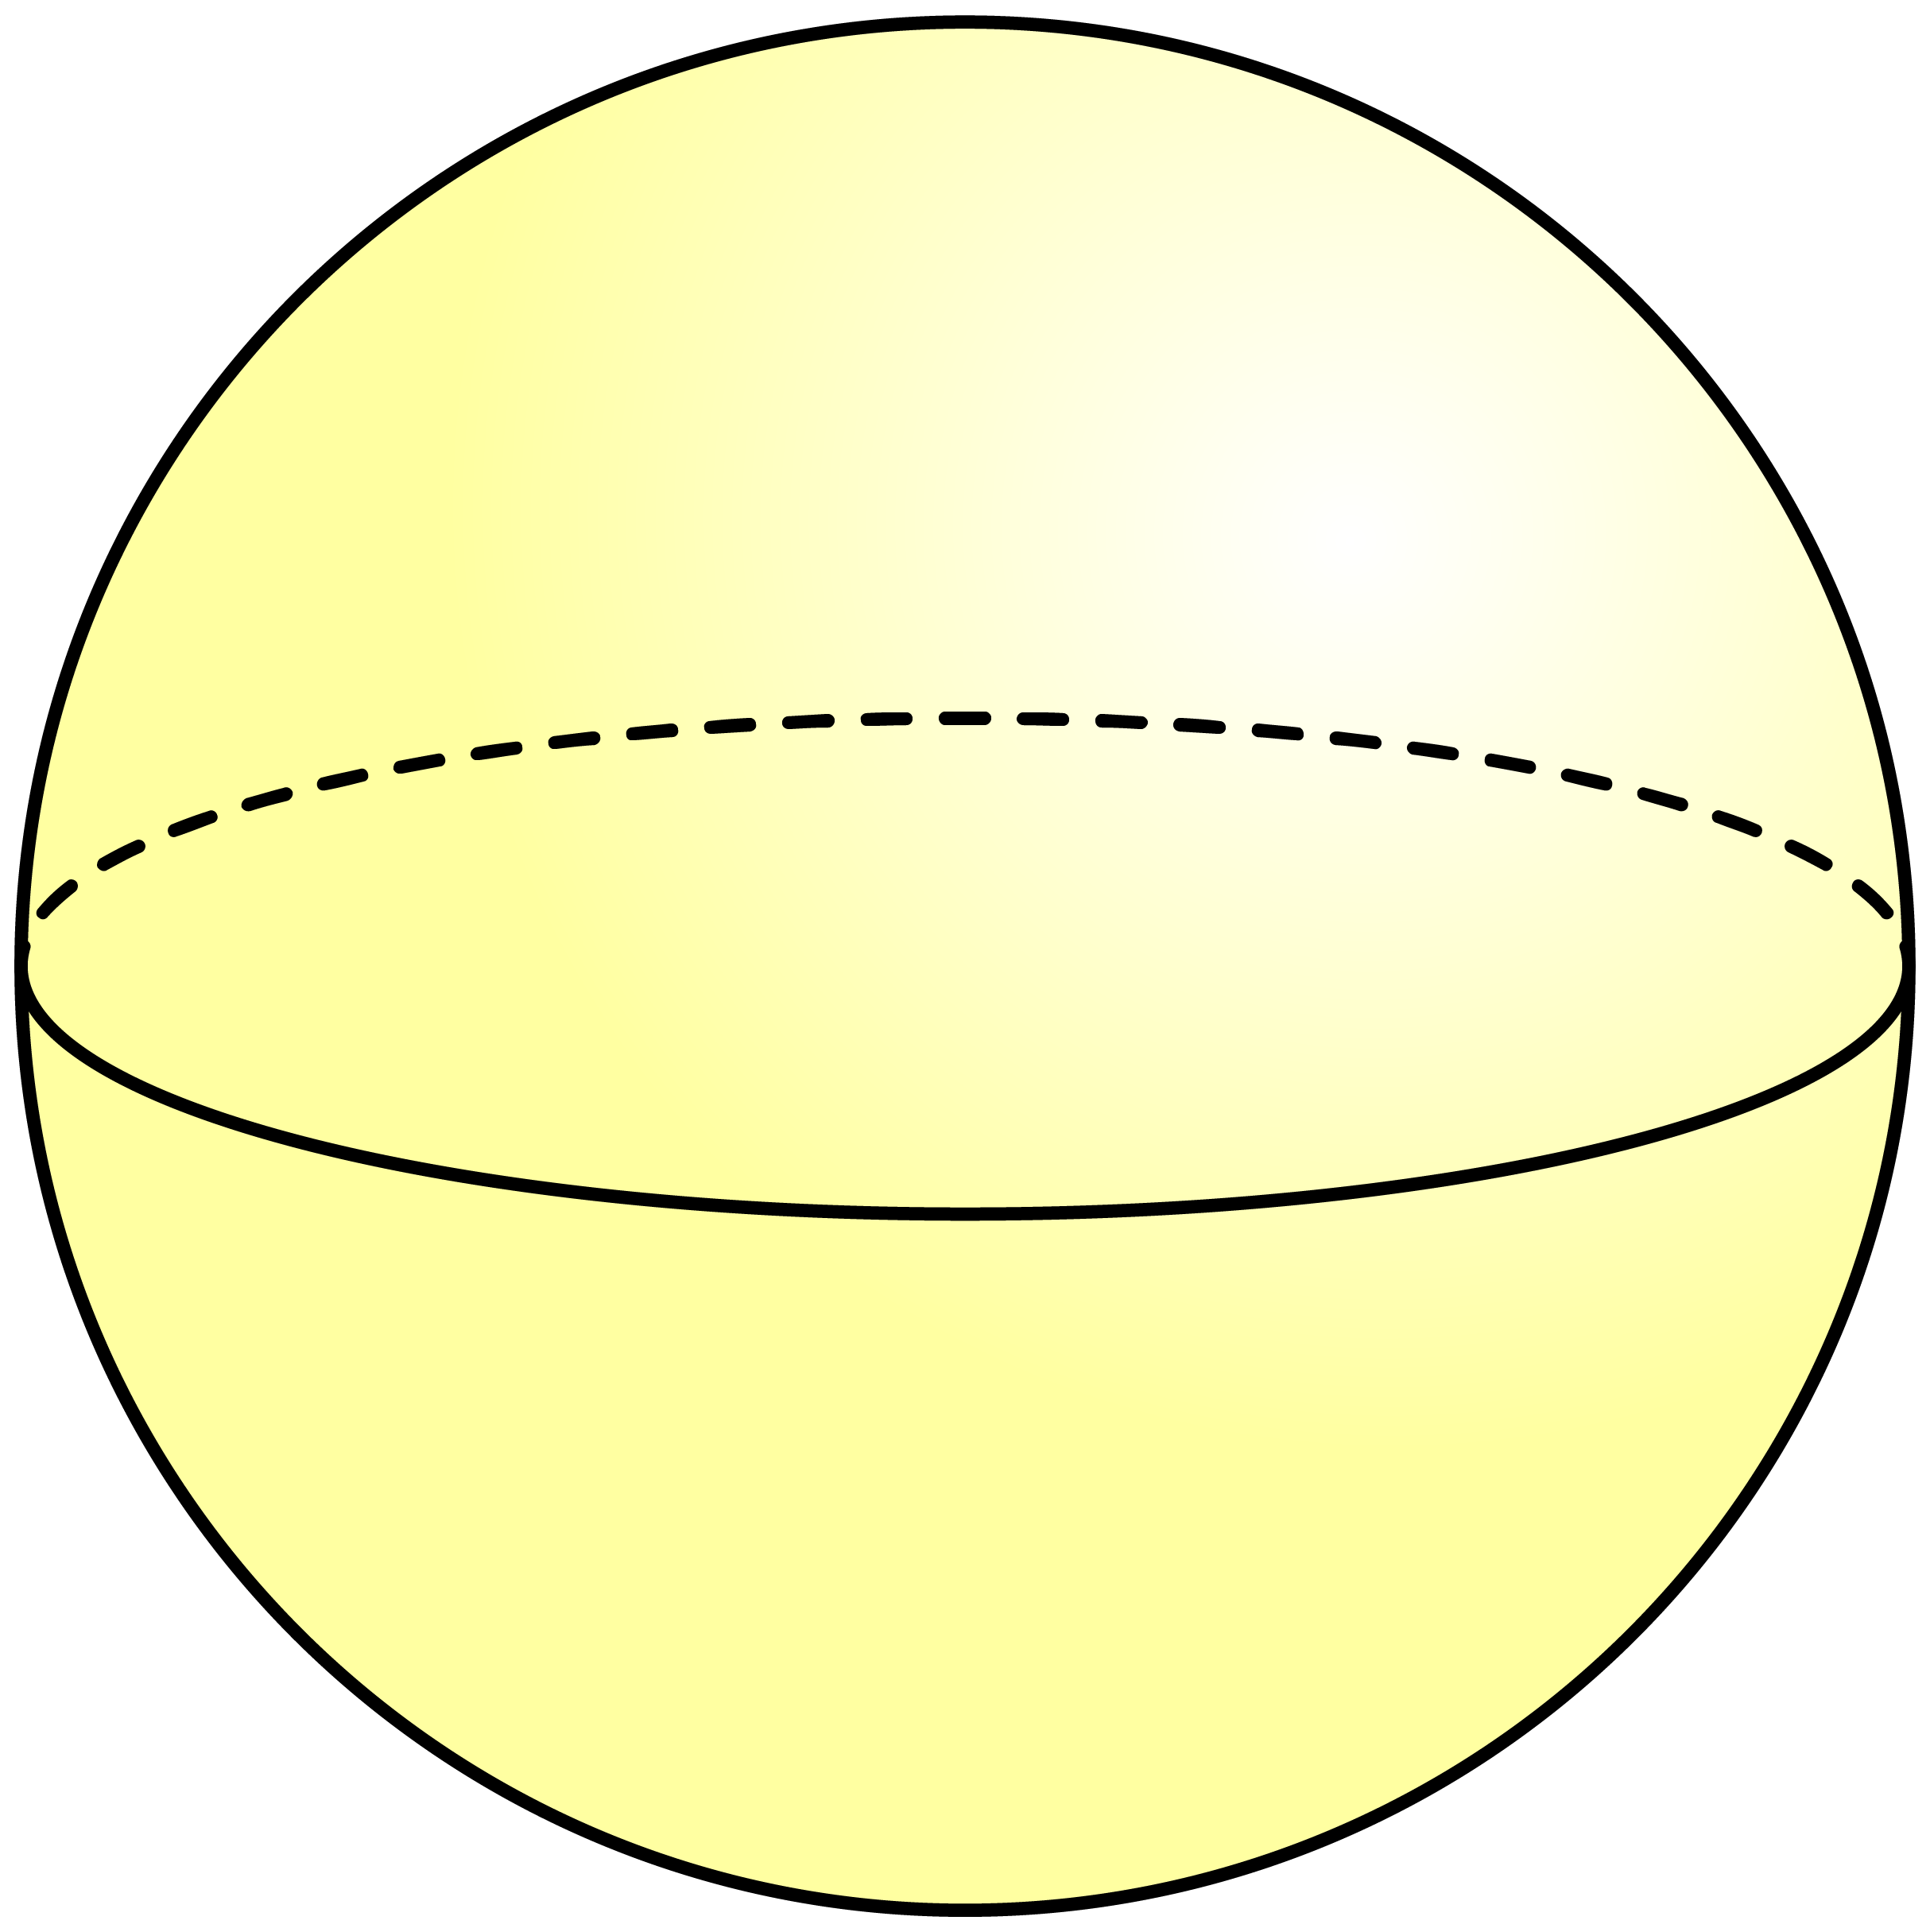
Q1
Work out the volume of each of the following spheres to three significant figures.
[a]
33.5cm³
[b]
268ft³
[c]
4.19m³
[d]
3050mm³
2cm
1m
4ft
9mm
[e]
4190yd³
[f]
524m³
[g]
2140in³
[h]
0.524ft³
10yd
8in
½ft
5m

Slide 5
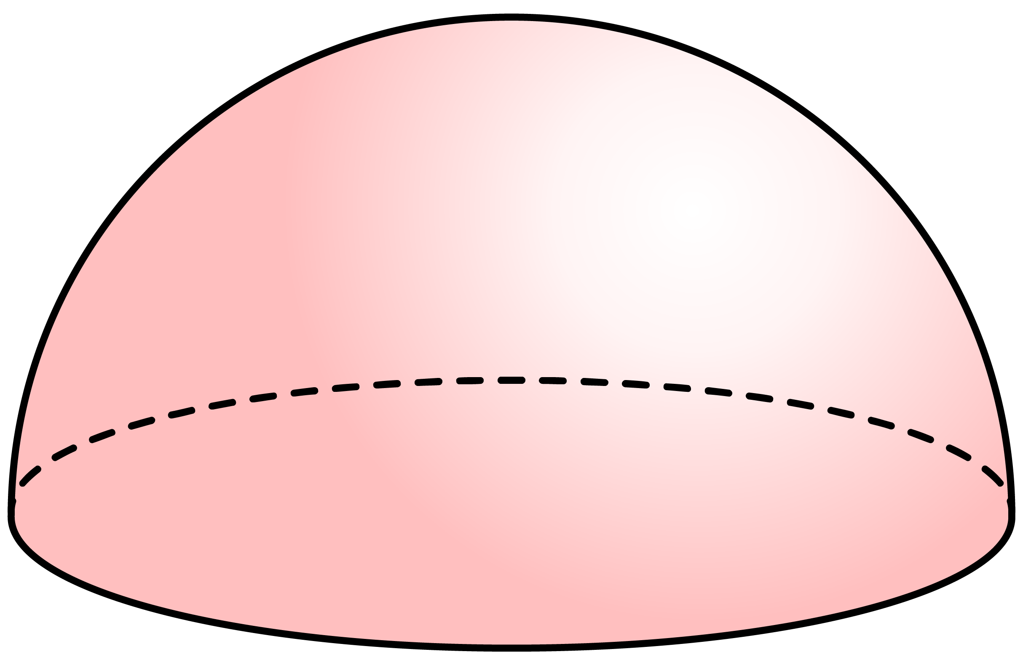
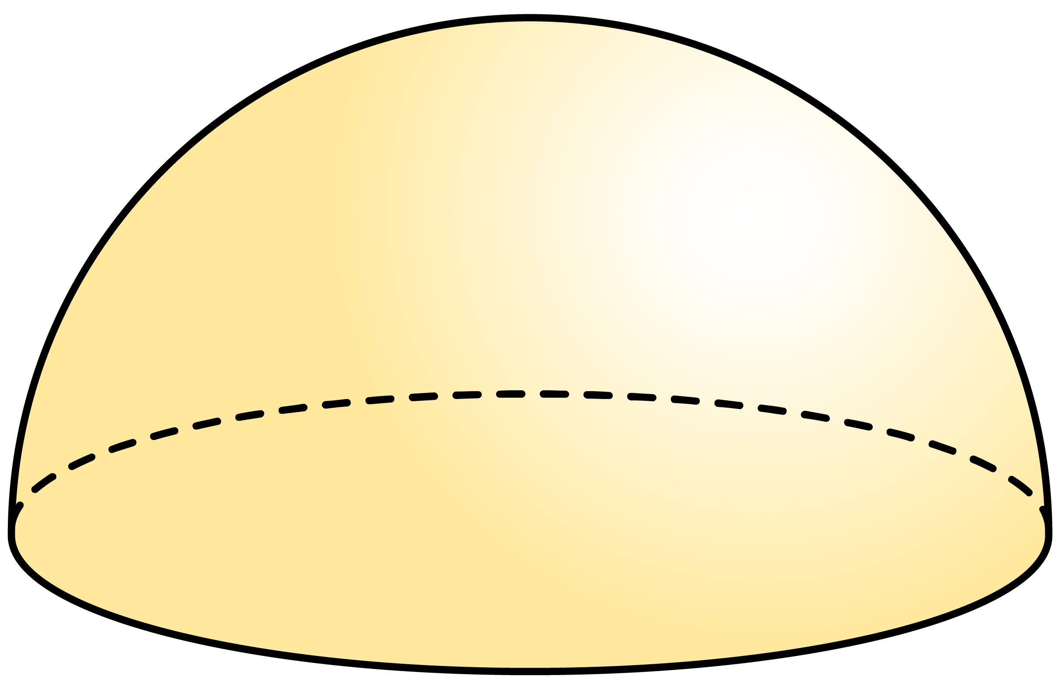
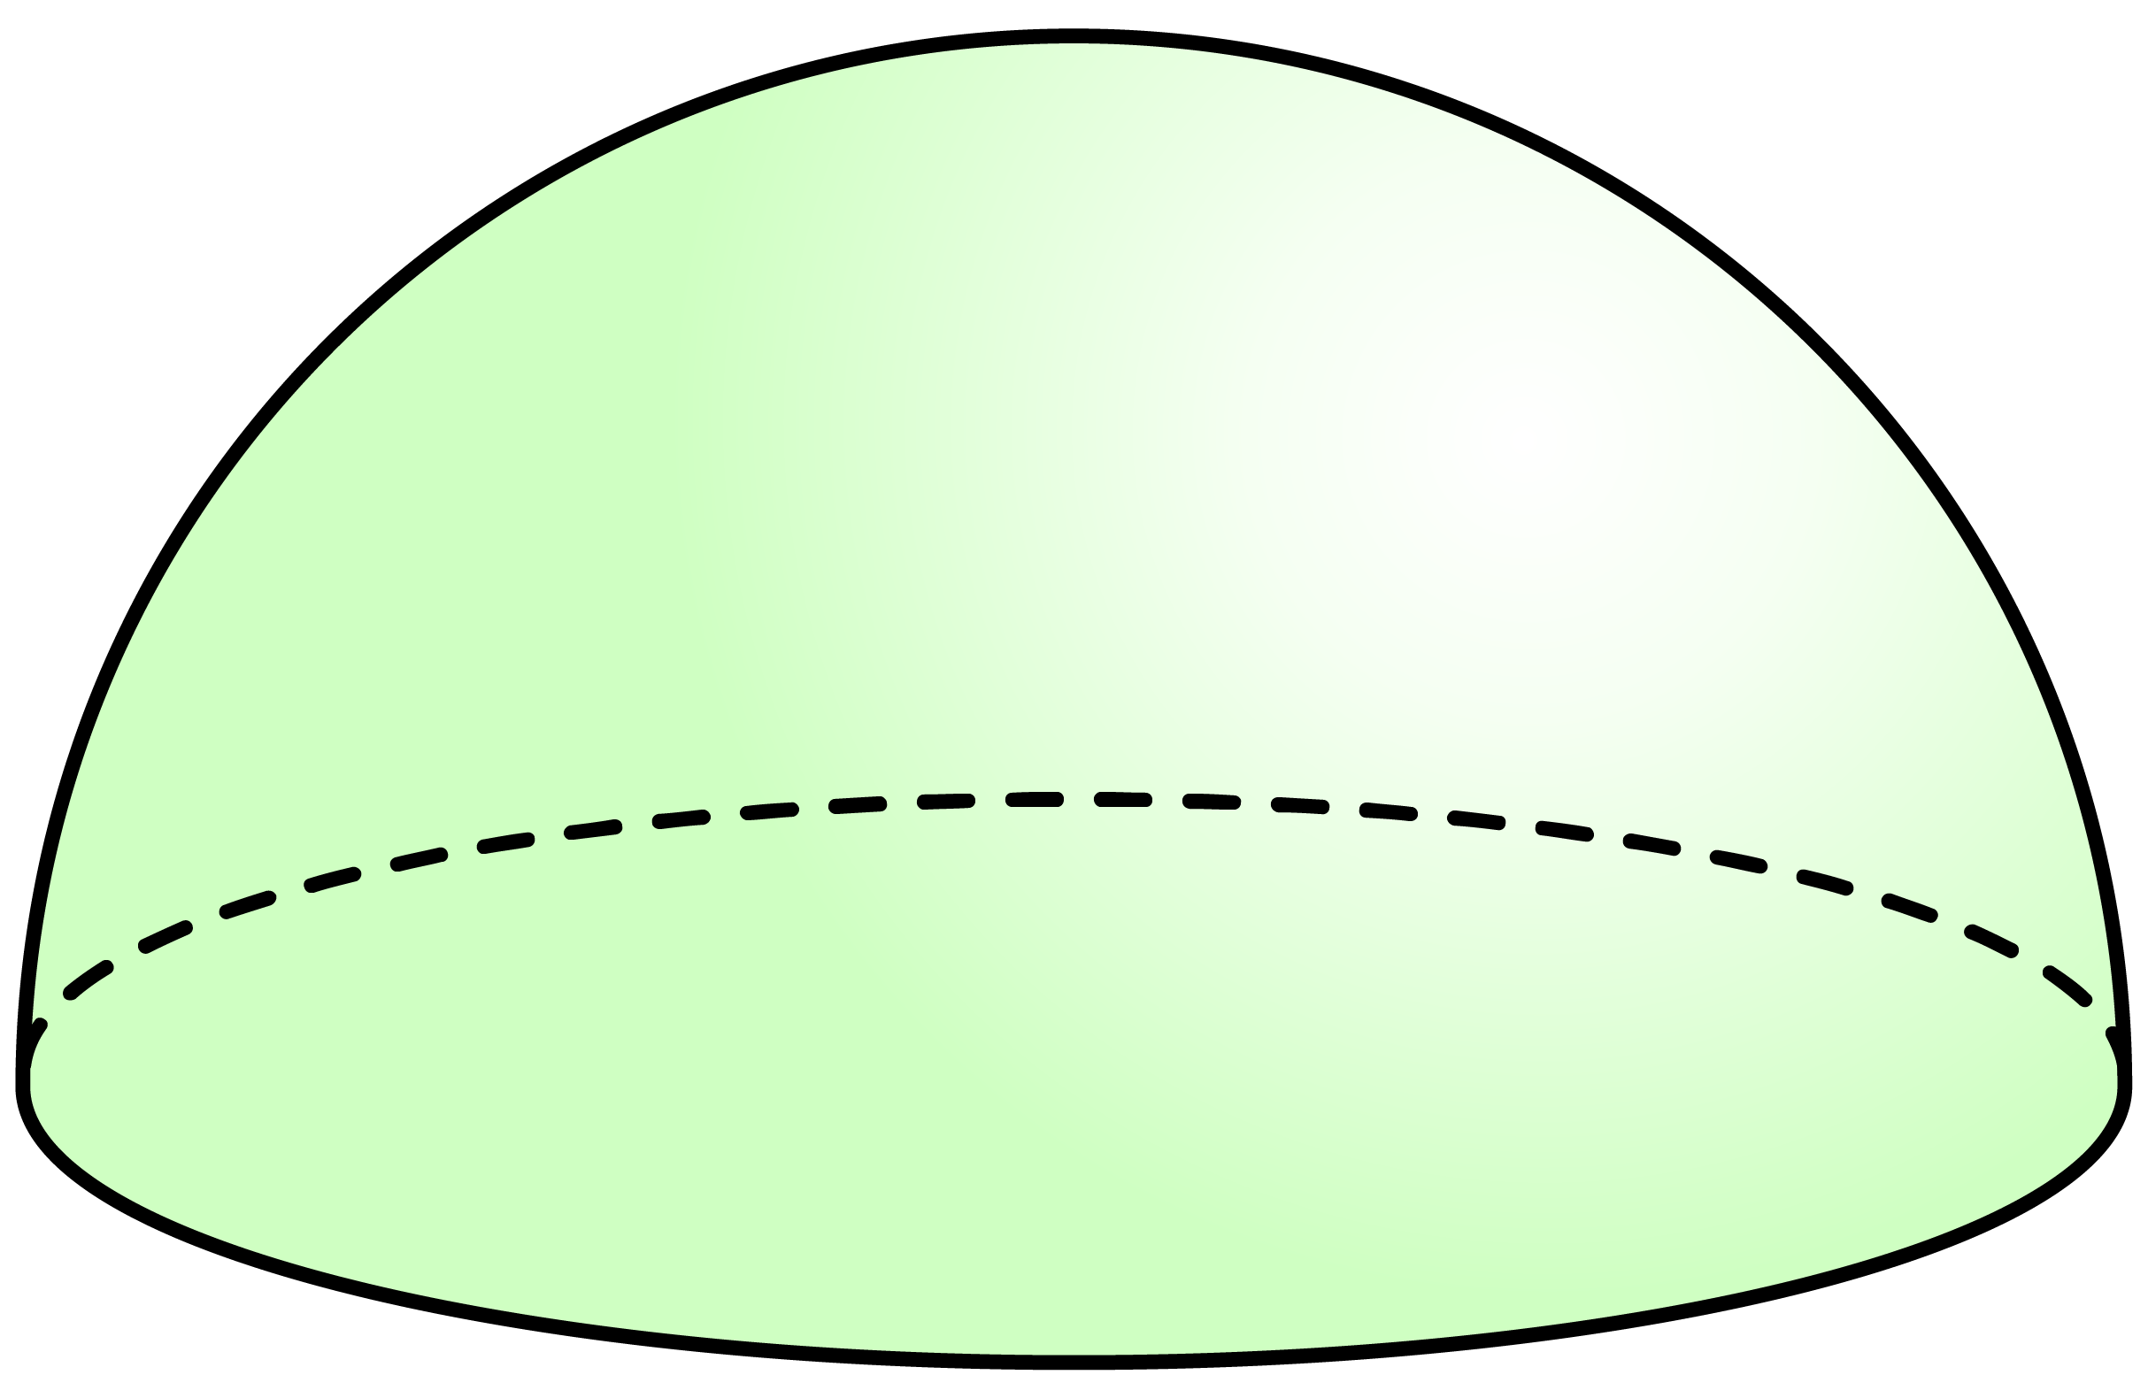
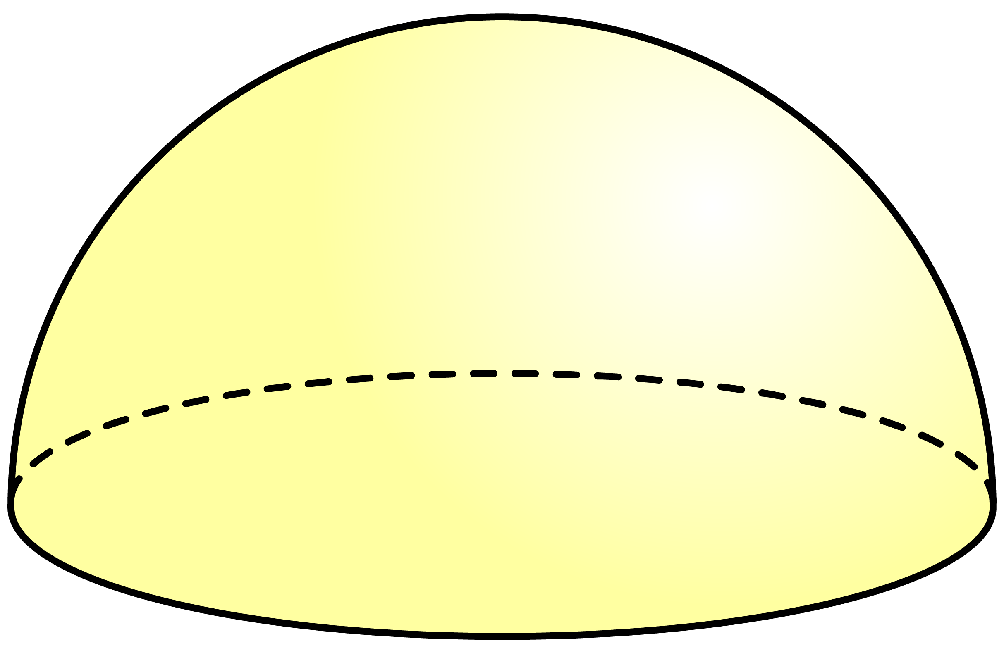



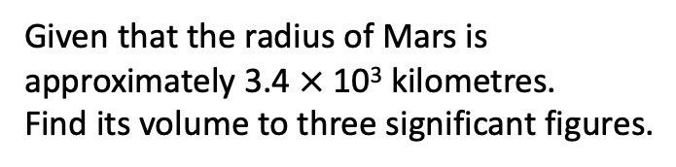

Q2
Work out the volume of each of the following hemispheres to three significant figures.
Q3
Work out, correct to four significant figures, the volume of a sphere with:
[a]
Radius $=$ 7cm
1437cm³
[a]
56.5cm³
[b]
32.7m³
[b]
Radius $=$ 1.5mm
14.14mm³
3cm
2.5m
[c]
Diameter $=$ 4.2yd
38.79yd³
[c]
452in³
[d]
0.134ft³
Q4
Given that the radius of Mars is approximately 3.4 $×$ 10³ kilometres. Find its volume to three significant figures.
0.4ft
1.65 $×$ 10¹¹ km
12in

Slide 6




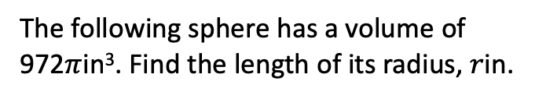

















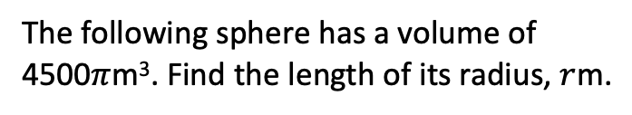





Ex3
The following sphere has a volume of 972$π$in³. Find the length of its radius, $r$in.
Q5
The following sphere has a volume of 4500$π$m³. Find the length of its radius, $r$m.
Solution
Solution
Volume $=$ ⁴⁄₃ $×$ $π$ $×$ $r$³
Volume $=$ ⁴⁄₃ $×$ $π$ $×$ $r$³
$r$in
$r$m
972$π$ $=$ ⁴⁄₃$πr$³
4500$π$ $=$ ⁴⁄₃$πr$³
$×$ 3
$×$ 3
$×$ 3
$×$ 3
2916$π$ $=$ 4$πr$³
13500$π$ $=$ 4$πr$³
$÷$ 4$π$
$÷$ 4$π$
Volume
$÷$ 4$π$
$÷$ 4$π$
Volume
972$π$in³
4500$π$m³
729 $=$ $r$³
3375 $=$ $r$³
$$\sqrt[3]{ }$$
$$\sqrt[3]{ }$$
$$\sqrt[3]{ }$$
$$\sqrt[3]{ }$$
9 $=$ $r$
15 $=$ $r$
Radius $=$ 9in
Radius $=$ 15m

Slide 7
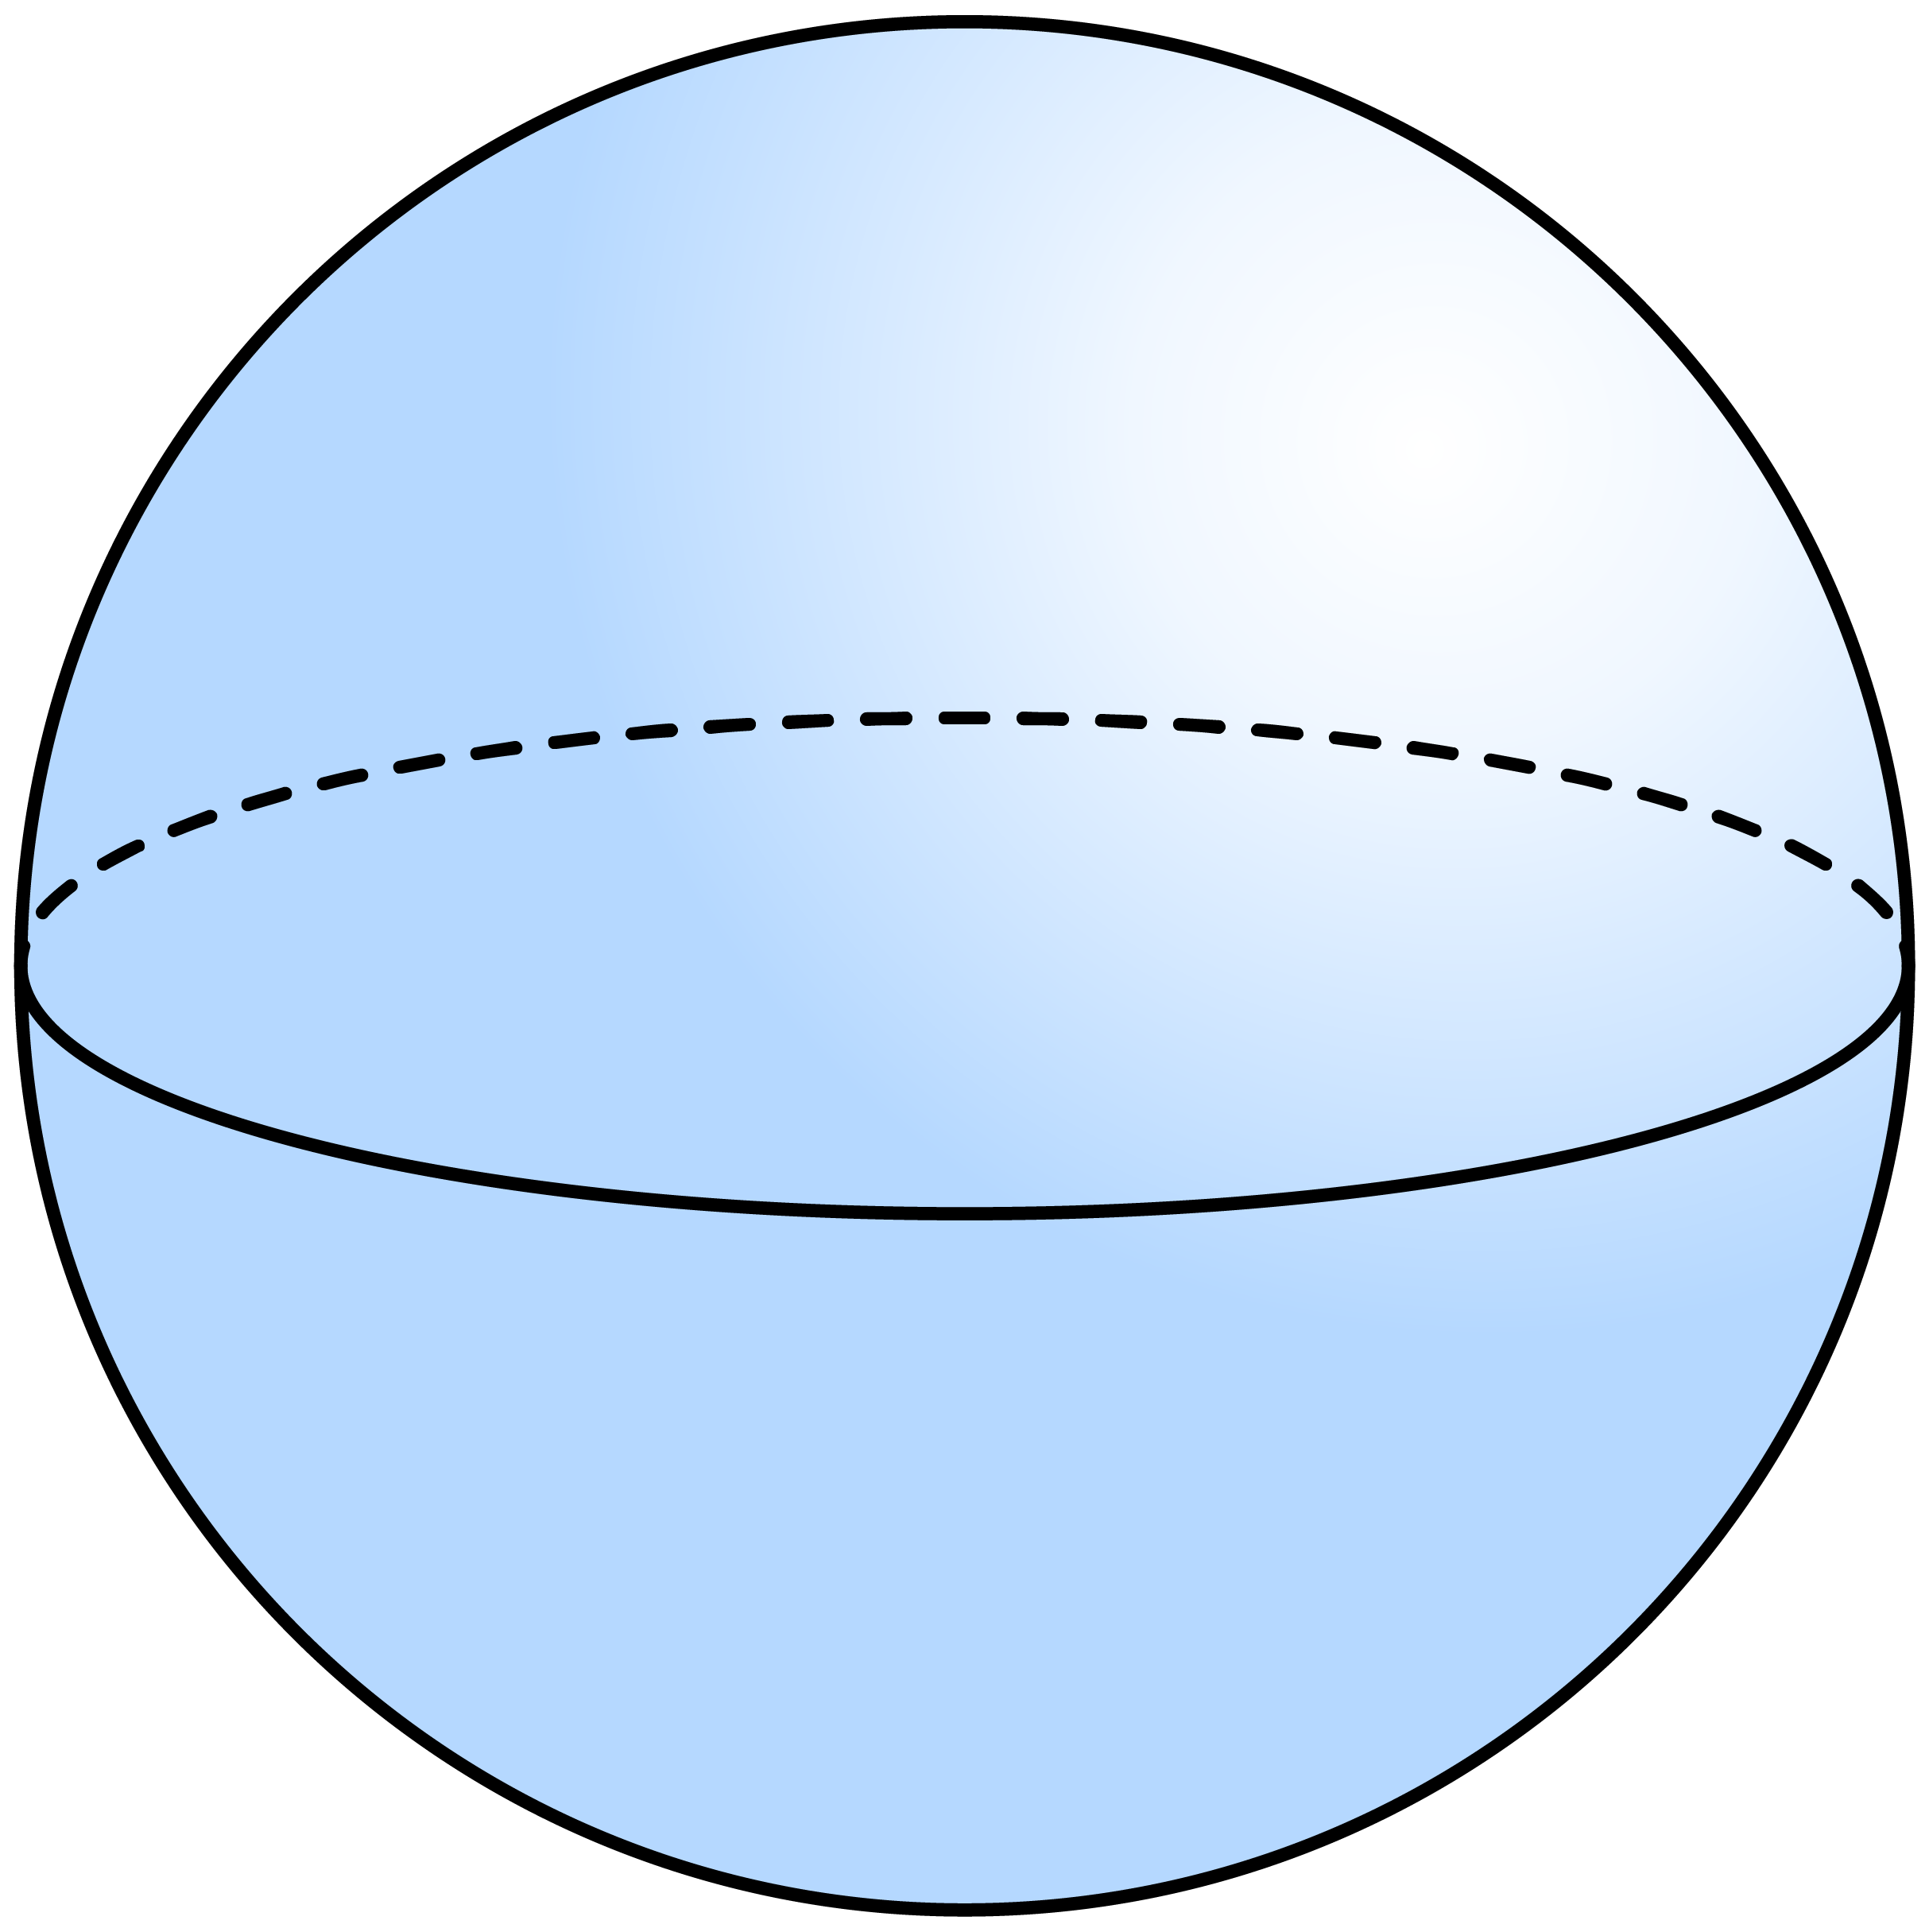
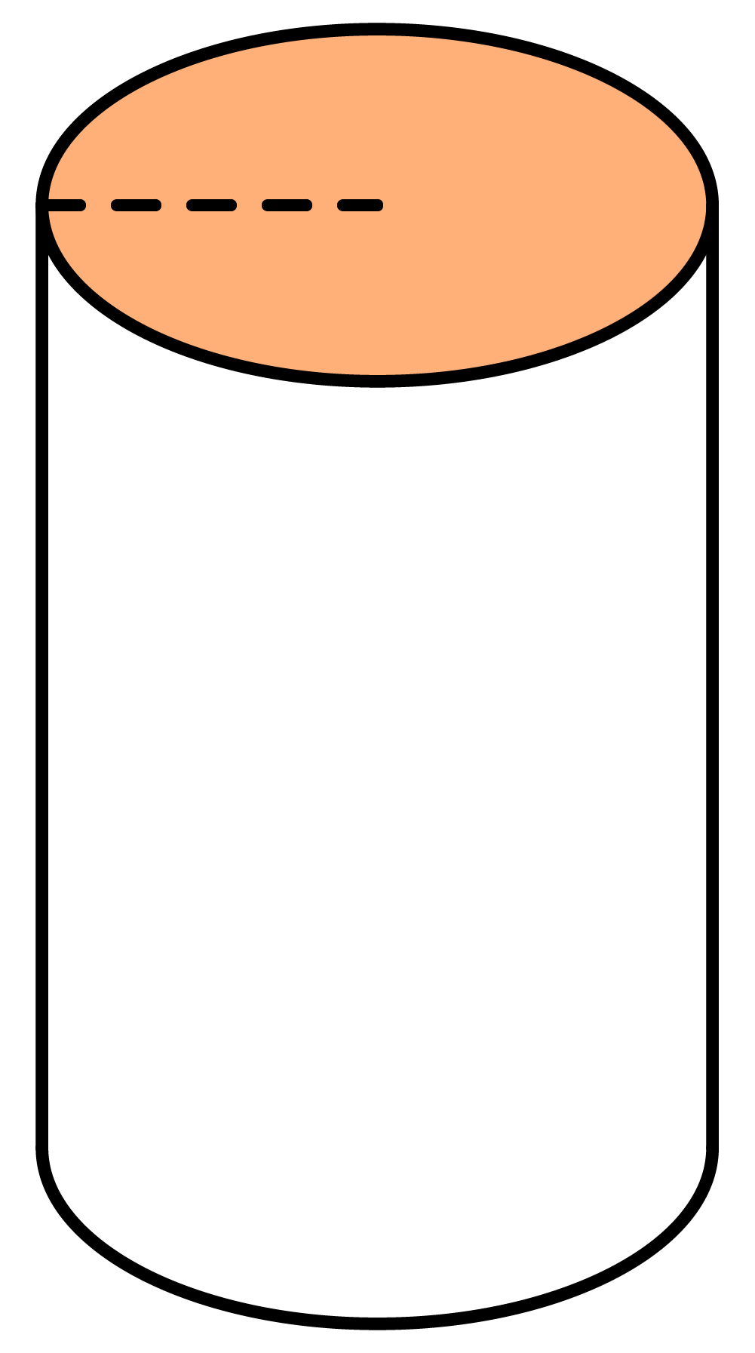

Q6
Work out the radius of the following spheres given their volume.
Q7
The following cylinder and sphere have the same volume. Find the diameter of the sphere.
[a]
12cm
[b]
6.2in
3cm
8.4cm
Volume
Volume
2304$π$cm³
1000in³
11cm

Slide 8
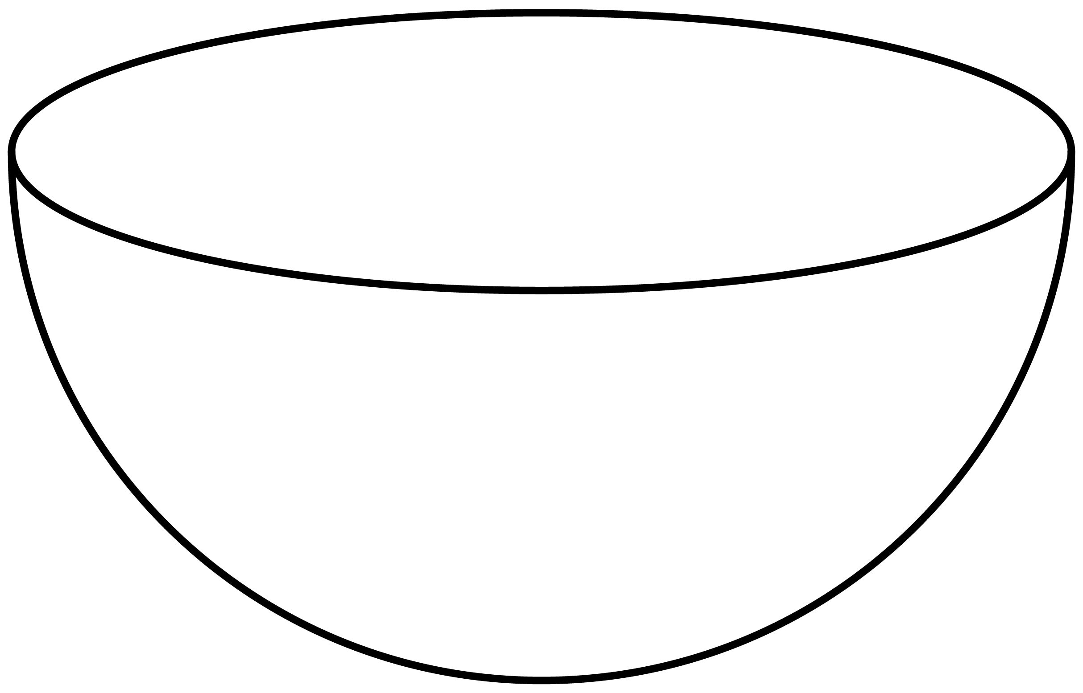
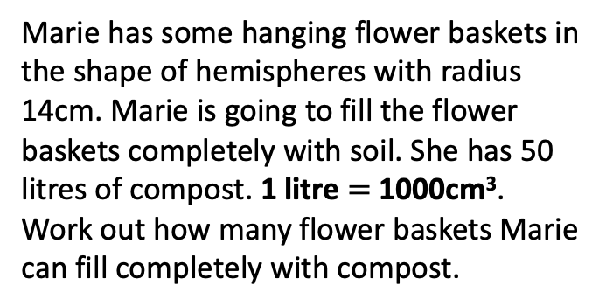
Q8
Craig buys two tennis balls which fit inside a cylindrical container of the same diameter. The tennis ball’s diameter is 6cm. What fraction of the container’s volume do the tennis balls take up?
Q9
Marie has some hanging flower baskets in the shape of hemispheres with radius 14cm. Marie is going to fill the flower baskets completely with soil. She has 50 litres of compost. 1 litre $=$ 1000cm³. Work out how many flower baskets Marie can fill completely with compost.
Solution
Solution
2
3
14cm
8 flower baskets

Slide 9
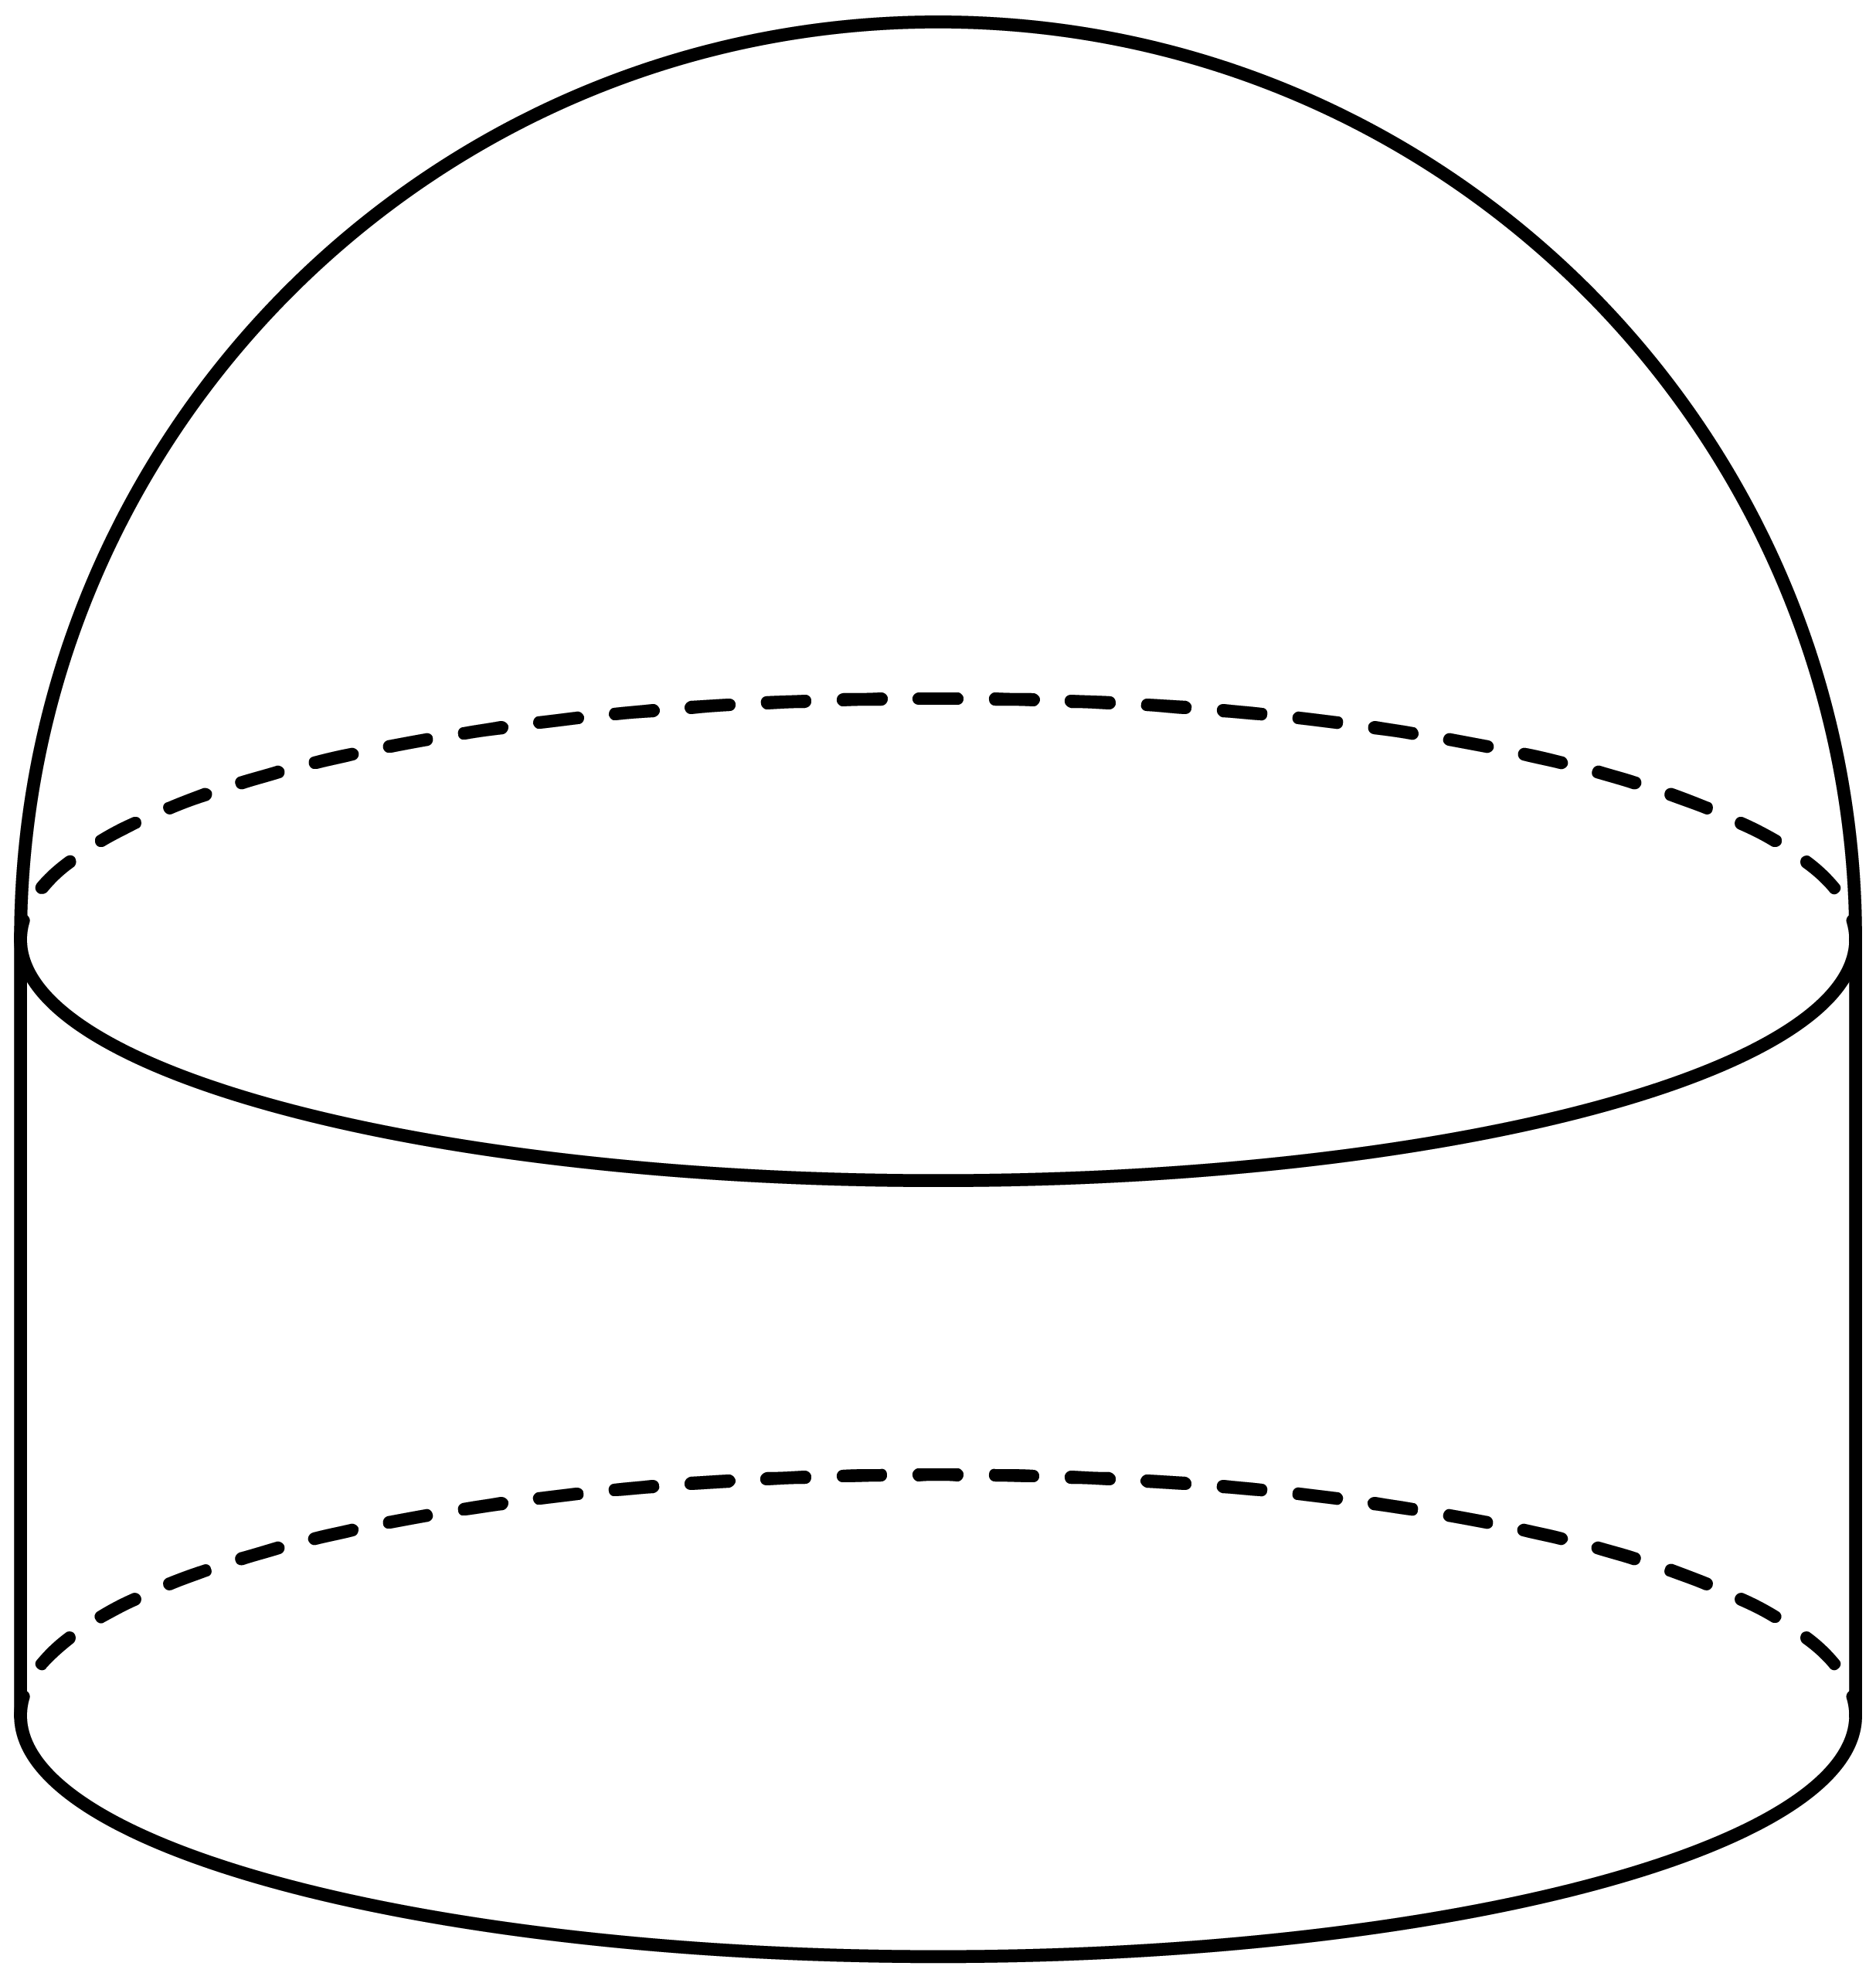

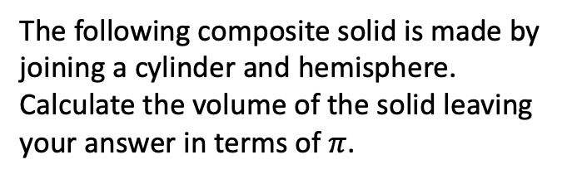




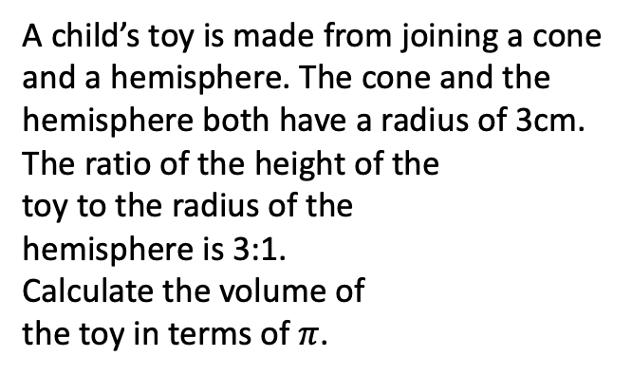

Q10
The following composite solid is made by joining a cylinder and hemisphere. Calculate the volume of the solid leaving your answer in terms of $π$.
Q11
A child’s toy is made from joining a cone and a hemisphere. The cone and the hemisphere both have a radius of 3cm. The ratio of the height of the toy to the radius of the hemisphere is 3:1. Calculate the volume of the toy in terms of $π$.
Solution
Solution
11cm
Volume $=$ 324$π$cm³
5cm
Hemisphere $=$ 18$π$cm²
Cone $=$ 54$π$cm²
Volume $=$ 72$π$cm³
3cm
Cylinder $=$ 180$π$cm²
Hemisphere $=$ 144$π$cm²

Slide 10
Q12
25 kilograms of metal is melted and moulded into spheres. The density of the metal is 15g/cm³. How many whole spheres can be made?
Solution
3cm
14 spheres can be made.

