Slide 1
Surface Area
Learning Intentions:
To be able to calculate the surface area of cubes and cuboids

Slide 2
Starter
Calculate the area of the shapes below!
3cm
4mm
4mm
6cm
Area = 16mm²
Area = 18cm²
6cm
7m
6cm
6m
Area = 18cm²
Area = 21m²

Slide 3
Surface Area
If I unfolded a cube what would it look like?
Draw what you think it looks like on your mini-white boards.

Slide 4
NETS OF CUBES
There are eleven different ways of sketching the nets of cubes.
Most
Common
Notes:
4

Slide 5
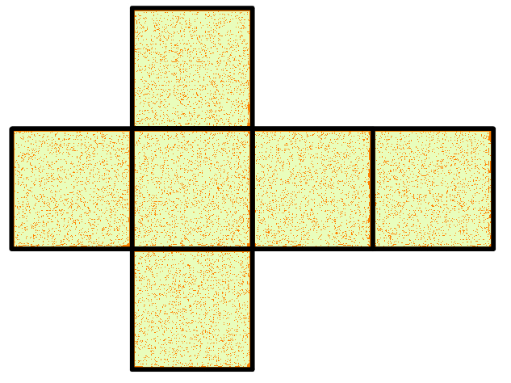
Surface Area
What types of shapes make up the faces of a cubes?
3 x 3 x 6 = 54cm²
3 cm
3 cm

Slide 6
Surface Area
5 cm
7 cm
5 cm
Surface Area = 150cm²
7 cm
Surface Area = 294cm²

Slide 7
Cuboids
10 cm
5 cm
4 cm
4 cm
10 cm
5 cm
4 cm
Total Surface Area = 220cm²
10 cm

Slide 8
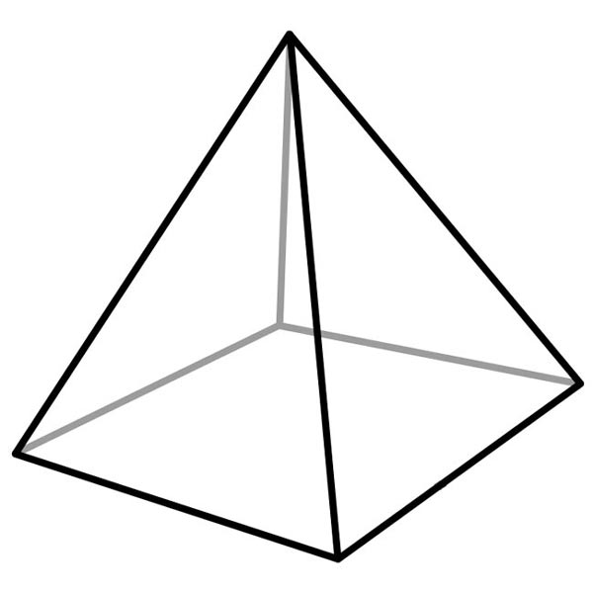
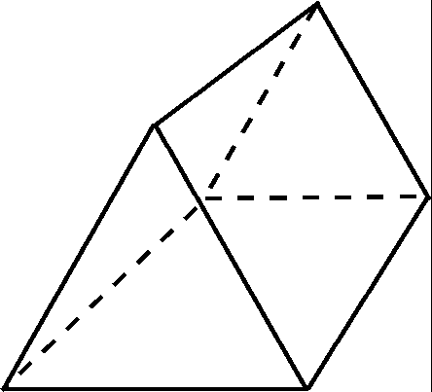
What about other 3D shapes?
Triangular Prism
Square based pyramid

Slide 9
Surface Area
Work out the surface area of the shapes on your worksheet.
Area of rectangle =
Length (L) x Height (H)
H
H
B
Area of Triangle =
(Base (B) x Height (H)) ÷ 2
L

Slide 10
Answers
Green:
1. 216cm² 2. 384mm² 3. 1350m²
Amber:
1. 62m² 2. 64cm² 3. 154m²
Red
1. 144cm² 2. 616m² 3. 268cm²

Slide 11
Surface Area
Investigation:
PART ONE
Find out the total surface area of all four walls in this classroom.
PART TWO
Calculate how many tins of paint will be needed
Each tin of paint covers exactly 12m²
PART THREE
Each tin of paint costs £11
How much will it cost to paint this entire room

Slide 12
Answers
Part One:
Total Surface Area to painted: 55m²
Part Two:
Total Number of Paint Cans Needed: 5
Part Three:
Cost: £55

Slide 13
Surface Area
8 cm
5 cm
12 cm
Total Surface Area = 392cm²

Slide 14
New Toblerone
Toblerone are making a new family sized bar:
Each piece will have the following dimensions
The bar will consist of 12 equal pieces.
QUESTION:
What will the total surface area of the wrapper need to be?
4cm
1cm
4cm

