Slide 1
Variables and Expressions

Slide 2
Vocabulary
Variable – A symbol, usually a letter of the alphabet, such as the letter n, that is used to represent a number.
Variable expression (A.K.A. - Algebraic Expression) – An expression, such as n – 5, that consists of one or more numbers and variables along with one or more arithmetic operations. (Note: No equal sign)
Evaluate a Variable Expression – write the expression, substitute a number for each variable, and simplify the result.

Slide 3

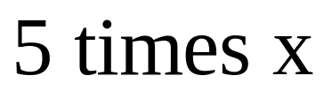
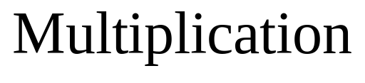
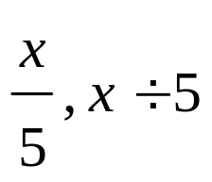

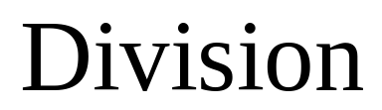
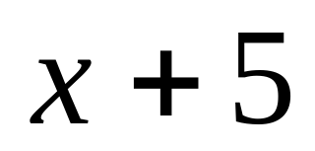
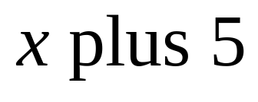
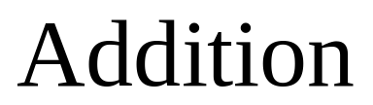
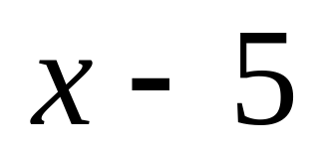
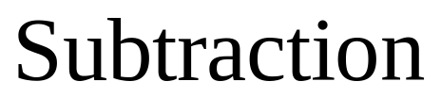

How Do You Describe a Variable Expression?
Variable Expression | Meaning | Operation

Slide 4
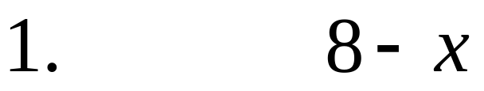
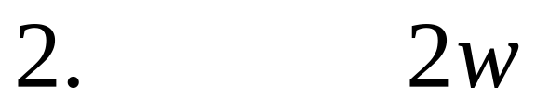
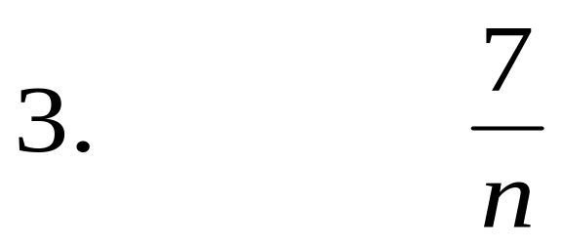
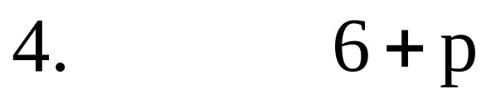
State the meaning of the variable expression and name the operation
A
A
A
Please click to bypass answer slide
A

Slide 5
Answer:
State the meaning of the variable expression and name the operation
Click in the middle of the window to view each answer
8 minus x; Subtraction
2 times w; Multiplication
7 divided by n; Division
6 plus p; Addition
You must click on the answer to return to the previous slide

Slide 6

More Variable Expressions or Algebraic Expressions
An algebraic expression can
consist of one or more numbers
and variables along with one or
more arithmetic operations.

Slide 7
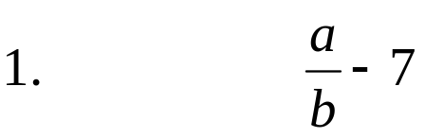



**Verbal expressions are usually more detailed than stating the meaning. Verbal expressions are used to translate words or language into variable or algebraic equations. They consist of key words that help identify the type of equation that will need to be simplified. These key words are usually introduced when writing variable expressions and writing equations for problem solving.
More Variable Expressions or Algebraic Expressions
Examples:
**Verbal expression
Algebraic Expressions
a divided by b; minus 7
(note: fractions are division problems)
r times the product of 4 and k
(note: multiplication is implied when two or more
letters xy or numbers 4k are together and there
is no operation symbol).
The product of 5xy divided by 3z
The sum of 4 and n; divided by m

Slide 8
Evaluate a Variable Expression
Evaluate a Variable Expression – write the expression, substitute a number for each variable, and simplify the result.
Value of a Variable – A number that may be substituted or assigned to a particular variable; such as n = 3; or x = 5.

Slide 9
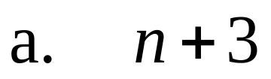
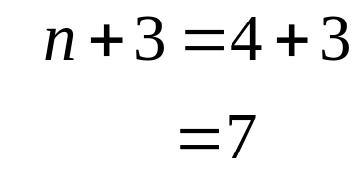

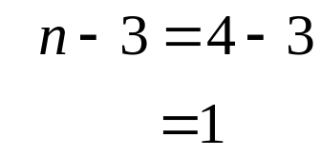
Evaluate a Variable Expression
Example 1: Evaluate each expression when n = 4
Substitute 4 for n. Simplify
Simplify (means to solve the problem or perform as many of the indicated operations as possible.)
Solution:
Substitute 4 for n. Simplify
Solution:

Slide 10
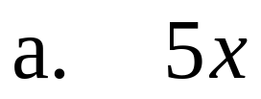
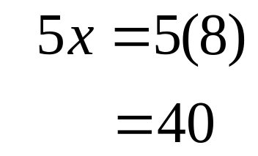


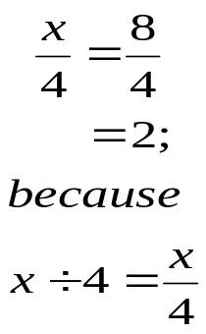
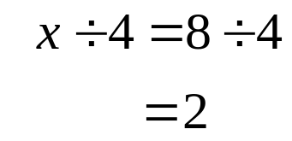
Evaluate a Variable Expression
Example 2: Evaluate each expression when x = 8
Substitute 7 for x. Simplify
Solution:
Simplify (means to solve the problem or perform as many of the indicated operations as possible.)
Using parenthesis is the preferred method to show multiplication. Additional ways to show multiplication are:
Note: No operation sign between a variable and number– indicates multiplication problem.
Substitute 7 for x. Simplify
Solution:
Recall that division problems are also fractions – this problem could be written as:

Slide 11
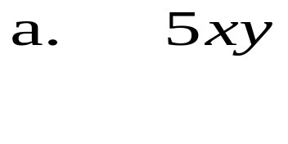
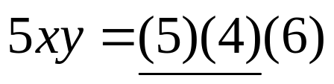
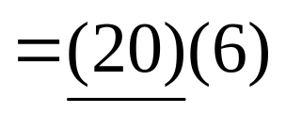
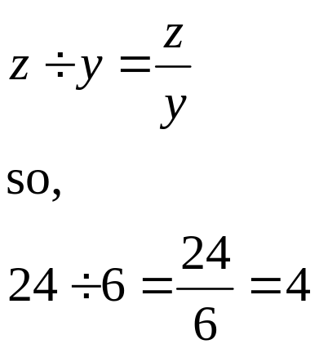
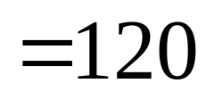
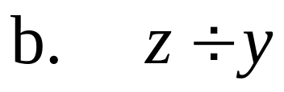
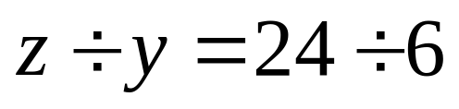
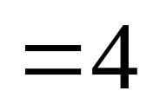
Evaluate a Variable Expression
Example 3: Evaluate each expression when x = 4, y = 6, z = 24.
Substitute 4 for x; 6 for y. simplify
Recall: No operation sign between variable(s) and a number– indicates multiplication problem.
Xy means 4(6);
5xy means 5(4)(6)
solution
Recall that:
Solution:

Slide 12
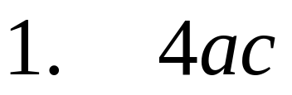
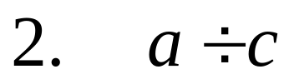
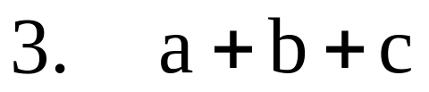
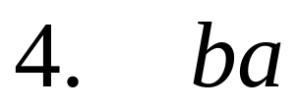


Evaluate a Variable Expression
You Try IT:
Evaluate each expression when a = 6, b = 12, and c = 3
A
A
A
A
A
A

Slide 13
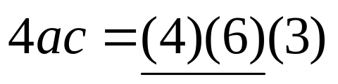
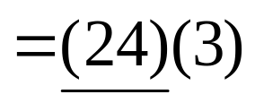
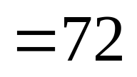
Evaluate a Variable Expression
Click in the middle of the window to view each answer
You Try IT: Answers
Evaluate each expression when a = 6, b = 12, and c = 3
Notice that all the numbers and letters are together and that there are no operation symbols which indicates that this is a multiplication problem.
Substitute the value for a = 6 and c = 3 into the problem and multiply
multiply
Click to return to “You try it” slide
Simplified

Slide 14
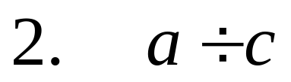

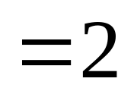
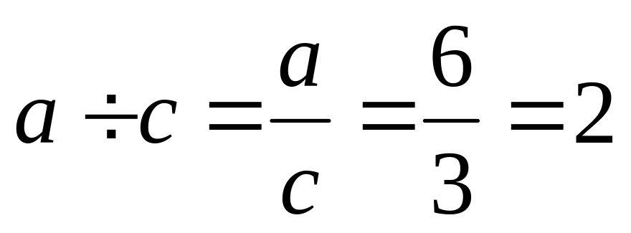
Evaluate a Variable Expression
Click in the middle of the window to view each answer
You Try IT: Answers
Evaluate each expression when a = 6, b = 12, and c = 3
Division Problem
Substitute the value for a = 6 and c = 3 into the problem and divide
Simplified
Another way to solve division problems is to write them as fractions and simplify.
Click to return to “You try it” slide

Slide 15
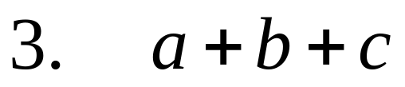
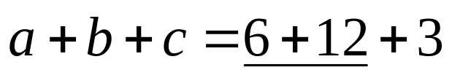
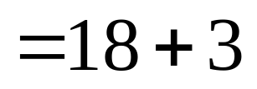
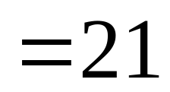
Evaluate a Variable Expression
Click in the middle of the window to view each answer
You Try IT: Answers
Evaluate each expression when a = 6, b = 12, and c = 3
Addition problem
Substitute the value for a = 6, b=12, and c = 3 into the problem, then add
Add
Simplified
Click to return to “You try it” slide

Slide 16
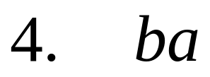
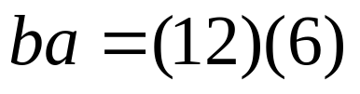

Evaluate a Variable Expression
Click in the middle of the window to view each answer
You Try IT: Answers
Evaluate each expression when a = 6, b = 12, and c = 3
multiplication problem
Substitute the value for b=12 and a = 6 into the problem, then multiply
Simplified
Click to return to “You try it” slide

Slide 17
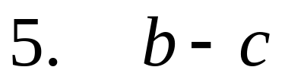

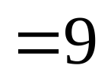
Evaluate a Variable Expression
Click in the middle of the window to view each answer
You Try IT: Answers
Evaluate each expression when a = 6, b = 12, and c = 3
Subtraction problem
Substitute the value for b=12 and a = 3 into the problem, then Subtract
Simplified
Click to return to “You try it” slide

Slide 18
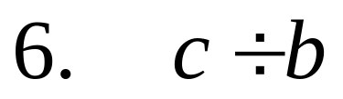

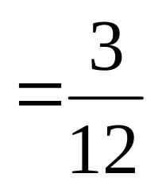
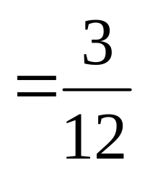


Evaluate a Variable Expression
Click in the middle of the window to view each answer
You Try IT: Answers
Evaluate each expression when a = 6, b = 12, and c = 3
Division problem
Substitute the value for c=3 and b = 12 into the problem, then Divide
Note: It is better to rewrite this division problem as a fraction.
This fraction can now be reduced to its simplest form.
Divide both numerator and denominator by the GCF = (3) to reduce this fraction.
Click to return to “You try it” slide
Simplified
It is OK to have a fraction as an answer.

