Slide 1
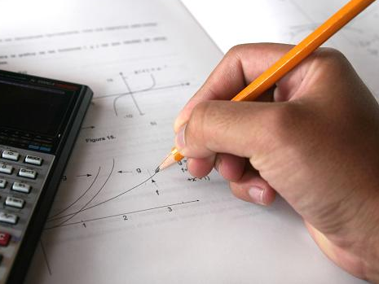
Simplify
A
B
C
D

Slide 2
Simplify
A
B
C
D
2
Notes:
2

Slide 3
Simplify
A
B
C
D
3
Notes:
3

Slide 4
Simplify
A
B
C
D
4
Notes:
4

Slide 5
Simplify
A
B
C
D
5
Notes:
5

Slide 6
Simplify
A
B
C
D
6
Notes:
6

Slide 7
Simplify
A
B
C
D
7
Notes:
7

Slide 8
Simplify
A
B
C
D
8
Notes:
8

Slide 9
Simplify
A
B
C
D
9
Notes:
9

Slide 10
Simplify
A
B
C
D
10
Notes:
10

