Slide 1
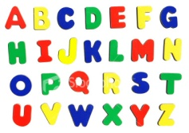

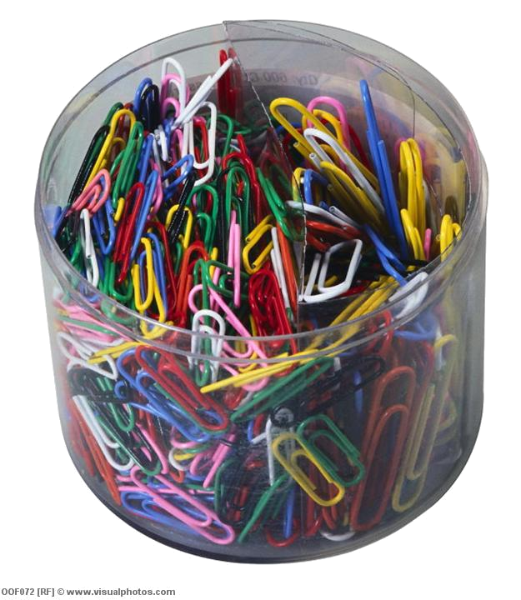
Math with Letters
Z
Tick the Learning Objective(s) you
are aiming for today
Learning Objectives
F/E
Understand how letters can be used in Math (F)
Identify and write algebraic expressions (F)
Collect and simplify like algebraic terms (E)
Starter: How many paperclips?
  How many paperclips are there in the pot?
  Write your guess down in your book
GCSE Algebra

Slide 2
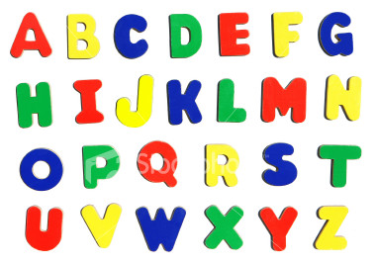
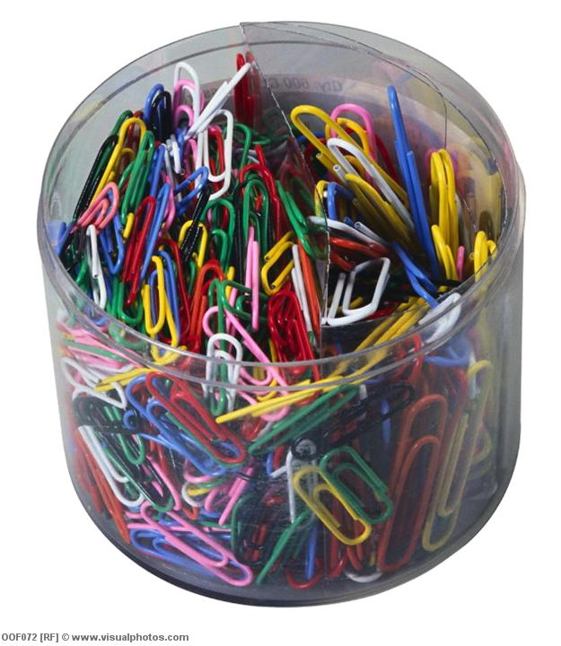

Paperclips
F
How many paperclips in the pot?
n

Slide 3
Paperclips
F
What if I took 2 out?
n-2

Slide 4
Paperclips
F
What if I added 4?
n+4

Slide 5
Paperclips
F
What if I took 12 out?
n-12
n+12

Slide 6
Paperclips
F
What if I added 100?
n+100

Slide 7
Paperclips
F
What if I added another pot?
n+n
2xn
2n

Slide 8
Paperclips
F
What if I added another 2 more pots?
3xn
n+n+n
3n

Slide 9

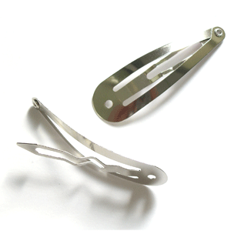
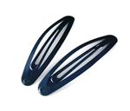
Your Turn: Hair Clips
F
Elizabeth has a box of hair clips at home
How can we represent the number of hair clips in the box?

Slide 10
Your Turn: Hair Clips
F
Elizabeth has a box of hair clips at home
She takes 5 clips out to wear, how many left?

Slide 11
Your Turn: Hair Clips
F
Elizabeth has a box of hair clips at home
She adds in 15 new clips that she bought at Primark

Slide 12
Your Turn: Hair Clips
F
Elizabeth has a box of hair clips at home
She is given a new box of clips, with t clips in it

Slide 13
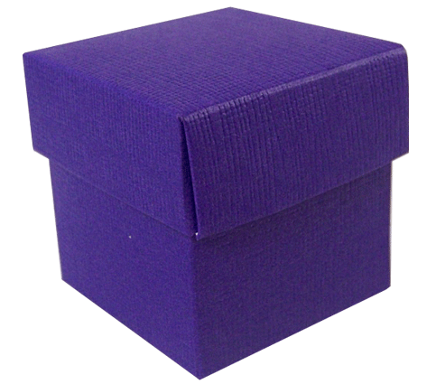
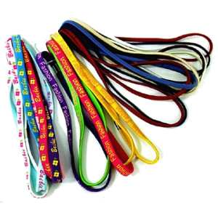
Your Turn: Hair Bands
F
Laurelle has a box of hair bands at home, all different colours
How can we represent the number of hair band in the box?

Slide 14
Your Turn: Hair Bands
F
Laurelle has a box of hair bands at home, all different colours

Slide 15
Algebraic Expressions
F
Write an expression for:
There are c cars in a car park, then 5 more cars arrive
There are s sweets in a box, then someone eats 6 of them
There are 4 pupils in the canteen, then n more arrive
Mrs Comber is r years old, her brother is 2 years younger
c + 5
s - 6
4 + n
r - 2
Create your own question (and answer)
E

Slide 16

Z
Learning Objectives
F/E
Understand how letters can be used in Maths (F)
Identify and write algebraic expressions (F)
Collect and simplify like algebraic terms (E)

Slide 17
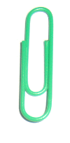
Like Terms
E
Shaneil
Georgia
Firoza
Fatmata
How many green paperclips are there?
3 + 3 + 4 + 2
= 12

Slide 18
Like Terms
E
Shaneil
Georgia
Firoza
Fatmata
3g
3g
4g
2g
What if we represented each green paper clip with the letter g?
3g + 3g + 4g + 2g
= 12g
collected like terms
simplified

Slide 19
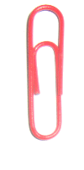
Like Terms
E
Zaime
Yaimun
Poppy
Sophie
Took away
r
4r
3r
-2r
1r
-2r
4r + 3r + r
= 6r
collected like terms
simplified

Slide 20
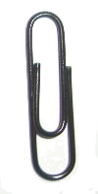
Collecting Like Terms
F
Write a long expression and then the simplified expression for:
3g + 2g + 2g + 4g =
11g
2r – r + 5r – 2r
=
Take away
Take away
4r
3b + 3b – 2b + b
=
Take away
5b
Ask for the extension sheet
E+

Slide 21
Extension Work
1.
2.
Take away
Take away
3.
Take away

Slide 22
Plenary: True or False?
An algebraic
expression
is an expression like being happy or sad
You can use any
letters in algebraic expressions

Slide 23
Plenary: True or False?
5 more than n
Is
n + 5
n + 5 is the
same as 5 + n

Slide 24
Plenary: True or False?
Rob is 5 years
older than Bob
If Bob is t years old,
Rob is t – 5 years old
Mrs Coomber’s Dad is twice as old as her.
If Mrs Coomber is y
years old, how old
is her Dad?

