Slide 1


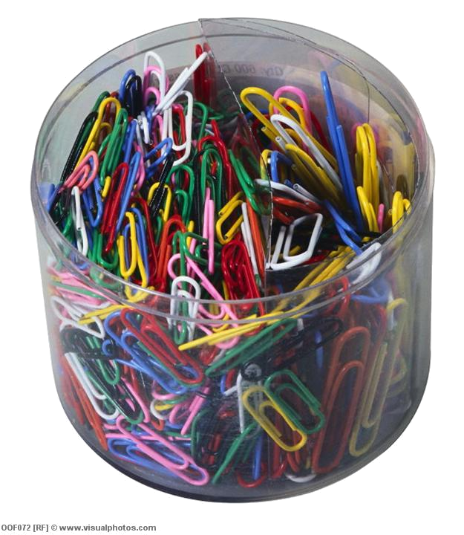
Maths with Letters
Z
Tick the Learning Objective(s) you
are aiming for today
Learning Objectives
F/E
Understand how letters can be used in Maths (F)
Identify and write algebraic expressions (F)
Collect and simplify like algebraic terms (E)
Starter: How many paperclips?
  How many paperclips are there in the pot?
  Write your guess down in your book
GCSE Algebra

Slide 2

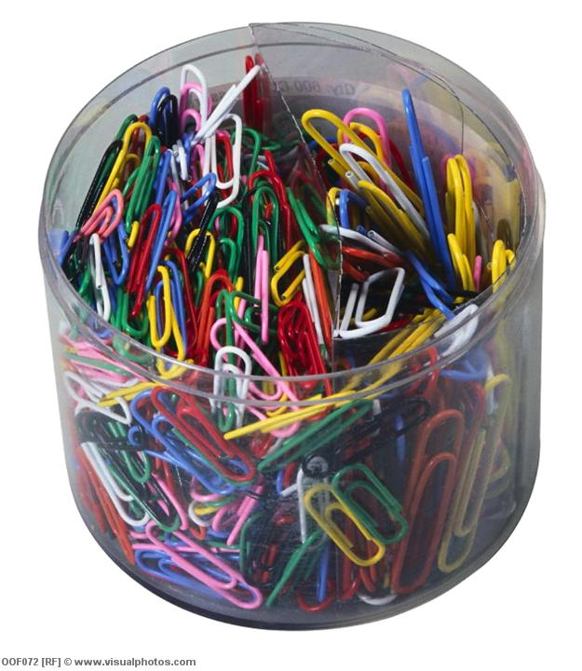

Paperclips
F
How many paperclips in the pot?
n

Slide 3
Paperclips
F
What if I took 2 out?
n-2

Slide 4
Paperclips
F
What if I added 4?
n+4

Slide 5
Paperclips
F
What if I took 12 out?
n-12
n+12

Slide 6
Paperclips
F
What if I added 100?
n+100

Slide 7
Paperclips
F
What if I added another pot?
n+n
2xn
2n

Slide 8
Paperclips
F
What if I added another 2 more pots?
3xn
n+n+n
3n

Slide 9

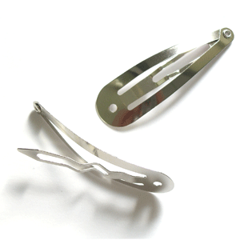

Your Turn: Hair Clips
F
Elizabeth has a box of hair clips at home
How can we represent the number of hair clips in the box?

Slide 10
Your Turn: Hair Clips
F
Elizabeth has a box of hair clips at home
She takes 5 clips out to wear, how many left?

Slide 11
Your Turn: Hair Clips
F
Elizabeth has a box of hair clips at home
She adds in 15 new clips that she bought at Primark

Slide 12
Your Turn: Hair Clips
F
Elizabeth has a box of hair clips at home
She is given a new box of clips, with t clips in it

Slide 13
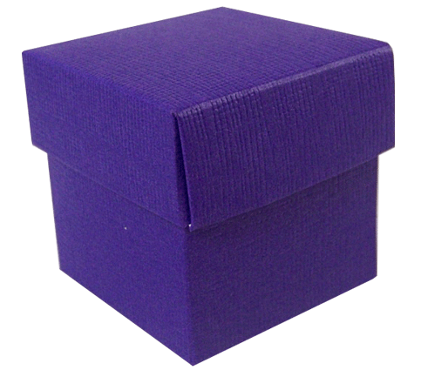
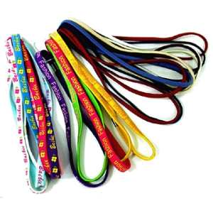
Your Turn: Hair Bands
F
Laurelle has a box of hair bands at home, all different colours
How can we represent the number of hair band in the box?

Slide 14
Your Turn: Hair Bands
F
Laurelle has a box of hair bands at home, all different colours

Slide 15
The Actual Number of Paperclips
?
If there are 300 paperclips in a full pot, how many paperclips did we have each time?
Expression
Number Paperclips
The full pot | n | 300
Take 2 out of full pot | n – 2 | 300 – 2 = 298
Add 4 to full pot | n + 4 | 300 + 4 = 304
Take 12 out of full pot | n – 12 | 300 – 12 = 288
Add 100 to full pot | n + 100 | 300 + 100 = 400
Add one full pot to the full pot | n + n = 2n | 2 x 100 = 200
Add two full pots to the full pot | n + 2n = 3n | 3 x 100 = 300

Slide 16
The Actual Number of Paperclips
?
If there are 300 paperclips in a full pot, how many paperclips did we have each time?
Expression
Number Paperclips
The full pot | n | 300
Take 2 out of full pot | n – 2 | 300 – 2 = 298
Add 4 to full pot | n + 4 | 300 + 4 = 304
Take 12 out of full pot | n – 12 | 300 – 12 = 288
Add 100 to full pot | n + 100 | 300 + 100 = 400
Add one full pot to the full pot | n + n = 2n | 2 x 100 = 200
Add two full pots to the full pot | n + 2n = 3n | 3 x 100 = 300

Slide 17
Number of Paperclips
?
We have just discovered that the full pot only had 270 paperclips in it…
Description | Expression | 300 in full pot | 270 in full pot
The full pot | n | 300
Take 2 out of full pot | n – 2 | 300 – 2 = 298
Add 4 to full pot | n + 4 | 300 + 4 = 304
Take 12 out of full pot | n – 12 | 300 – 12 = 288
Add 100 to full pot | n + 100 | 300 + 100 = 400
Add one full pot to the full pot | n + n = 2n | 2 x 100 = 200
Add two full pots to the full pot | n + 2n = 3n | 3 x 100 = 300
Repeat for 276 in the full pot

Slide 18
Hair Clips & Bands
?
We have just discovered that the full pot only had 270 paperclips in it…
Description | Expression (in box) | Value
Number of clips in the box
Take 5 clips out of the box
Buy 14 new clips & add to box
Add t clips to the box
Number bands in the box
Add in 3 descriptions of your own
Create another scenario

Slide 19
Differentiated
Hair Clips & Bands
?
Complete the blanks
Description | Expression (in box) | Value
Number of clips in the box | c | 20
Take 5 clips out of the box | c – 5 | 20 – ___
Buy 14 new clips & add to box
Add t clips to the box |  | 20 + t
Number bands in the box | b | 35
Take 12 bands out of the box
Add another b bands to the box
Add in a description of your own
Create another scenario

Slide 20
Algebraic Expressions
F
Write an expression for:
There are c cars in a car park, then 5 more cars arrive
There are s sweets in a box, then someone eats 6 of them
There are 4 pupils in the canteen, then n more arrive
Mrs Comber is r years old, her brother is 2 years younger
c + 5
s - 6
4 + n
r - 2
Create your own question (and answer)
E

Slide 21

Z
Learning Objectives
F/E
Understand how letters can be used in Maths (F)
Identify and write algebraic expressions (F)
Collect and simplify like algebraic terms (E)

Slide 22

Like Terms
E
Shaneil
Georgia
Firoza
Fatmata
How many green paperclips are there?
3 + 3 + 4 + 2
= 12

Slide 23
Like Terms
E
Each green paper clip is worth g pence
Shaneil
Georgia
Firoza
Fatmata
3g
3g
4g
2g
How much are they all worth?
3g + 3g + 4g + 2g
= 12g
collected like terms
simplified

Slide 24
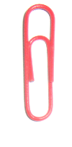
Like Terms
E
Red paperclips are worth r pence
Zaime
Yaimun
Poppy
Sophie
Took away
r
4r
3r
-2r
1r
-2r
4r + 3r + r
= 6r
collected like terms
simplified

Slide 25
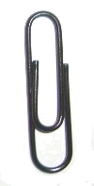
Collecting Like Terms
F
Write a long expression and then the simplified expression for:
If g = 2, r = 5 and b = 6, work out the
value of your answers for questions 1 to 3
3g + 2g + 2g + 4g =
11g
22
2r – r + 5r – 2r
=
Take away
Take away
4r
20
3b + 3b – 2b + b
=
Take away
5b
60
Ask for the extension sheet
E+

Slide 26
Extension Work
1.
2.
Take away
Take away
3.
Take away

Slide 27
Plenary: True or False?
An algebraic
expression
is an expression like being happy or sad
You can use any
letters in algebraic expressions

Slide 28
Plenary: True or False?
5 more than n is
n + 5
n + 5 is the
same as 5 + n

Slide 29
Plenary: True or False?
Bob is t years old
Rob is 5 years
older than Bob
So, Rob is t – 5 years old
Mrs Coomber’s Dad is twice as old as her.
If Mrs Coomber is y
years old, how old
is her Dad?

