Slide 1





Maths Counts Insights into Lesson Study

Slide 2

Teacher: Olivia Kelly
SHS Maths department
Class: First year Maths
Ability: Mixed

Slide 3
Insights into Lesson Study
Introduction: Focus of Lesson
Student Learning : What we learned about students’ understanding based on data collected
Teaching Strategies: What we noticed about our own teaching
Strengths & Weaknesses of adopting the Lesson Study process

Slide 4

Topic investigated:
Introducing a variable in Algebra

Slide 5
Why this topic?
Traditionally,
we begin algebra with:
- evaluating expressions
adding & subtracting terms
multiplying terms.

Slide 6

Why this topic?
Foundation of learning
We noticed cracks in senior cycle
Traditional approach is not working

Slide 7
How we planned the lesson
Discussed ideas
Decided to incorporate use of Teaching &Learning Plans available
Researched other resources and ideas online
Syllabus

Slide 8
Enduring Understanding:
Syllabus
“The relationships-based approach to learning algebra should culminate in students having a deep understanding of algebra which allows easy movement between story, table, graph and equation.”

Slide 9
Learning Outcomes
By the end of the first lesson students should be able to:
Explore the idea of variable as a symbol that can stand for any member of a set of numbers
Substitute numbers for variables (letters) to discover unknown values

Slide 10
Student Learning
Data Collected from the Lesson:
Academic e.g. samples of students’ work
Motivation
Social Behaviour

Slide 11
Resources
Variable Machine
Overhead Projector
‘Cracking the Code’ student hand-out
Whiteboard
Word Bank
Student copies
Teaching & Learning Plans

Slide 12
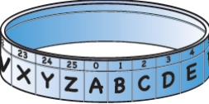
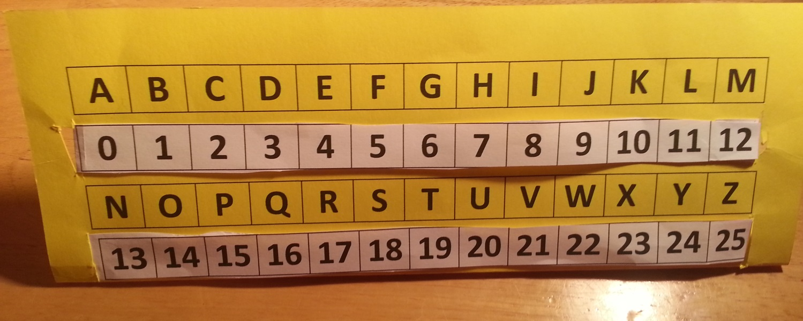
The Variable Machine
http://illuminations.nctm.org/Default.aspx

Slide 13
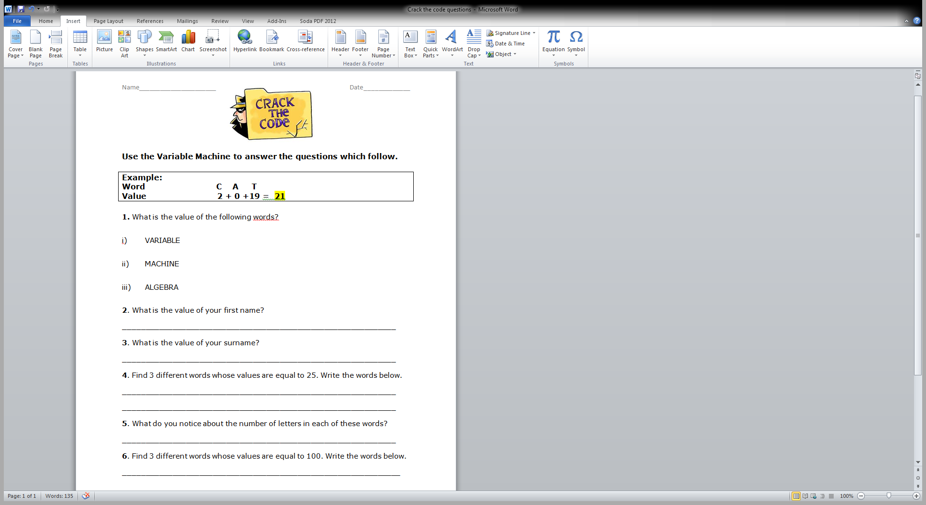
Student Hand-out

Slide 14
Student Learning
Lesson Opening (prior learning)
Word Bank
The Variable Machine!
Student Activity hand-out
Pair Work for Q.3 onwards

Slide 15
Testing for Understanding
Questioning
What is a variable?
How did you use your variable machine to determine the value of your first name?
Is it possible to change the values of each of the letters in a variable machine, or are they always the same value?

Slide 16
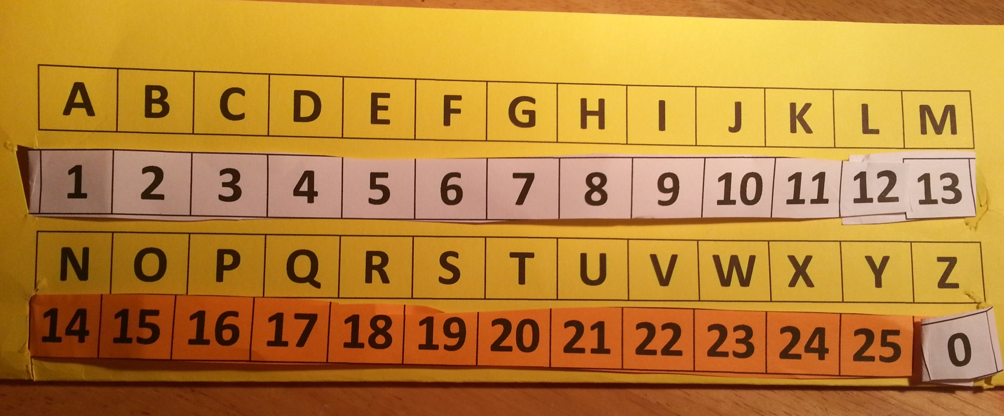
Student learning
Extension Learning
The value of the letter can vary!

Slide 17
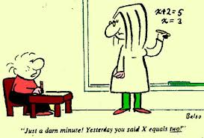
General Misconceptions

Slide 18

Motivation
High levels of enthusiasm for
- Variable machine
Deriving values for their name
Straight to work, excitement in the room
Lower levels of enthusiasm
- Q4 & 5 as they found this more difficult

Slide 19
Social Behaviour
Student pair work
Students enjoyed interaction
They engaged with other pairs trying to find words with a value of 25 and 100.
Higher than usual noise levels
Some students seemed to lose interest if they couldn’t crack the code

Slide 20
Topic development
After the initial introduction of a variable in Algebra, we continued the topic using a patterns-based approach

Slide 21
Continued Learning Outcomes
TOPIC LEARNING OUTCOMES…
use tables to explore and represent a repeating pattern
generalise and explain patterns and relationships in words and numbers
write an arithmetic expressions for particular terms in a sequence
find the underlying formula written in words from which the data is derived (linear relations)

Slide 22

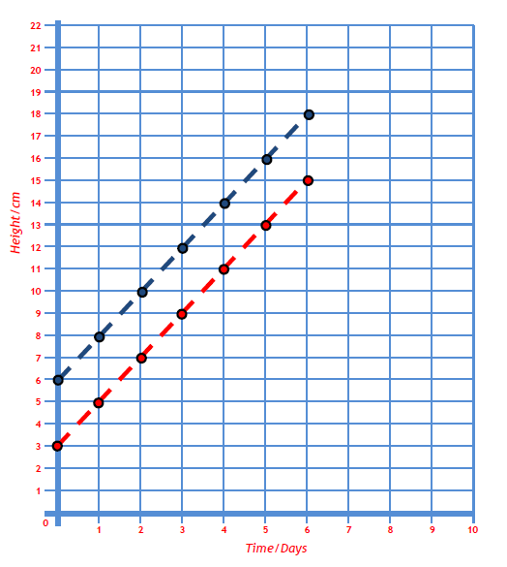
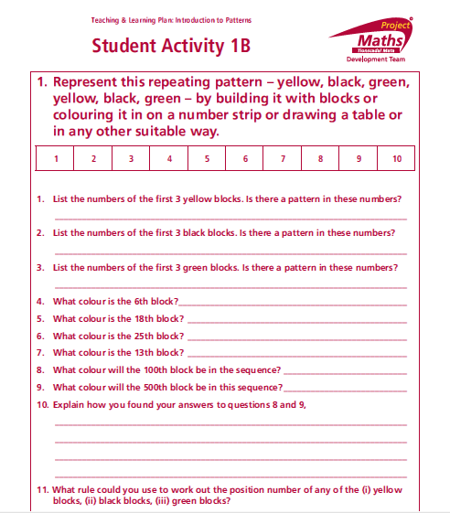
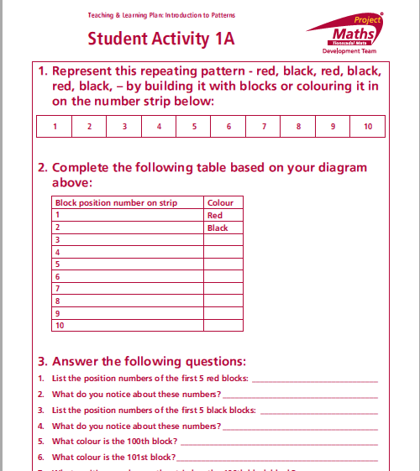
Resources used:
Resources used:
Use of Teaching &Learning Plan & Student Activities

Slide 23
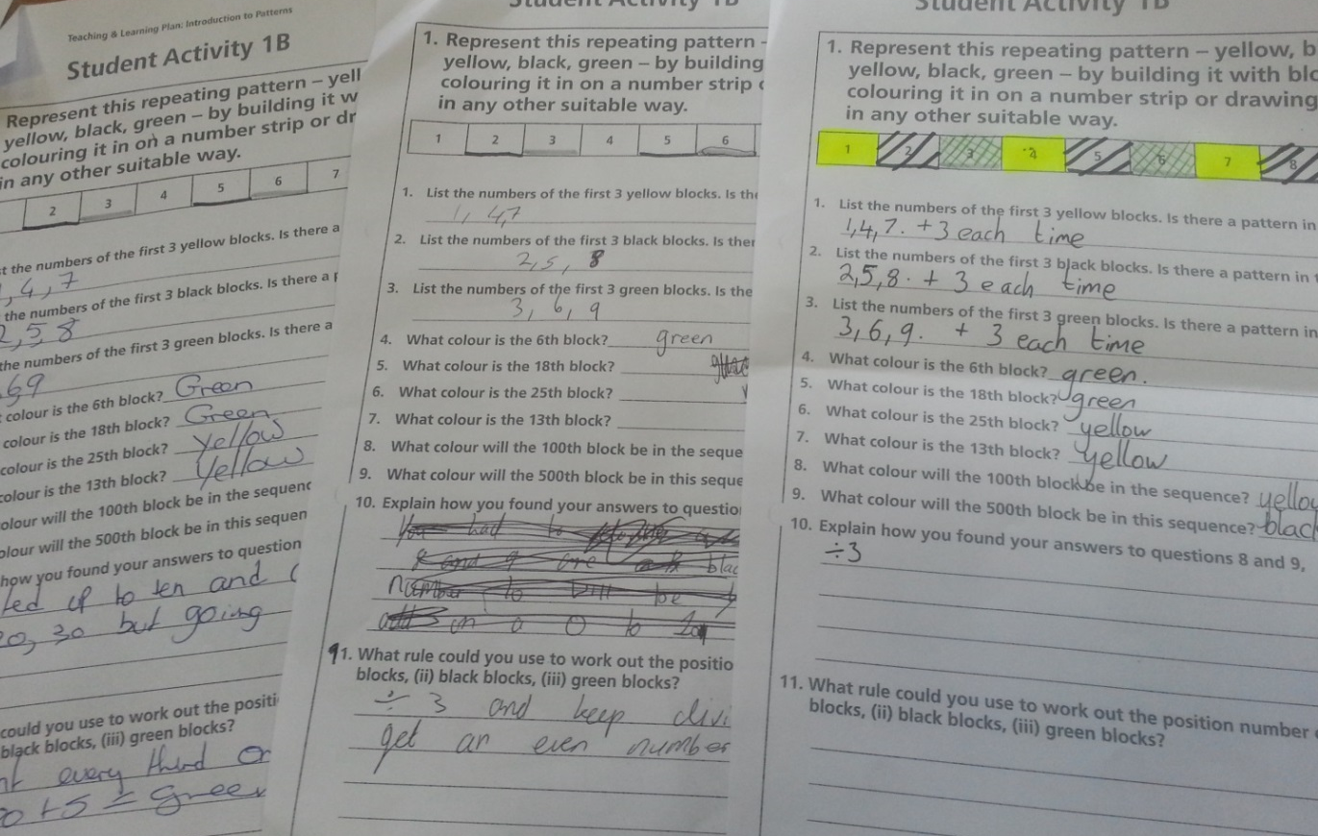
Student Understanding
Examples of student work.

Slide 24
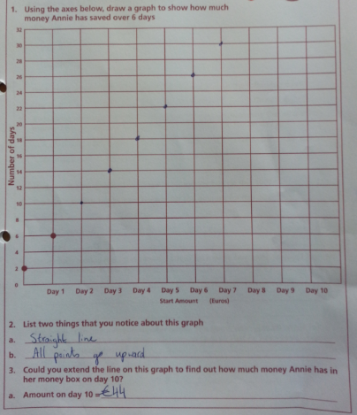
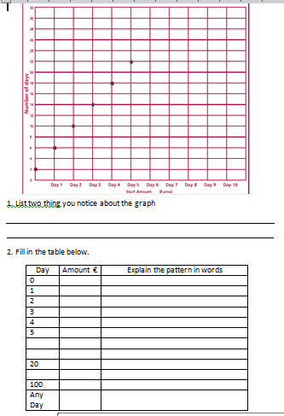
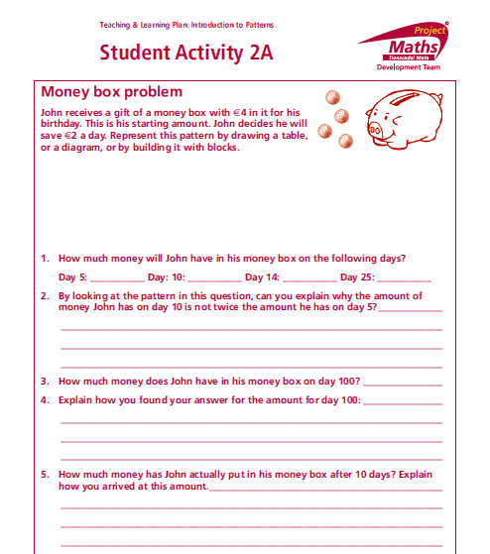
Resources used:

Slide 25
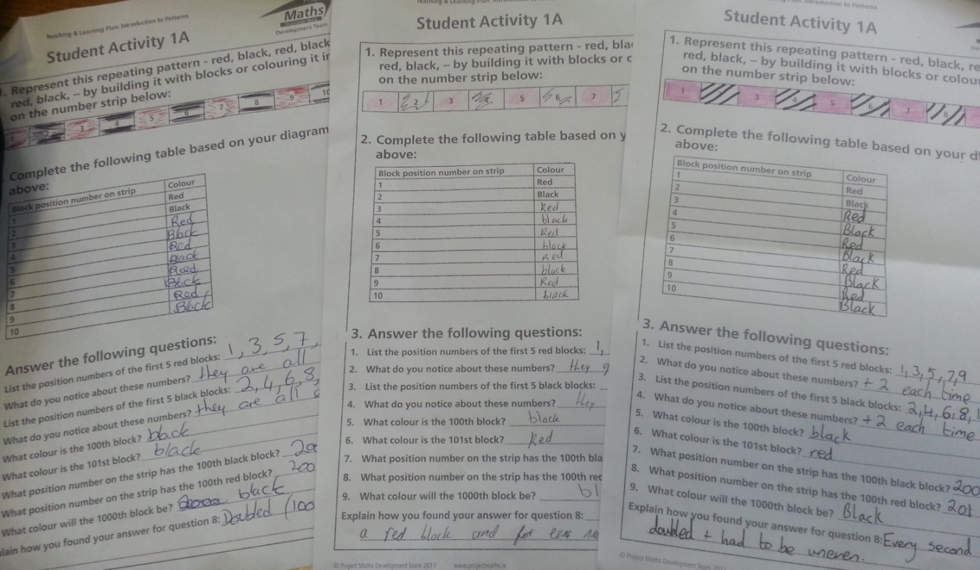
Student Understanding
Examples of student work.

Slide 26
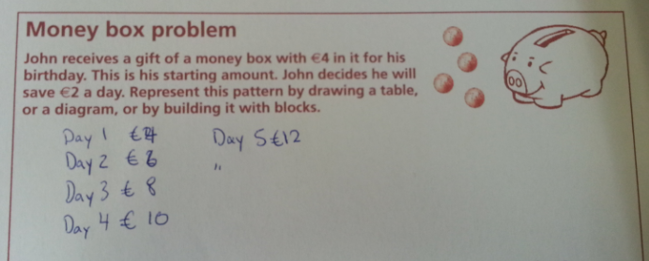
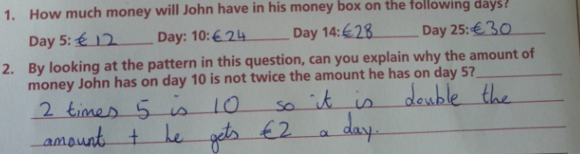
Common Misconceptions

Slide 27
General Misconceptions

Slide 28
Addressing Misconceptions
Recommendations
The adjustments you have made or would make in the future

Slide 29
Summary
Students enjoyed active learning where they engaged in the topic

Slide 30
Teaching Strategies
What did I notice about my own teaching?
Considerably more preparation time required than usual
I felt my role changed in the classroom
It was difficult to work out different ideas presented by students, so we began the following class with a recap, and used their combined answers. All students took this down

Slide 31
Teaching Strategies
Was it difficult to ask questions to provoke students’ deep thinking?
Yes, as they were all working at different paces
I was nervous that they might ask something I wasn’t fully prepared for, and steer away from the direction I intended

Slide 32
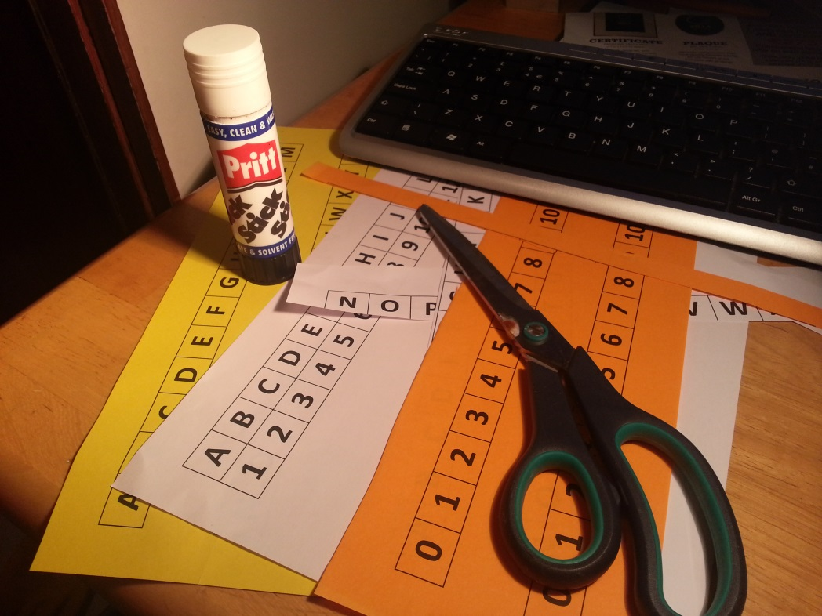
Teaching Strategies
How did I engage and sustain students’ interest and attention during the lesson?

Slide 33
Teaching Strategies
How did I assess what students knew and understood during the lesson?
Directed Questioning
Observation
All students got involved individual work and pair work

Slide 34
Teaching Strategies
How did I put closure to the lesson?
I asked students to answer three questions for homework based on the lesson, intended to recap and reinforce student understanding

Slide 35
Reflections on the Lesson
Student Learning :
Students were engaged and active throughout topic series
Teaching Strategies:
Other than the preparation, most of the work in class was from the students

Slide 36
Reflections on Lesson Study Process
Strengths & Weaknesses
As a mathematics team how has Lesson Study impacted on the way we work with other colleagues?
We work closely as a pilot school, but have collaborated a lot during this task.

Slide 37
Reflections on Lesson Study Process
Strengths & Weaknesses
Personally, how has Lesson Study supported my growth as a teacher?
More confident to try new approaches to my teaching

Slide 38
Questions
Thank you for listening

