Slide 1
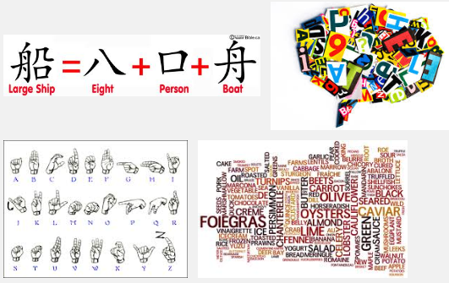
Language uses symbols and words

Slide 2
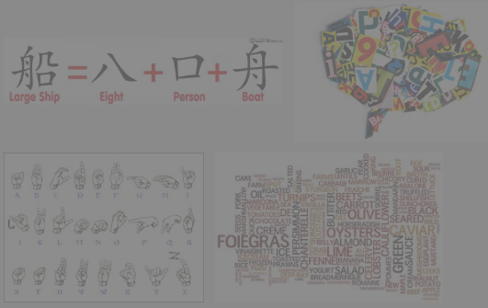

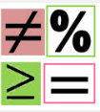
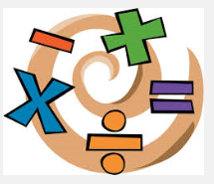
The Cool Language of Algebra…
…also uses symbols and words!

Slide 3
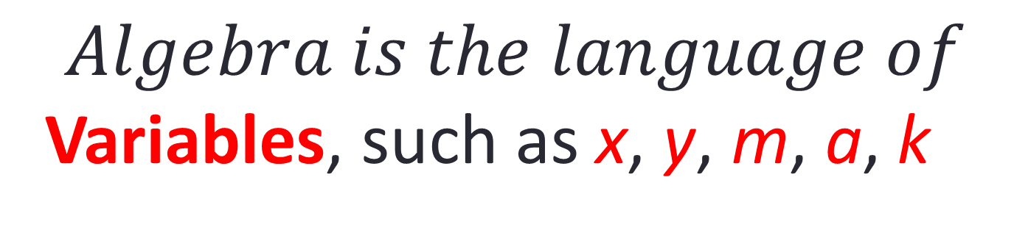
The Cool Language of Algebra!
$$Algebra is the language of$$
Variables, such as x, y, m, a, k

Slide 4
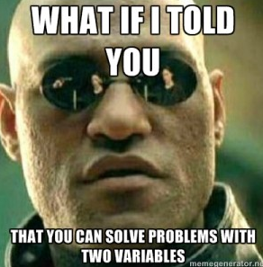
The Cool Language of Algebra!

Slide 5
The Cool Language of Algebra!
Algebra
Solves real Problems…
…using variables!

Slide 6

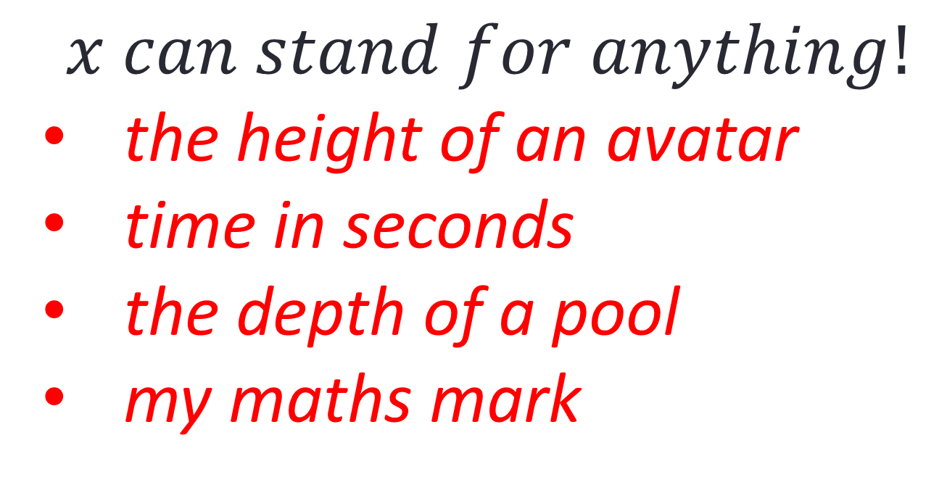
The Cool Language of Algebra!
$$x can stand for anything!$$
the height of an avatar
time in seconds
the depth of a pool
my maths mark

Slide 7
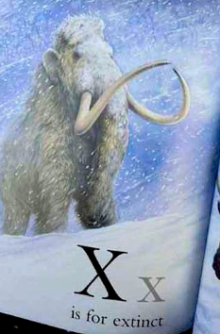
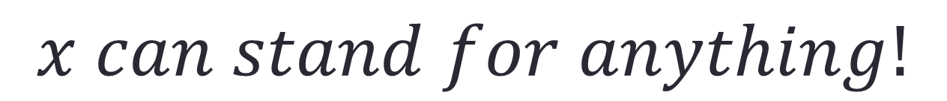
The Cool Language of Algebra!
$$x can stand for anything!$$

Slide 8
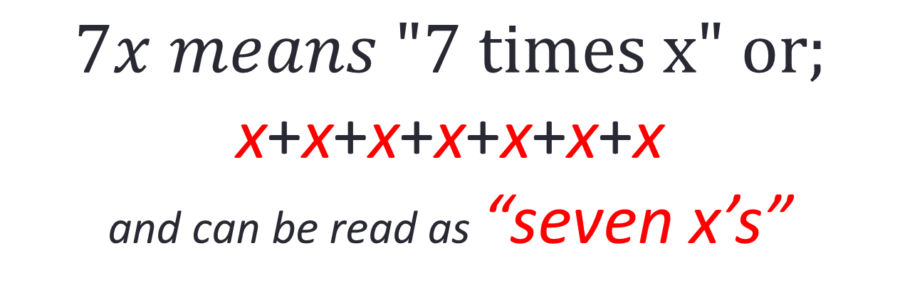
The Cool Language of Algebra!
$$7x means \text{"7 }\text{times} \text{x}\text{" }\text{or}\text{;}$$
x+x+x+x+x+x+x
and can be read as “seven x’s”

Slide 9
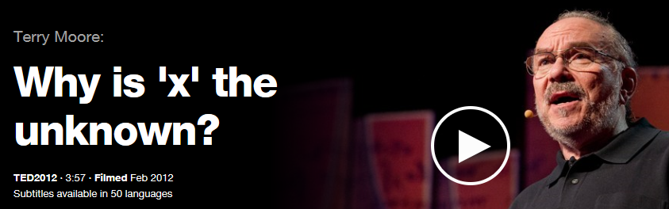

Where did the idea of x come from?

Slide 10
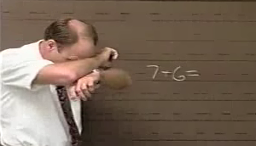
Understanding x as buried treasure

Slide 11
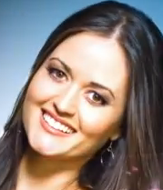
Finding x is for your future!
“In algebra (as in real life), x can be anything: 12, -47, a billion—the sky’s the limit… But can you imagine if, when we solved for x, we started by stereotyping it, shutting out a whole range of possible solutions? Like, “Hmm, I just don’t think x could be a very big number; I mean look, it’s so little.”
I know it sounds crazy, but this happens all the time
in life. The x you’re solving for is your future, and it,
too, can be anything.”
extract from Algebra Exposed by Danica McKellar

Slide 12
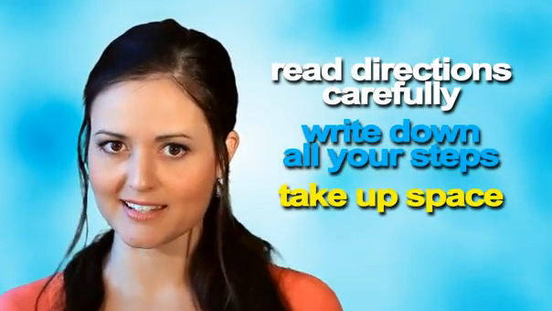
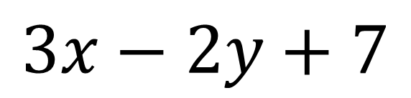
Stop Making Mistakes!!!
$$3x−2y+7$$

Slide 13
Name parts of an Algebraic Expression
$$3x−2y+7$$

Slide 14
Name parts of an Algebraic Expression
Term
$$3x−2y+7$$

Slide 15
Name parts of an Algebraic Expression
Terms
$$3x−2y+7$$

Slide 16
Name parts of an Algebraic Expression
Variables or Pronumerals
$$3x−2y+7$$

Slide 17
Name parts of an Algebraic Expression
Variables
$$3x−2y+7$$
Variable = vary (the x and y values change or are variable)

Slide 18
Name parts of an Algebraic Expression
Constant
$$3x−2y+7$$
Constant doesn’t change at all – it remains constant!

Slide 19
Name parts of an Algebraic Expression
A value that doesn’t change!
Constant
$$3x−2y+7$$
Constant doesn’t change at all – it remains constant!

Slide 20
Name parts of an Algebraic Expression
Coefficient
$$3x−2y+7$$

Slide 21
Name parts of an Algebraic Expression
Coefficients
$$3x−2y+7$$
Note: Coefficient could be a fraction too! e.g. $\frac{3}{5} x$

Slide 22
Name parts of an Algebraic Expression
$$3x−2y+7$$
operators

Slide 23
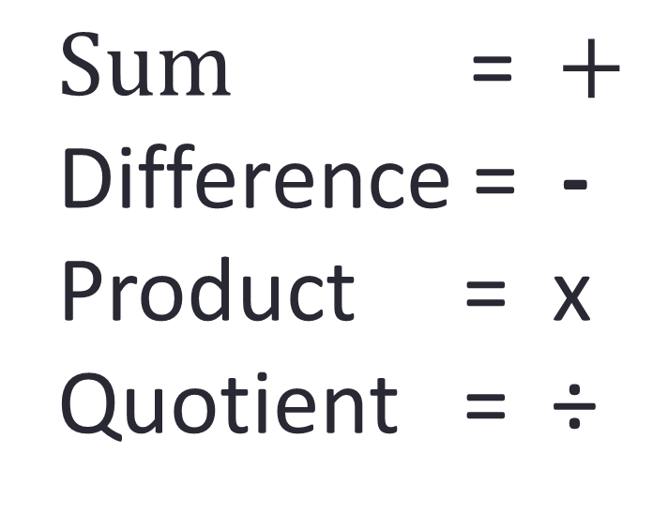
A quick reminder that …
$$Sum \text{=} +$$
Difference = -
Product = x
Quotient = ÷

Slide 24
A quick reminder that …
$$Sum \text{=} +$$
Difference = -
Product = x
Quotient = ÷

Slide 25
Let’s check your knowledge…
For the expression: 7x + 3y – 9
Name: 1. a term ____
2. the constant ____
3. a coefficient ____
4. a variable ____
5. an operator ____

Slide 26
Let’s check your knowledge…
6. What is the sum of 9 and 2? ____
7. What is the product of 11 and 5? ____
8. What is the difference of 8 and 3? ____
9. What is the quotient of 12 and 4? ____
10. How many terms are in the expression: 125x – 17y + 80? ___

Slide 27
Let’s check your knowledge…Answers
For the expression: 7x + 3y – 9
Name: 1. a term 7x or 3y or -9
2. the constant -9
3. a coefficient 7 or 3
4. a variable x or y
5. an operator + or -

Slide 28
Let’s check your knowledge…
6. What is the sum of 9 and 2? sum = + 9+2 = 11
7. What is the product of 11 and 5? product = x 11 x 5 = 55
8. What is the difference of 8 and 3? difference = so, 8-3 = 5
9. What is the quotient of 12 and 4? quotient = divide,
so 12/4 = 3
10. How many terms are in the expression: 125x – 17y + 80? 3

Slide 29
Let’s check your knowledge…
Bonus Question:
Write an algebraic expression for “20 less than the product of x and 5”

Slide 30
Let’s check your knowledge…
Bonus Question:
Write an algebraic expression for “20 less than the product of x and 5”
Answer: 5x -20

