Slide 2
Variables, Expressions, and Equations
1.3
1
Evaluate algebraic expressions, given values for the variables.
Translate word phrases to algebraic expressions.
Identify solutions of equations.
Identify solutions of equations from a set of numbers.
Distinguish between expressions and equations.
2
3
4
5

Slide 3


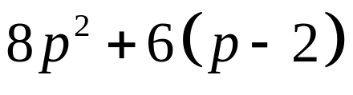



Variables, Expressions, and Equations
A variable is a symbol, usually a letter such as x, y, or z, used to represent any unknown number.
An algebraic expression is a sequence of numbers, variables operation symbols and/or grouping symbols (such as parentheses) formed according to the rules of algebra.
, , Algebraic expressions
In , the 2m means , the product of 2 and m; 8p² represents the product of 8 and p². Also, means the product of 6 and .
Slide 1.3- <number>

Slide 4
Objective 1
Evaluate algebraic expressions,
given values for the variables.
Slide 1.3- <number>

Slide 5

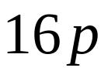


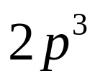
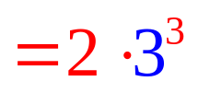



EXAMPLE 1
Evaluating Expressions
Find the value of each algebraic expression when .
Solution:
Remember, 2p³ means 2 · p³, not 2p· 2p · 2p. Unless parentheses are used, the exponent refers only to the variable or number just before it. To write 2p· 2p · 2p with exponents, use (2p)³.
Slide 1.3- <number>

Slide 6

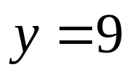
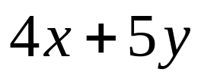



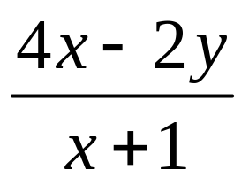
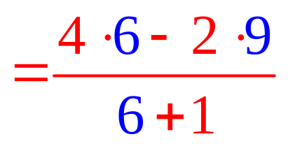
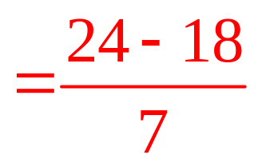
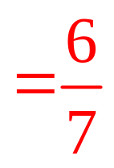
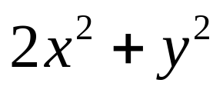
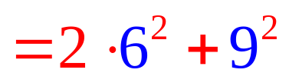



EXAMPLE 2
Evaluating Expressions
Find the value of each expression when and
.
Solution:
A sequence such as 3) · x ( + y is not an algebraic expression because the rules of algebra require a closing parentheses or bracket for every opening parentheses or bracket
Slide 1.3- <number>

Slide 7
Objective 2
Translate word phrases to algebraic expressions.
Slide 1.3- <number>

Slide 8


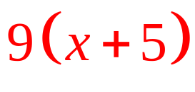
EXAMPLE 3
Using Variables to Write Word Phrases as Algebraic Expressions
Write each word phrase as an algebraic expression using x as the variable.
A number subtracted from 48
The product of 6 and a number
9 multiplied by the sum of a number and 5
Solution:
Slide 1.3- <number>

Slide 9
Objective 3
Identify solutions of equations.
Slide 1.3- <number>

Slide 10



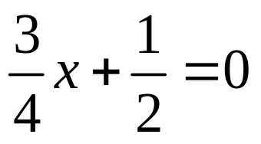

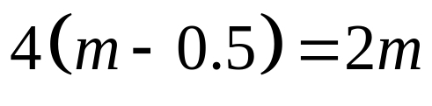
Identify solutions of equations.
An equation is a statement that two algebraic expressions are equal. Therefore, an equation always includes the equality symbol, = .
, ,
, ,
}
Equations
To solve an equation means to find the values of the variable that make the equation true. Such values of the variable are called the solutions of the equation.
Slide 1.3- <number>

Slide 11




EXAMPLE 4
Deciding whether a Number Is a Solution of an Equation
Decide whether the given number is a solution of the equation.
Solution:
Yes
Remember that the rules of operations still apply to equations.
Slide 1.3- <number>

Slide 12
Objective 4
Identify solutions of equations from a set of numbers.
Slide 1.3- <number>

Slide 13
Identify solutions of equations from a set of numbers.
A set is a collection of objects. In mathematics these objects are most often numbers. The objects that belong to the set, called elements of the set, are written between braces. For example, the set containing the numbers (or elements) 1, 2, 3, 4, and 5 is written as
{1, 2, 3, 4, 5}.
One way of determining solutions is the direct substitution of all possible replacements. The ones that lead to true statements are solutions.
Slide 1.3- <number>

Slide 14

EXAMPLE 5
Finding a Solution from a Given Set
Write the statement as an equation. Find all solutions from the set {0, 2, 4, 6, 8, 10}.
Three times a number is subtracted from 21, giving 15.
Solution:
2 is the solution from this set of elements.
Slide 1.3- <number>

Slide 15
Objective 5
Distinguish between expressions and equations.
Slide 1.3- <number>

Slide 16


Distinguish between equations and expressions.
An equation is a sentence—it has something on the left side, an = sign, and something on the right side.
An expression is a phrase that represents a number.
Equation
(to solve)
Expression
(to simplify or evaluate)
One way to help figure this out is, equation and equal are similar.
Slide 1.3- <number>

Slide 17
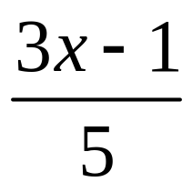
EXAMPLE 6
Distinguishing between
Equations and Expressions
Decide whether the following is an equation or an
expression.
Solution:
There is no equals sign, so this
is an expression.
Slide 1.3- <number>

