Slide 1

Inequalities
Level 7
17/04/2013
Learning Objectives
Understand the inequality symbols
Able to list integers that satisfy an
inequality
Able to represent an inequality on a number
line

Slide 2
Inequalities
< means “less than”
> means “greater than”
≤ means “less than or equal to”
≥ means “greater than or equal to”

Slide 3

Inequalities
What do these inequalities mean?
$x > 7$
$x ≤3$
$5<x<9$
$0.3<x≤3.6$

Slide 4

Inequalities
An integer is a whole number.
What integers satisfy these inequalities?
$0<x<6$
$−4<x≤3$
$−7≤x≤−1$
$3.4≤x<7$
$−2.1<x<3$

Slide 5
Inequalities
You will often be asked to represent an inequality on a number line.
To do this we use circles to signify the start and end points and a line to represent the range of possible values
You need to learn the following key:
means that value isn’t included
means that value is included

Slide 6

Inequalities
For example:
$x>5$means that $x$ can take any value greater than 5. This would be shown on a number line as:
4
5
6
7
8
9
10
11

Slide 7
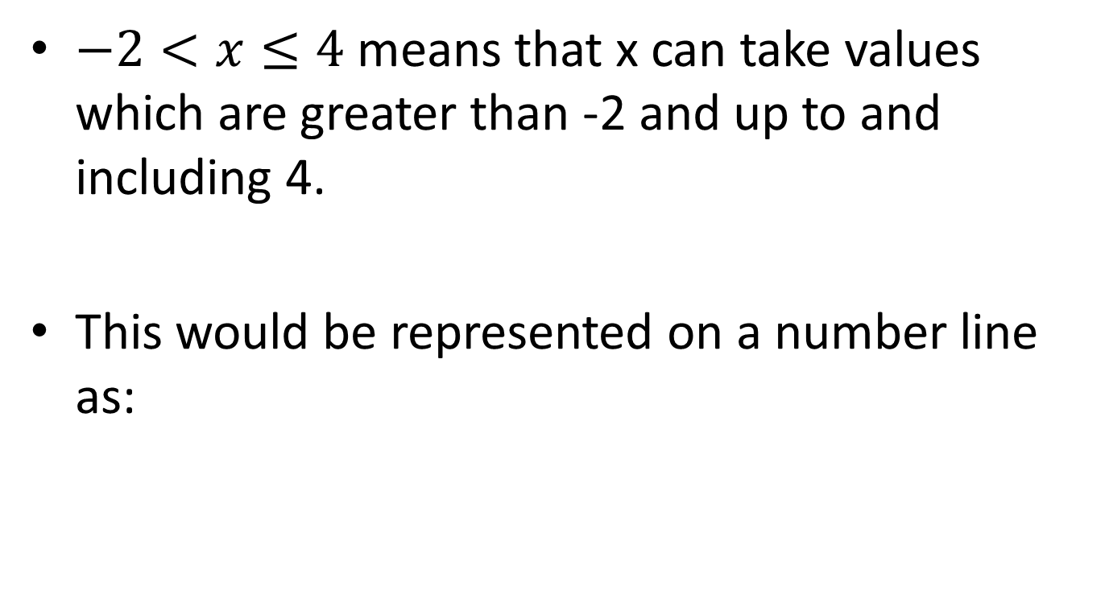
Inequalities
$−2<x≤4$ means that x can take values which are greater than -2 and up to and including 4.
This would be represented on a number line as:
-3
-2
-1
0
1
2
3
4

Slide 8









Inequalities
On your whiteboards, draw a number line from -5 to 5. On your number line, draw the following inequalities:
$$−4≤x<4$$
$$x≥1$$
$$x<4$$
$$−3.5≤x<0.5$$
$$0<x<5$$
$$−−2<x≤5$$
$$x>−3$$
$$x<0$$
$$−5≤x≤−1$$

Slide 9
Starter
Match the inequalities to the number lines

Slide 10
Solving Inequalities
You solve an inequality in exactly the same way as you do an equation except:
you use an inequality symbol rather than equal sign
you must flip the sign if you multiply or divide by a negative number

Slide 11
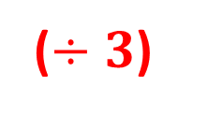

Solving Inequalities
$$3x – 5 > 13$$
$$3x > 18$$
$$x > 6$$
(+ 5)
(+ 5)
($÷3$)
(÷ 3)

Slide 12

Solving Inequalities
$$6(2x + 7) ≤ 150$$
$$12x + 42 ≤ 150$$
$$12x ≤ 108$$
$$x ≤ 9$$
(- 42)
(- 42)
(÷ 12)
(÷ 12)

Slide 13
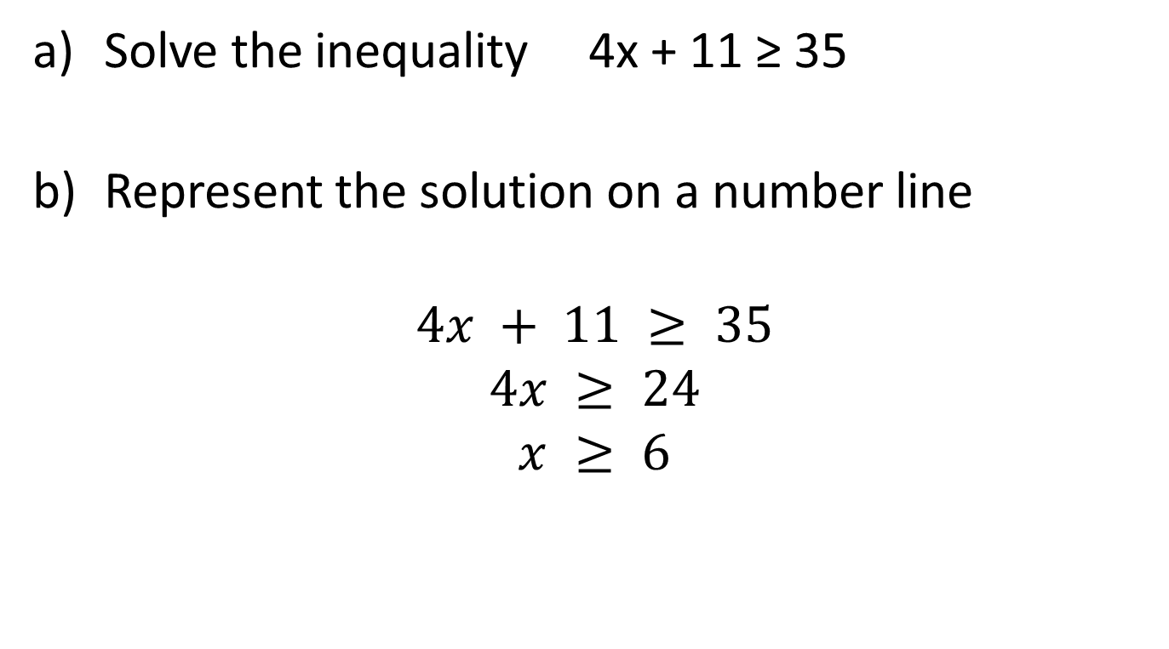
Solving Inequalities
Solve the inequality 4x + 11 ≥ 35
Represent the solution on a number line
$$4x + 11 ≥ 35$$
$$4x ≥ 24$$
$$x ≥ 6$$
a)
(- 11)
(- 11)
(÷ 4)
(÷ 4)
b)
5
6
7
8
9

Slide 14






Solving Inequalities
On your whiteboards, solve the following inequalities and represent the solution on a number line
$$5x+5<30$$
$$7x+3≥0$$
$$2x + 3 > 11$$
$$4x −9<11$$
$$10x −7 ≤−17$$
$$15−2x>3$$

Slide 15

Solving Inequalities
Solve the inequality:
$$−8 ≤ 3x – 17 < 19$$
$$9 ≤ 3x < 36$$
$$3 ≤ x < 12$$

Slide 16

Solving Inequalities
$$2 < 12 – 5x < 27$$
$$−10 < −5x < 15$$
$$2 > x > −3$$
$$−3 < x < 2$$

Slide 17

Starter
Solve the inequalities:
$5x – 1 > 14$
$2x – 7 < 8x + 11$
$31 < 3x + 13 ≤ 46$
$−6 ≤ 14 – 10x < 17$

Slide 18
Solving Inequalities
Level 7
17/04/2013
Learning Objectives:
Able to solve simple linear inequalities
Able to solve more complex linear
inequalities
Able to solve non-linear inequalities

Slide 19

Solving Inequalities
$$x^{2}=9$$
$$x=3 or x=−3$$

Slide 20

Solving Inequalities
$$x^{2}<9$$
$$x < 3$$
This satisfies the inequality
Does $x< −3$?
It must be $x > −3$
So: $−3 < x < 3$

Slide 21

Solving Inequalities
$$x^{2}>9$$
$$x > 3$$
Does $x> −3$?
It must be $x< −3$
So: $x<−3, x>3$

Slide 22
Solving Inequalities
Solve the inequalities and match them to the answers to form a large hexagon

