Slide 1
Solving Inequalities

Slide 2
Inequality Signs
An inequality is like an equation, but instead of an equal sign (=) it has one of these signs:
< : less than
≤ : less than or equal to
> : greater than
≥ : greater than or equal to

Slide 3
“x < 5”
means that whatever value x has,
it must be less than 5.
What could x be?

Slide 4
“x ≥ -2”
means that whatever value x has,
it must be greater than or equal to -2.
What could x be?

Slide 5
Graphing Rules
Symbol | Circle | Direction of Arrow
< | Open | Left
> | Open | Right
≤ | Closed | Left
≥ | Closed | Right

Slide 6



Examples:
x < 5
x > -2
x ≤ -8
x ≥ 4

Slide 7
You Try:
x < -6
x > 2
x ≤ 0
x ≥ -7

Slide 8
Practice
x + 5 > 13
2x – 14 > 4
5 + x < 7
^{x}/₄ + 3 < 7

Slide 9
DAY 2

Slide 10
Use the Key Words to Write an Inequality
A number added to 5 is greater than 12
The quotient of 2 and a number is at most 6
7 multiplied by a number is less than 16
18 decreased by a number is no less than 12.8
17 is greater than or equal to 8 less than a number

Slide 11
Solving One-Step Inequalities
Addition Property for Inequalities
X-15<73

Slide 12
Solving One-Step Inequalities
y+15<25

Slide 13
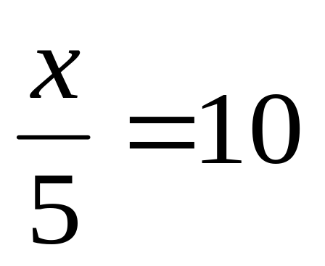
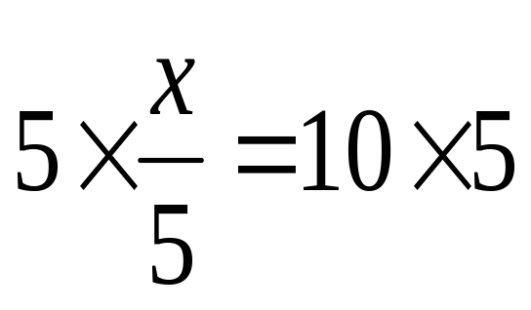
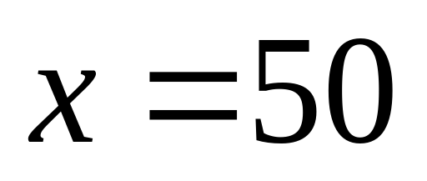
Solving One-Step Inequalities
Multiply both sides by the reciprocal of the coefficient

Slide 14
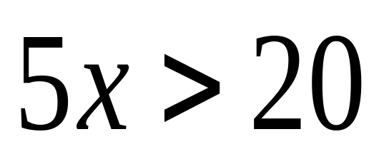
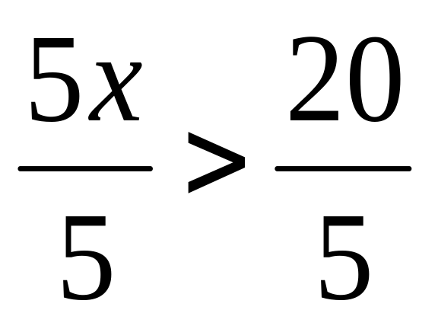
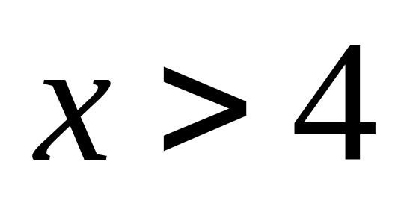
Solving One-Step Inequalities
Division Property for Inequalities
Divide both sides by the coefficient of x

Slide 15
Solving Inequalities!
Solving inequalities is the same as solving equations.
There are only 2 things you need to know…
  1.) If you multiply or divide by a negative number you must switch the sign.
  -7x < 21
  -7 -7
  x > -3
  2.) You will graph your solutions.
Dividing by a negative means switch the sign!!

Slide 16
Special Case 1: Switching the Signs
When solving inequalities, if you multiply or divide by a negative you must switch the signs.
Switching the signs:
  Less than becomes Greater than < switches to >
  Greater than becomes Less than > switches to <
  Less than or equal to becomes Greater than or equal to
  ≤ switches to ≥
  Greater than or equal to becomes Less than or equal to
  ≥ switches to ≤

Slide 17
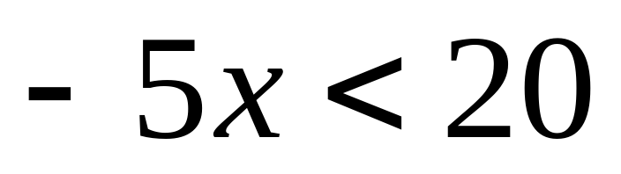
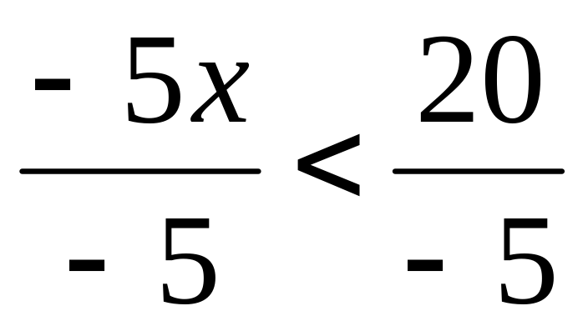
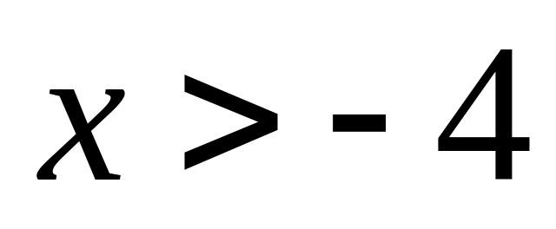
Division Property for Inequalities
Caution! Dividing by a negative number
Same if multiplying?
Notice: Sign CHANGED

Slide 18
Multiplication Property for Inequalities
Caution! When you multiply by a negative number…
YES!
-x > 2
5
…the sign CHANGES
x < -10
(-5 )-x > 2(-5)
1 5

Slide 19
Solving One-Step Inequalities
Let’s try some on our own …… ready?

Slide 20
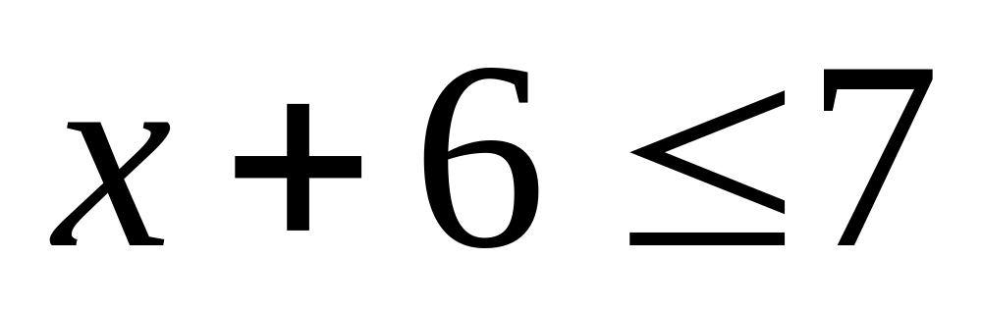
Solving One-Step Inequalities #1

Slide 21
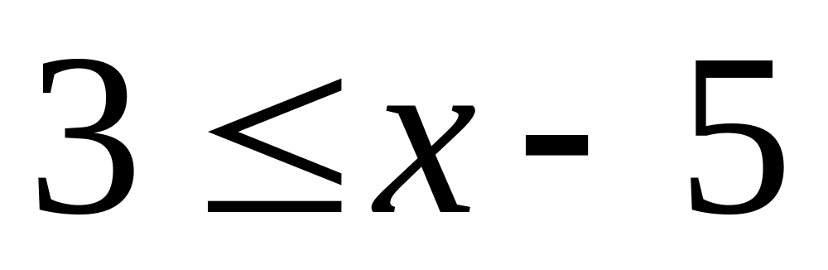
Solving One-Step Inequalities #2

Slide 22
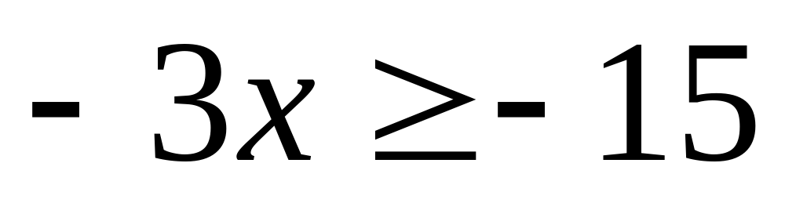
Solving One-Step Inequalities #3

Slide 23
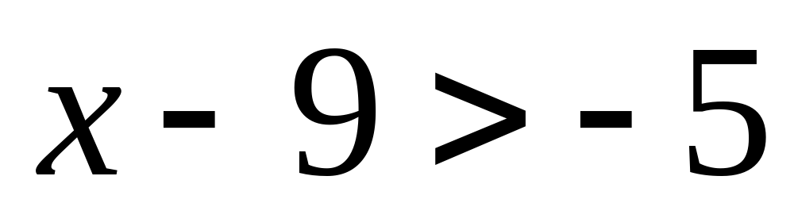
Solving One-Step Inequalities #4

Slide 24
Answers for #1 - #4
x ≤ 1
8 ≤ x or x ≥ 8
x ≤ 5
x > 4

Slide 25
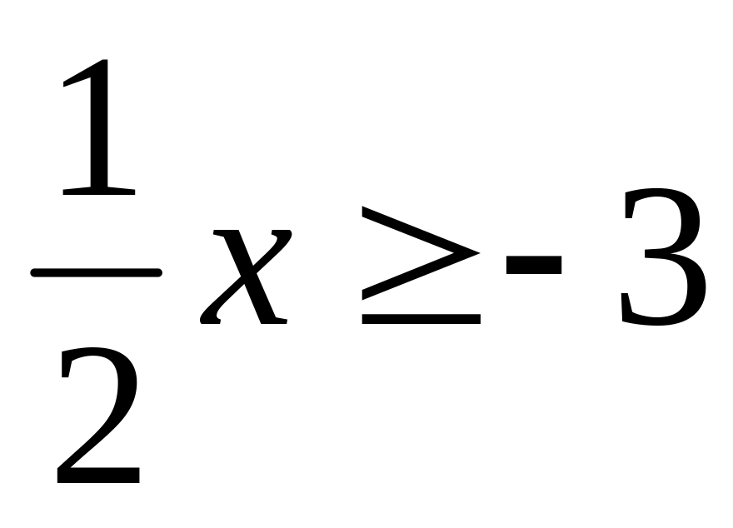
Solving One-Step Inequalities #5

Slide 26
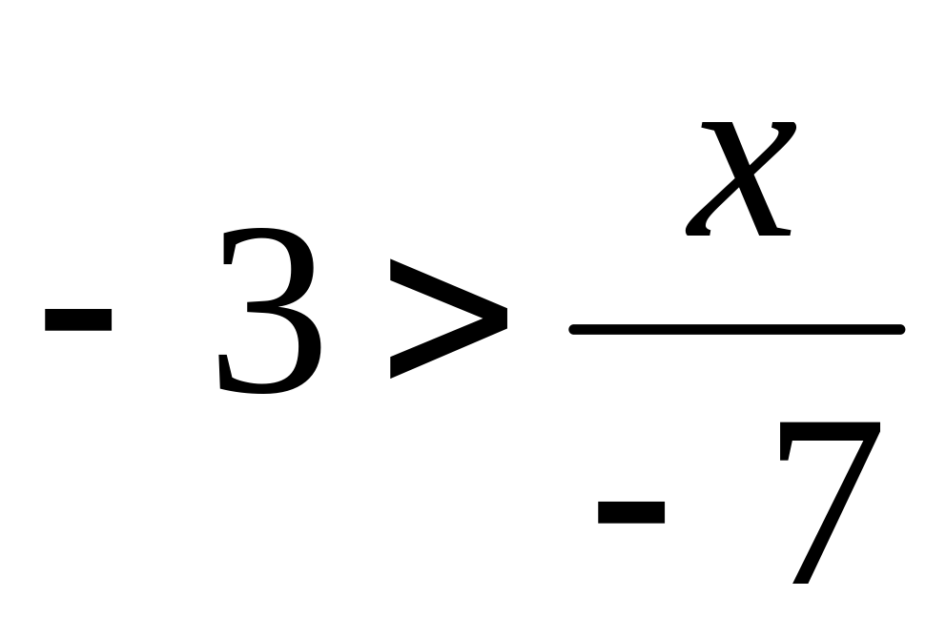
Solving One-Step Inequalities #6

Slide 27
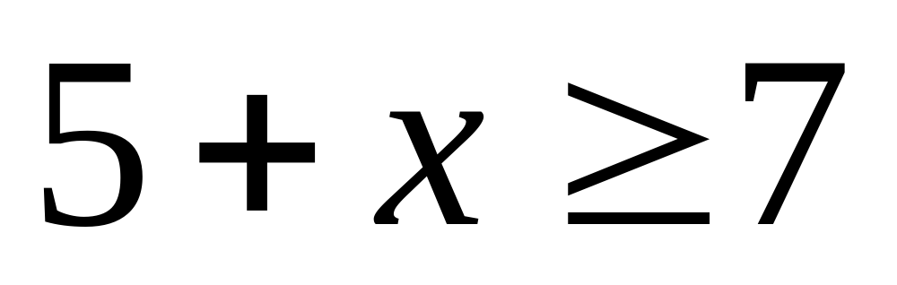
Solving One-Step Inequalities #7

Slide 28
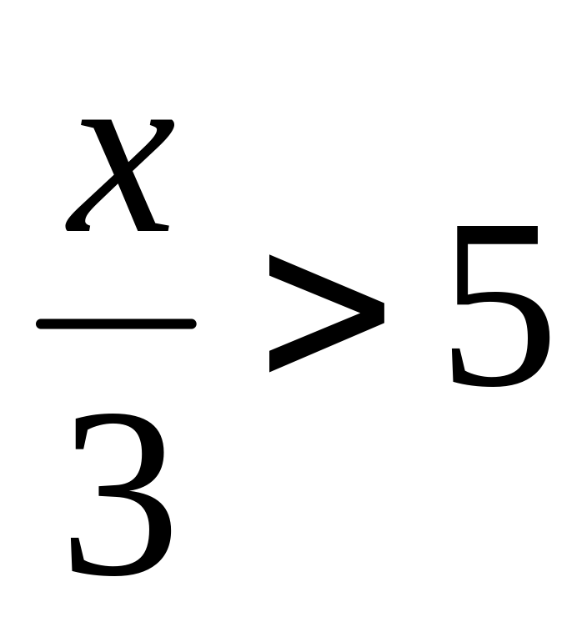
Solving One-Step Inequalities #8

Slide 29
Answers for #5 - #8
5. x ≥ -6
6. 21 < x or x > 21
7. x ≥ 2
8. x > 15

Slide 30
Day 3 Solving Multi-Step Inequalities

Slide 31

Solving Inequalities
Follow same steps used to solve equations:
3x + 4 < 13
- 4 -4
3x < 9
3 3
x < 3

Slide 32
Practice
-2x + 5 > 15
14 > x + 4
-4
17 – 3 x < 41
x < 7
-5

Slide 33
Time to Practice!
Solve:
6x – 8 > 22

Slide 34
Practice Problem 1
−4 − 5v < −29

Slide 35
Practice Problem 2
−1 + 4x ≤ 31

Slide 36
Practice Problem 3
−2 + r > −1
9

Slide 37
Practice Problem 4
−52 < 8 − 5k

Slide 38
Practice Problem 5
8 − 7n > −20

Slide 39
Practice Problem 6
−9 ≥ −8 + v
−6

