Slide 1
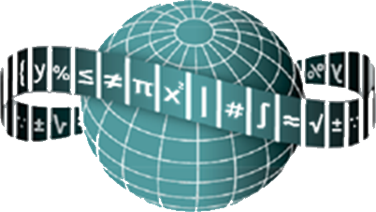




Maths Counts Insights into Lesson Study

Slide 2

St Mark’s Community School
Gemma Fay, Claire Kennedy, Gerry McAndrew
Second years
Introduction to Nets
Our lesson covers nets of a cube, cuboid and cylinder. Subsequent classes will cover drawing nets to scale, surface area and nets of cones.

Slide 3
Insights into Lesson Study
Introduction: Focus of Lesson
Student Learning : What we learned about students’ understanding based on data collected
Teaching Strategies: What we noticed about our own teaching
Strengths & Weaknesses of adopting the Lesson Study process

Slide 4
Introduction
Topic investigated Introduction to Nets
How we planned the lesson:
Group Meeting
We decided to use discovery learning and group work with the teacher acting mainly as a facilitator.
We decided on the order we would ask students to draw the nets of a cube, cuboid and cylinder.
Dimensions would be given and would fit on an A4 sheet.
We made a PowerPoint show.
We collected resources.

Slide 5
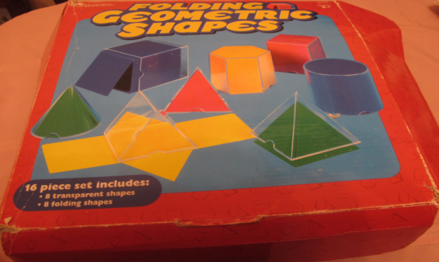
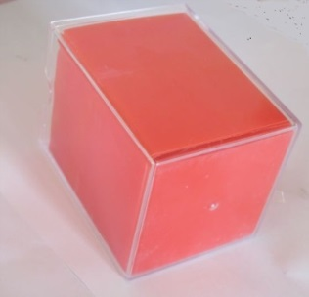
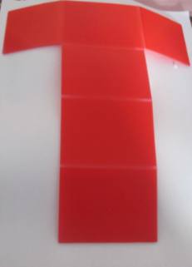
Introduction
Topic investigated: Introduction to Nets
Resources used:
A4 paper
Scissors
Mathematical Instruments
PowerPoint containing pictures of nets, and extension exercises
3D visual shapes

Slide 6
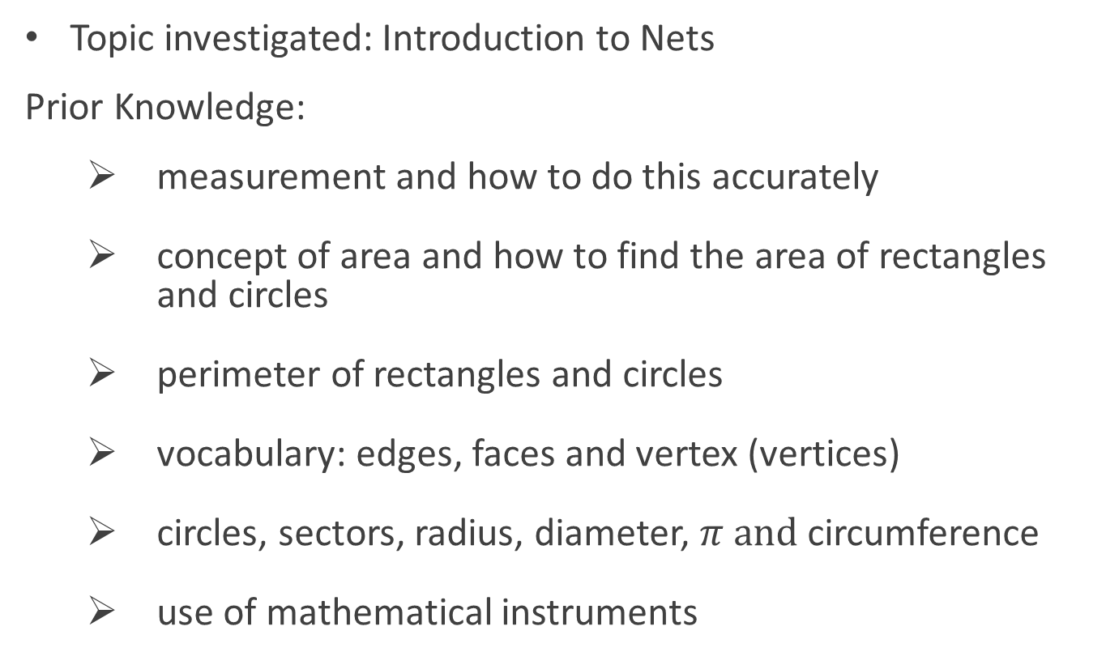
Introduction
Topic investigated: Introduction to Nets
Prior Knowledge:
measurement and how to do this accurately
concept of area and how to find the area of rectangles and circles
perimeter of rectangles and circles
vocabulary: edges, faces and vertex (vertices)
circles, sectors, radius, diameter, $π and$circumference
use of mathematical instruments

Slide 7
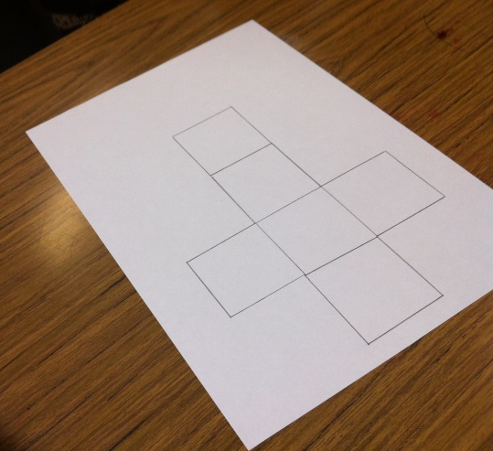
Introduction
Learning Outcomes:
We wanted students to be able to draw the net of a cube, cuboid and cylinder.
We wanted students to be able to move from 3D to 2D and 2D to 3D.

Slide 8
Introduction
Why did we choose to focus on this mathematical area?
Students’ lack of spatial awareness
Idea of going from 3D to 2D and 2D to 3D
Students’ lack of understanding of surface area
Students being unable to calculate the cost of materials used to make these shapes in real-life applications

Slide 9
Introduction
Enduring understandings:
Students being able to
recognise what is meant by a net
look at a cube, cuboid or cylinder and draw its net
recognise the surface area of these shapes from their nets
recognise potential nets that would not make these shapes.

Slide 10
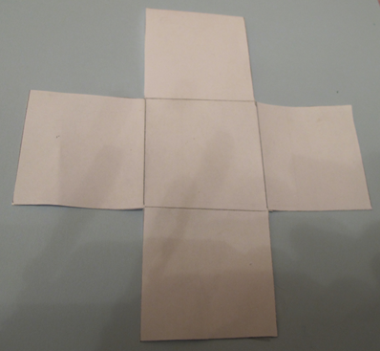
Introduction
Only 5 faces
Not a net of a cube

Slide 11
Reflections on the Lesson
Student Learning : What we learned about students’ understanding, based on data collected.
Teaching Strategies: What we noticed about our own teaching.

Slide 12
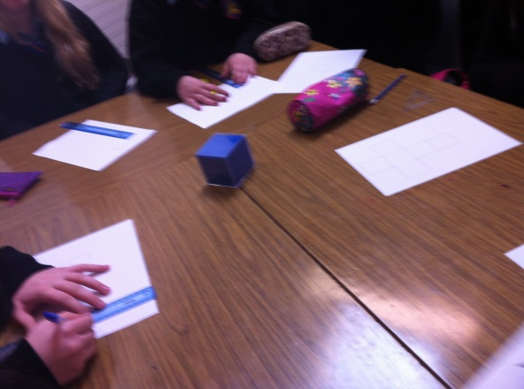
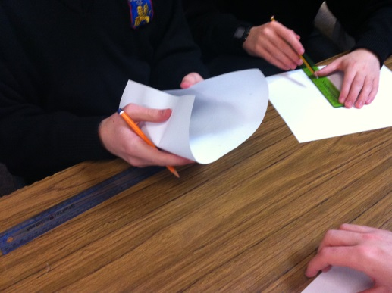
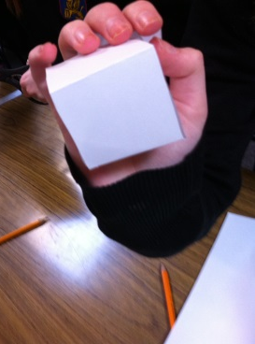
Student Learning
Data Collected from the Lesson:
Academic: e.g. samples of students’ work
Motivation
Social Behaviour

Slide 13
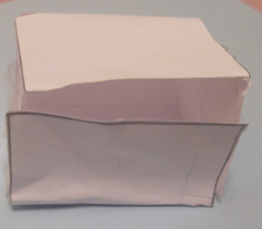
Reflections on the Lesson
Student Learning :
Some students lack spatial awareness.
Some students excelled at spatial awareness, who would normally struggle with problem solving.
Students need time to discuss their work with their peers.
With the hands-on approach, students see their own mistakes.
One side too small

Slide 14
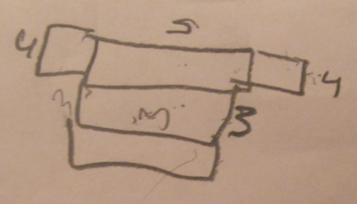
Reflections on the Lesson
Teaching Strategies:
Discovery learning
Manipulatives and the hands-on approach
The need to refrain from jumping in too quickly
Advantages of cross-curricular references (e.g. Technical Graphics.)

Slide 15
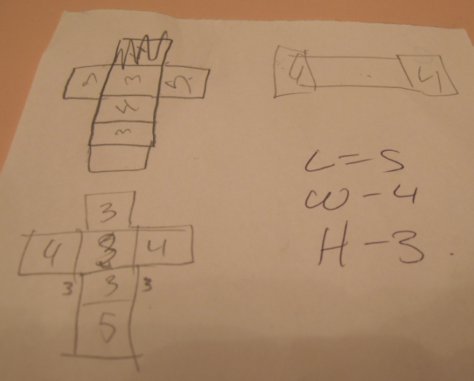

Student Understanding
What we learned about the way different students understand the content of this topic?
Some students found the visualisation of the nets difficult.
Some students found measurement difficult.

Slide 16
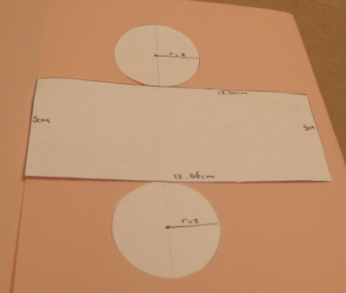
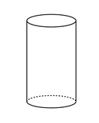
Effective Student Understanding
What effective understanding of this topic looks like:
3D to 2D
2D to 3D

Slide 17
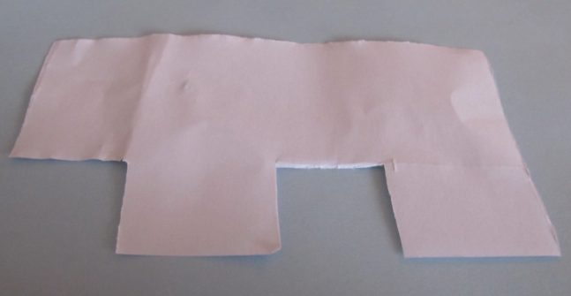
Common Misconceptions
6 sides for a rectangular box, but does not overlap

Slide 18
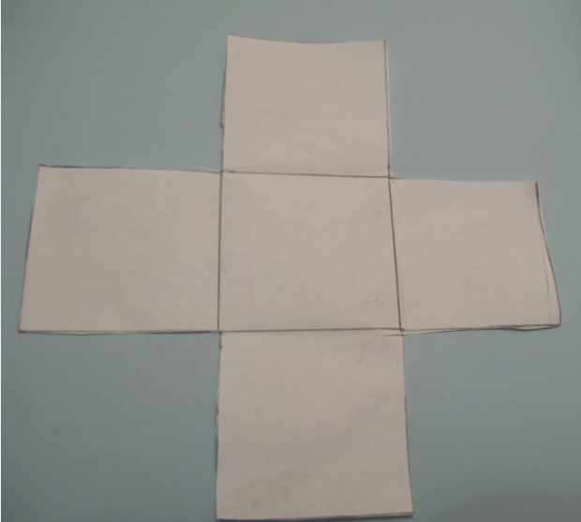
Common Misconceptions
5 sides in a cuboid, or a cube missing the top or bottom

Slide 19
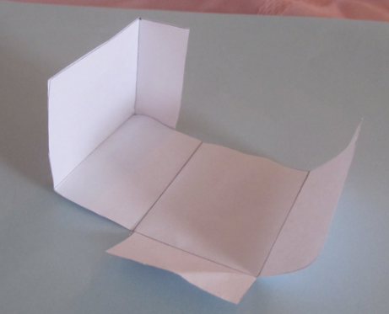
Common Misconceptions
For the rectangular box, some students missed the relationship between the height of the end and the width of the side face.
A practical example for some students was their own maths set boxes in front of them.

Slide 20
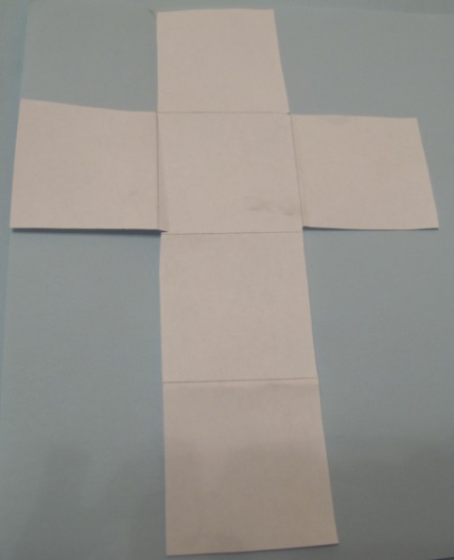
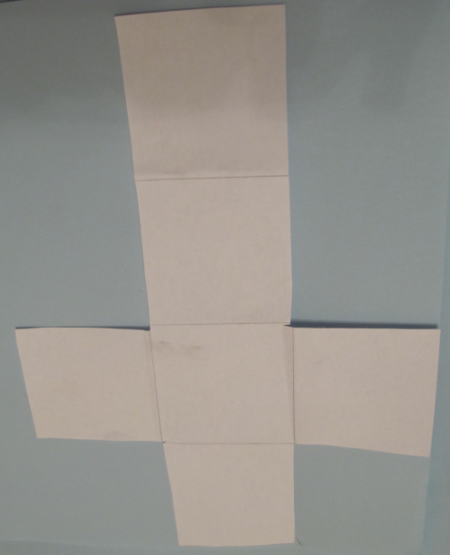
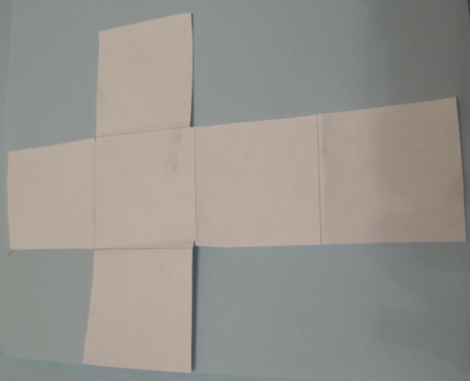
Common Misconceptions
A few students failed to recognize these as rotations of the same net.

Slide 21
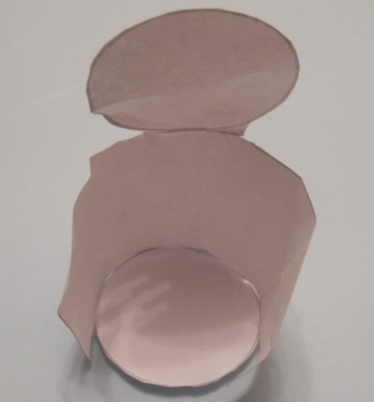
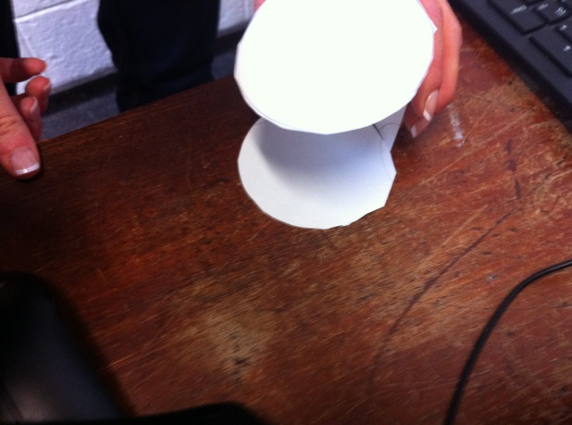

Common Misconceptions
Misconceptions/ Knowledge Gap
Missing the connection between the circumference of the circular top or bottom ($2πr)$ and the length of the rectangle ($2πr)$.

Slide 22
Addressing Misconceptions
Recommendations
The adjustments you have made or would make in the future:
Provide a template of the nets for students who are struggling.
Allow groups who are having problems to interact with other groups.

Slide 23
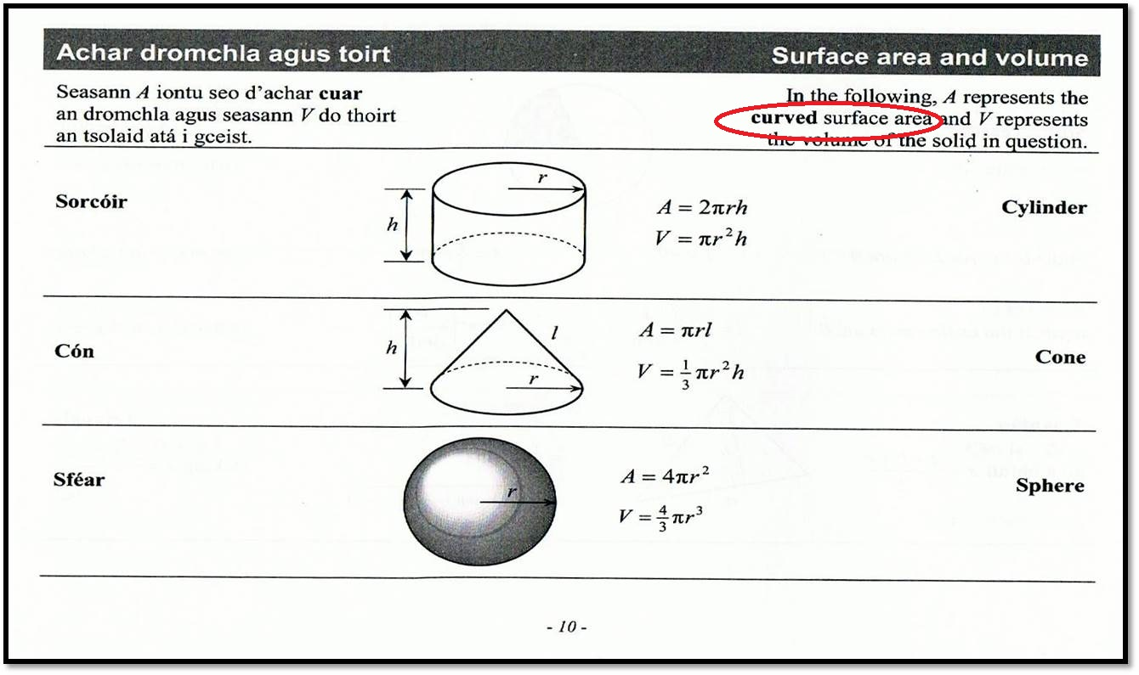
Summary
The understandings we gained regarding students’ learning as a result of being involved in the research lesson:
The time needed to teach this topic effectively.
Students can derive the formulas for surface area more effectively after studying nets.
Nets enable students to differentiate between Total Surface Area and Curved Surface Area.

Slide 24
Summary
What did we learn about this content to ensure we had a strong conceptual understanding of this topic?
The need for a hands-on approach to this topic.
How useful the concept of nets is for the understanding of surface area.
The need to start with basic nets before moving to nets involving scale.

Slide 25
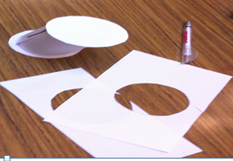
Teaching Strategies
What did I notice about my own teaching?
What was difficult?
Do not intervene too quickly.
Let other students help with misconceptions.

Slide 26
Teaching Strategies
Was it difficult to facilitate and sustain communication and collaboration during the lesson?
Students working in groups, and comments like:
“You can do it this way; no, also this way; or, how about this way?”
“We are missing a top(lid).”

Slide 27
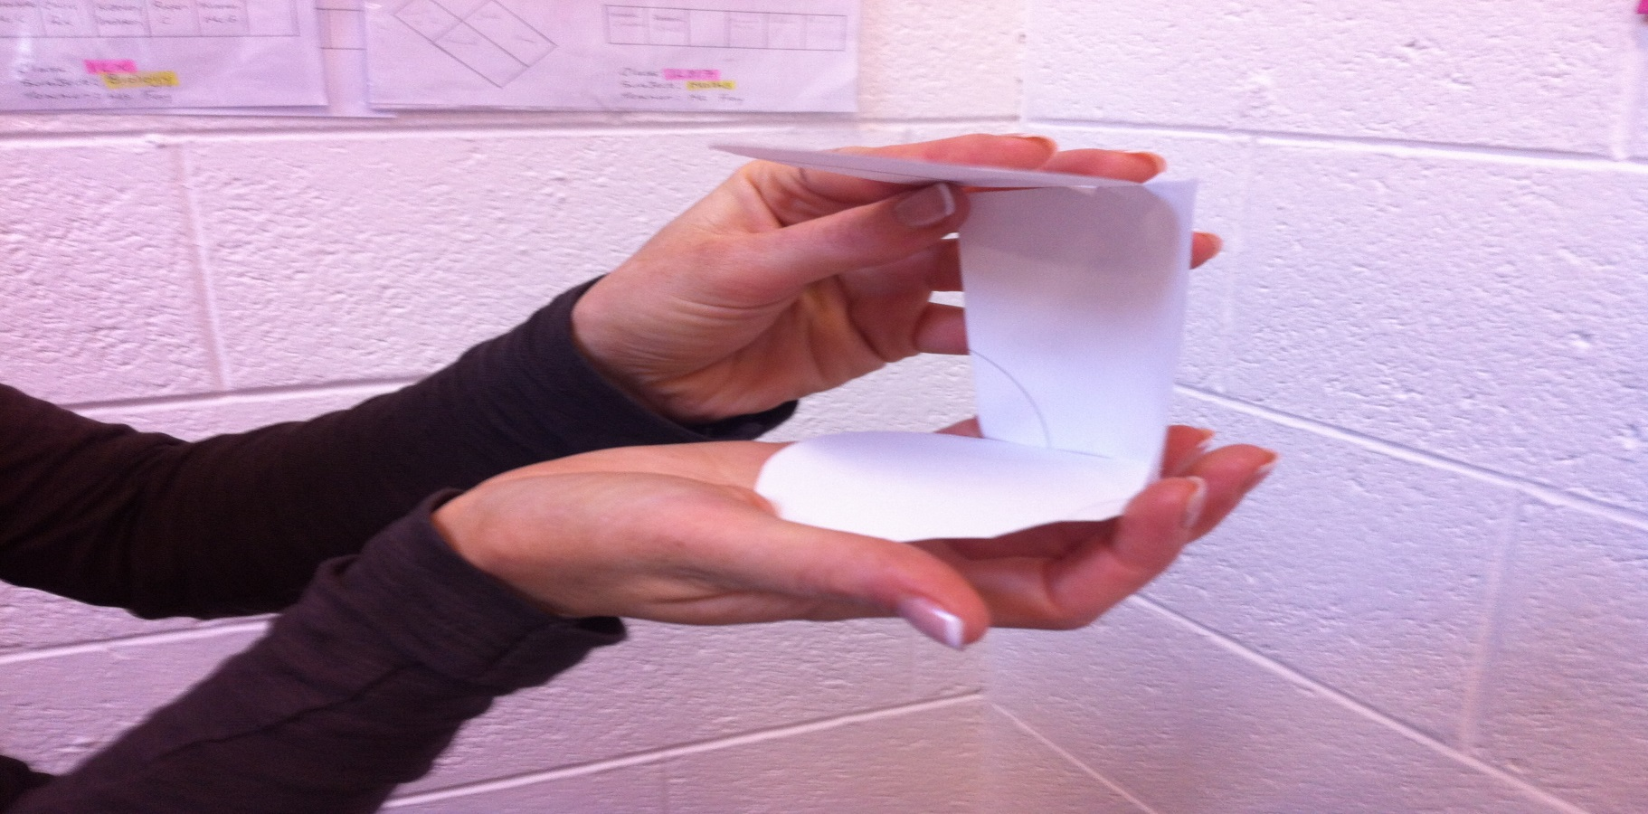
Teaching Strategies
Was it difficult to ask questions to provoke students’ deep thinking?
Encouraged students to fold their 2D shapes to 3D and discuss why some did not work.
Can now visualise, which measurements need to be adjusted.

Slide 28
Teaching Strategies
How did I engage and sustain students’ interest and attention during the lesson?
Progressed through the shapes, from cube to cuboid to cylinder.

Slide 29
Teaching Strategies
How did I assess what students knew and understood during the lesson?
Shapes showed their progress from 2D to 3D.
I listened to discussions during the class.
I ensured all students participated in their groups.
All students were first asked to draw a rough sketch individually.
Appropriate observation during the class and encouragement to progress through the shapes.

Slide 30
Teaching Strategies
How did I put closure to the lesson?
Students demonstrated their shapes.
What understandings have I developed regarding teaching strategies for this topic as a result of my involvement in Lesson Study?
No option but to use a hands-on, discovery learning approach for this topic.

Slide 31
Teaching Strategies
What changes would I make in the future, based on what I have learned in my teaching, to address students’ misconceptions?
Select groups with a mix of abilities.

Slide 32
Reflections on Lesson Study Process
Strengths & Weaknesses
As a mathematics team how has Lesson Study impacted on the way we work with other colleagues?
Always co-operate as a team but:
Advantages of seeing another teacher’s style in the classroom.
Having an opportunity to observe students in the classroom without the responsibility.

Slide 33
Reflections on Lesson Study Process
Strengths & Weaknesses
Personally, how has Lesson Study supported my growth as a teacher?
It encouraged me to use a practical approach, where possible, in maths classes.
Staff discussions need to be about methodologies and sharing ideas, not just about planning.
Recommendations as to how Lesson Study could be integrated into a school context.
Cross-curricular discussions; for example, nets are called developments in Technical Graphics.

