Slide 1

1st Year Maths

Slide 2

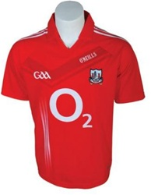

Shops buy goods from suppliers at cost price.
COST PRICE: €40

Slide 3
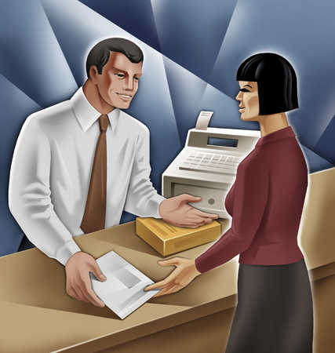

Cummins Sports then sell the good to the consumer at a higher price. This is known as the selling price.
THE DIFFERENCE BETWEEN THE COST PRICE AND THE SELLING PRICE IS CALLED PROFIT

Slide 4

Question: How much profit did Cummins Sports make on the jersey?
Answer: €20
Companies express the profit they make in percentage figures rather than in money.
This is known as a percentage profit or it can also be a percentage loss.
Question: What type of situation would a shop have a percentage loss?

Slide 5



PERCENTAGE PROFIT (OR LOSS) =

Slide 6



Q: What percentage profit did Cummins Sports make on selling the Cork jersey?
Cost Price: €40
Selling Price: €60
Profit: €20
Percentage Profit =
Percentage Profit =

Slide 7

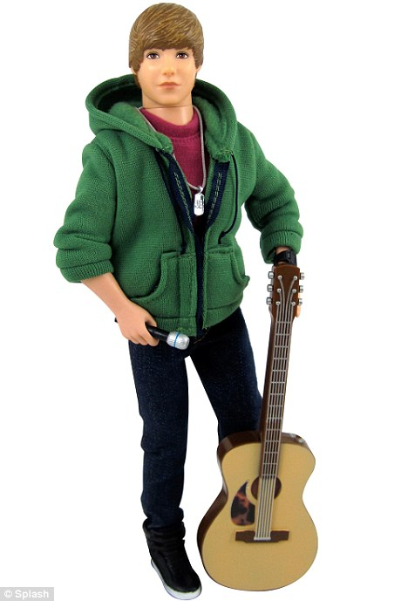
A shop buys Justin Bieber figures in boxes of 50 units.
The shop purchases 10 boxes of dolls.
The total cost of purchasing the 10 boxes was €6000.
Each doll was sold at a price of €15
Q: Find the following:
Cost Price of each doll
The profit made on each doll.
The profit percentage made on each doll.

Slide 8

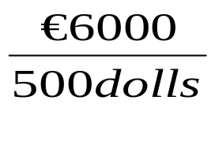
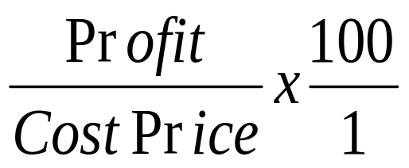
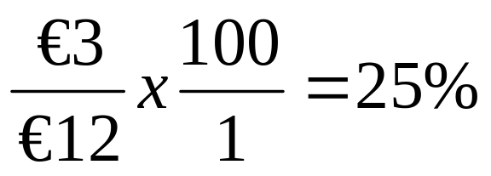
(i) Cost Price =
Cost Price = €12 per doll
(ii) Profit = €15 - €12 = €3 profit on each doll
(iii) Profit Percentage =
=

Slide 9

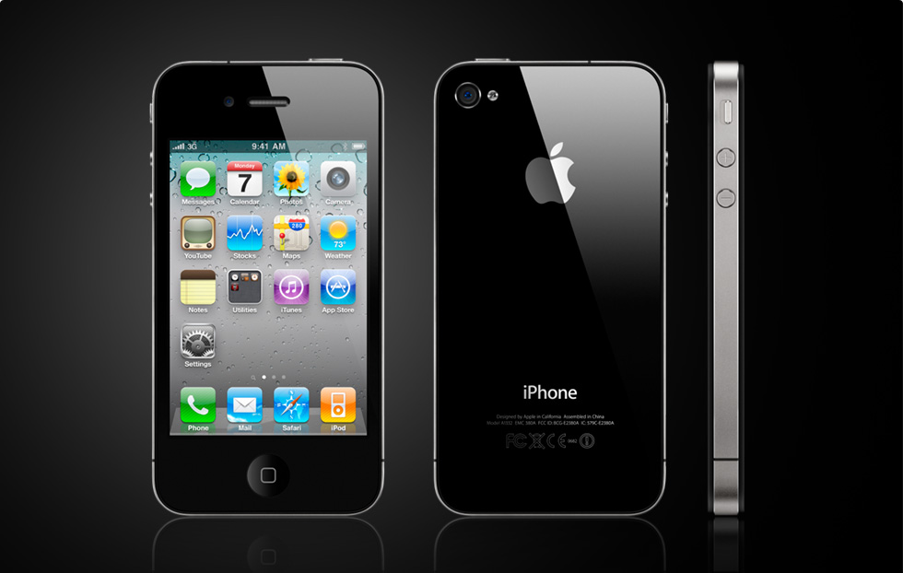
The Carphone Warehouse bought 50 iPhone 4S @ €400 each.
They sold 40 of them at the marked price of €600.
The remaining were sold during a sale at a discount of 10%.
Questions:
How much was paid for the 50 iPhones?
Find the selling price of each of the iPhones during the sale.
Find the total profit on selling the 50 iPhones.
Find the percentage profit made.

Slide 10
REMEMBER
COST PRICE = 100%
ALWAYS WORK FROM THERE

Slide 11
REMEMBER
Percentage Profit (or loss) =

Slide 12
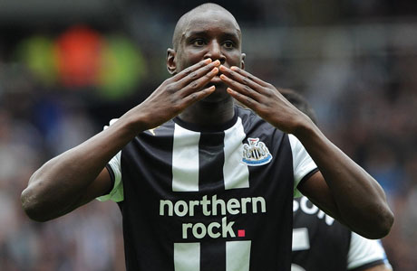
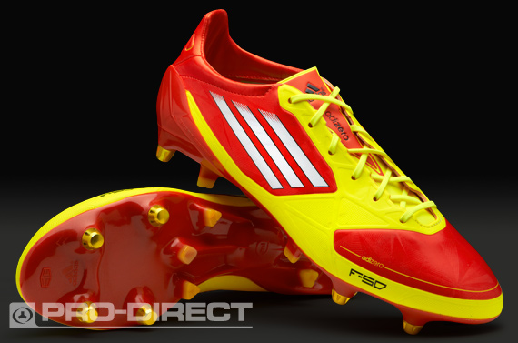
Newcastle Football Player Demba Ba wears Adidas F50 adiZero Football Boots.
The selling price of these football boots are €180.
This selling price includes a profit of 20%.
Questions:
Find the cost price of the football boots.
Find the percentage profit made if the boots were sold at €165.

Slide 13
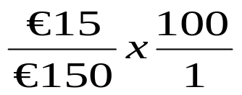
120% = €180
1% = €180/120
1% = €1.50
100% (Cost Price) = €150
Boots Sold @ €65
Percentage Profit =
Percentage Profit =
Percentage Profit = 10%

Slide 14



Pennys are having a huge sale to clear some old stock from last year.
A pair of shoes are being sold at €3.60
When selling at this price Pennys make a loss of 10%.
Questions:
Find the cost price of the shoes.
Find the percentage loss if Pennys discount the shoes by a further 10%.

Slide 15

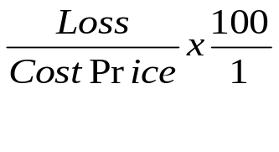
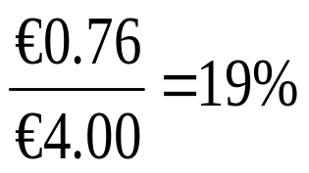
Selling Price = €3.60 (10% Loss)
90% = €3.60
1% = €0.04 (4 cents)
100% (Cost Price) = €4.00
€3.60 – 10%
€3.60 - €0.36 = €3.24 (New Selling Price)
Total Loss = €4.00 - €3.24 = €0.76
Percentage Loss =
Percentage Loss =

