Slide 2



Diving into Mastery Guidance for Educators
Each activity sheet is split into three sections, diving, deeper and deepest, which are represented by the following icons:
These carefully designed activities take your children through a learning journey, initially ensuring they are fluent with the key concept being taught; then applying this to a range of reasoning and problem-solving activities.
These sheets might not necessarily be used in a linear way. Some children might begin at the ‘Deeper’ section and in fact, others may ‘dive straight in’ to the ‘Deepest’ section if they have already mastered the skill and are applying this to show their depth of understanding.
Diving
Deeper
Deepest

Slide 3
Aim
Multiply and divide whole numbers and those involving decimals by 10, 100 and 1000.

Slide 4
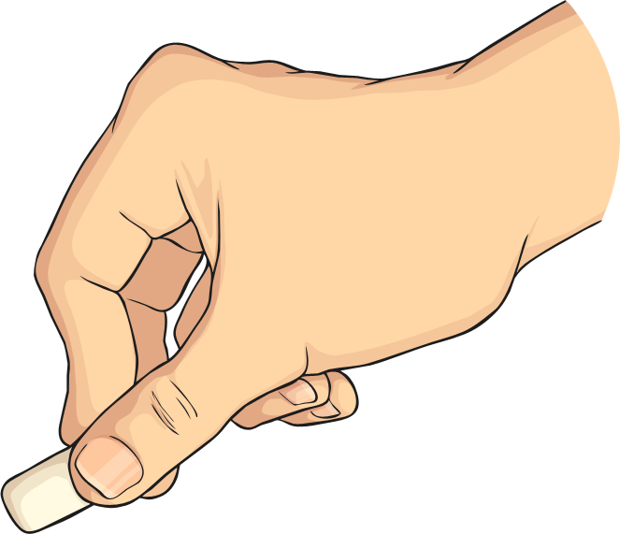

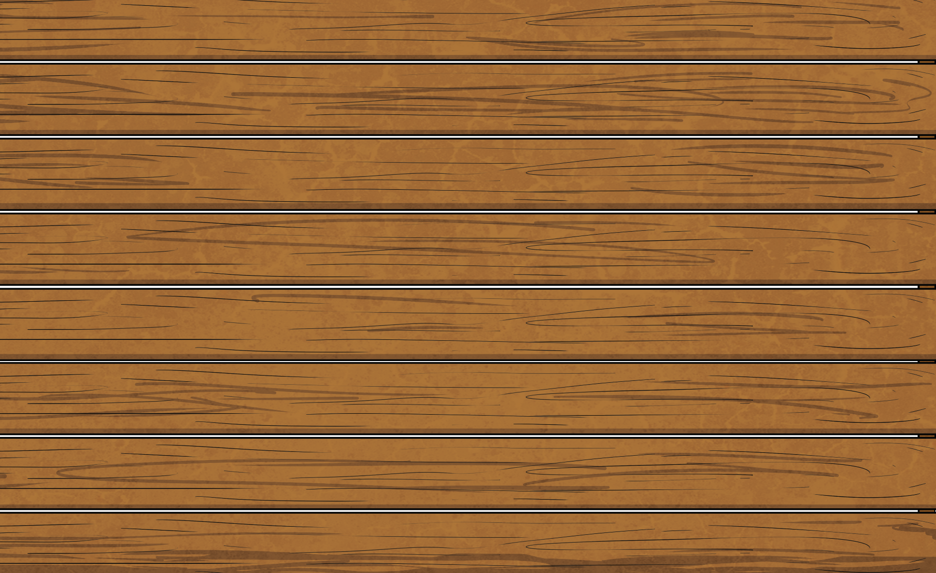

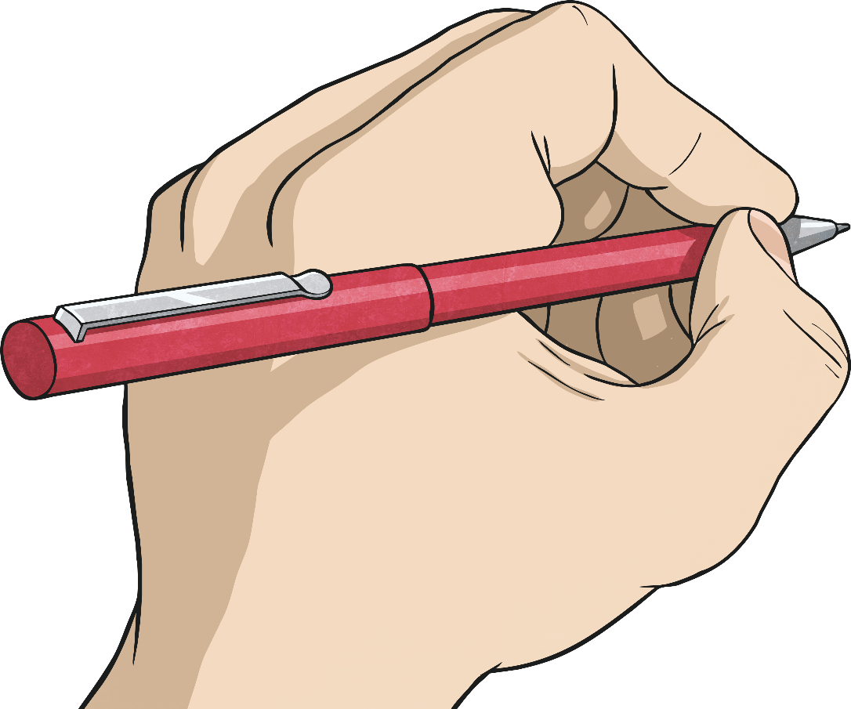
Multiplying Decimals by 10, 100 and 1000.
Diving
What is the answer when 2.34 is multiplied by 100?
hundreds | tens | ones | tenths | hundredths | thousandths
2
3
4
23.4
234
2340
23
234

Slide 5
Multiplying Decimals by 10, 100 and 1000.
Diving
What is the answer when 0.056 is multiplied by 10?
1.102 × 100 =
1201
hundreds | tens | ones | tenths | hundredths | thousandths
0
0
5
6
110.2 × 10 =
1102
0.056
056
0.56
1.201 × 1000 =
0.56
56
0.56
110.2

Slide 6
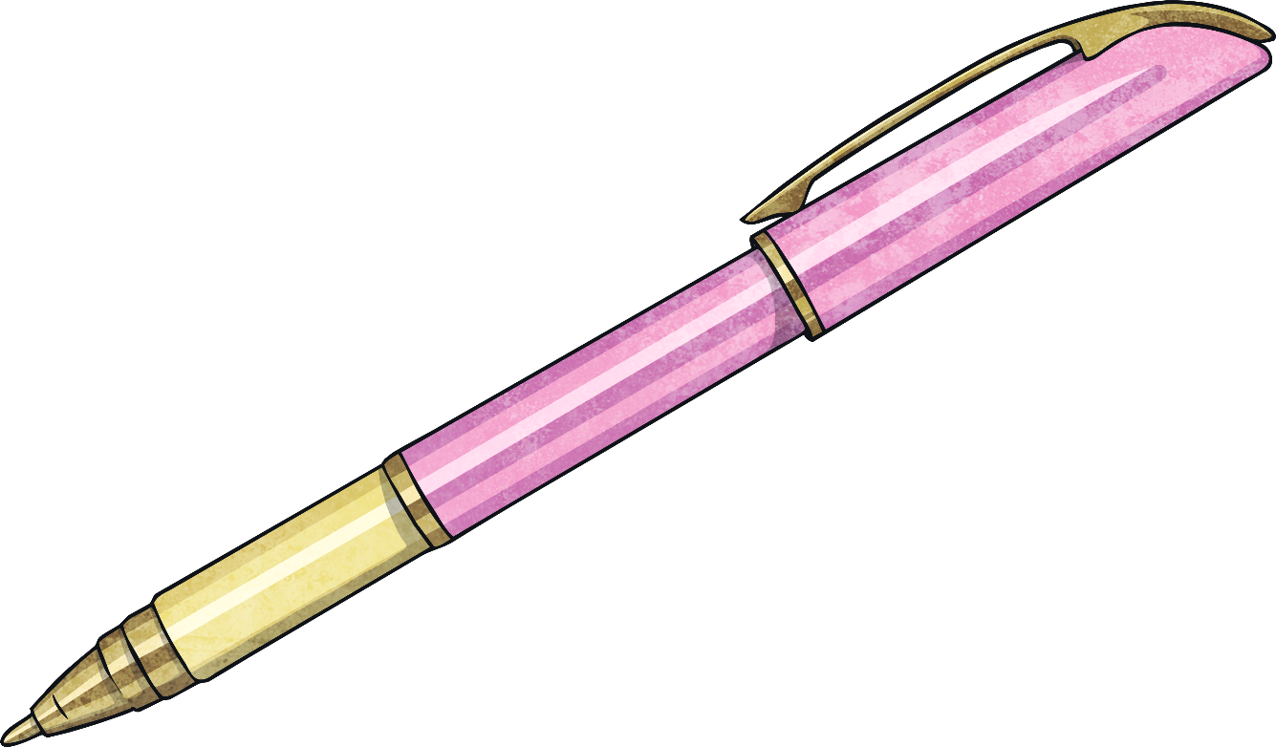
Multiplying Decimals by 10, 100 and 1000.
Diving
Match each calculation to the correct answer.
1.102 × 100 =
1201
110.2 × 10 =
1102
1.201 × 1000 =
110.2

Slide 7

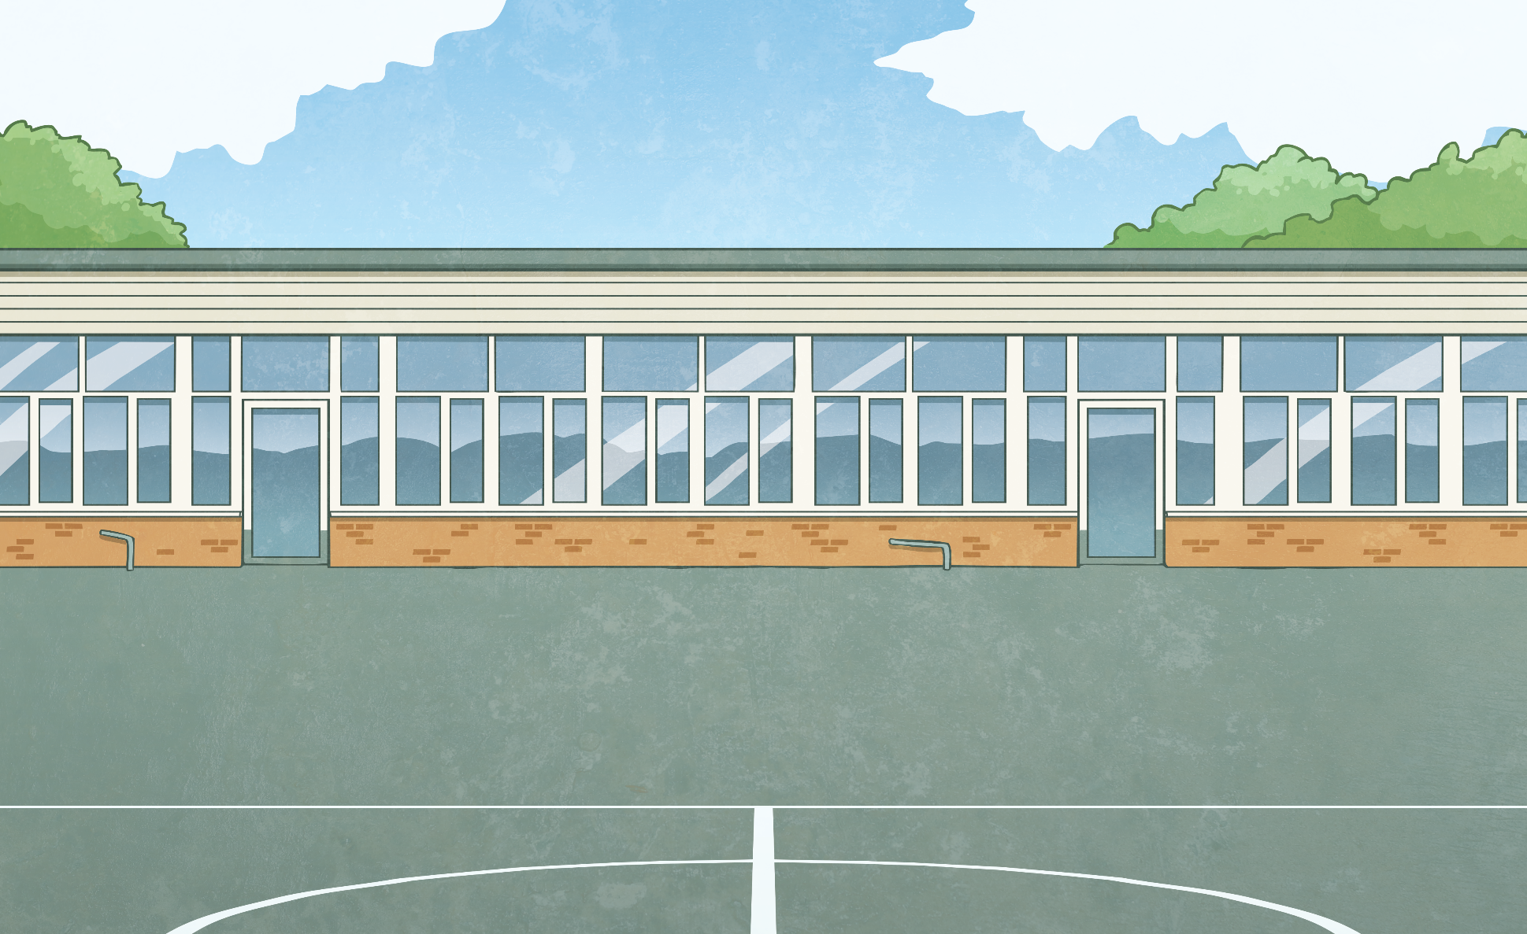
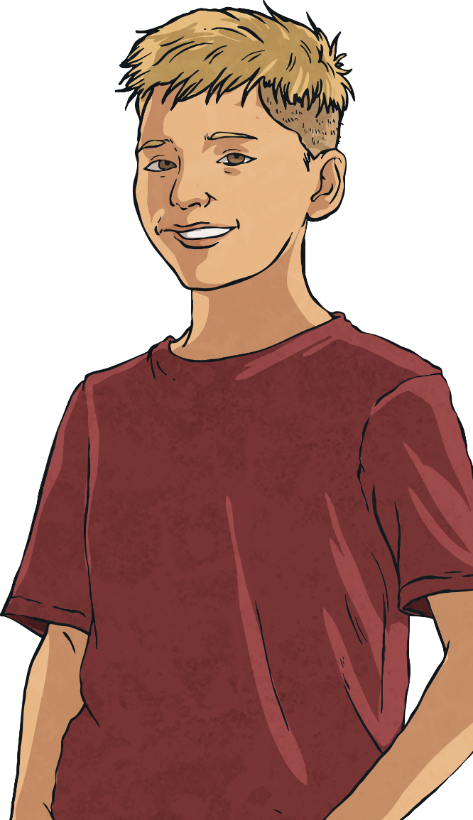
Multiplying Decimals by 10, 100 and 1000.
Deeper
You only ever need to add a zero when multiplying by 10.
Do you agree with Ben? Explain your answer.
Ben is incorrect.
Although 235 × 10 requires ‘adding’ a zero to the end to give you 2350, this does not necessarily work with decimals:
1.34 × 10 = 13.4
1.34 × 10 ≠ 1.340

Slide 8
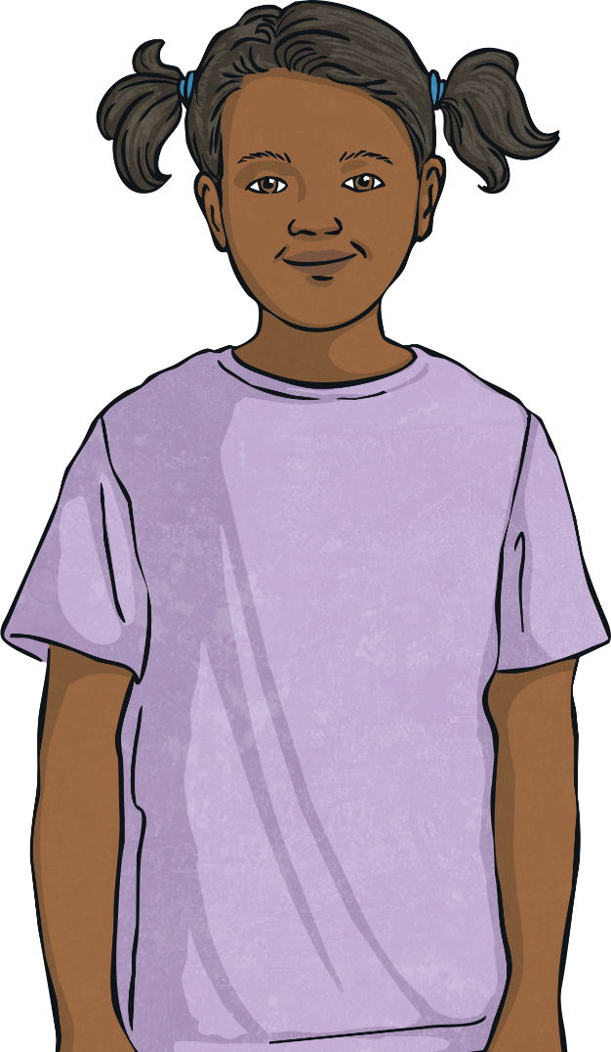
Multiplying Decimals by 10, 100 and 1000.
Deeper
Multiplying by 100 is the same as multiplying by 10 and then by another 10.
Do you agree with Simran? Explain your answer.
Simran is correct.
10 × 10 is 100 so multiplying by 100 is the same as multiplying by 10 twice.

Slide 9
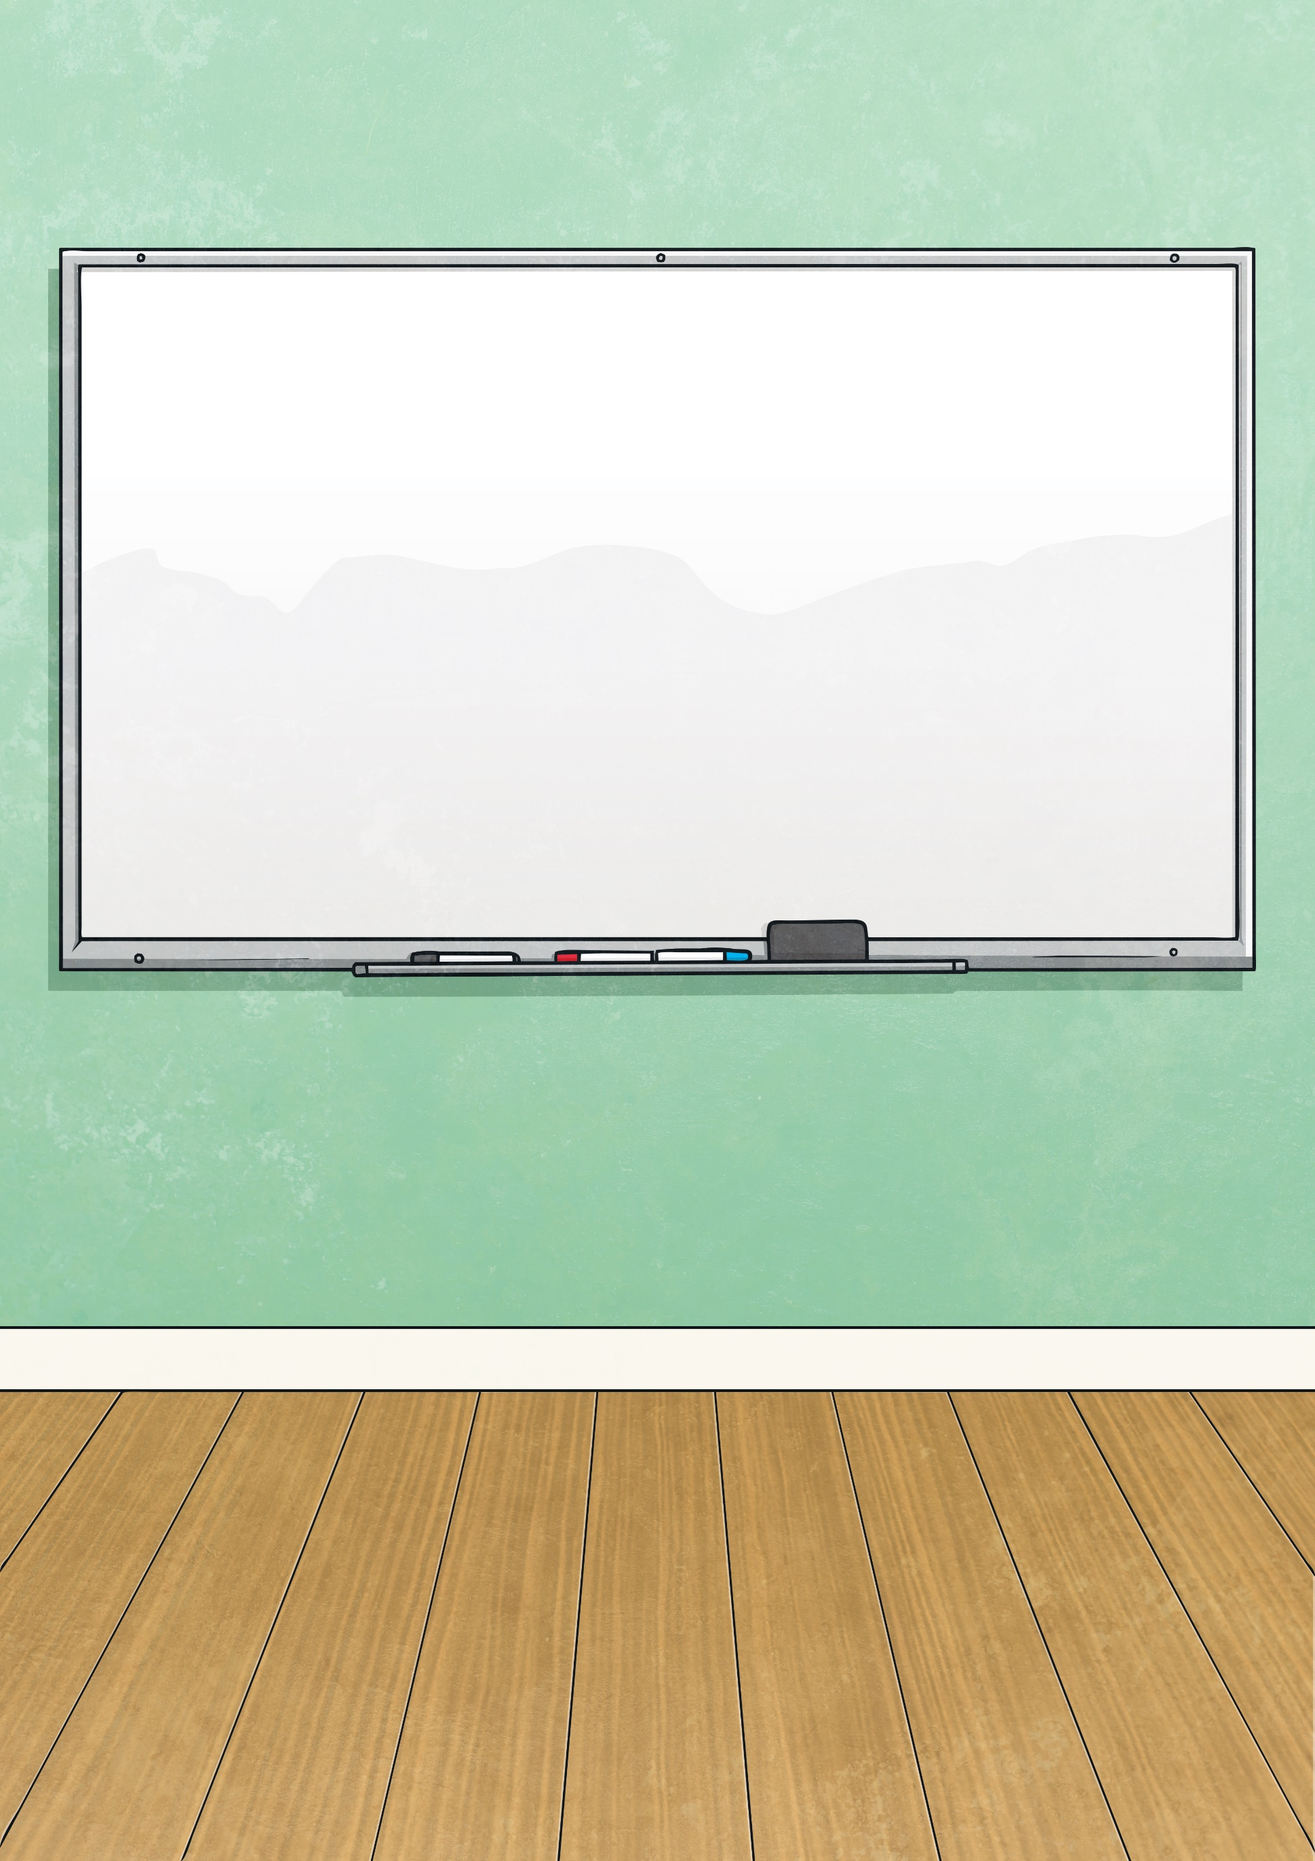
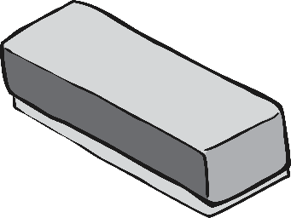

Multiplying Decimals by 10, 100 and 1000.
Deeper
Complete the calculation. Explain your answer.
10
5.06 × 100 × = 5060
÷ 10 ÷ 10 = 3.412
5.06 × 100 = 506 506 × 10 = 5060
5.06 × 100 × 10 = 5060

Slide 10
Multiplying Decimals by 10, 100 and 1000.
Deeper
Complete the calculation. Explain your answer.
3.412
÷ 10 ÷ 10 = 3.412
We can find the answer using the inverse of division which is multiplication.
3.412 × 10 × 10 = 341.2
Therefore:
341.2 ÷ 10 ÷ 10 = 3.412

Slide 11

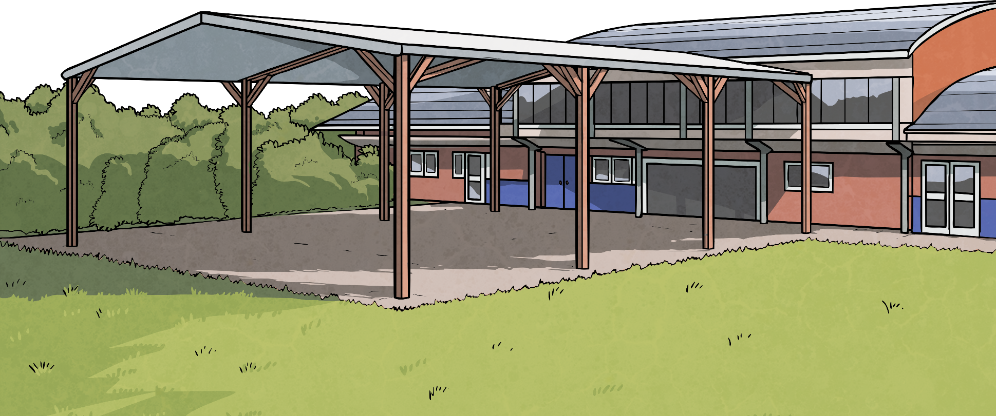
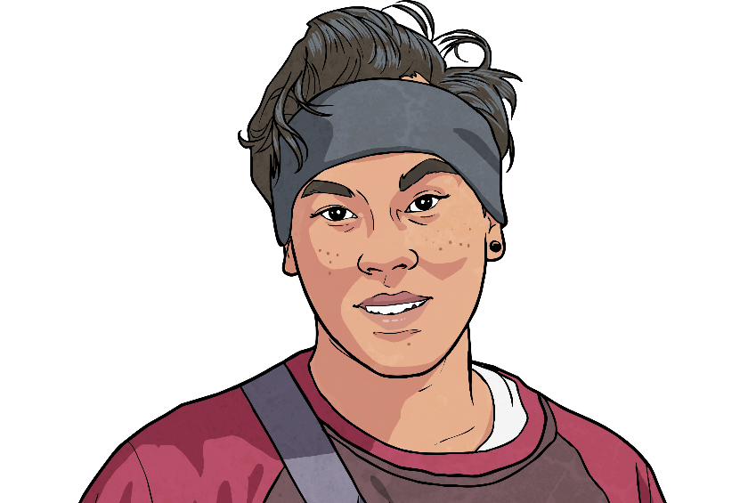
Multiplying Decimals by 10, 100 and 1000.
Deepest
394.569 is multiplied by 100 and then by 10.
One 9 will now be in the ten thousands column and the other 9 will be in the tenths column.
Do you agree with Raz? Explain fully.
394.569 × 100 × 10 = 394 569
Raz is incorrect. One 9 is in the ten thousands column and the other nine is in the ones column.

Slide 12
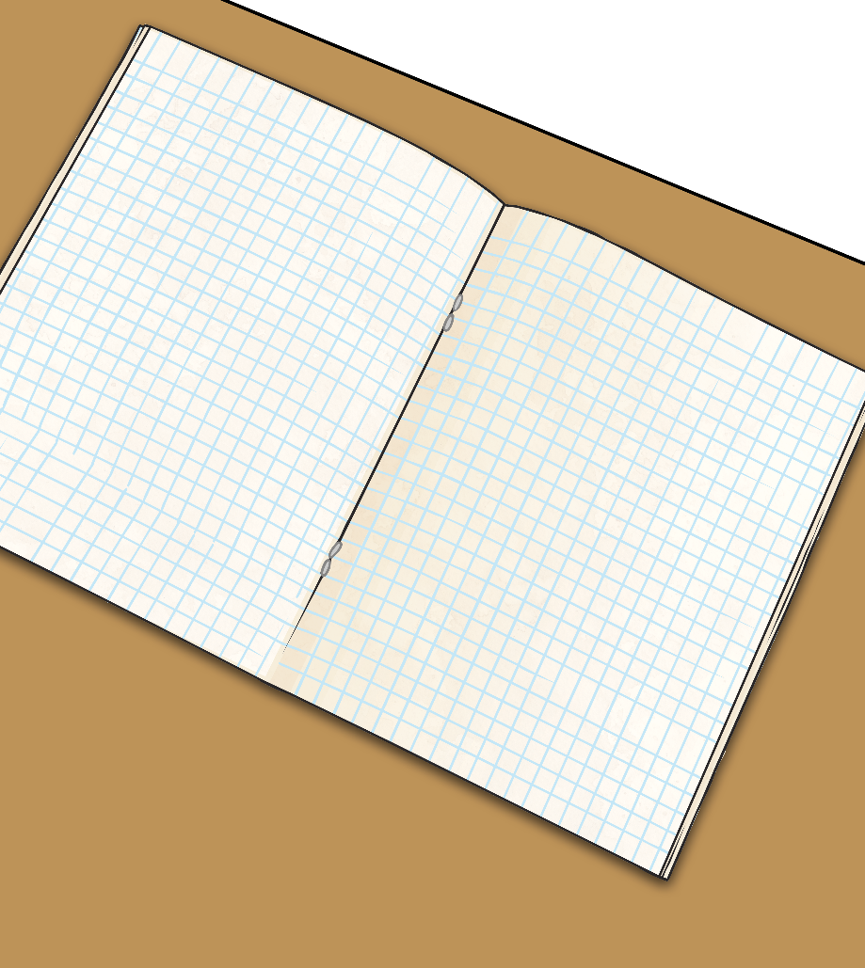
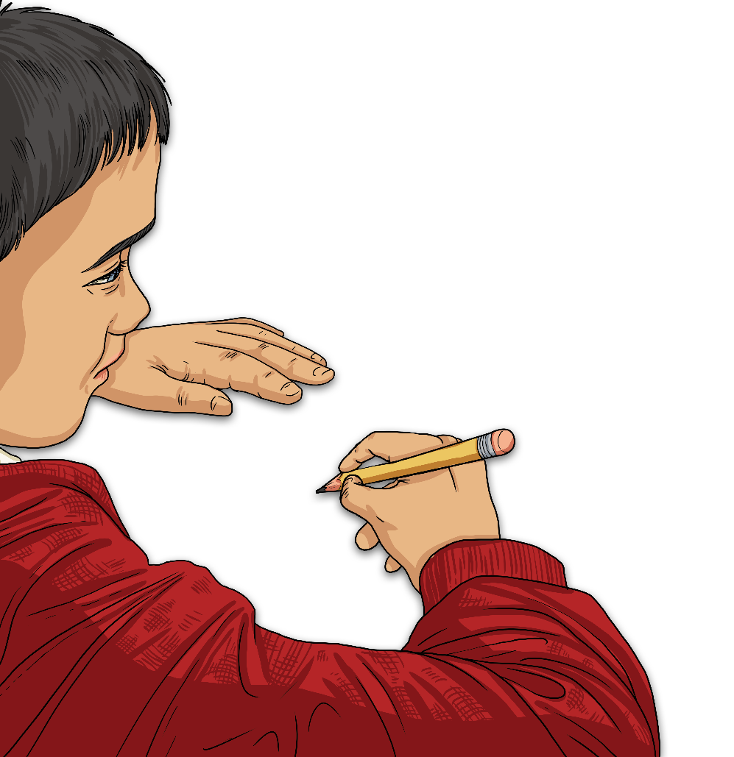
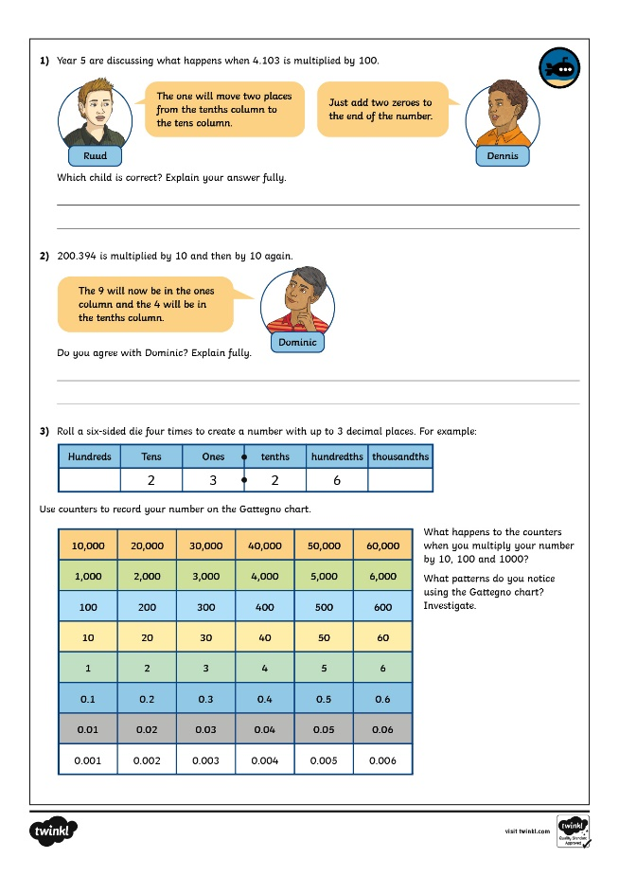
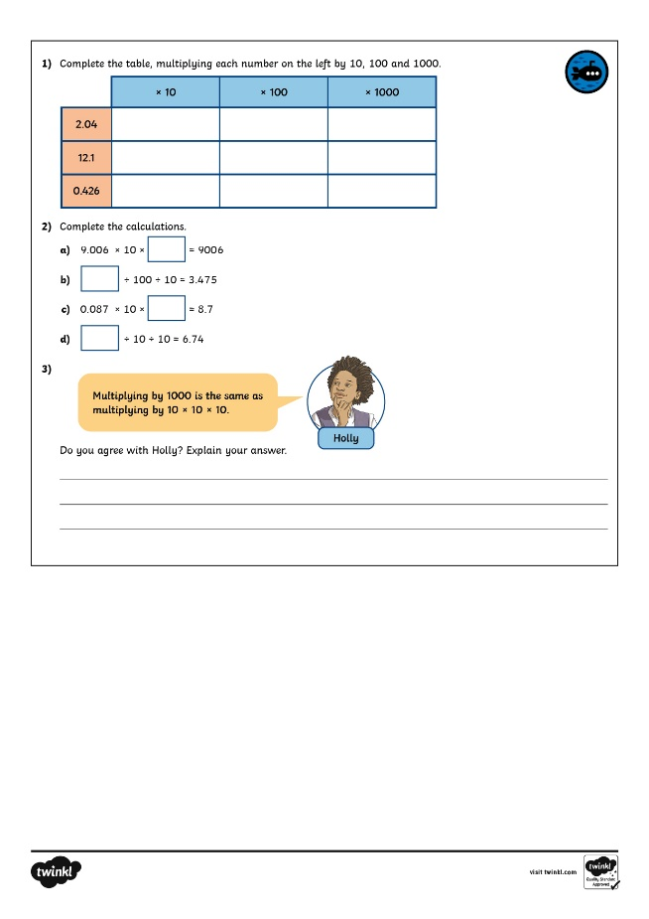
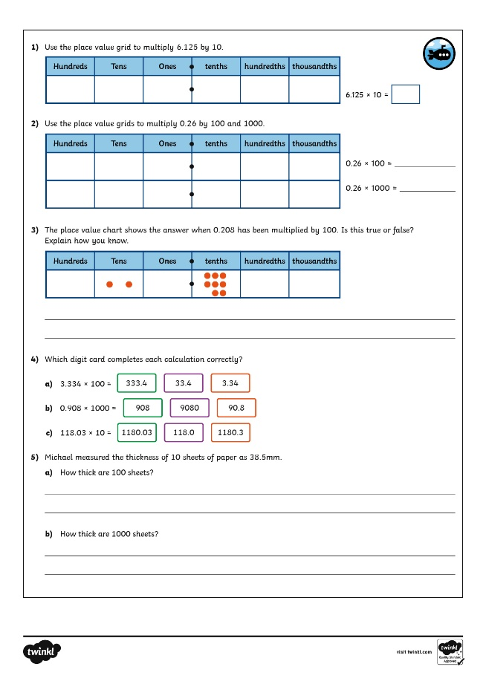

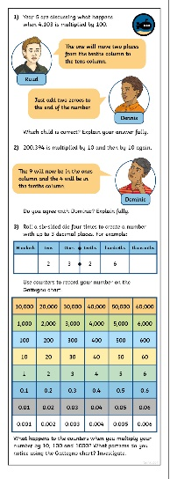
Multiplying Decimals by 10, 100 and 1000.
Dive in by completing your own activity!

Slide 13
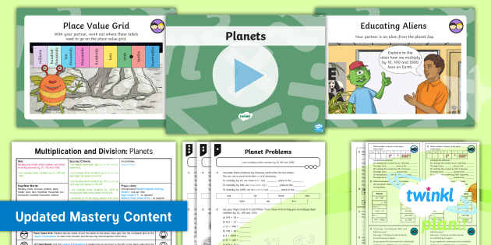
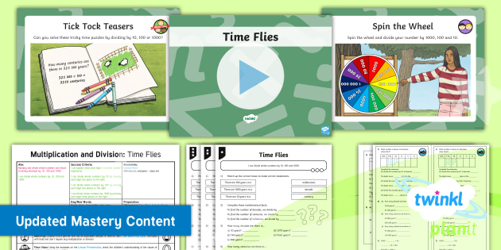

Need Planning to Complement this Resource?
National Curriculum Aim
Multiply and divide whole numbers and those involving decimals by 10, 100 and 1000.
For more planning resources to support this aim, click here.
Twinkl PlanIt is our award-winning scheme of work with over 4000 resources.

