Slide 2



Diving into Mastery Guidance for Educators
Each activity sheet is split into three sections, diving, deeper and deepest, which are represented by the following icons:
These carefully designed activities take your children through a learning journey, initially ensuring they are fluent with the key concept being taught; then applying this to a range of reasoning and problem-solving activities.
These sheets might not necessarily be used in a linear way. Some children might begin at the ‘Deeper’ section and in fact, others may ‘dive straight in’ to the ‘Deepest’ section if they have already mastered the skill and are applying this to show their depth of understanding.
Diving
Deeper
Deepest

Slide 3
Aim
Solve addition and subtraction multi-step problems in contexts, deciding which operations and methods to use and why.

Slide 4
Add and Subtract Integers
Diving
Give the missing digits in these addition and subtraction calculations.
 | 8 | 4 | 3 | 8 | 7 | 4
− | 3 |  | 1 | 9 | 4 | 5 | 8
 |  | 7 | 1 |  | 2 |  | 1
6
7
1
2
1
6
1
9
 |  | 6 | 2 | 4 | 7 |  | 4
+ |  |  | 9 |  | 5 | 4
 | 1 | 1 | 1 | 7 | 3 | 0 | 7
4
2
3
7
4
9
9
1
1
1

Slide 5


Add and Subtract Integers
Diving
A supermarket had £345 231 worth of stock. They sell £124 763 during the first week and £53 752 during the second week.
What is the value of the stock that is left over?
£124 763 + £53 752 = £178 515
£345 231 - £178 515 = £166 716
Jacob is saving up to buy a new games console and two new games. The games console costs £176.89. One of the games is £28.75 and the other is £31.58. He has manged to save £194.
How much more money does Jacob need to save before he can afford to buy the console and the games?
£176.89 + £28.75 + £31.58 = £237.22
£237.22 - £194 = £43.22

Slide 6




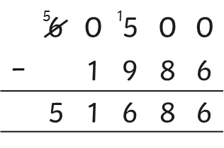




Add and Subtract Integers
Deeper
Three children are discussing the most efficient way to solve this question:
60 500 − 1986
Each child has made an error in their method. Click on each of the children to see their method. Explain the error that each child has made and how you would correct it.
Ciara
Oliver
Ruby
I think the most efficient way to solve 60 500 - 1986 is to use mental methods. I would take 2000 away from 60 500 and then add 14 back on. That would leave me with 57 514.
I think the best way to solve this calculation is to place it in columns and do column subtraction.
I would use mental methods to solve this question. I would take 500 from both the 1986 and the 60 500 so that I was left with 60 000 minus 1486. The answer to that subtraction is 58 614.
Ciara’s method is correct but when calculating, she has taken away 3000 from her number instead of 2000. This means that her answer is now 1000 too small.
Oliver has incorrectly exchanged between the ten thousands column and the hundreds column. He has also taken away a greater number from a smaller number in the ones, tens and hundreds columns instead of exchanging.
Ruby’s method is correct but she has miscalculated her final answer by making an error in the final subtraction. She has taken away 100 too many. The correct answer would be 58 514.
Answer
Answer
Answer

Slide 7
Add and Subtract Integers
Deeper
Correct the errors that have been made in this subtraction calculation.
 | 6 | 5 | 0 | 7 | 6 | 8 | 5
− | 1 | 3 | 2 | 8 | 3 | 9 | 4
 | 5 | 1 | 7 | 9 | 2 | 9 | 1
 | 6 | 5 | 0 | 7 | 6 | 8 | 5
− | 1 | 3 | 2 | 8 | 3 | 9 | 4
 | 5 | 1 | 2 | 9 | 3 | 1 | 1
9
4
1
4
1
1
5
1

Slide 8

Add and Subtract Integers
Deepest
Use this bar model and the clues below to find the possible values of A and B.
A | B
1 550 000
A
B
It is between 800 000 and 900 000.
It is a multiple of 2.
It has a digit total of 20.
It has 9 thousands.
It has a digit total less than 40.
It is an even number.
A variety of answers are possible, such as:
A = 820 028 and B = 729 972
A = 820 046 and B= 729 954
A = 820 244 and B = 729 756

Slide 9


Add and Subtract Integers
Deepest
Using any of the digits 1-9, can you make the given target number using addition? You may use each digit only twice.
1 | 4 | 3 | 7
+
2 | 8 | 9 | 5
=
4 | 3 | 3 | 2

Slide 10
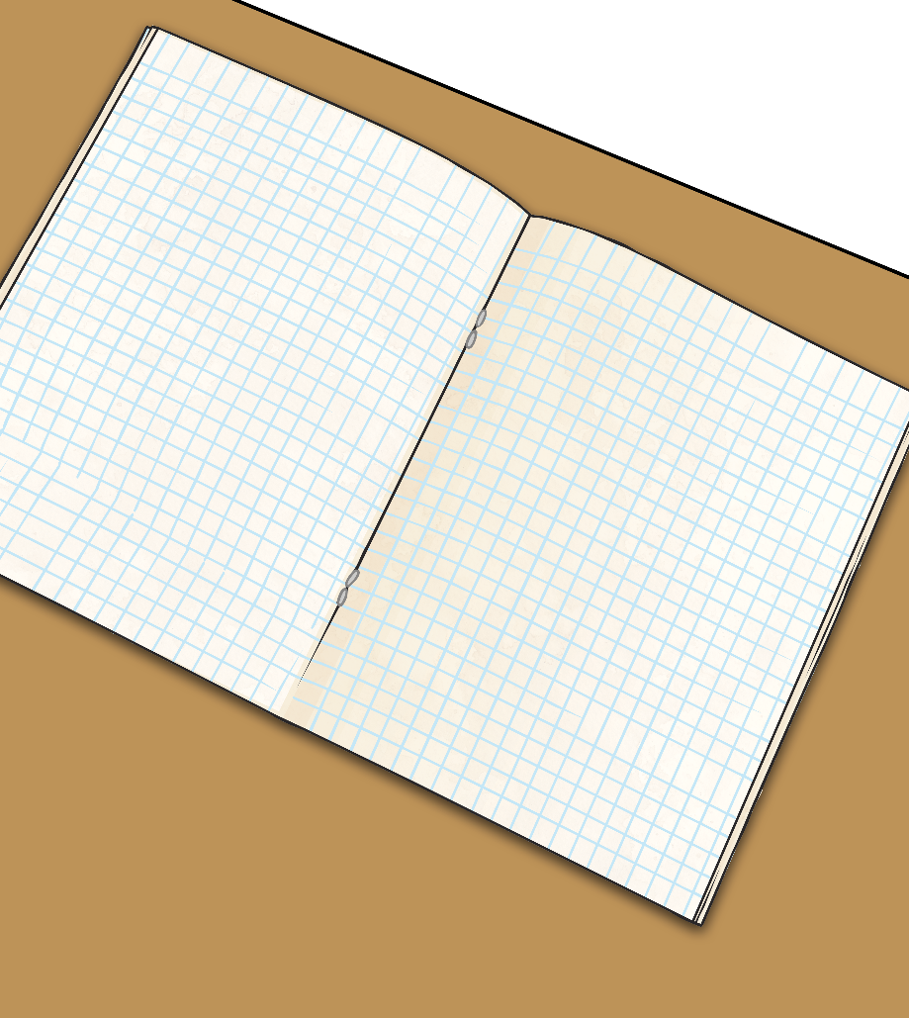

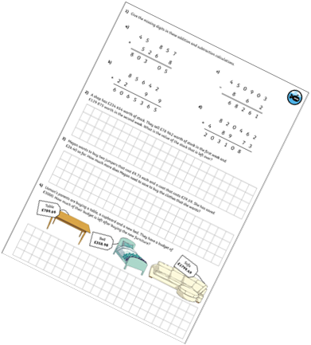
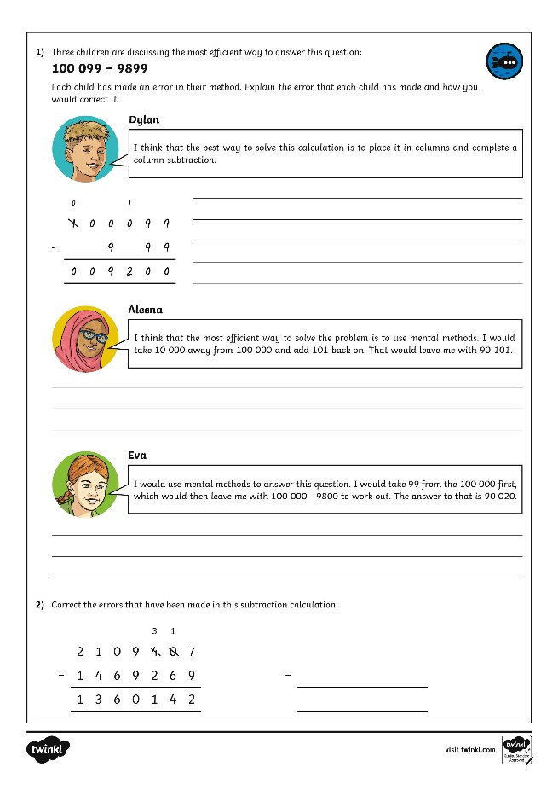
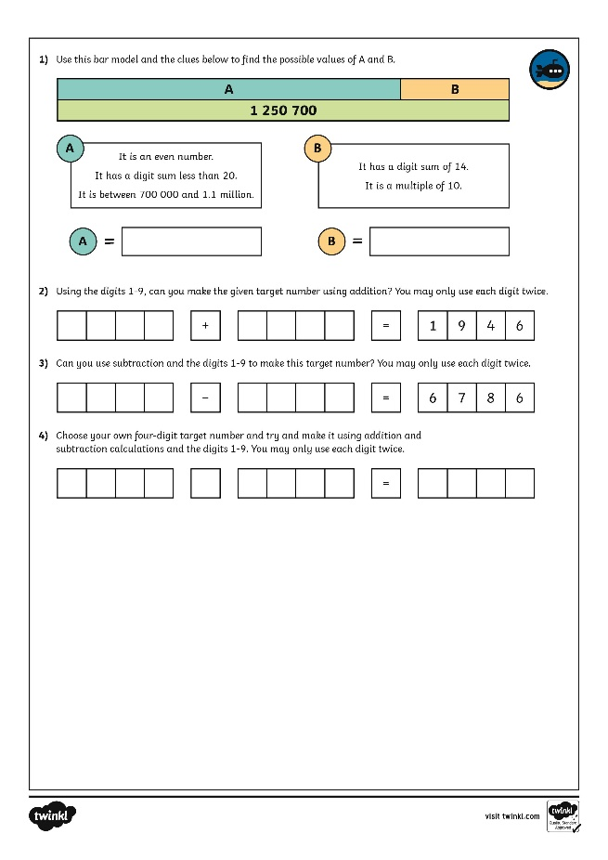
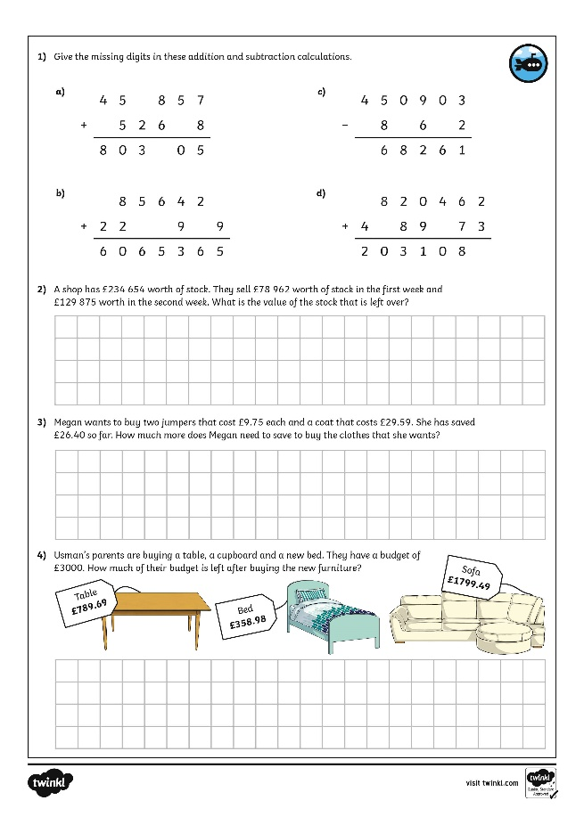
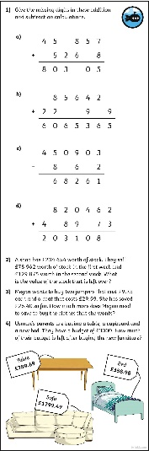
Add and Subtract Integers
Dive in by completing your own activity!

Slide 11
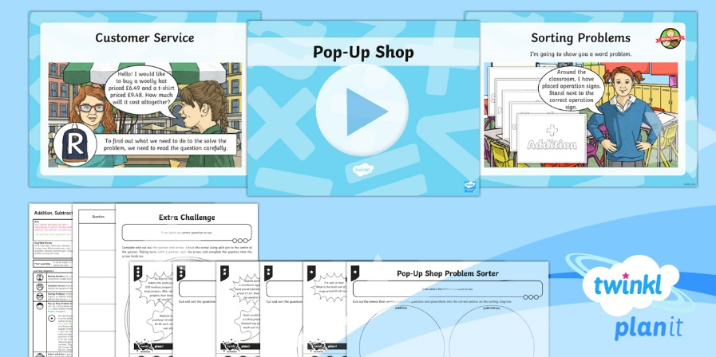
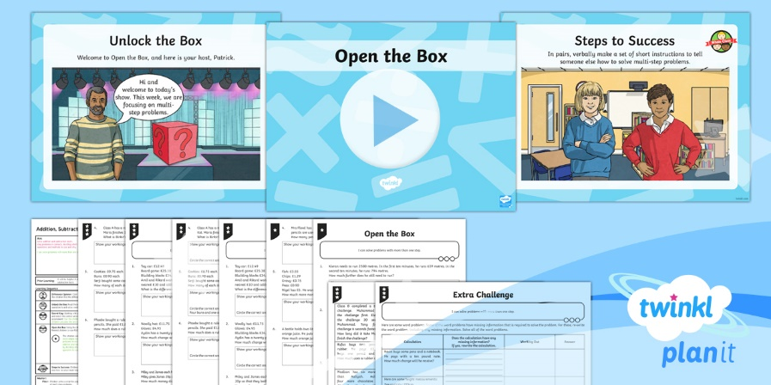

Need Planning to Complement this Resource?
National Curriculum Aim
Solve addition and subtraction multi-step problems in contexts, deciding which operations and methods to use and why.
For more planning resources to support this aim, click here.
Twinkl PlanIt is our award-winning scheme of work with over 4000 resources.

