Slide 1

Developing the Formula for the Volume of a Sphere

Slide 2
Volume of a Sphere
Using relational solids and pouring material we noted that the volume of a cone is the same as the volume of a hemisphere (with corresponding dimensions)
Using “math language” Volume (cone) = ½ Volume (sphere)
Therefore 2(Volume (cone)) = Volume (sphere)
OR
=
+

Slide 3
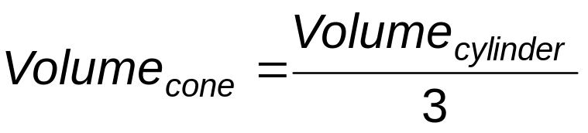
Volume of a Sphere
We already know the formula for the volume of a cone.
OR
=
÷ 3

Slide 4
Volume of a Sphere
AND we know the formula for the volume of a cylinder
Height
BASE

Slide 5
Volume of a Sphere
SUMMARIZING:
Volume (cylinder) = (Area Base) (height)
Volume (cone) = Volume (cylinder) /3
Volume (cone) = (Area Base) (height)/3
AND 2(Volume (cone)) = Volume (sphere)
=
÷ 3
2 X
=

Slide 6
Volume of a Sphere
2(Volume (cone)) = Volume (sphere)
2( ) (height) /3= Volume (sphere)
2( )(h)/3= Volume (sphere)
BUT h = 2r
2(πr²)(2r)/3 = Volume_{(sphere)}
4(πr³)/3 = Volume_{(sphere)}
2 X
=
Area of Base
πr²
r
h
r

Slide 7
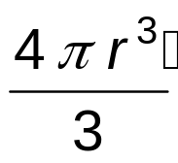
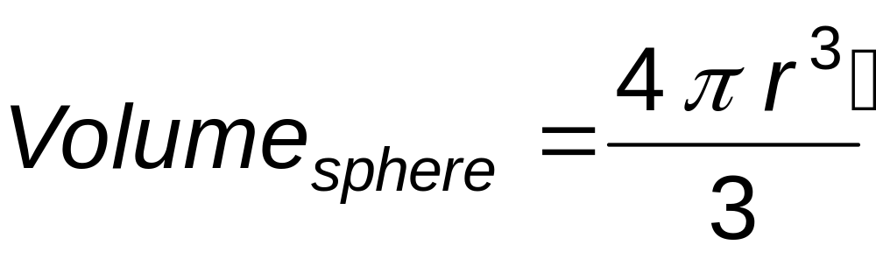
Volume of a Sphere

