Slide 2
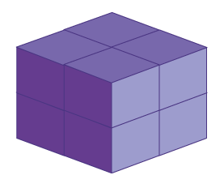

Question 1
What is the volume of the shape?
Reveal the Answer
8 cubic units

Slide 3
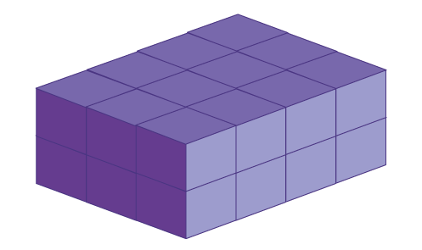
Question 2
What is the volume of the shape?
Reveal the Answer
24 cubic units

Slide 4
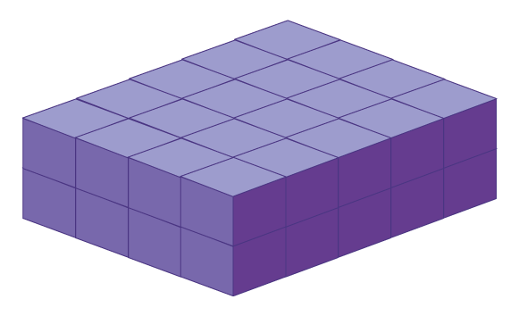
Question 3
What is the volume of the shape?
Reveal the Answer
40 cubic units

Slide 5
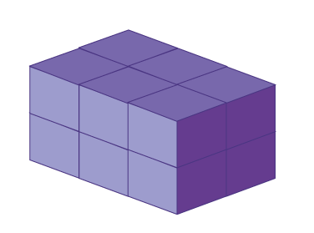
Question 4
What is the volume of the shape?
Reveal the Answer
12 cubic units

Slide 6
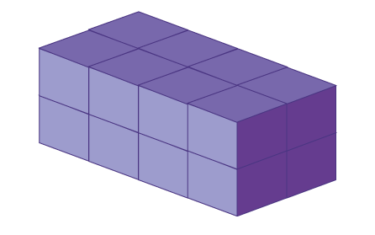
Question 5
What is the volume of the shape?
Reveal the Answer
16 cubic units

Slide 7
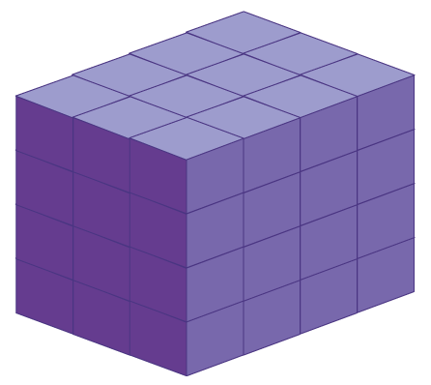
Question 6
What is the volume of the shape?
Reveal the Answer
48 cubic units

Slide 8
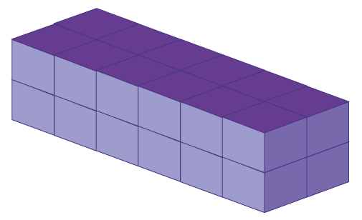
Question 7
What is the volume of the shape?
Reveal the Answer
24 cubic units

Slide 9
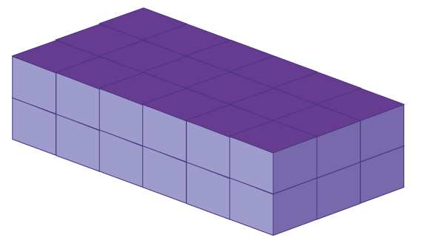
Question 8
What is the volume of the shape?
Reveal the Answer
36 cubic units

Slide 10
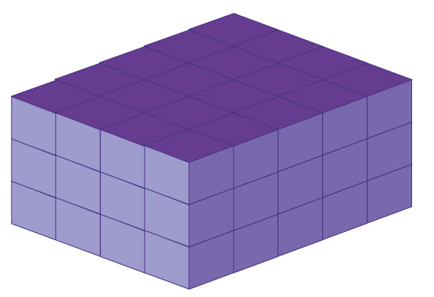
Question 9
What is the volume of the shape?
Reveal the Answer
60 cubic units

Slide 11
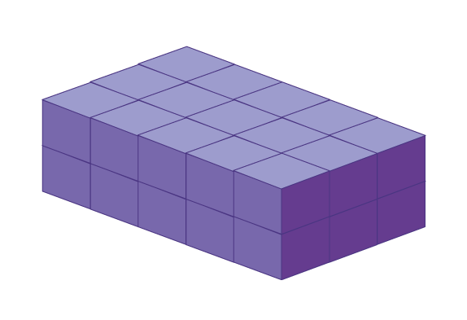
Question 10
What is the volume of the shape?
Reveal the Answer
30 cubic units

