Slide 1

Volume of Cones and Cylinders
A) Find the volume of the following cylinders, give the volume to 3 significant figures
9cm
8cm
10cm
14cm
10cm
12cm
14cm
19cm
V=________cm³
V=________cm³
V=________cm³
V=________cm³
8cm
7cm
9cm
13cm
4cm
6cm
9cm
10cm
V=________cm³
V=________cm³
V=________cm³
V=________cm³
B) Find the volume of the following cones, give the volume to 2 decimal places
h=18cm
h=12cm
h=22cm
r=10cm
d=10cm
r=15cm
V=________cm³
V=________cm³
V=________cm³
h=16cm
h=14cm
h=15cm
d=22cm
r=7cm
d=12cm
V=________cm³
V=________cm³
V=________cm³

Slide 2
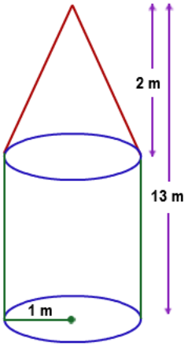
Extension
5m
Area of circle base=
Volume of cylinder=
Volume of cone=
Total volume=
15m
5m
6m
Area of circle base=
Volume of cylinder=
Volume of cone=
Total volume=
13m
9m
4m
Area of circle base=
Volume of cylinder=
Volume of cone=
Total volume=
11m
6m

