Slide 1
Volumes Of Solids.
5m
7cm
8m
5 cm
14cm
6cm
4cm
4cm
3cm
10cm

Slide 2
What Is Volume ?
The volume of a solid is the amount of space inside the solid.
Consider the cylinder below:
If we were to fill the cylinder with water the volume would be the amount of water the cylinder could hold:

Slide 3
Measuring Volume.
Volume is measured in cubic centimetres (also called centimetre cubed).
Here is a cubic centimetre
It is a cube which measures 1cm in all directions.
1cm
1cm
1cm
We will now see how to calculate the volume of various shapes.

Slide 4
Volumes Of Cuboids.
Look at the cuboid below:
4cm
3cm
10cm
We must first calculate the area of the base of the cuboid:
The base is a rectangle measuring 10cm by 3cm:
10cm
3cm

Slide 5
10cm
3cm
Area of a rectangle = length x breadth
Area = 10 x 3
Area = 30cm²
We now know we can place 30 centimetre squares on the base of the cuboid. But we can also place 30 cubic centimetres on the base:
4cm
3cm
10cm

Slide 6
4cm
3cm
10cm
We have now got to find how many layers of 1cm cubes we can place in the cuboid:
We can fit in 4 layers.
Volume = 30 x 4
Volume = 120cm³
That means that we can place 120 of our cubes measuring a centimetre in all directions inside our cuboid.

Slide 7
4cm
3cm
10cm
We have found that the volume of the cuboid is given by:
Volume = 10 x 3 x 4 = 120cm³
This gives us our formula for the volume of a cuboid:
Volume = Length x Breadth x Height
V=LBH for short.

Slide 8
What Goes In The Box ?
Calculate the volumes of the cuboids below:
(1)
(2)
7cm
3.4cm
5 cm
3.4cm
14cm
490cm³
3.4cm
39.3cm³
(3)
3.2m
2.7m
76.9 m³
8.9 m

Slide 9
The Cross Sectional Area.
When we calculated the volume of the cuboid :
4cm
3cm
10cm
We found the area of the base :
This is the Cross Sectional Area.
The Cross section is the shape that is repeated throughout the volume.
We then calculated how many layers of cross section made up the volume.
This gives us a formula for calculating other volumes:
Volume = Cross Sectional Area x Length.

Slide 10
For the solids below identify the cross sectional area required for calculating the volume:
(1)
(2)
Circle
Right Angled Triangle.
(4)
A2
(3)
A1
Pentagon
Rectangle & Semi Circle.

Slide 11
The Volume Of A Cylinder.
Consider the cylinder below:
It has a height of 6cm .
What is the size of the radius ?
2cm
6cm
Volume = cross section x height
What shape is the cross section?
Circle
Calculate the area of the circle:
A = ∏ r ²
4cm
A = 3.14 x 2 x 2
The formula for the volume of a cylinder is:
V = ∏ r ² h
r = radius h = height.
A = 12.56 cm²
Calculate the volume:
V = ∏ r ² x h
V = 12.56 x 6
V = 75.36 cm³

Slide 12
The Volume Of A Triangular Prism.
Consider the triangular prism below:
Volume = Cross Section x Height
What shape is the cross section ?
Triangle.
5cm
Calculate the area of the triangle:
A = ½ x base x height
A = 0.5 x 5 x 5
8cm
A = 12.5cm²
5cm
Calculate the volume:
Volume = Cross Section x Length
The formula for the volume of a triangular prism is :
V = ½ b h l
B= base h = height l = length
V = 12.5 x 8
V = 100 cm³

Slide 13
What Goes In The Box ? 2
Calculate the volume of the shapes below:
(1)
(2)
14cm
4m
5m
16cm
2813.4cm³
3m
(3)
30m³
8m
12cm
288cm³
6cm

Slide 14
More Complex Shapes.
Calculate the volume of the shape below:
12m
Calculate the volume:
Volume = Cross sectional area x length.
V = 256 x 23
V = 2888m³
16m
A1
A2
23m
20m
Calculate the cross sectional area:
Area = A1 + A2
Area = (12 x 16) + ( ½ x (20 –12) x 16)
Area = 192 + 64
Area = 256m²

Slide 15
Example 2.
Calculate the volume of the shape below:
A2
10cm
A1
Calculate the volume.
Volume = cross sectional area x Length
18cm
12cm
V = 176.52 x 18
Calculate the cross sectional area:
V = 3177.36cm³
Area = A1 + A2
Area = (12 x 10) + ( ½ x ∏ x 6 x 6 )
Area = 120 +56.52
Area = 176.52cm²

Slide 16
What Goes In The Box ? 3
11m
(1)
4466m³
14m
22m
(2)
18m
17cm
19156.2cm³
32cm
23cm

Slide 17
Volume Of A Cone.
Consider the cylinder and cone shown below:
D
D
The diameter (D) of the top of the cone and the cylinder are equal.
H
H
The height (H) of the cone and the cylinder are equal.
If you filled the cone with water and emptied it into the cylinder, how many times would you have to fill the cone to completely fill the cylinder to the top ?
3 times.
This shows that the cylinder has three times the volume of a cone with the same height and radius.

Slide 18
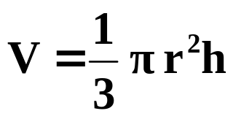
The experiment on the previous slide allows us to work out the formula for the volume of a cone:
The formula for the volume of a cylinder is :
V = ∏ r ² h
We have seen that the volume of a cylinder is three times more than that of a cone with the same diameter and height .
The formula for the volume of a cone is:
r
h
r = radius h = height

Slide 19
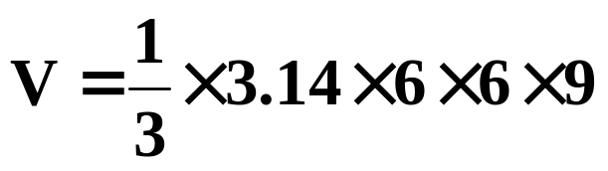
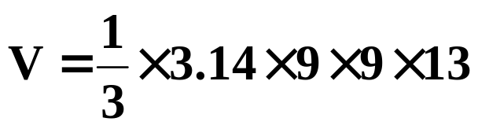
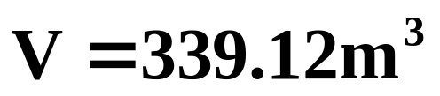
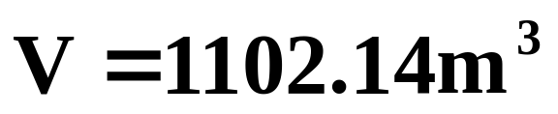
Calculate the volume of the cones below:
(1)
(2)
18m
6m
9m
13m

Slide 20
Summary Of Volume Formula.
r
h
h
b
l
V = l b h
V = ∏ r ² h
r
h
h
l
b
V = ½ b h l

