Slide 1



Creating and using Variables
Key Stage 3: Year 7
Cian Lyons
04/03/2025

Slide 2
Understanding variables
Sometimes we need computers to remember the information we give it and that it calculates during programs.
A variable can be thought of as a box that the computer can use to store a value.
The value held in that box can change or ‘vary’. A program can use as many variables as it needs it to.

Slide 3
All variables are made up of three parts:
a name
a type
a value
Why use variables? Do many things vary?

Slide 4
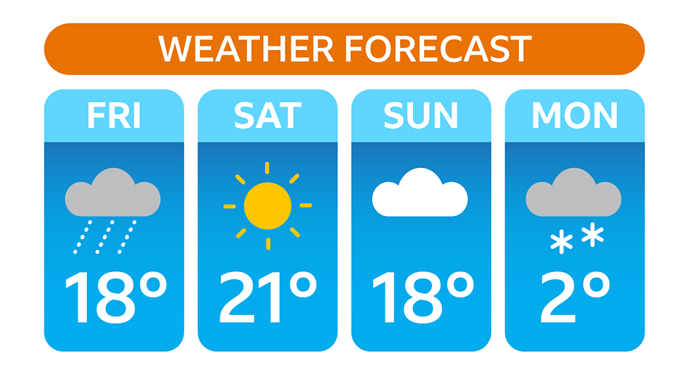
Variables in life
Notes:
Adapted from BBC Bitesize (KS2 Y6)
https://www.bbc.co.uk/bitesize/articles/zw3dwmn

Slide 5
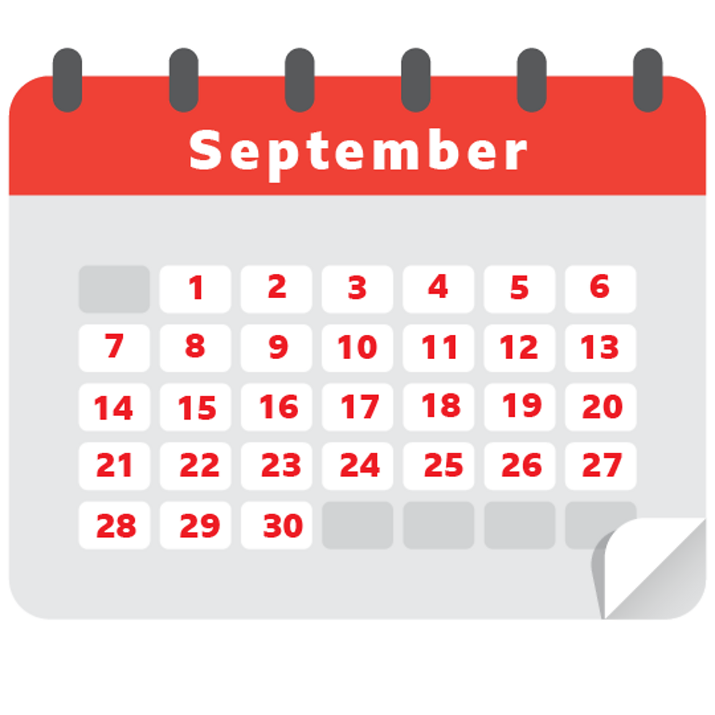
Variables in life

Slide 6
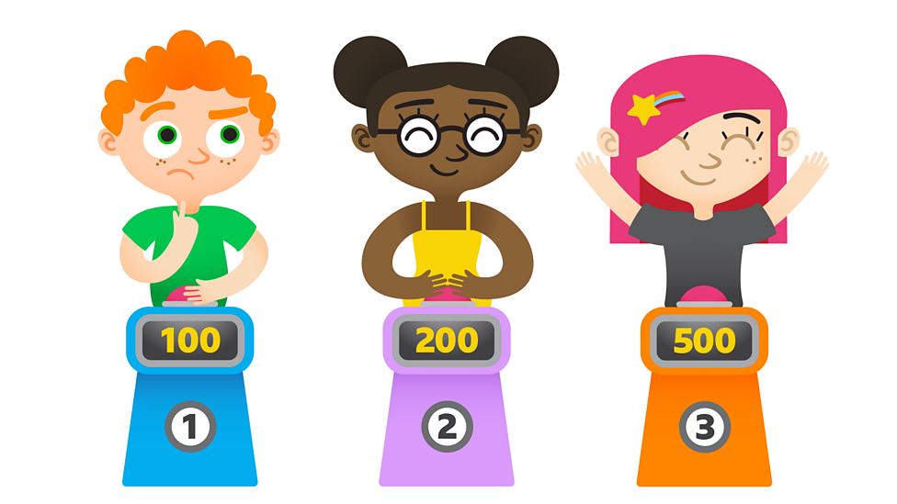
Variables in life

Slide 7
Variables in life
Notes:
Source Geogebra file:
https://www.geogebra.org/classic/GtjHbuKk

Slide 8
Variables in Scratch
What changes in this project?
When does it change?
Is the change always the same?
Notes:
Adapted from NCCE
https://scratch.mit.edu/projects/1142540763/editor/

Slide 9
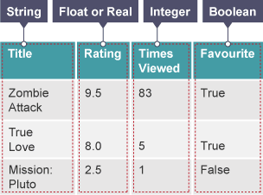
Variable types in programming
Notes:
Source BBC Bitesize:
https://www.bbc.co.uk/bitesize/guides/zwmbgk7/revision/3

Slide 10
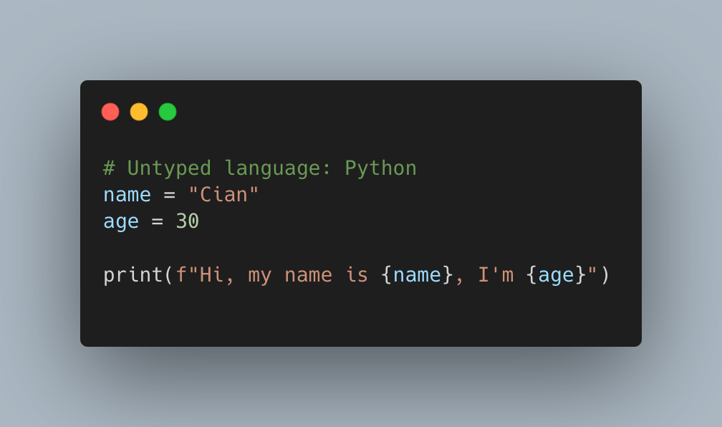
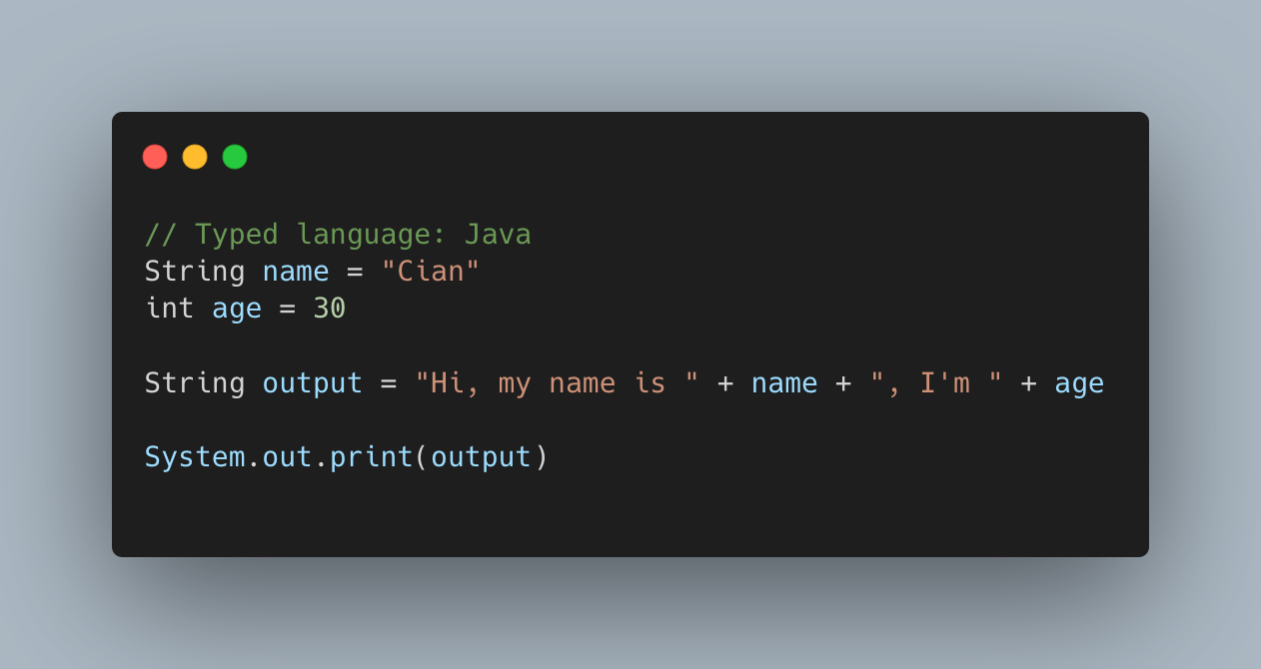
Typed vs Untyped Programming Languages
Notes:
Code screenshot tool:
https://carbon.now.sh/

Slide 11




Worksheet Q1
In the Scratch example we looked at earlier you identified the variable Score.
More complicated situations might involve more than one variable:
ESP
0 - 0
ENG
USA
JPN
Home_team
Home_score
Away_score
Away_team
Notes:
Adapted from NCCE and Raspberry Pi Foundation

Slide 12


On the activity sheet, find the values of the variables.

Slide 13
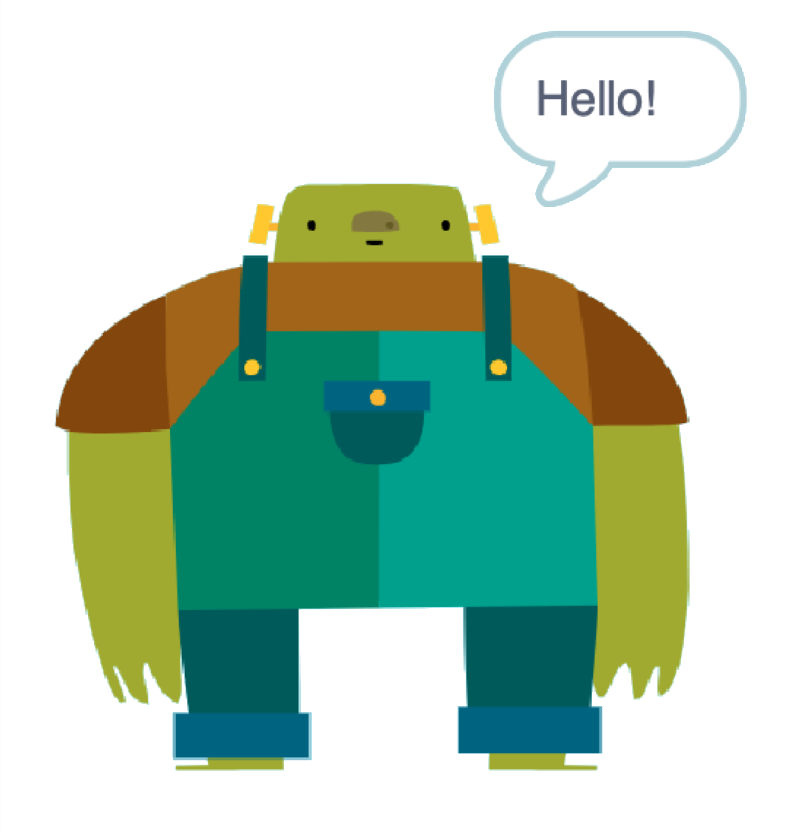
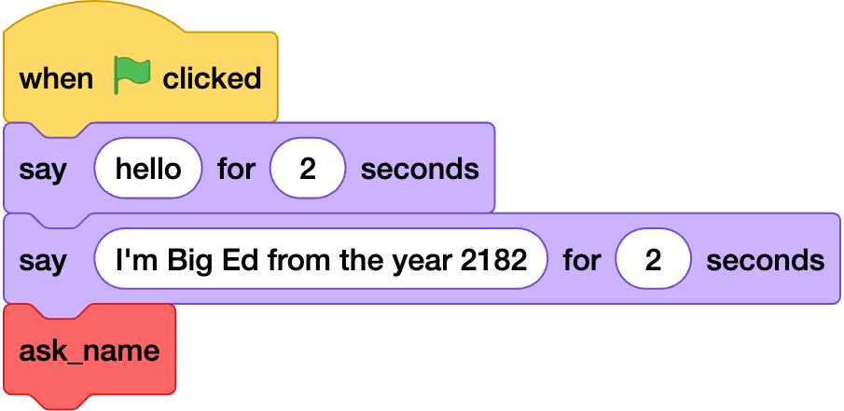
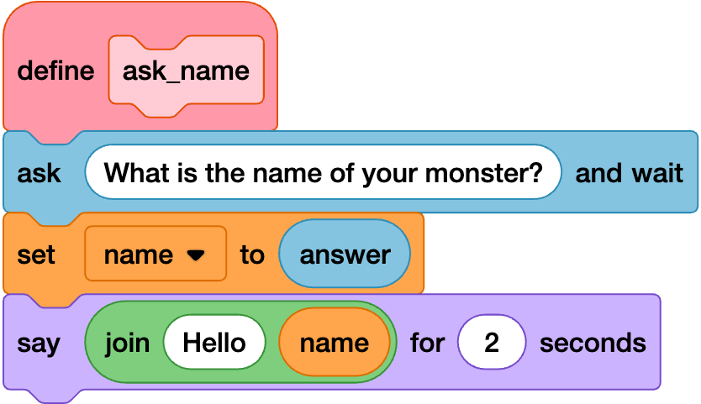
Worksheet Q2
Worksheet Q1
Big Ed is your friendly chatbot.
This code has been added to Big Ed in Scratch:
Notes:
Adapted from Oak National Academy

Slide 14
Notes:
Adapted from Oak Academy / Raspberry PI Foundation
https://scratch.mit.edu/projects/1142541142/editor/

Slide 15
Use variables in a program
What are the two variables in this code block?

Slide 16
Use variables in a program
What are the two variables in this code block?
name and answer
‘answer’ is a built-in variable in Scratch that holds the value a user types in. The variable ‘name’ has been created by the programmer.

Slide 17
Predict what will happen when this code is run.

Slide 18
Use variables in a program
The Big Ed sprite will say hello and introduce themselves. It will then call the ask_name function / subroutine.
The ask_name subroutine will run a sequence of commands that asks the user for the name of their monster, stores that name in a variable, before outputting it in a hello {name} message.

Slide 19

How confident are you? (1–3)
I can identify examples of information that is variable
I can explain that the way that a variable changes can be defined
I can identify that variables can hold numbers or letters
3 – Very confident
2 – Unsure
1 – Not confident
Notes:
Image source: https://pixabay.com/vectors/thumb-up-hand-like-confirm-go-top-307176

Slide 20
Update and trace the value of a variable
As variables can change during a program, it is useful for a programmer to trace the value of the variable.
This means the programmer will know exactly what the value of the variable will be at each stage.
Unexpected program behaviour or output might require us to debug, tracing is a useful skill to debug.

Slide 21
Update and trace the value of a variable
Worksheet Q3
Big Ed has just arrived on a new planet and he’s measuring the temperature of his new environment.
Is the temperature likely to change?
Yes, the temperature will change, so the variable that holds the temperature will need to be updated.
Notes:
Adapted from Oak National Academy

Slide 22
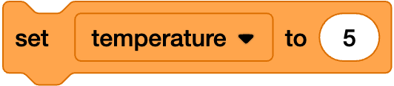
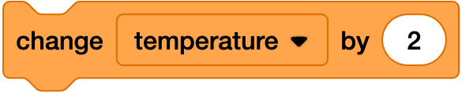
Update and trace the value of a variable
Variables can be updated in Scratch by using two different blocks.
You can update the value a variable holds by using the set block.
You can also use the change by block. This block will change the temperature value that is stored.

Slide 23


Update and trace the value of a variable
Trace the value of temperature, what value does temperature hold at the end of this code block?
5
temperature starts at 5 and is then changed by 2, so becomes 7.
a
3
b
7
c

Slide 24
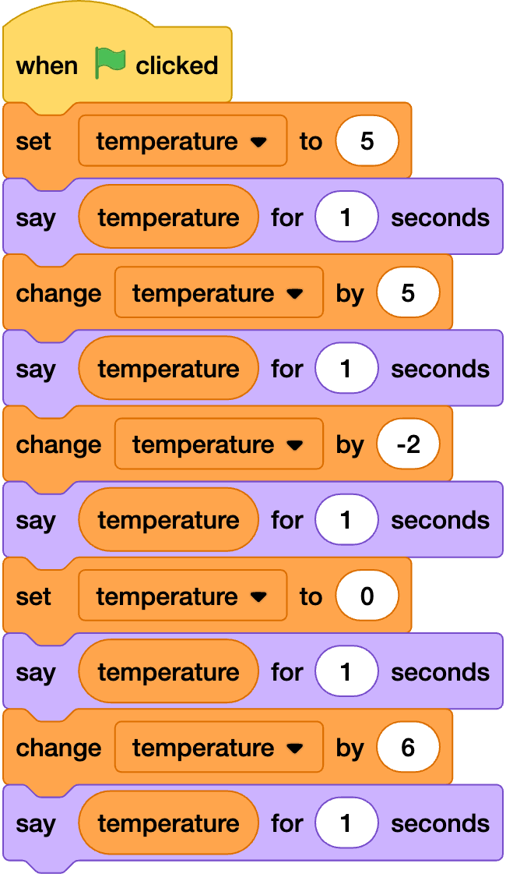
Update and trace the value of a variable
The following code was added to the Big Ed Scratch program:

Slide 25
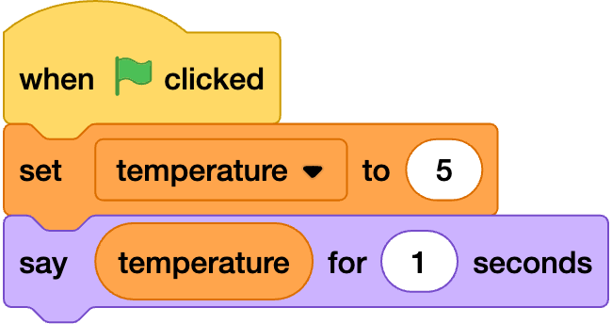
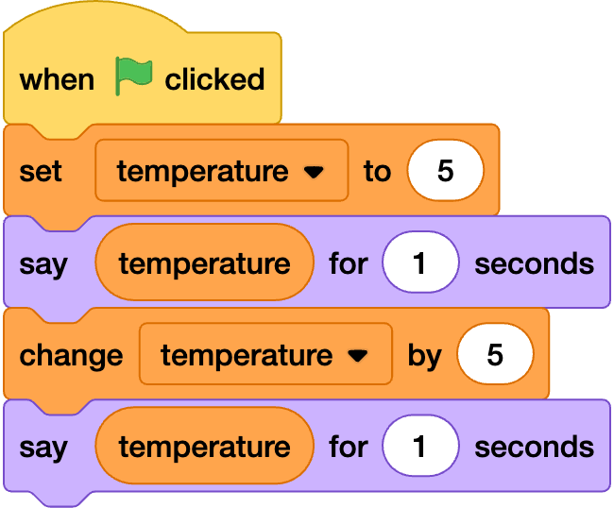
Update and trace the value of a variable
Trace the value of temperature at each stage.
stage | code | value of temperature
a)
b)

Slide 26
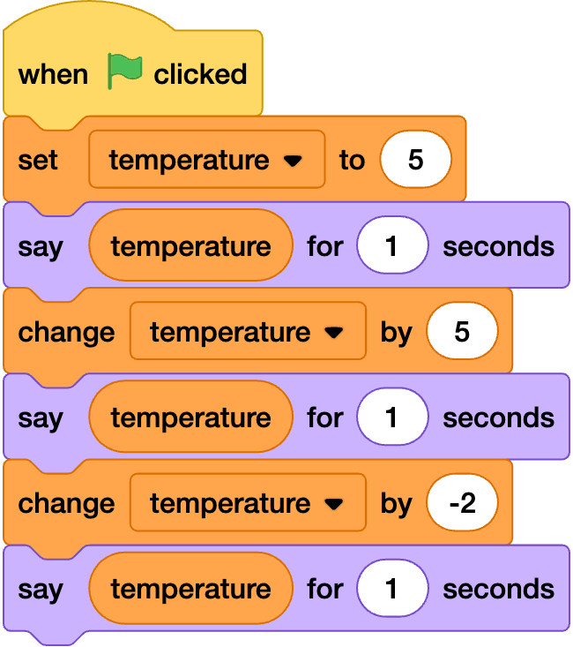
Update and trace the value of a variable
Trace the value of temperature at each stage.
stage | code | value of temperature
c)
Image: Scratch Foundation under CC BY-SA 2.0

Slide 27
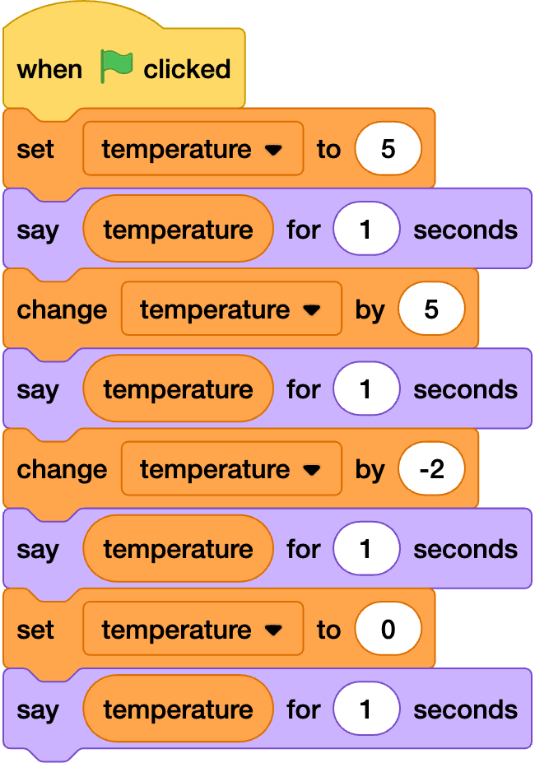
Update and trace the value of a variable
Trace the value of temperature at each stage.
stage | code | value of temperature
d)

Slide 28
Update and trace the value of a variable
Trace the value of temperature at each stage.
stage | code | value of temperature
e)

Slide 29
Update and trace the value of a variable
Trace the value of temperature at each stage.
stage | value of temperature
a) | 5
b) | 10
c) | 8
d) | 0
e) | 6

Slide 30
Worksheet Q4
Notes:
Game created to be relatable to students, Marvel Rivals are in the Top 10 currently played games
Sprites chosen to account for a wide range of student preferences (e.g. gender, race)
https://scratch.mit.edu/projects/1142510575/editor/

Slide 31
Plickers Quiz

Slide 32
Recap
A variable is a named piece of data, stored in a memory location in a computer.
A variable can be initialised with a starting value, commonly of type integer, String or float.
If the value of a variable is updated, the previous value is overwritten.
A list can store multiple variables.
You can trace the value a variable holds during a program, this can help you find bugs.

