Slide 1
Lesson 1: Introducing variables
Year 6 – Programming A – Variables in games
Notes:
Last updated: 07-02-22
Resources are updated regularly — the latest version is available at: ncce.io/tcc.
This resource is licensed under the Open Government Licence, version 3. For more information on this licence, see ncce.io/ogl.

Slide 2
Lesson 1: Introducing variables
Objectives
To define a ‘variable’ as something that is changeable
I can identify examples of information that is variable
I can explain that the way a variable changes can be defined
I can identify that variables can hold numbers or letters

Slide 3
What is changing?
Introduction
Have a look at this clip:
https://www.youtube.com/watch?v=rJRskDg6p3A
What happens to the score? When does it change?
What happens to the time? When does it change?

Slide 4


Changing the score
Introduction
In the video, there are two variables related to the score, one for the USA and one for Japan.
When a goal is scored, the value in the variable changes. In this example, it is a number that changes.
USA
3 - 1
0 - 0
1 - 0
2 - 0
2 - 1
JPN
Value
Value
Notes:
Image sources:
USA flag: https://pixabay.com/illustrations/american-flag-usa-flag-symbol-2144392/
Japan flag: https://pixabay.com/vectors/japan-flag-asia-national-signs-26803/

Slide 5
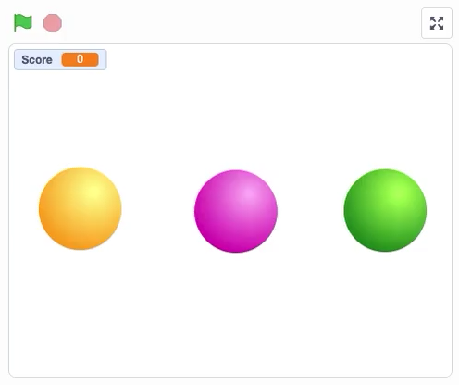
Variables in a project
Activity 1
Try this project:
ncce.io/scorechange
What changes in this project?
When does it change?
Is the change always the same?

Slide 6
A variable can be set and changed throughout the running of a program.
Activity 1

Slide 7
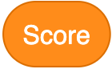
The project includes a number variable for ‘Score’
Activity 1
Click on See inside.
Modify the yellow ball to increase the score by two.
Modify the pink ball to increase the score by ten.
Modify the green ball to decrease the score by two.

Slide 8



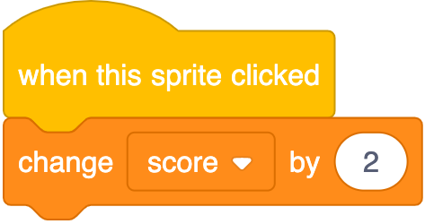


This is what your new code should look like
Activity 1

Slide 9
Design your own project including variables
Activity 2
In the previous activity, you modified a project.
Now, complete your own design on the activity sheet.
Note: You can only add or subtract to change the value of these variables.
Here is an example...
Sprite | Event | Change in value
Cat | When clicked | Add 2
Dog | When clicked | Add 5
Bird | When clicked | Subtract 3

Slide 10
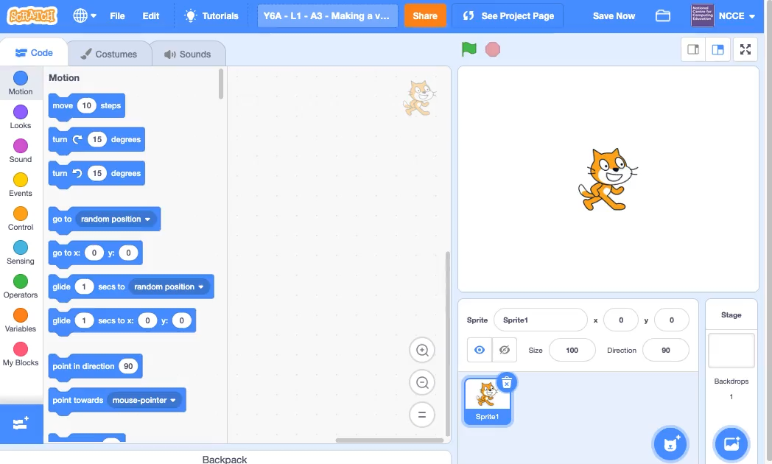
Creating a variable
Activity 3

Slide 11
Task: Use your design to make your own project with three sprites. When you click on each sprite, the score should change by a different amount.
Activity 3

Slide 12


Different variables
Plenary
In the example you looked at earlier in the lesson, you identified that there are two variables for ‘Score’.
There are also variables for the teams — these are letters. Just like the score, these can change.
ESP
0 - 0
ENG
USA
JPN
Home_team
Home_score
Away_score
Away_team
Notes:
Spain flag: https://pixabay.com/vectors/spain-flag-spanish-national-ensign-28530/
England flag: https://pixabay.com/vectors/flag-england-civil-state-red-28514/
USA flag: https://pixabay.com/illustrations/american-flag-usa-flag-symbol-2144392/
Japan flag: https://pixabay.com/vectors/japan-flag-asia-national-signs-26803/

Slide 13


Variables
Plenary
On the activity sheet, find the values of the variables.
Notes:
Germany flag: https://pixabay.com/vectors/germany-flag-nationality-country-31017/
Mexico flag: https://pixabay.com/vectors/mexico-flag-mexican-national-26989/
South Korea flag: https://pixabay.com/vectors/south-korea-flag-national-flag-162427/
Sweden flag: https://pixabay.com/vectors/flag-swedish-sweden-national-257636/

Slide 14

Assessment
How confident are you? (1–3)
I can identify examples of information that is variable
I can explain that the way that a variable changes can be defined
I can identify that variables can hold numbers or letters
3 – Very confident
2 – Unsure
1 – Not confident
Notes:
Image source: https://pixabay.com/vectors/thumb-up-hand-like-confirm-go-top-307176

Slide 15
Next lesson
Summary
In this lesson, you…
Learned that a variable can be set and changed
Modified an existing variable
Created your own examples
Next lesson, you will…
Find out how variables are updated
Learn about the importance of naming variables carefully

