Slide 1
Consumer Preferences, Utility Functions
and Budget Lines
Overheads

Slide 2
Utility is a measure of satisfaction or pleasure
Utility is defined as the pleasure or satisfaction obtained
from consuming goods and services
Utility is defined on the
entire consumption bundle of the consumer

Slide 3
Mathematically we define the utility function as
u represents utility
q_{j} is the quantity consumed of the jth good
(q₁, q₂, q₃, . . . q_{n}) is the consumption bundle
n is the number of goods and services available to the consumer

Slide 4
Marginal utility
Marginal utility is defined as the
increment in utility
an individual enjoys from consuming
an additional unit of a good or service.

Slide 5


Mathematically we define marginal utility as
If you are familiar with calculus, marginal utility is

Slide 6
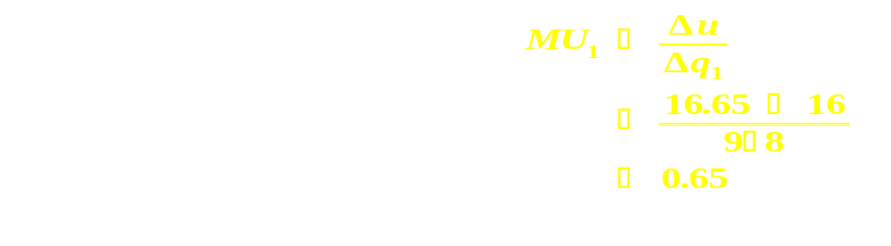
Data on utility and marginal utility
q₁ q₂ utility marginal utility
1 4 8.00
2.08
2 4 10.08
1.46
3 4 11.54
1.16
4 4 12.70
0.98
5 4 13.68
0.86
6 4 14.54
0.77
7 4 15.31
0.69
8 4 16.00
0.65
9 4 16.65
0.59
10 4 17.24
0.56
11 4 17.80
0.52
12 4 18.32
Change q₁ from 8 to 9 units

Slide 7
Marginal utility
3.0
mu₁(q₁,q₂=3)
2.5
2.0
mu₁ (q₁, q₂=4)
Marginal utility
1.5
1.0
0.5
0.0
0
2
4
6
8
10
12
14
q₁

Slide 8
Law of diminishing marginal utility
The law of diminishing marginal utility says
that as the consumption of a good of service increases,
marginal utility decreases.
The idea is that the marginal utility of a good diminishes,
with every increase in the amount of it that a consumer has.

Slide 9
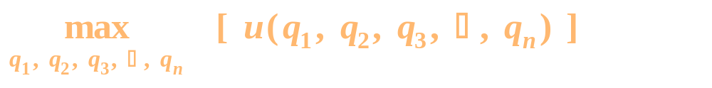
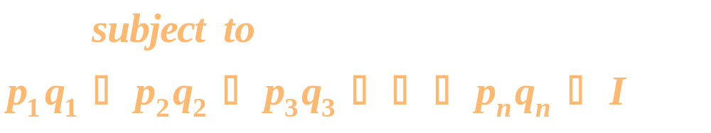
The Consumer Problem
As the consumer chooses more of a given good,
utility will rise,
but because goods cost money, the consumer
will have to consume less of another good
because expenditures are limited by income.

Slide 10
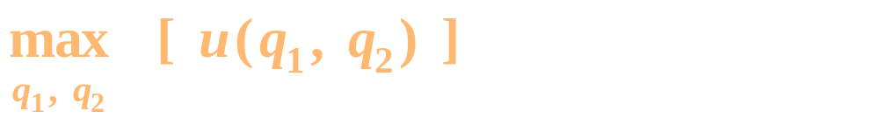
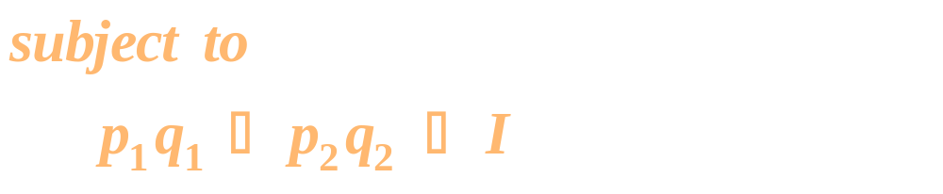
The Consumer Problem (2 goods)

Slide 11
Notation
u - utility
Income - I
Quantities of goods - q₁, q₂, . . . q_{n}
Prices of goods - p₁, p₂,. . . p_{n}
Number of goods - n

Slide 12
Optimal consumption is along the budget line
Given that income is allocated among
a fixed number of categories
and all goods have a positive marginal utility,
the consumer will always choose a point
on the budget line.
Why?

Slide 13
Budget Constraint - 0.3q₁ + 0.2q₂ = $1.20
q₁
5
4
3
Not Affordable
2
Affordable
1
q₂
1
2
3
4
5
6
7

Slide 14
Marginal decision making
To make the best of a situation, decision makers
should consider the incremental or marginal effects
of taking any action.
In analyzing consumption decisions,
the consumer considers small changes
in the quantities consumed,
as she searches for the “optimal” consumption bundle.

Slide 15
Implementing the small changes approach - p₁ = p₂
q₁ q₂ Utility Marginal
Utility
4 3 11.00
0.85
5 3 11.85
0.74
6 3 12.59
3 4 11.54
1.16
4 4 12.70
0.98
5 4 13.68
0.86
6 4 14.54
4 5 14.20
1.10
5 5 15.30
0.96
6 5 16.26
Consider the point (5, 4)
with utility 13.68
Now raise q₁ to 6 and reduce
q₂ to 3. Utility is 12.59
Now lower q₁ to 4 and raise
q₂ to 5. Utility is 14.20
q = (4, 5) is preferred to
q = (5, 4) and q = (6, 3)

Slide 16
Budget lines and movements toward higher utility
Given that the consumer will consume along the budget line,
the question is
which point will lead to a higher level of utility.
Example
p₁ = 5 p₂ = 10 I = 50
q₁ = 2 q₂ = 4 (5)(2) + (10)(4) = 50
q₁ = 4 q₂ = 3 (5)(4) + (10)(3) = 50
q₁ = 6 q₂ = 2 (5)(6) + (10)(2) = 50

Slide 17
Budget Constraint
p₁ = 5 p₂ = 10 I = 50
11
q
10
1
9
8
7
(6,2)
6
5
(4,3)
4
3
(2,4)
2
1
0
0
1
2
3
4
5
6
q₁ q₂ utility
6 2 10.280
q
2
Exp = I = 50
2 4 10.080
Exp = I = 50
4 3 10.998
Exp = I = 50

Slide 18
Indifference Curves
An indifference curve represents
all combinations of two categories of goods
that make the consumer equally well off.

Slide 19
Example data and utility level
q₁ q₂ utility
8 1 8
2.83 2 8
1.54 3 8
1 4 8
0.72 5 8

Slide 20
Graphical analysis
Indifference Curve
14
q₁
12
10
8
u = 8
6
4
2
0
0
1
2
3
4
5
6
7
q₂

Slide 21
Example data with utility level equal to 10
q₁ q₂ utility
15.625 1 10.00
8 1 8.00

Slide 22
Example data with utility level equal to 10
q₁ q₂ utility
15.625 1 10.00
5.524 2 10.00
3.007 3 10.00
1.953 4 10.00
1.398 5 10.00
1.063 6 10.00
0.844 7 10.00

Slide 23
Graphical analysis with u = 10
Indifference Curves
18
q₁
16
14
12
10
u = 10
8
6
4
2
0
0
1
2
3
4
5
6
7
q₂

Slide 24
Graphical analysis with several levels of u
Indifference Curves
20
q
18
1
u = 8
16
14
u = 10
12
u = 12
10
8
u = 15
6
4
2
0
0
1
2
3
4
5
6
q
2

Slide 25
Slope of indifference curves
Indifference curves normally have a negative slope
If we give up some of one good, we have to get
more of the other good to remain as well off
The slope of an indifference curve is called the
marginal rate of substitution (MRS)
between good 1 and good 2

Slide 26
Indifference Curves
20
q
18
1
16
14
12
u = 12
10
8
6
4
2
0
0
1
2
3
4
5
6
q
2

Slide 27
Slope of indifference curves (MRS)
The MRS tells us the decrease in the quantity
of good 1 (q₁) that is needed to accompany
a one unit increase
in the quantity of good two (q₂),
in order to keep the consumer indifferent to the change

Slide 28
Indifference Curves
20
q
18
1
16
14
12
u = 12
10
8
6
4
2
0
0
1
2
3
4
5
6
q
2

Slide 29
Shape of Indifference Curves
Indifference curves are convex to the origin
This means that as we consume more and more of a good,
its marginal value in terms of the other good becomes less.

Slide 30
The Marginal Rate of Substitution (MRS)
40
q
35
1
30
⟨
u = 12
25
20
15
10
⟨
5
⟨
0
0
1
2
3
4
5
6
q₂
The MRS tells us the decrease in the quantity of good 1 (q₁)
that is needed to accompany a one unit increase
in the quantity of good two (q₂),
in order to keep the consumer indifferent to the change

Slide 31

Algebraic formula for the MRS
The marginal rate of substitution of good 1 for good 2 is
We use the symbol - | _{u = constant} - to remind us that the
measurement is along a constant utility indifference curve

Slide 32


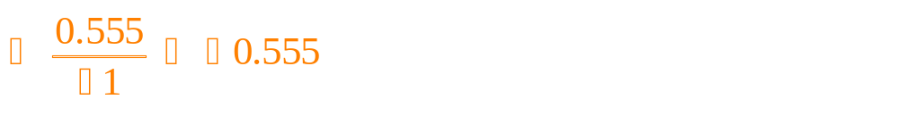
Example calculations
q₁ q₂ utility
5.524 2 10.00
3.007 3 10.00
1.953 4 10.00
1.398 5 10.00
1.063 6 10.00
Change q₂ from 4 to 5

Slide 33
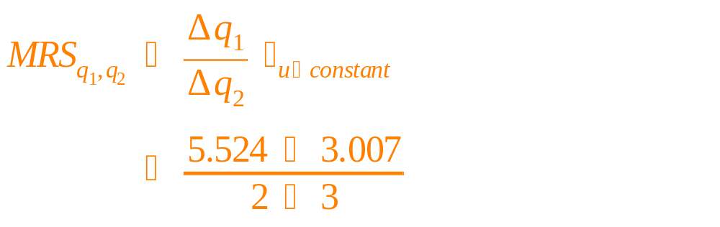
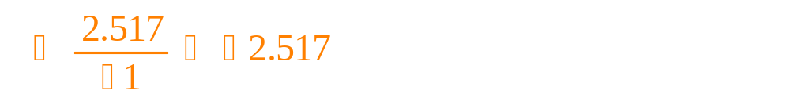
Example calculations
Change q₂ from 2 to 3
q₁ q₂ utility
5.524 2 10.00
3.007 3 10.00
1.953 4 10.00
1.398 5 10.00
1.063 6 10.00

Slide 34
A declining marginal rate of substitution
The marginal rate of substitution becomes
larger in absolute value,
as we have more of a product.
The amount of a good we are willing to give up
to keep utility the same,
is greater when we already have a lot of it.

Slide 35
Indifference Curves
40
q
1
35
30
25
u = 10
20
15
Give up lots of q₁ to get 1 q₂
10
-2.517
Give up a little q₁
to get 1 q₂
5
0
0
1
2
3
4
5
6
-0.555
q
2

Slide 36
A declining marginal rate of substitution
When I have 1.953 units of q₁,
I can give up 0.55 units for a one unit increase in good 2
and keep utility the same.
q₁ q₂ utility
3.007 3 10.00
1.953 4 10.00
1.398 5 10.00
1.063 6 10.00
40
q
1
35
-0.555
30
25
20
15
u = 10
10
5
-0.555
0
0
1
2
3
4
5
q
6
2

Slide 37
A declining marginal rate of substitution
When I have 5.52 units of q_{1,} I can give up 2.517 units
for an increase of 1 unit of good 2 and keep utility the same.
q₁ q₂ utility
5.524 2 10.00
3.007 3 10.00
1.953 4 10.00
40
-2.517
q
1
35
30
25
20
15
u = 10
10
-2.517
5
0
0
1
2
3
4
5
6
q
2

Slide 38
A declining marginal rate of substitution
When I have 15.625 units of q_{1,} I can give up 10.101 units
for an increase of 1 unit of good 2 and keep utility the same.
q₁ q₂ utility
15.625 1 10.00
5.524 2 10.00
3.007 3 10.00
1.953 4 10.00
40
-10.101
q
1
35
30
25
20
15
-10.101
u = 10
10
5
0
0
1
2
3
4
5
6
q
2

Slide 39
Break

Slide 40
Indifference curves and budget lines
We can combine indifference curves and budget lines
to help us determine the optimal consumption bundle
The idea is to get on the highest indifference curve
allowed by our income

Slide 41
Budget Lines
q₁ q₂ cost utility
8 1 50.00 8.000
2.828 2 34.14 8.000
Indifference Curves
18
3.007 3 45.04 10.000
q₁
16
4 3 50.00 10.998
14
3.375 4 56.88 12.000
12
10
u = 8
8
u = 10
6
4
u = 12
2
Budget Line
0
0
1
2
3
4
5
6
7
q₂

Slide 42
At the point (1,8) all income is being spent and utility is 8
The point (2, 2.828) will give the utility of 8, but at a lessor cost of $34.14.
q₁ q₂ cost utility
8 1 50.00 8.000
2.828 2 34.14 8.000
18
q₁
16
14
12
10
u = 8
8
6
4
2
Budget Line
0
0
1
2
3
4
5
6
q₂
7

Slide 43
The point (3, 3.007) will give a higher utility level of 10,
but there is still some income left over
18
q₁ q₂ cost utility
8 1 50.00 8.000
2.828 2 34.14 8.000
3.007 3 45.04 10.000
q₁
16
14
12
10
u = 8
8
u = 10
6
4
2
Budget Line
0
0
1
2
3
4
5
6
7
q₂

Slide 44
The point (3,4) will exhaust the income of $50
and give a utility level of 10.998
18
q₁ q₂ cost utility
8 1 50.00 8.000
2.828 2 34.14 8.000
3.007 3 45.04 10.000
4 3 50.00 10.998
q₁
16
14
12
10
u = 8
8
u = 10
6
4
2
Budget Line
0
0
1
2
3
4
5
6
7
q₂

Slide 45
The point (4, 3.375) will give an even higher utility level of 12, but costs more than the $50 of income.
q₁ q₂ cost utility
8 1 50.00 8.000
2.828 2 34.14 8.000
3.007 3 45.04 10.000
4 3 50.00 10.998
3.375 4 56.88 12.000
18
q₁
16
14
12
10
u = 8
8
u = 10
6
4
u = 12
2
Budget Line
0
0
1
2
3
4
5
6
7
q₂

Slide 46
The utility function depends on quantities
of all the goods and services
For two goods we obtain
We can graph this function in 3 dimensions

Slide 47
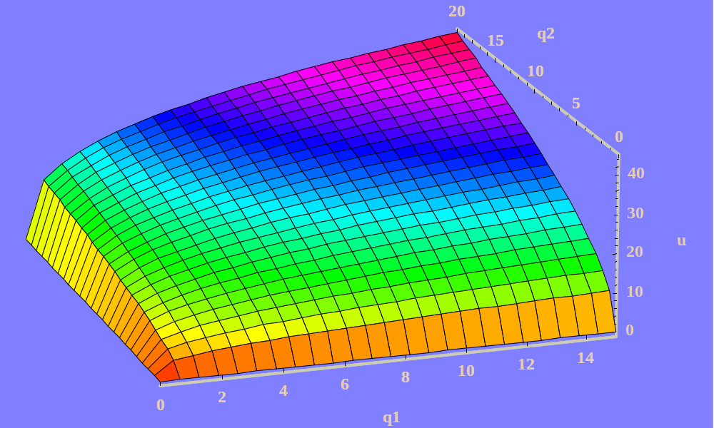
3-dimensional representation of the utility function

Slide 48
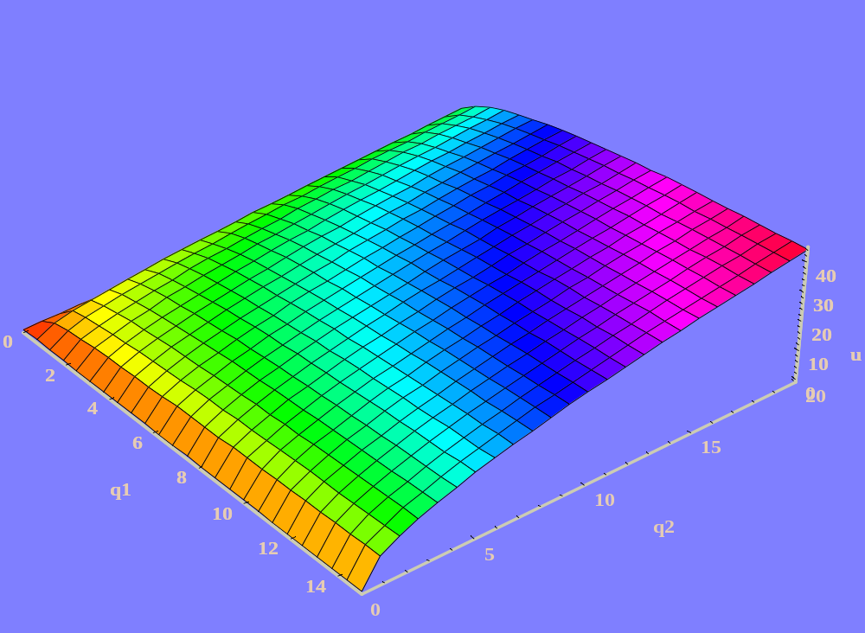
Another view of the same function

Slide 49
Contour lines are lines of equal height or altitude
If we plot in q₁ - q₂ space all combinations of q₁ and q₂
that lead to the same (value) height for the utility function,
we get contour lines
similar to those you see on a contour map.
For the utility function at hand, they look as follows:

Slide 50
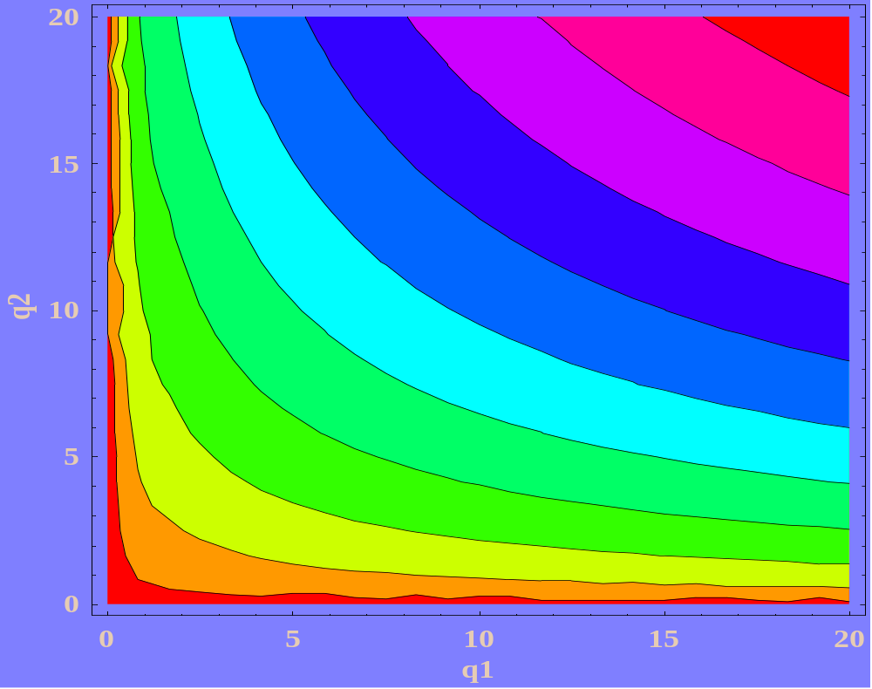
Contour lines

Slide 51
Function

Slide 52
Contour lines

Slide 53
Representing the budget line in 3-space
p₁q₁ + p₂ q₂ = I
5q₁ + 10 q₂ = 50
q₁ = 10 - 2q₂

Slide 54
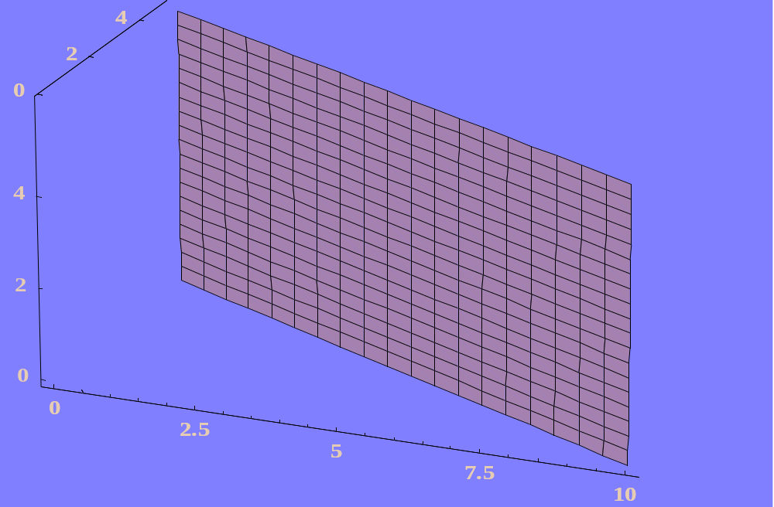
The budget line in q₁ - q₂ - u (3) space
All the points directly above the budget line create a plane

Slide 55
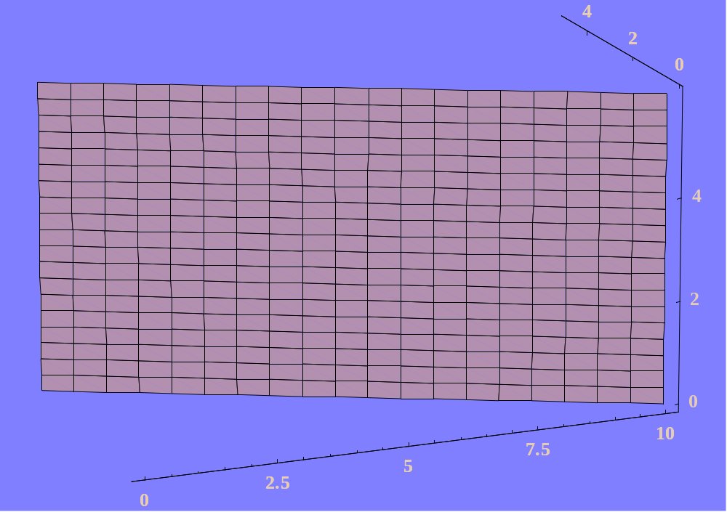
Another view of the budget line (q₁ - q₂ - u (3) space)

Slide 56
We can combine the budget line
with the utility function
to find the optimal consumption point

Slide 57
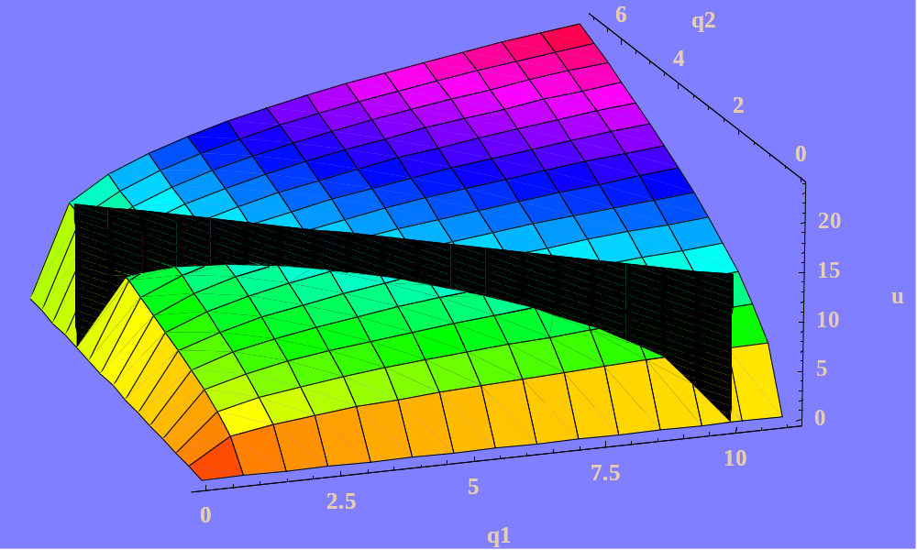
Combining the budget line and the utility function

Slide 58
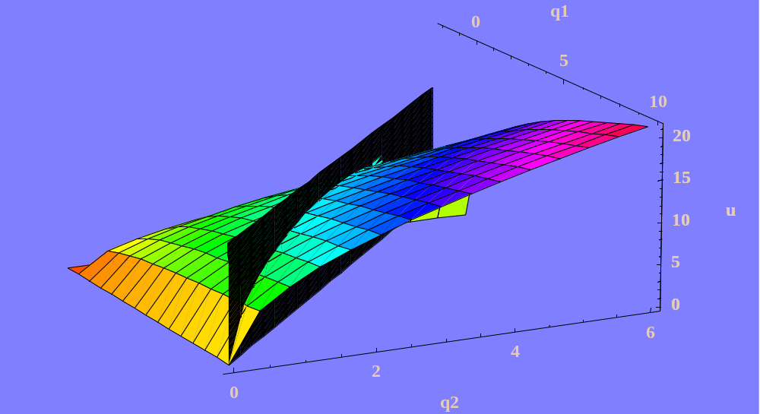
Along the budget “wall” we can find the highest utility point

Slide 59
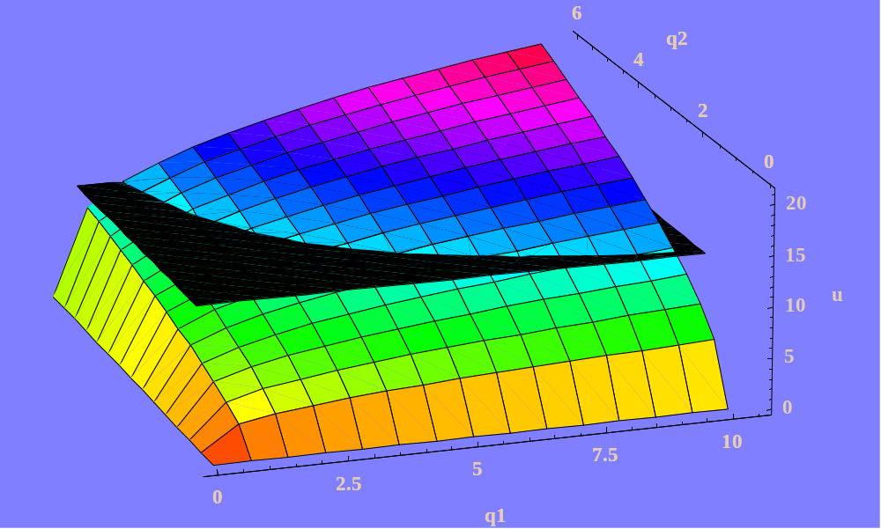
The plane at the level of maximum utility
All points at the height of the plane have the same utility

Slide 60
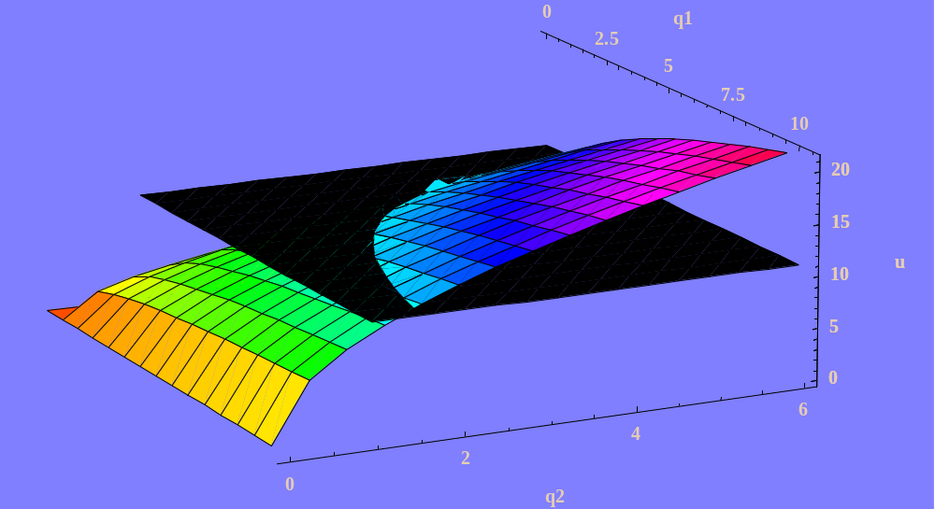
Another view of the plane at the level of maximum utility

Slide 61
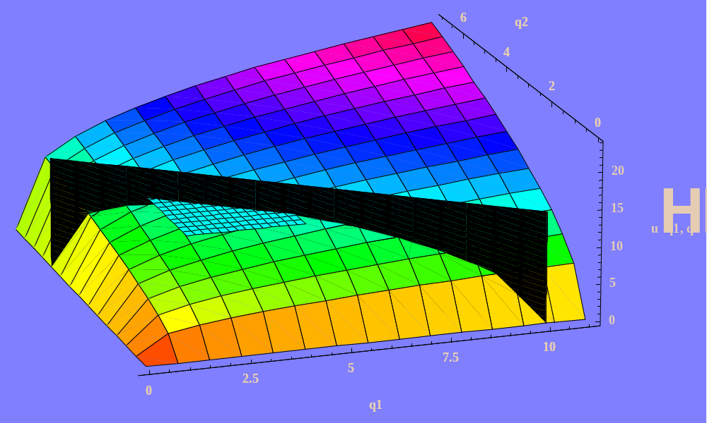
Combining the three pictures

Slide 62
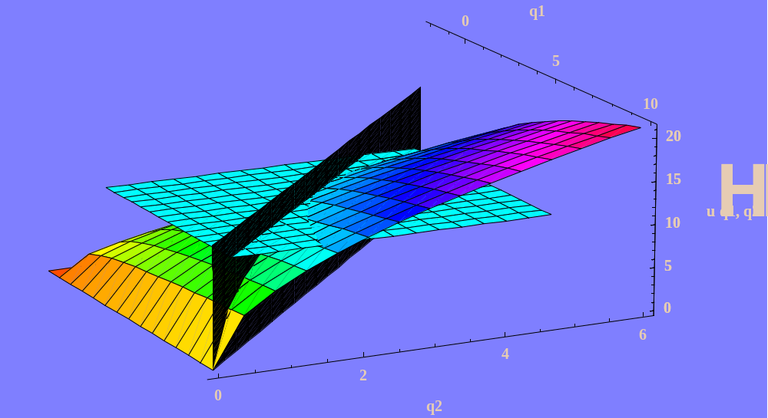
Another view

Slide 63
We can also depict the optimum in q₁ - q₂ space
Different levels of utility are represented
by indifference curves
The budget wall is represented by the budget line

Slide 64
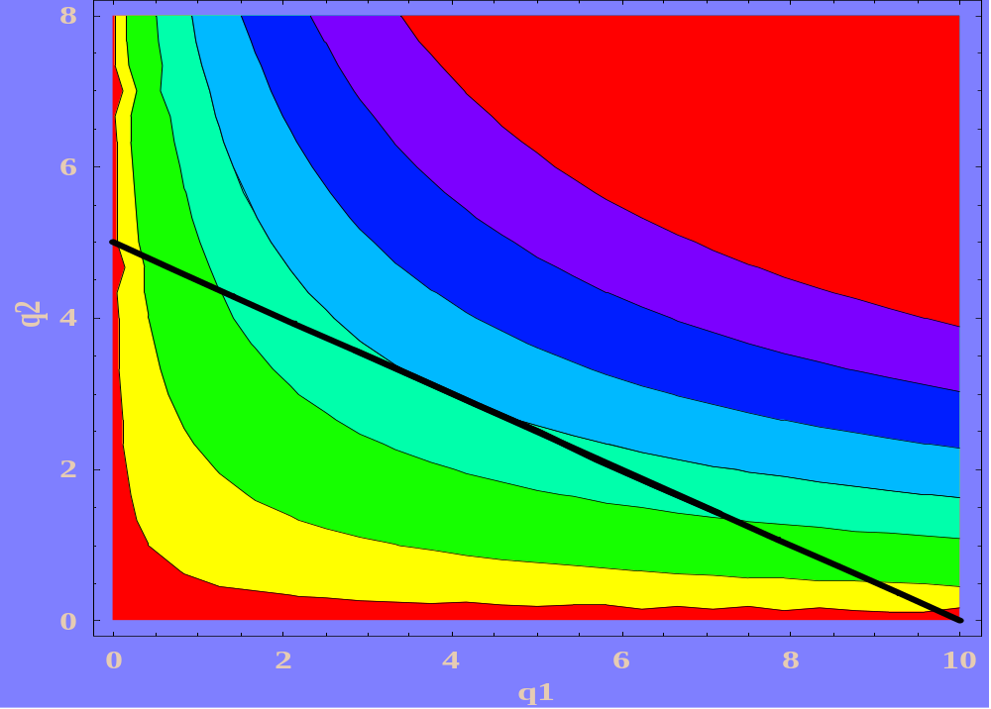
The optimum in q₁ - q₂ space

Slide 65
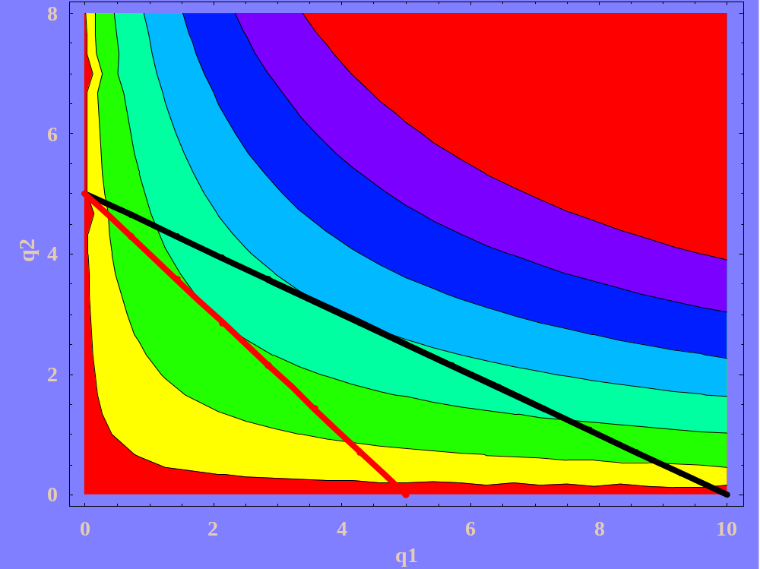
Raise p₁ to 10

Slide 66

Characteristics of an optimum
From observing the geometric properties of the optimum levels
of q₁ and q₂, the following seem to hold:
a. The optimum point is on the budget line
b. The optimum point is on the highest indifference curve
attainable, given the budget line
c. The indifference curve and the budget line are tangent
at the optimum combination of q₁ and q₂
d. The slope of the budget line and the slope
of the indifference curve are equal at the optimum

Slide 67
Intuition for the conditions
The budget line tells us the rate at which
the consumer is able to trade one good for the other,
given their relative prices and income

Slide 68
Slope of Indifference Curves
and the Budget Line
18
q
16
1
For example in this case,
the consumer must give up 2 units of good 1 in order to buy a unit of good 2
14
12
10
8
6
4
Budget Line
2
0
0
1
2
3
4
5
6
7
q
2

Slide 69
The indifference curve tells us the rate
at which the consumer could trade one good
for the other and remain indifferent.

Slide 70
Slope of Indifference Curves
and the Budget Line
18
16
For example on the indifference curve where
u = 10, the slope between the points (2, 5.524)
and (3, 3.007) is approximately -2.517.
q
1
14
12
10
8
6
u = 10
4
Budget Line
2
0
0
1
2
3
4
5
6
7
q
2

Slide 71
The consumer is willing give up
2.517 units of good 1 for a unit of good 2,
but only has to give up 2 units of good 1
for 1 unit of good 2 in terms of cost
So give up some q₁

Slide 72
Slope of Indifference Curves
and the Budget Line
18
On the indifference curve where u = 8,
the slope between the points (1, 8)
and (2, 2.828) is approximately -5.172
q
16
1
14
12
10
u = 8
8
6
4
Budget Line
2
0
0
1
2
3
4
5
6
7
q
2

Slide 73
Where did -5.172 come from?
q₁ q₂ cost utility
8 1 50.00 8.000
2.828 2 34.14 8.000
3.007 3 45.04 10.000
4 3 50.00 10.998
Δq₁ = 2.828 - 8 = -5.172

Slide 74
The consumer is willing give up
5.172 units of good 1 for a unit of good 2,
but only has to give up 2 units of good 1
for 1 unit of good 2 in terms of cost
So give up some q₁

Slide 75
Slope of Indifference Curves
and the Budget Line
18
Move down the line
q
16
1
14
12
10
u = 8
8
6
u = 10
4
Budget Line
2
0
0
1
2
3
4
5
6
7
q
2

Slide 76
If the consumer is willing give up
5.172 units of good 1 for a unit of good 2,
but only has to give up 2 units (in terms of cost),
the consumer will make the move
down the budget line,
and consume more of q₂

Slide 77
Slope of Indifference Curves
and the Budget Line
18
16
u = 8
q
1
14
Move down
u = 10.998
12
u = 10.28
10
8
Budget Line
6
4
2
0
0
1
2
3
4
5
6
7
q
2

Slide 78
If the consumer is willing give up
2.517 units of good 1 for a unit of good 2,
but only has to give up 2 units (in terms of cost),
the consumer will make the move
down the budget line,
and consume more of q₂

Slide 79
When the slope of the indifference curve is steeper
than the budget line,
the consumer will move down the line
When the slope of the indifference curve is less steep
than the budget line,
the consumer will move up the line

Slide 80
Slope of Indifference Curves
and the Budget Line
18
q
16
1
14
u = 8
12
10
u = 10
8
6
Budget Line
4
2
0
0
1
2
3
4
5
6
7
q
2

Slide 81
Slope of Indifference Curves
and the Budget Line
18
q
16
1
14
u = 8
12
10
u = 10
8
6
Budget Line
4
2
0
0
1
2
3
4
5
6
7
q
2

Slide 82
Slope of Indifference Curves
and the Budget Line
18
q
16
u = 8
1
14
u = 10
12
u = 10.998
10
8
Budget Line
6
4
2
0
0
1
2
3
4
5
6
7
q₂

Slide 83
Slope of Indifference Curves
and the Budget Line
18
When an indifference curve intersects a budget line,
the optimal point will lie between the
two intersection points
q
16
1
14
12
Move down the line
10
Move up the line
8
6
u = 10
4
Budget Line
2
0
0
1
2
3
4
5
6
7
q
2

Slide 84
Slope of Indifference Curves
and the Budget Line
18
q
16
1
14
12
u = 10
10
8
u = 10.998
6
4
2
0
0
1
2
3
4
5
6
7
q
2

Slide 85

Alternative interpretation of optimality conditions
Marginal utility is defined as the increment in utility
an individual enjoys from consuming
an additional unit of a good or service.

Slide 86

Marginal utility and indifference curves
All points on an indifference curve are associated
with the same amount of utility.
Hence the loss in utility associated with q₁
must equal the gain in utility from q₂ ,
as we increase the level of q₂ and decrease the level of q₁.

Slide 87


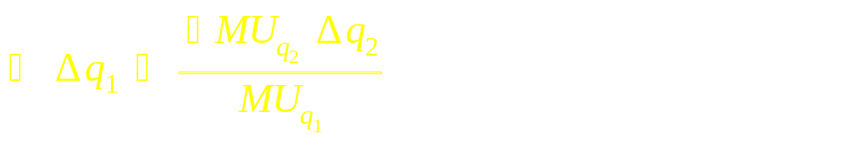
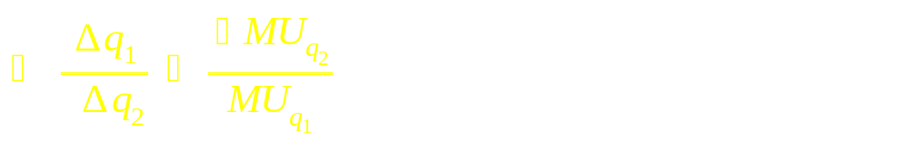
Rearrange this expression by subtracting MU_{q2} Δ q₂
from both sides,
Then divide both sides by MU_{q1}
Then divide both sides by Δ q₂

Slide 88

The left hand side of this expression is the marginal
rate of substitution of q₁ for q₂, so we can write
So the slope of an indifference curve is equal to
the negative of the ratio of the marginal utilities
of the two goods at a given point

Slide 89
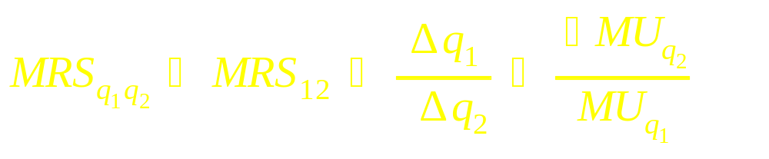
So the slope of an indifference curve ( MRS_{q1q2} )
is equal to the negative of the ratio
of the marginal utilities of the two goods

Slide 90

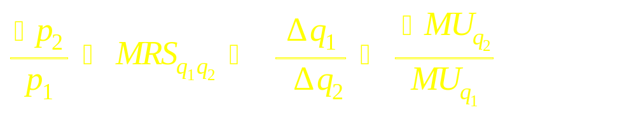
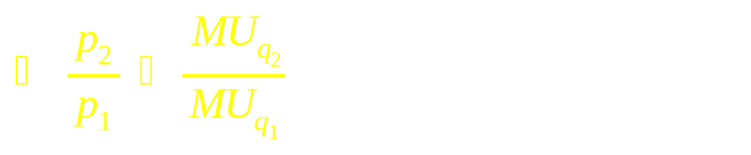
Optimality conditions
Substituting we obtain
The price ratio equals the ratio of marginal utilities

Slide 91
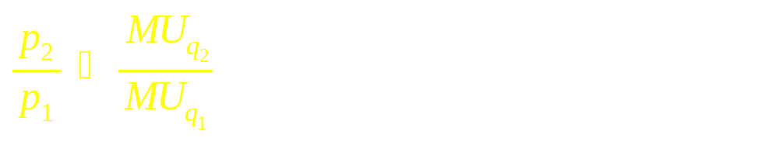
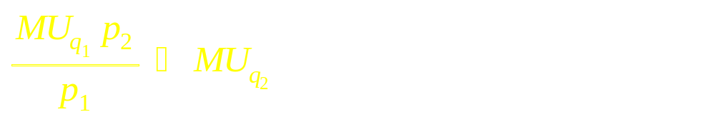
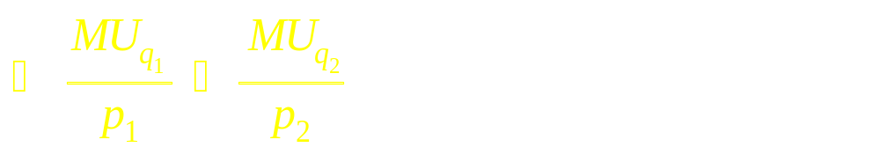
We can write this in a more interesting form
Multiply both sides by MU_{q1}
and then divide by p₂

Slide 92
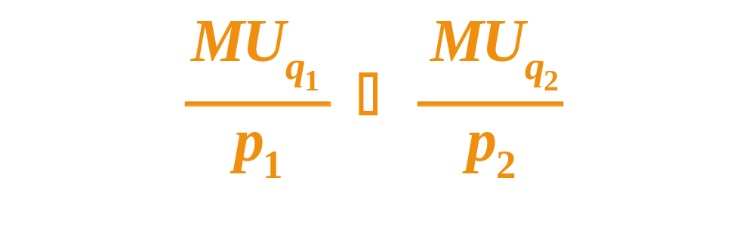
Interpretation ?
The marginal utility per dollar for each good
must be equal at the optimum point of consumption.

Slide 93
Example
p₁ = 5 p₂ = 10 I = 50
q₂ q₁ u MU₁ MU₂ MU₁/p₁ MU₂/p₂
0 10 0.000 0.000  0.000 
1 8 8.000 0.334 4.000 0.067 0.4
2 6 10.280 0.572 2.570 0.115 0.257
3 4 10.998 0.917 1.833 0.184 0.184
4 2 10.080 1.680 1.260 0.336 0.126
5 0 0.000  0.000  0.000

Slide 94
Budget Constraint
p₁ = 5 p₂ = 10 I = 50
11
0
q
10
1
9
1
8
Budget Line
2
7
6
3
5
4
4
3
2
5
1
0
0
1
2
3
4
5
6
q
2

Slide 95
q₂ q₁ u MU₁ MU₂ MU₁/p₁ MU₂/p₂
0 10 0.000 0.000  0.000 
1 8 8.000 0.334 4.000 0.067 0.4
Consider the consumption point where q₂ = 0 and q₁ = 10.
The marginal utility (per dollar) of an additional unit
of q₁ is 0.00,
while the utility of an additional unit (per dollar)
of q₂ is is infinite
Thus we should clearly move to the point q₂ = 1, q₁ = 8.

Slide 96
q₂ q₁ u MU₁ MU₂ MU₁/p₁ MU₂/p₂
0 10 0.000 0.000  0.000 
1 8 8.000 0.334 4.000 0.067 0.4
2 6 10.280 0.572 2.570 0.115 0.257
Consider q₂ = 1 and q₁ = 8.
The marginal utility (per dollar) of an additional unit
of q₁ is 0.067,
while the utility of an additional unit (per dollar)
of q₂ is 0.4
Thus we should clearly move to the point q₂ = 2, q₁ = 6

Slide 97
q₂ q₁ u MU₁ MU₂ MU₁/p₁ MU₂/p₂
0 10 0.000 0.000  0.000 
1 8 8.000 0.334 4.000 0.067 0.4
2 6 10.280 0.572 2.570 0.115 0.257
3 4 10.998 0.917 1.833 0.184 0.184
At the consumption point where q₂ = 3 and q₁ = 4,
the marginal utility (per dollar) of an additional unit of q₁ is 0.184,
and the utility of an additional unit (per dollar) of q₂ is 0.184.
We should stay here

Slide 98
The other way
q₂ q₁ u MU₁ MU₂ MU₁/p₁ MU₂/p₂
0 10 0.000 0.000  0.000 
1 8 8.000 0.334 4.000 0.067 0.4
2 6 10.280 0.572 2.570 0.115 0.257
3 4 10.998 0.917 1.833 0.184 0.184
4 2 10.080 1.680 1.260 0.336 0.126
5 0 0.000  0.000  0.000
Because  > 0, we move from q₂ = 5, q₁ = 0 to q₂ = 4, q₁ = 2
Because 0.336 > 0.126, we move from q₂ = 4, q₁ = 2 to q₂ = 3, q₁ = 4
And we stop!

Slide 99
The End

Slide 100
Slope of Indifference Curves
and the Budget Line
18
q
16
1
14
u = 8
12
10
u = 10
8
6
Budget Line
4
2
0
0
1
2
3
4
5
6
7
q
2

Slide 101
Slope of Indifference Curves
and the Budget Line
18
Move down the line
q
16
1
14
Move down the line
12
10
u = 8
8
6
u = 10
4
Budget Line
2
0
0
1
2
3
4
5
6
7
q
2

Slide 102
Slope of Indifference Curves
and the Budget Line
18
q
16
1
14
Move down the line
12
10
u = 8
8
6
u = 10
4
Budget Line
2
0
0
1
2
3
4
5
6
7
q
2

