Slide 1
“Plankal-cool”
The First Ever Programming Language

Slide 2
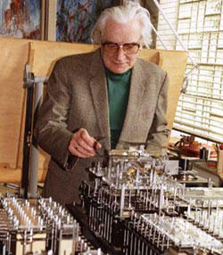
Konrad Zuse
22 June 1910 – 18 December 1995
German Civil Engineer, Computer Scientist and Inventor.
Worked in an aircraft factory where he had to do many routine calculations by hand.
Built the first programmable computer (1941)
Z1 contained some 30,000 metal parts
original blueprints destroyed by a British air raid.
“Zuse completed his work entirely independently of other leading computer scientists and mathematicians of his day.”

Slide 3
The first ever programming language?
Working in machine code was too complicated
PhD Thesis years ahead of its time.
In comes the first ever high-level programming language
Plankalkül
Designed during 1942-1945
Chess Engine ‘example’ program

Slide 4
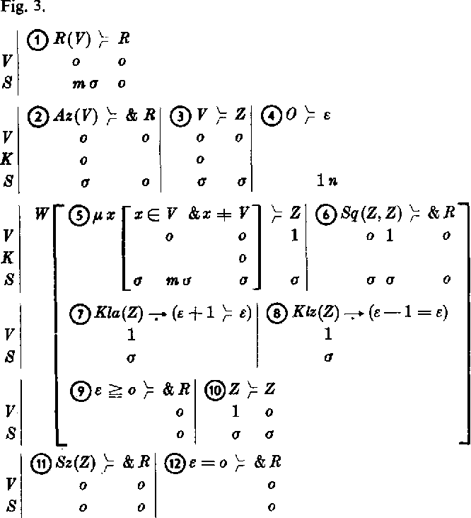
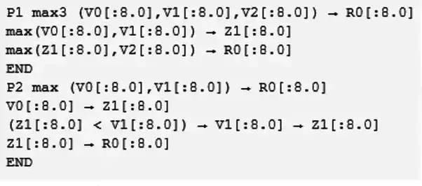
Notes:
After finishing the Z1 in 1938, Zuse discovered that the calculus he had independently devised already existed and was known as propositional calculus.^{[5]} What Zuse had in mind, however, needed to be much more powerful (propositional calculus is not Turing-complete and is not able to describe even simple arithmetic calculations^{[6]}).

Slide 5
What is Plankalkül?
Plankalkül is a typed high-level imperative programming language.
Programs are reusable functions, and functions are not recursive.
Variables are local to functions (programs).
Fundamental data types are arrays and tuples of arrays, but there are also floating point, fixed point, complex numbers; records; hierarchical data structures; list of pairs.
There is no GOTO construct
Assignment operation (e.g.: V1 + V2 => R1).
Conditional statement (e.g.: V1 = V2 => R1. This means: Compare the variables V1 and V2: If they are identical then assign the value true to R1, otherwise assign the value false.
Possibility for defining sub-programs and loops.
Logical operations (predicate logic and Boolean algebra).

Slide 6
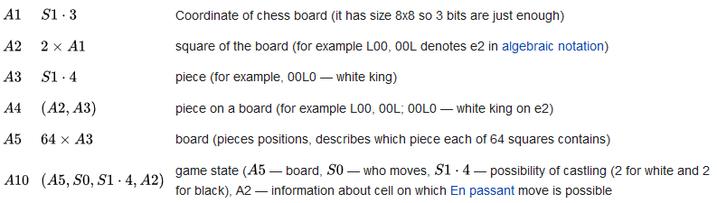
Single primitive type (bit / boolean) = S0
Notes:
All the further data types are composite, and build up from primitive by means of "arrays" and "records"

Slide 7
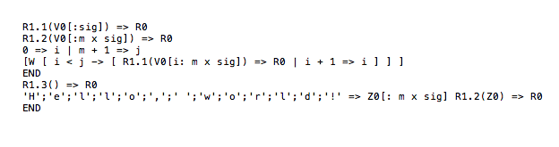
Hello World!

Slide 8
In summary - Zeus was pretty kül
Developed the first known formal system of algorithm notation capable of handling branches and loops.
Zuse discovered that the calculus he had independently devised already existed and was known as propositional calculus.
He never got to finish his chess program..
Notes:
built the first computer, the first ever high level programming language, all during ww2

Slide 9
“In 1945, Zuse described Plankalkül in an unpublished book...
The collapse of Nazi Germany, however, prevented him from submitting his manuscript.”

Slide 10
Thank you!

