Slide 1
CA1 OCT 2021
Completed by:
Fionnuala Hyndman - X00179539
Ciara Agar - X00174339

Slide 2

Our Project idea
Salon Website
Salon_home
Salon_shop
Salon_reviews
Salon_request
Our structure
Home.html
Base.html
User accounts

Slide 3
Salon_home
A starting point when accessing this website
Included a signup and login feature, further displayed on home.html
Within the code it gave a platform for the salon to post their own news
Gave structure to the home.html file
-- x00179539

Slide 4
Salon_shop
This is the site page which displays all of the hairdressers and barbers hairstyles options.
There is a display of images with a description of the hairstyle and also the price of the haircut.
This is not a purchasing system but more of an information page.
In this app we have a register category admin and a registered style admin.

Slide 5
Salon_reviews
This took the model of a blog post and manipulated it to suit a client reviews post forum for the salon
Within the code was included a post entry form which operated under the custom pk of Review
An aspect of this app held crud functionality, which offered the client a chance to see, edit and delete their review
-x00179539

Slide 6

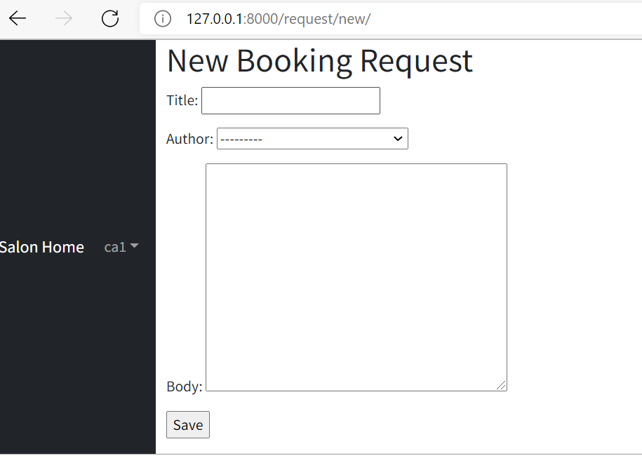
Salon_request
This is the site page where customers can book in for an appointment.
There is also a site page where all requests are posted , this is monitored by the salon
There is an author field which is taken by the logged in users username, a category field which is where the user decided barbers or hairdressers and finally a text field where the user informs the salon of the style and time of appointment that they want.
There is also an edit request option in case the user changes their mind and a delete option too.

Slide 7

Base.html
The base.html provided a body canvas for any page to customize.
Within ours gave a space for all apps to function
Implemented in the base.html were 3rd party apps bootstrap, crispy and the inclusion of static files

Slide 8
Home.html
This operated as the homepage html for our website
It extends base.html and provide the visual of the website
Included was a login/signup button enhanced by user authentication, its creation code present within the accounts app
We included the salon logo and access to our reviews and request system

Slide 9
That’s it!
Thank you so much for listening to our presentation!

