Slide 1
Walmart Analysis
Camden Lannin, Ciara Graves, Kiersten Bruns, Olympia Sauerwein

Slide 2
Data Cleaning
Key Cleaning Steps:
•Transactions: negatives kept as returns; 37 category labels reduced to 10; duplicates removed
•Product catalog: 27 category labels reduced to 10; package sizes standardized
•Distribution centers: removed ~ from Miami capacity; added capacity_approximate
•Store locations: IDs and state labels standardized; Tallahassee coordinates filled and flagged
•Daily sales summary: 34 negative revenues and fractional units kept and flagged
•Inventory levels: 626 missing units_on_order kept as NaN; 4 unmatched SKUs flagged
Notes:
-Cleaned and standarized six datasets prior to analysis
-Removed duplicate transactions and standrized product categories and store IDs
-Tried to preserve as much data as possible (rather than deleting it) - ex: negative quantities representing returns
-Rather than deleting, flagged missed/uncertain values
-

Slide 3
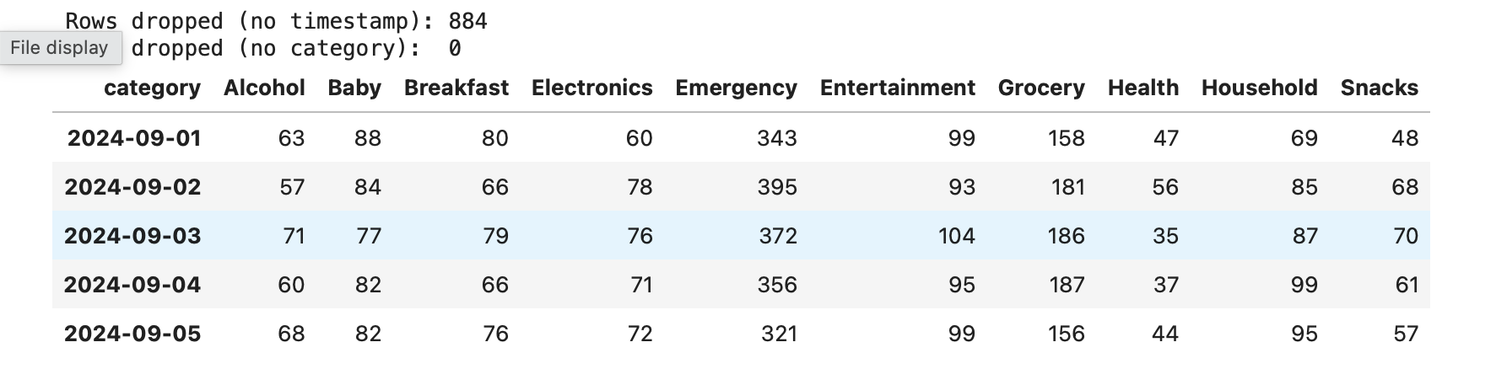
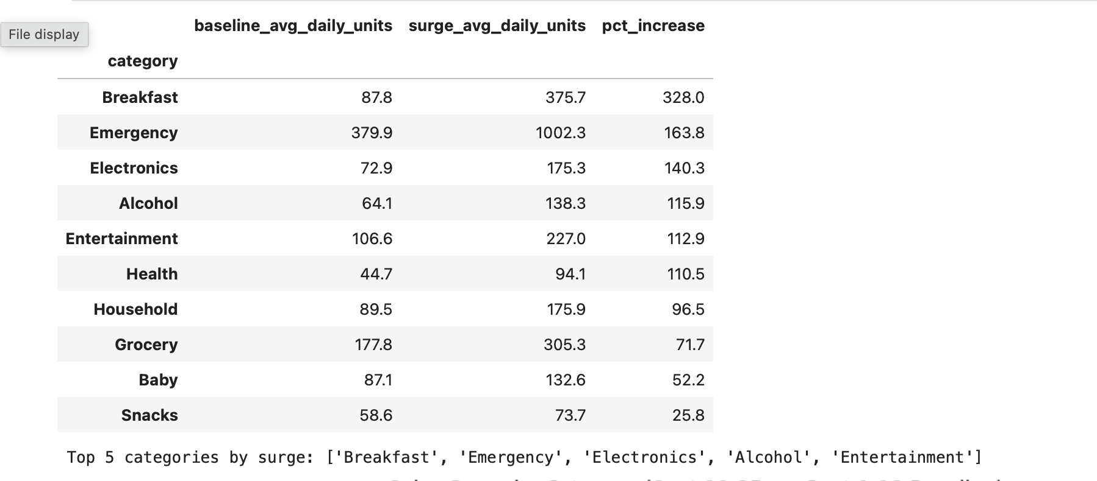
Q1 Demand Surge
Step 1
-Step 1: Established Baseline (Sept 1-18) and Surge Window (Sept 19-25); dropped 884 rows (no timestamp); added up sales per day per category
-Step 2: Found avg daily units sold during the baseline and surge period; then found the percent increase between the two periods; determined top five surging categories
Step 2
Notes:
-Effort to identify which product categories experienced the largest sales increases in the week leading up to hurricane landfall
-Compare the baseline of Sept 1-18 against the Sept 19-25 surge period
-Notably, excluded 884 transactions with missing timestamps - no way to reliably assign them to a date
-Calculated average daily units sold in each period and the percentage increase
-Breakfast, Emergency, Electronics, Alcohol, and Entertainment had the largest percentage increases

Slide 4
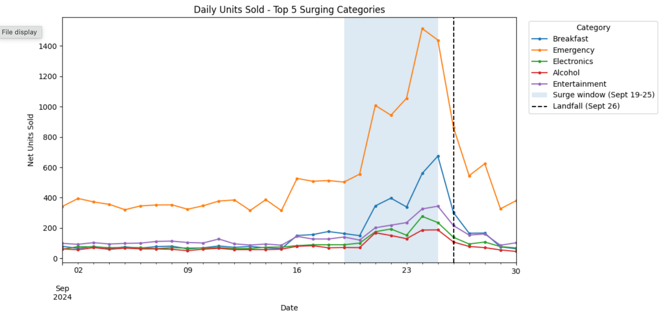
Visualizing units sold per day for top 5 surging categories
Notes:
Can see a clear spike in demand leading up to landfall, particularly for emergency supplies, and a decline afterward

Slide 5
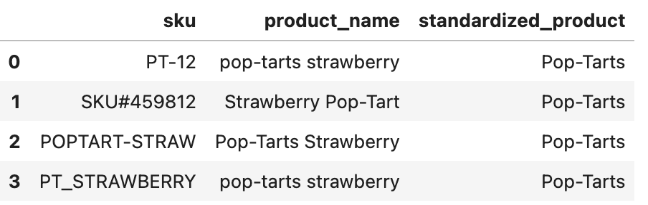
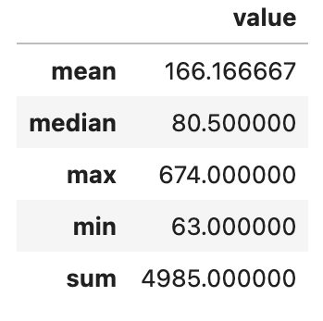
Before Consolidation:
Statistics after consolidation:
Notes:
We consolidated the strawberry poptarts. There were 4 sku’s that needed to be consolidated to better represent the data. There was PT-12, SKU#459812, POPTART-STRAW, and PT_STRAWBERRY. Each one had a total of 1,328, 1,233, 1,222, and 1,202.The true daily sales volume is 4985 units, with an average of 166.17 units per day. The max was 674 units in one day.

Slide 6
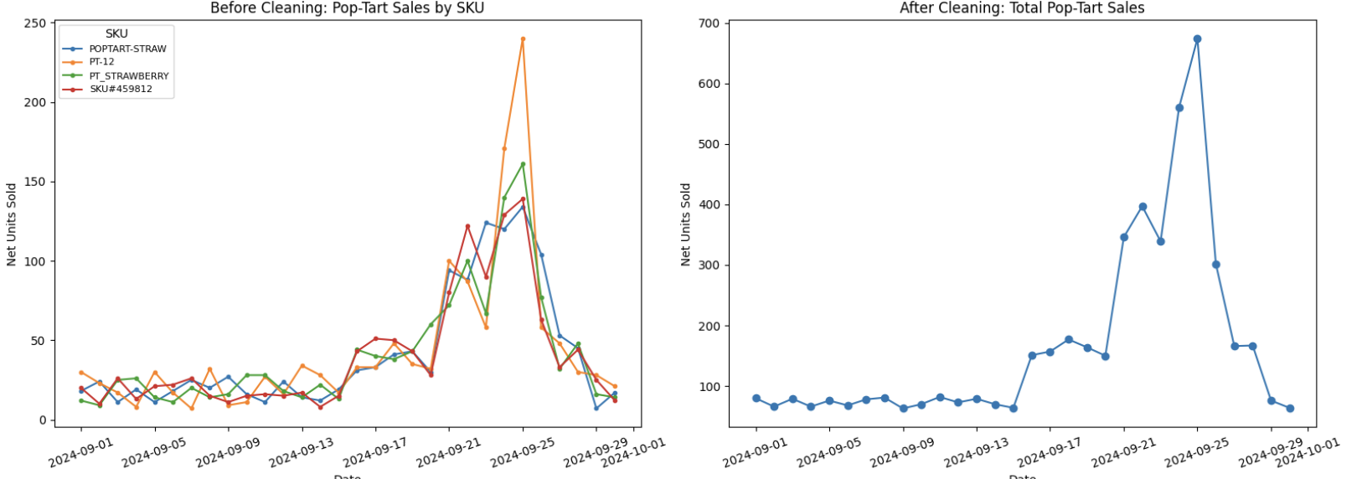
Sku Consolidation
Notes:
The fragmented skus make it seem like the pop-tarts are not overly high in sales, but when combined they are. The consolidated shows nearly 700 in total, when the fragmented had a peak at almost 250.

Slide 7
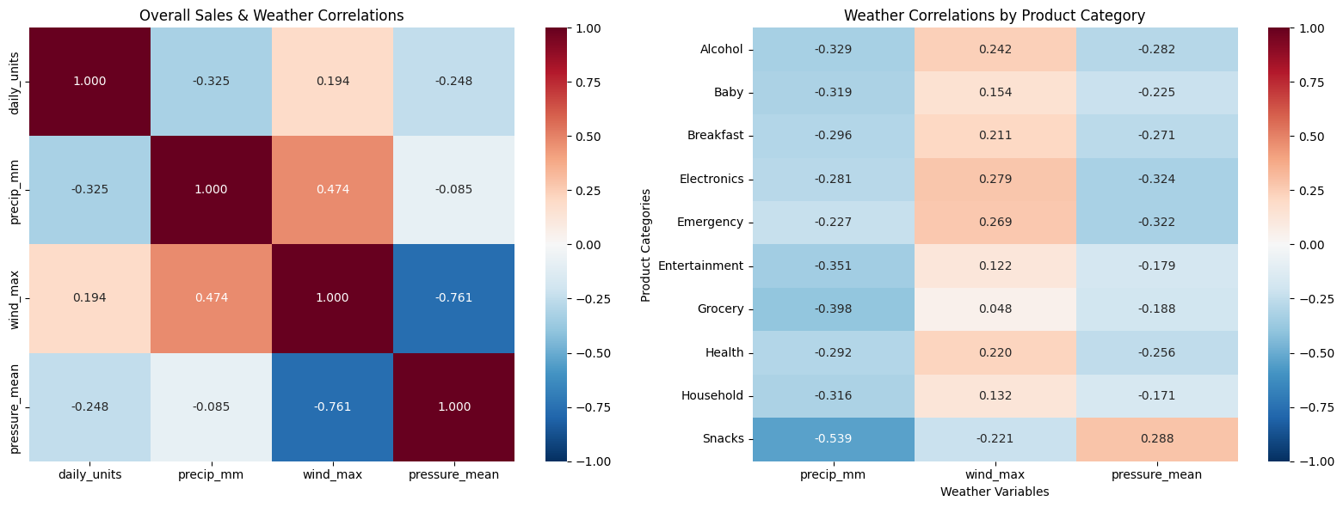
Weather Correlations
Notes:
Our side-by-side heatmaps allow for us to compare the difference in correlations between daily sales and weather conditions, and daily sales by product category and weather conditions. From this we get a general and in-depth view of the relationship between product sales and weather conditions during our storm period. It is of note that there are no strong correlations presented. Thus, we conclude that sales, both general and by product category, are not specifically strongly correlated with the weather conditions precipitation (in mm), wind (maximum), and pressure (mean). Therefore, the weak correlations suggest that weather conditions alone do not explain purchasing behavior and there are other factors to consider. Further, factors such as lag or delayed sales or nonlinearity should be considered.

Slide 8
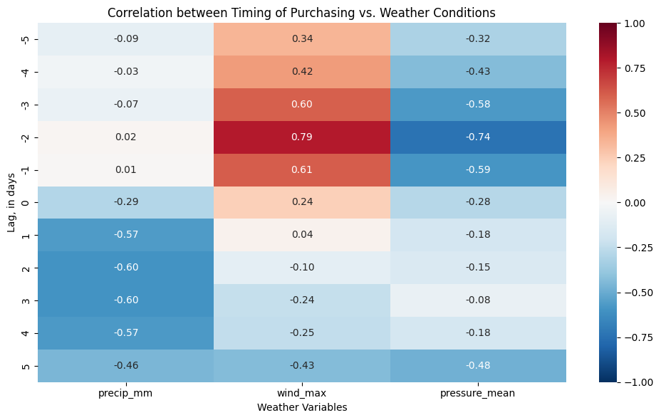
Weather Correlations Continued: Lag Analysis
Notes:
To continue our weather correlation analysis, we investigated lag in the timing of purchasing to see if a delay in sales would have any effect in our understanding of the relationship between weather conditions and sales. From this we have some moderate and strong correlations, such as wind (max) with r = 0.79 at 2 days prior to landfall, pressure (mean) with r= -0.74 at 2 days prior to landfall, and precipitation (mm) with r= -0.60 at 2 days post landfall. This suggests a relationship between consumer purchasing as they start to experience the effects of the storm.

Slide 9
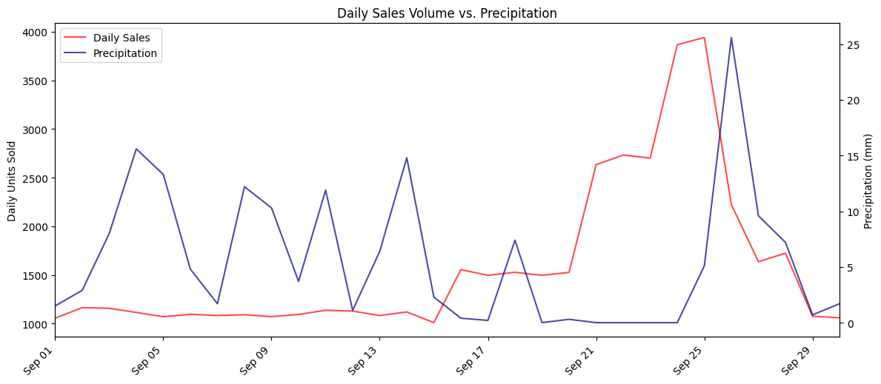
Time-Series Analysis: Daily Sales vs. Precipitation
Notes:
To further analyze weather data, we wanted to capture the relationship between sales and precipitation, relative to the timing of the storm. From our line chart, we see that sales experience a strong increase in the days leading up to the peak rainfall, and then experience a strong decline afterwards.

Slide 10
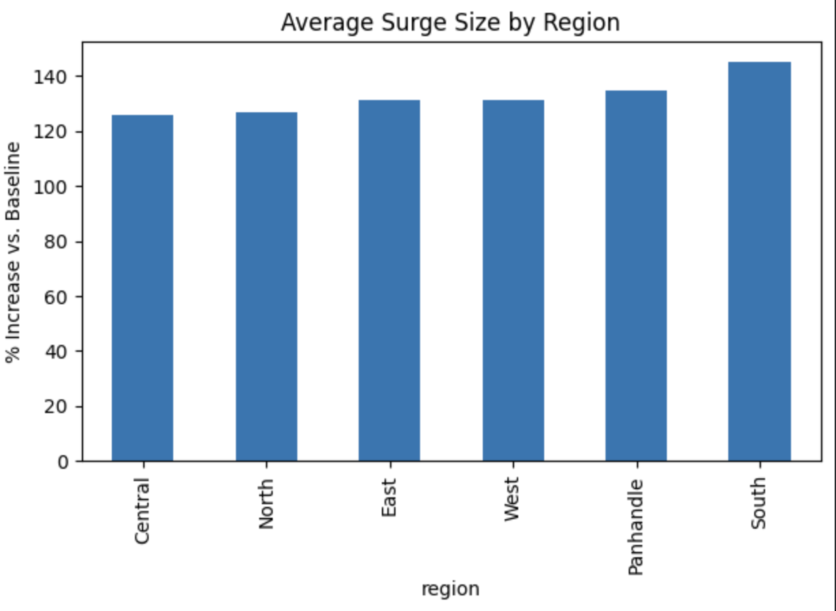
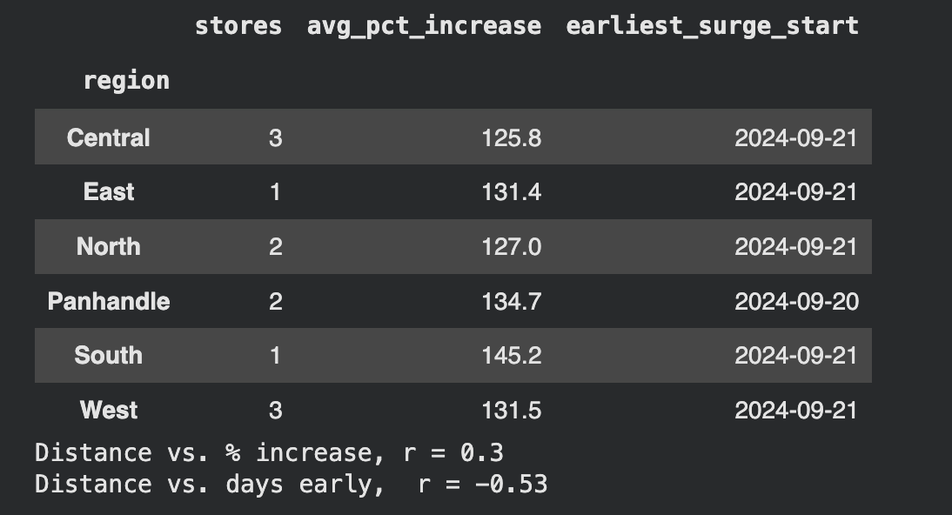
Stores and Geography
Notes:
The baseline is from September 1st through the 18th and the surge window is September 19th to the 25th. The surge timing begins the first day a store’s sales exceed 1.5x its own baseline average. Distance is determined by straight-line degrees from the approximate Hurricane Helene landfall point (30.0, -83.7), found from the National Hurricane Center.
Store surges were similar across Florida: all 12 stores roughly doubled their sales in the 7 days before landfall (+116% to +145% over each store’s own Sept 1-18 baseline), and 11 of 12 first exceeded 1.5x their baseline on Sept 21.

Slide 11
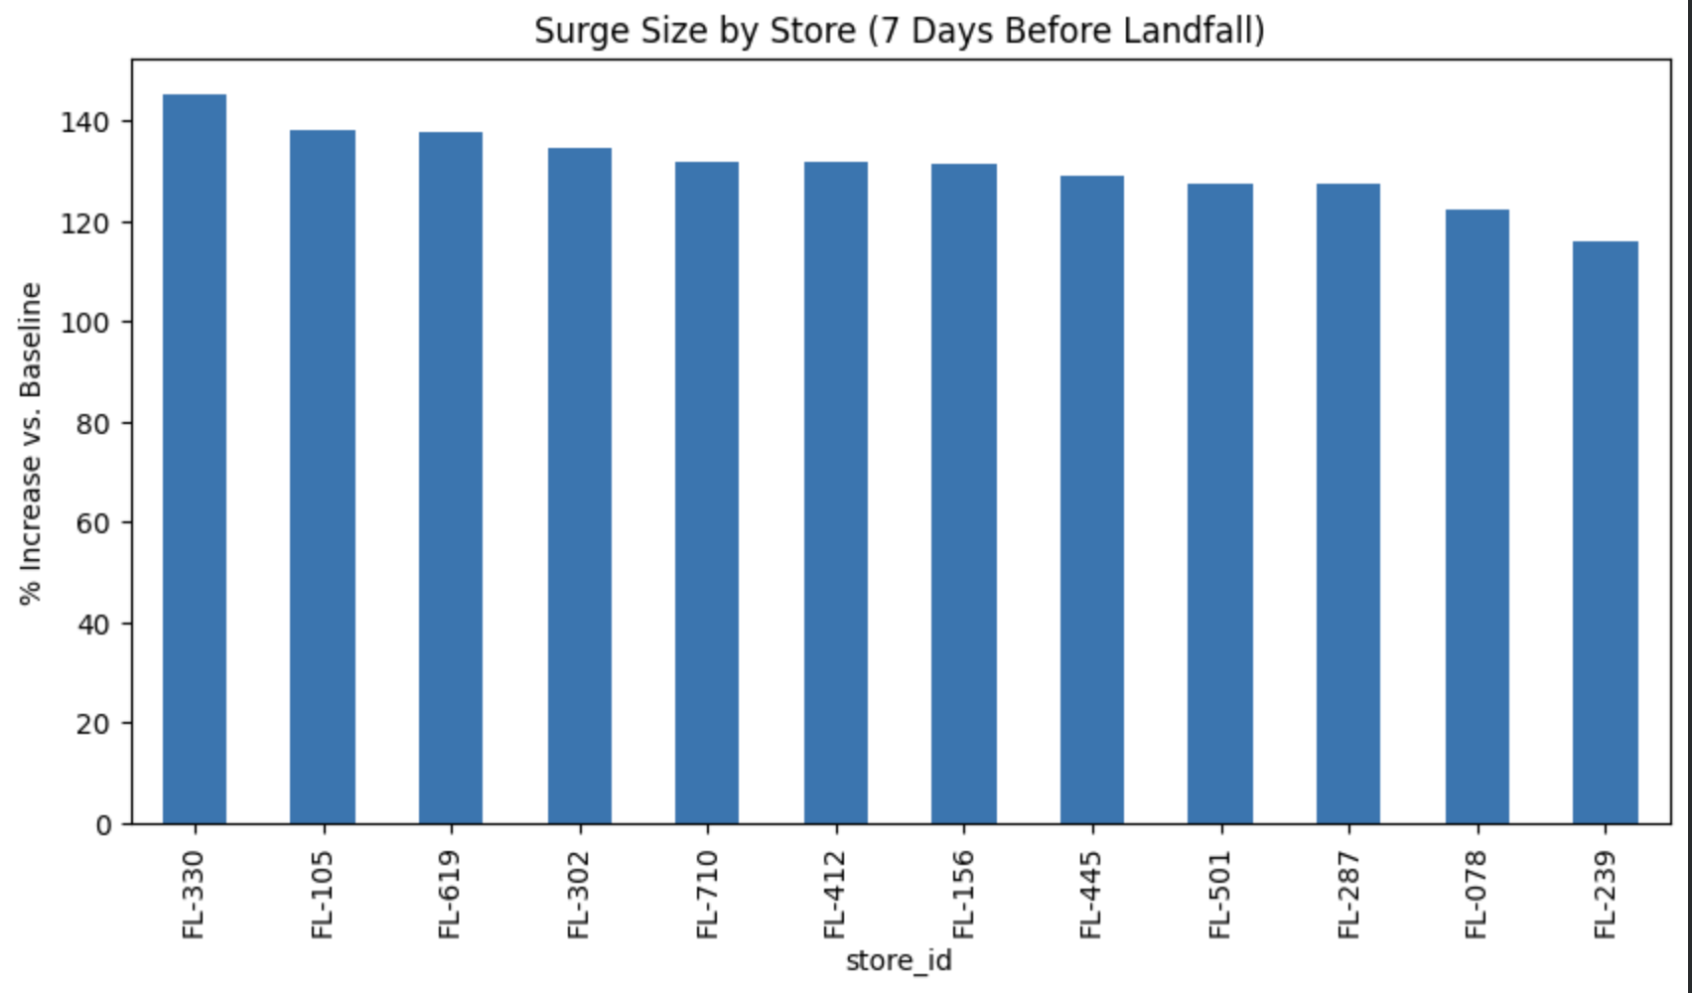
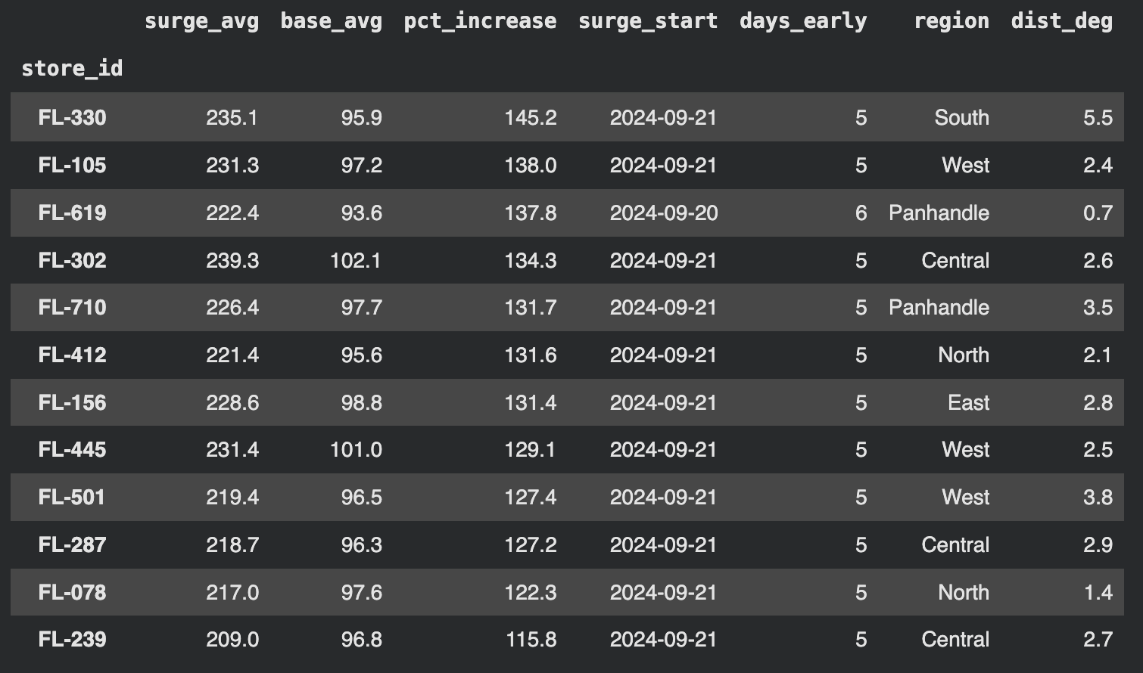
Surge Size by Store
Notes:
Storm surges were similar across all of Florida with all 12 stores roughly doubling in sales in the 7 days preceding landfall. 11 out of 12 of the store increased by over 1.5x their approximate baseline on September 21st.

Slide 12
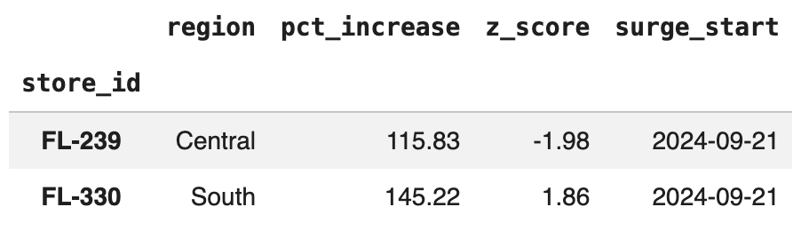
Outliers
Notes:
Using z-scores on surge size with a 1.5 cutoff, the Orando location in central Florida (z = -1.98) and the Miami location in southern Florida (z = 1.86) are the outliers, although the spread across stores is relatively narrow (29 percentage points).

Slide 13
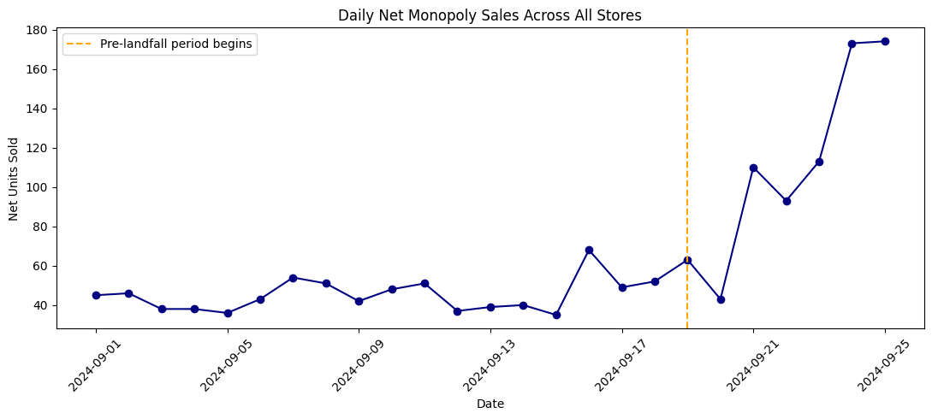
Recommendation
They should not order more board games before storm surges, as the data we have access to does not provide enough of an impact to justify the risk. It would be worth looking into states that experience other natural disasters, such as Tornadoes.
Notes:
Increase from 60 units to 180 units across the state of Florida cannot be deemed to be significant.
Access to additional historic sales data would be useful in identifying if Walmart should stock more board games, and how much
Hard to make business decision based on an increase of ~120 units / day

Slide 14
Citations
Hersbach, H., et al. (2023). ERA5 hourly data on single levels from 1940 to present. Copernicus Climate Change Service (C3S) Climate Data Store. https://doi.org/10.24381/cds.adbb2d47
Zippenfenig, Patrick. Open-Meteo.com Weather API. 2023. Zenodo, https://doi.org/10.5281/ZENODO.7970649. Accessed November 11, 2026.

