Slide 1
Impact of Features in Hierarchical Representation
By: Nazar Flome, Ciaran Shuhang Zhou, Sunhee Jin, Amberly Tam

Slide 2
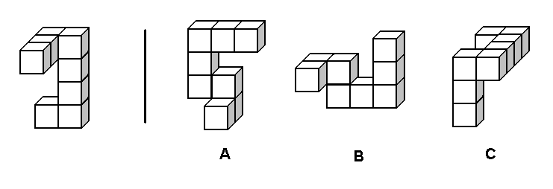
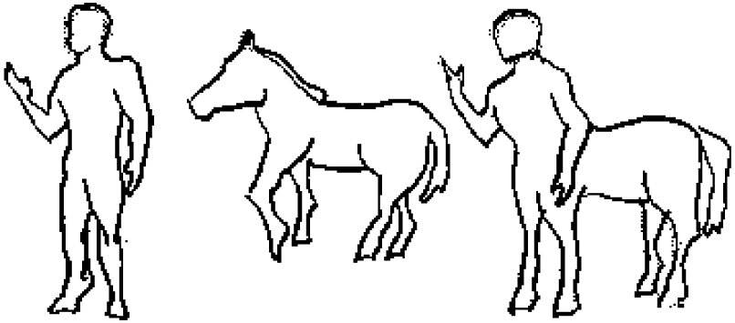
Background
How do humans create mental structures for the world around them?
Chomsky: Linguistic approach to cognition.
Shepard: Structure is inferred through similarity.
Tversky: Similarity may be modeled by looking at features through the contrast model.
Notes:
Nazar
Restricting the domain of the mind

Slide 3
Background
Human Representation-
Deyene: Going beyond feature generation tasks by utilizing more sophisticated methods for feature quantitation to the set the groundwork for further investigation into human representation. Our leuven dataset comes from the feature listing frequency data found in this study.
Michael Lee: Human similarity judgements of 21 animals presented as words on a five point scale. Investigating correlations between human judgements and several models of human judgement.
Deep Learning Model:
Turko BioNLP: Neural network algorithm that computes the vector representation of words. Using Bag-of-Words model where the frequency of occurrence of each word is used as a feature for training a classifier. This model is applied to a dataset of 100 billion words from google news.
Notes:
Nazar

Slide 4
Question(s):
How accurate are hierarchical clustering algorithms in representing human representations of animals?
In humans and deep learning models, how do features of animals affect hierarchical representations?
Notes:
Nazar
How do humans and deep learning models represent features? And

Slide 5
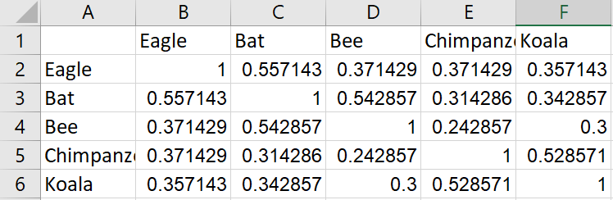
Method
In order to compare how human judgement and deep learning represent hierarchical structure differently, we collect animal data from Michael Lee’s data (human judgement), Leuven’s data (human judgement), and Word2Vec Deep Learning Model.
Michael Lee’s data contains the similarity matrix of 21 animals, which represents human’s similarity ratings of each pair of animals:
Notes:
Ciaran

Slide 6
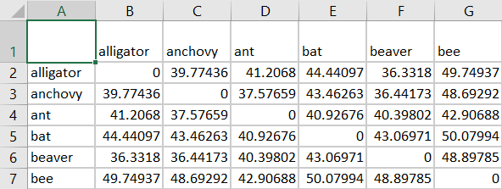
Method
In order to compare how human judgement and deep learning represent hierarchical structure differently, we collect animal data from Michael Lee’s data (human judgement), Leuven’s data (human judgement), and Word2Vec Deep Learning Model.
Leuven’s data contains human judgement of the features of 129 different animals. We used MATLAB built-in function pdist() to compute the distance matrix of each pair of animals:
Notes:
Ciaran

Slide 7
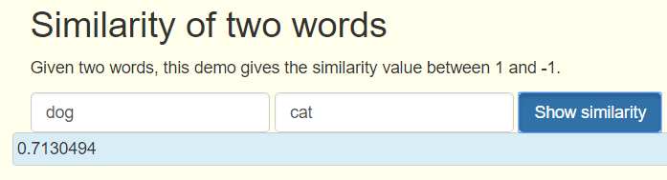
Method
In order to compare how human judgement and deep learning represent hierarchical structure differently, we collect animal data from Michael Lee’s data (human judgement), Leuven’s data (human judgement), and Word2Vec Deep Learning Model.
Word2Vec Deep Learning Model, is a neural network model trained with English GoogleNews Negative300 Database, which constructs different linguistic word contexts according to the input words. By feeding in two different animals, the model is able to give a similarity rating of them.
Notes:
Ciaran

Slide 8
Method
In order to compare how human judgement and deep learning represent hierarchical structure differently, we collect animal data from Michael Lee’s data (human judgement), Leuven’s data (human judgement), and Word2Vec Deep Learning Model.
Human Judgement vs. Deep Learning
Michael Lee’s Data vs. Word2Vec Deep Learning Model
Leuven’s data vs. Word2Vec Deep Learning Model
Comparing using Classical Multidimensional Scaling (MDS)
Notes:
Ciaran

Slide 9
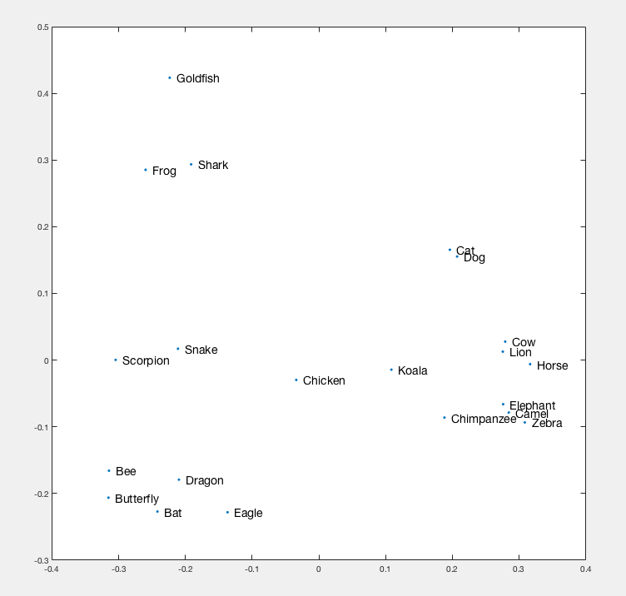
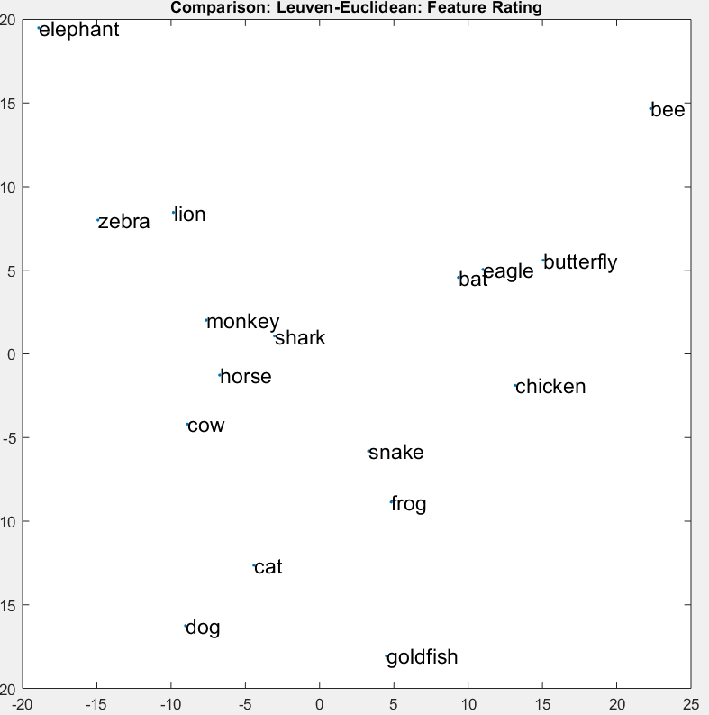
Human Judgment (ML)
Human Judgment (Leuven)
Sea animals
Wingless animals
Land animals
Winged animals

Slide 10
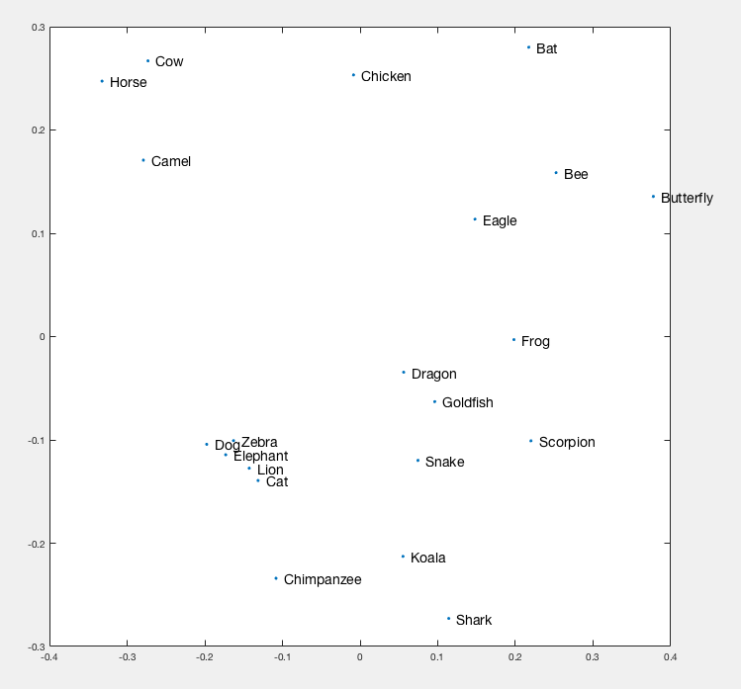
Michael Lee
Human Judgment
Deep Learning (Word2Vec)
Notes:
These are the representations based on the Michael Lee’s animals.
The one on the left is the hierarchical representation of animals based on human similarity rating.
Humans represent animals based on general relationships. While deep learning considers all features.

Slide 11
Michael Lee
Human Judgment
Deep Learning (Word2Vec)
Sea animals
Land animals
Notes:
Clearly, the human representation has two distinct clusters while the deep learning model has several clusters

Slide 12
Michael Lee
Human Judgment
Deep Learning (Word2Vec)
Notes:
Similar distances among animals across these two representations; however, animals are in different clusters.

Slide 13
Michael Lee
Human Judgment
Deep Learning (Word2Vec)
Notes:
Deep learning model is more conservative, compared to humans (dog and cat)
*there’s a fable called the scorpion and the frog.
A type of fish called dragon eye goldfish

Slide 14
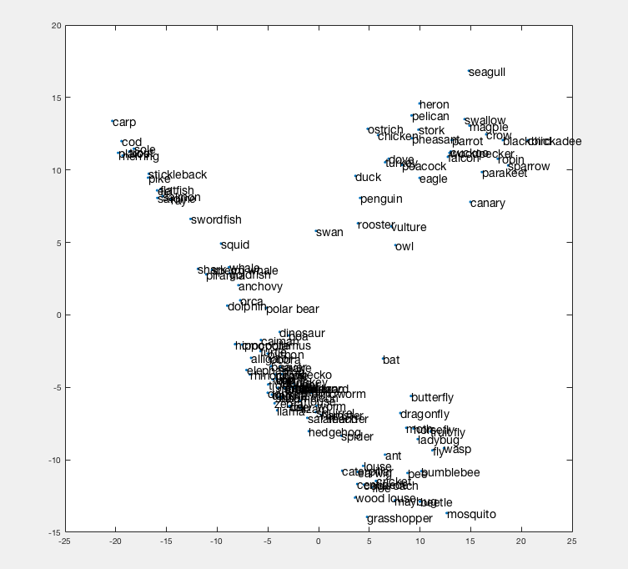
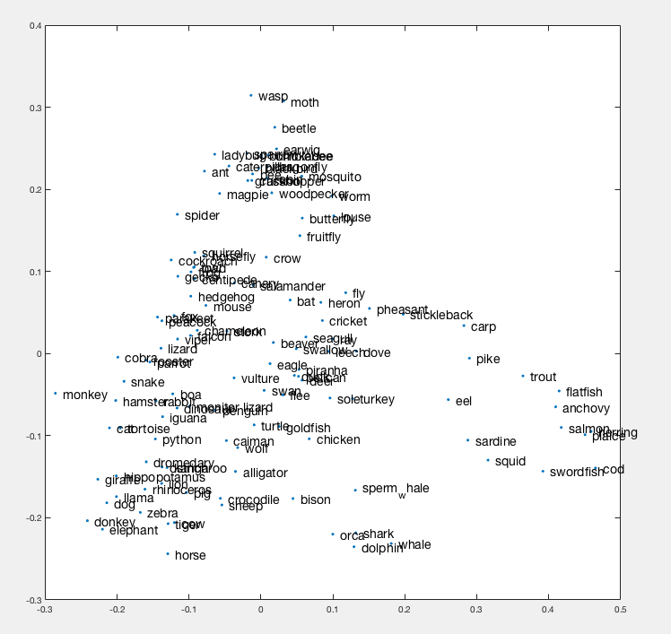
Results: Leuven --- Overview
Human Judgement
Deep Learning (Word2Vec)
Fish
Birds
Insects
Birds
Warm-
blooded animals
Fish
Insects
Mammals/
amphibians
Sea mammals
Notes:
Similar to the representation from the Michael Lee’s data, Humans have a clearer representation of categories within animals,
Deep learning more blurred and clumped together

Slide 15
Results: Leuven --- Fish
Human Judgement
Deep Learning (Word2Vec)
Fish
Fish
Sea mammals

Slide 16
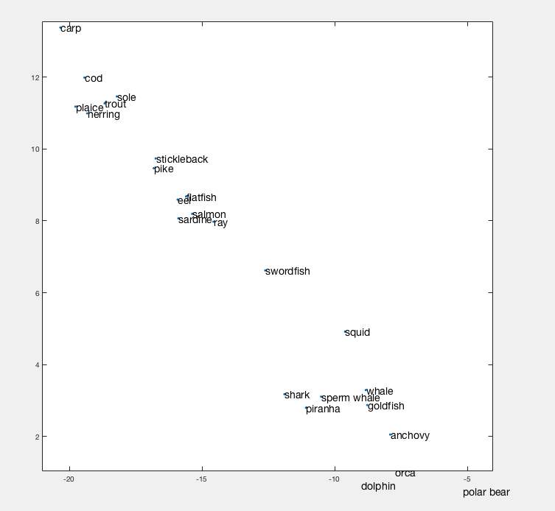
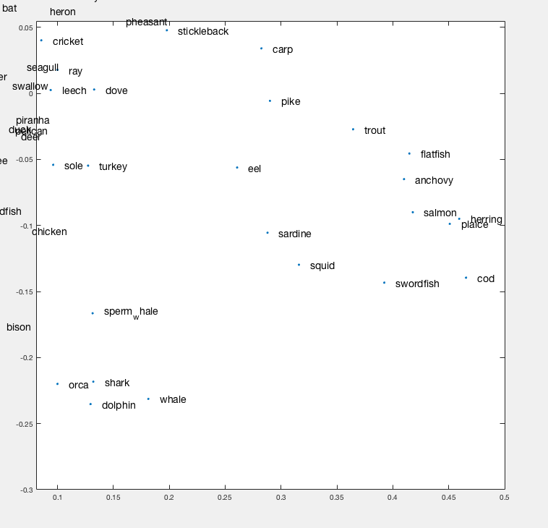
Results: Leuven --- Fish
Human Judgement
Deep Learning (Word2Vec)
Fish
Sea mammals
Notes:
The deep learning model has a more accurate hierarchical representation of fish; divides sea animals and fish to clusters.
Although humans cluster within fish category, we cannot explain these clusters. The bottom cluster seems to represent sea mammals, but there are some fish such as the goldfish and anchovy that are not within that category.
Sole is not in the fish hierarchy for deep learning model since sole has many meanings to it, yielded really low similarity ratings, used in many different contexts
Humans more small clusters, thinking all fish are similar, while word2vec is more spread out, retaining the differences between the different fish

Slide 17
Results: Leuven --- Insects
Human Judgement
Deep Learning (Word2Vec)
Insects
Insects
Mammals/
amphibians
Mammals/
amphibians

Slide 18
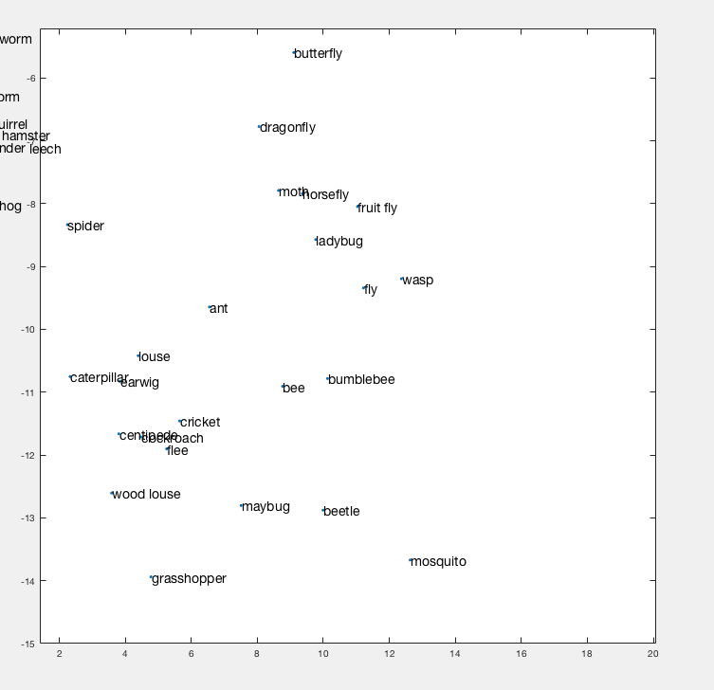
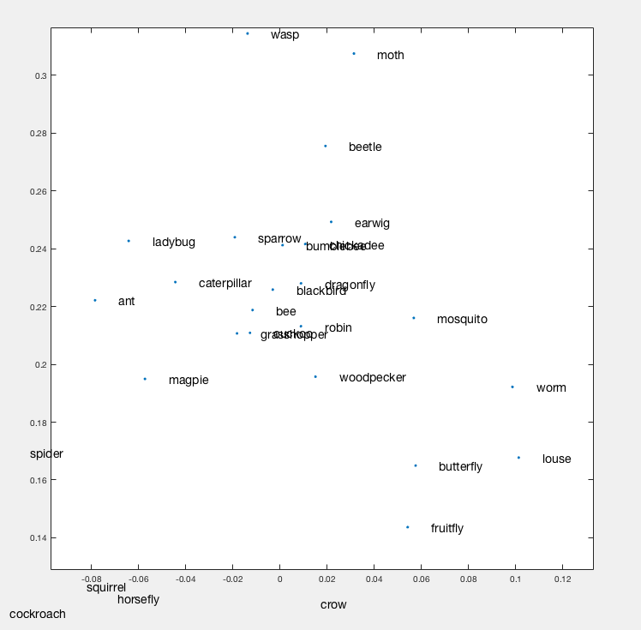
Results: Leuven --- Insects
Human Judgement
Deep Learning (Word2Vec)
Notes:
For deep learning model, there are birds within the category of insects. *might be because of the surrounding insects have the similar feature of the ability to fly
Deep learning doesnt have wood louse, where human does , human cluster wood louse with louse
Wasp is not close to bee in deep learning

Slide 19
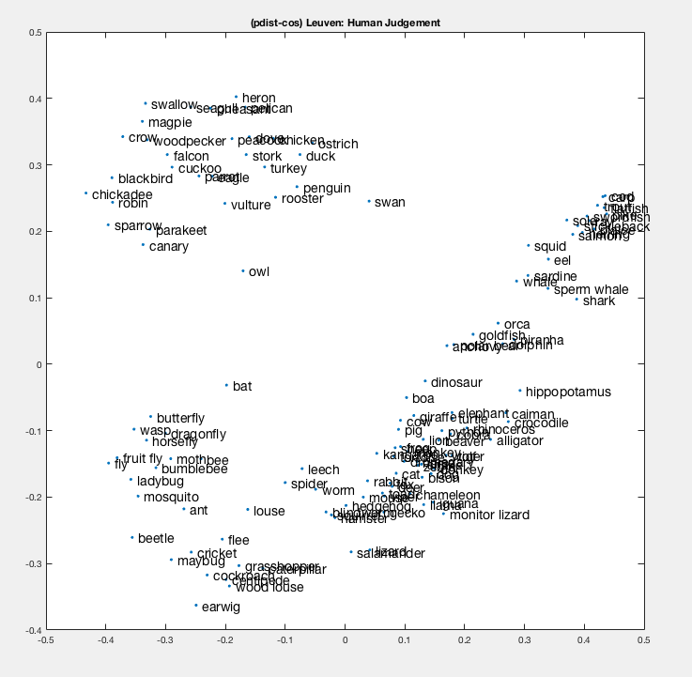
Results: Leuven - Cosine vs Euclidean
Cosine
Euclidean
Birds
Birds
Fish
Fish
Insects
Insects
Mammals/
amphibians
Notes:
For deep learning model, there are birds within the category of insects. *might be because of the surrounding insects have the similar feature of the ability to fly
Deep learning doesnt have wood louse, where human does , human cluster wood louse with louse
Wasp is not close to bee in deep learning

Slide 20
Bonus
In the similarity matrix generated by Word2Vec Deep Learning Model using Michael Lee’s Data, add several higher hierarchical animal-type names, then see where those names are located in the new graph and how they affect the overall layout of the graph.
Notes:
Ciaran

Slide 21
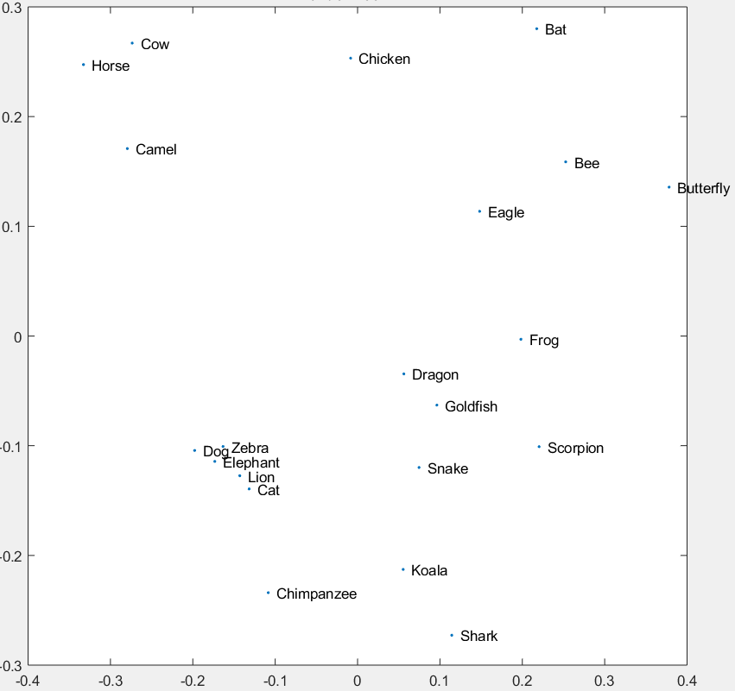
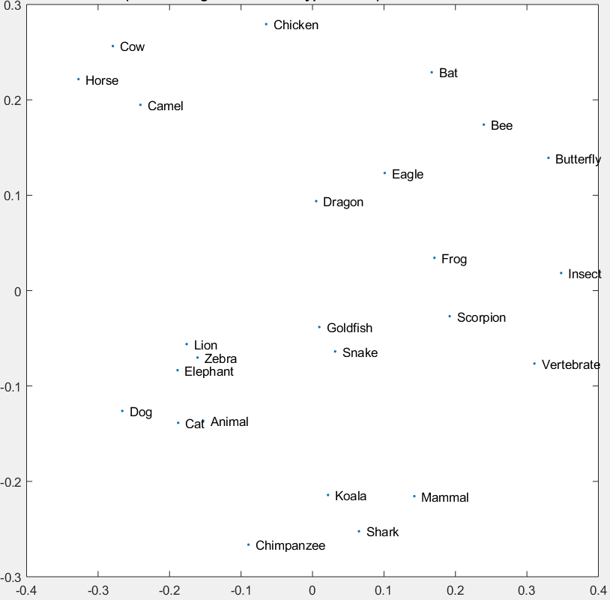
Michael Lee: Deep Learning (Word2Vec)
Without category names
With added category names
Notes:
Ciaran

Slide 22
Bonus: Results
The overall layout of the graph is shifted after adding those names
The placements of those higher hierarchical animal-type names are not very accurate
Not enough animals
Notes:
Ciaran

Slide 23
Discussion & Conclusion
Humans cluster animals using more simple and intuitive features/rules; Deep learning model uses more complicated and detailed features (e.g. Lueven Overview, insects)
Notes:
Ciaran

Slide 24
Results: Lueven --- Overview
Human Judgement
Deep Learning (Word2Vec)
Birds
Insects
Fish
Birds
Warm-
blooded animals
Fish
Insects
Mammals/
amphibians
Sea mammals
Notes:
Humans have clear hierarchies, deep learning more blurred and clumped together

Slide 25
Results: Lueven --- Insects
Human Judgement
Deep Learning (Word2Vec)
Notes:
For deep learning model, there are birds within the category of insects. *might be because of the surrounding insects have the similar feature of the ability to fly
Deep learning doesnt have wood louse, where human does
Wasp is not close to bee in deep learning

Slide 26
Discussion & Conclusion
Humans cluster animals using more simple features/rules; Deep learning model uses more complicated and detailed features (e.g. Lueven Overview, insects)
Within a specific cluster, humans are not good at determining how different animals are in that cluster; Deep learning model places more different animals further apart within the cluster (e.g. Michael Lee Overview)
Notes:
Ciaran

Slide 27
Michael Lee
Human Judgment
Deep Learning (Word2Vec)
Notes:
Similarity : lonely chicken
Deep learning model is more conservative, compared to humans (dog and cat)
Humans represent animals based on general relationships.
Even though clusters are different, the distances between certain animals are similar
Lacks hierarchies because of animals in it
*there’s a fable called the scorpion and the frog.
A type of fish called dragon eye goldfish

Slide 28
Results: Lueven --- Overview
Human Judgement
Deep Learning (Word2Vec)
Birds
Insects
Fish
Birds
Warm-
blooded animals
Fish
Insects
Mammals/
amphibians
Sea mammals
Notes:
Humans have clear hierarchies, deep learning more blurred and clumped together

Slide 29
Discussion & Conclusion
Humans cluster animals using more simple features/rules; Deep learning model uses more complicated and detailed features (e.g. Lueven Overview, insects)
Within a specific cluster, humans are not good at determining how different animals are in that cluster; the deep learning model places more different animals further apart within the cluster (e.g. Michael Lee Overview)
The deep learning model does not cluster animals hierarchically as clear as humans do because unlike humans who only consider simple features, the deep learning model considers all features which makes its clusters hard for humans to understand.
Notes:
Ciaran

Slide 30
Michael Lee
Human Judgment
Deep Learning (Word2Vec)
Notes:
Similarity : lonely chicken
Deep learning model is more conservative, compared to humans (dog and cat)
Humans represent animals based on general relationships.
Even though clusters are different, the distances between certain animals are similar
Lacks hierarchies because of animals in it
*there’s a fable called the scorpion and the frog.
A type of fish called dragon eye goldfish

Slide 31
Results: Lueven --- Overview
Human Judgement
Deep Learning (Word2Vec)
Birds
Insects
Fish
Birds
Warm-
blooded animals
Fish
Insects
Mammals/
amphibians
Sea mammals
Notes:
Humans have clear hierarchies, deep learning more blurred and clumped together

Slide 32
Limitations
Word2Vec Deep Learning Model
Based on English GoogleNews Negative300 Database
The similarity rating of two animals is calculated based on how often they appear in the same linguistic context
Humans are good at interpreting the animal names which are rare and ambiguous (e.g., sole, ray) ; However, deep learning model has difficulty understanding the words within our animal- clustering context
Notes:
Sunhee
Semantic ratings are very different
**Humans use category knowledge; however the deep learning model, they are trying to predict, abstract knowledge of the category.
Semantic space of michael lee;s data versus leuven’s data
Explore the cosine distance, deep learning model usually uses
Explore different meanings → bank (finance/nature)

Slide 33
Future Research
Utilizing different deep learning models
Utilizing different human representation datasets
Quantitative methods of comparison (correlational models)
Exploring representation in different mediums
Notes:
Nazar

Slide 34
References
De Deyne, S., Verheyen, S., Ameel, E., Vanpaemel, W., Dry, M. J., Voorspoels, W., & Storms, G. (2008). Exemplar by feature applicability matrices and other Dutch normative data for semantic concepts. Behavior Research Methods, 40, 1030 –1048. doi:10.3758/BRM.40.4.1030
Lee, M.D., Pincombe, B.M., & Welsh, M.B. (2005). An empirical evaluation of models of text document similarity. In B.G. Bara, L.W. Barsalou & M. Bucciarelli, (Eds.), Proceedings of the 27th Annual Conference of the Cognitive Science Society, pp. 1254-1259. Mahwah, NJ: Erlbaum.
Shepard, Roger N., and Jacqueline Metzler. "Mental rotation of three-dimensional objects." Science 171.3972 (1971): 701-703.
Tversky, A. (1977). Features of similarity. Psychological Review, 84(4), 327-352.
http://dx.doi.org/10.1037/0033-295X.84.4.327
Turko BioNLP Word2Vec Model:
http://bionlp-www.utu.fi/wv_demo/4

