Slide 1
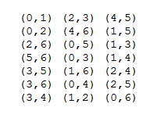
modMatch
match
time

