Slide 1
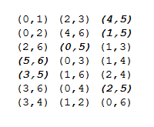
Skipper 5
4
1
0
6
3
2

