Slide 1
Prediction of the evolution of Alzheimer’s Disease A study with a multimodal approach
Ciarán McEvoy, A87240
Dissertation supervised by
Vitor Alves
Tiago Gil Oliveira

Slide 2
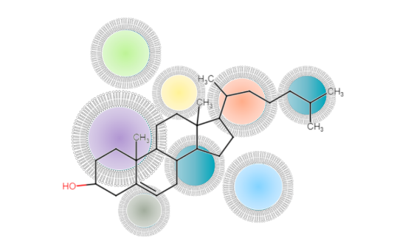
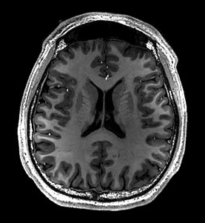

Overview

Slide 3
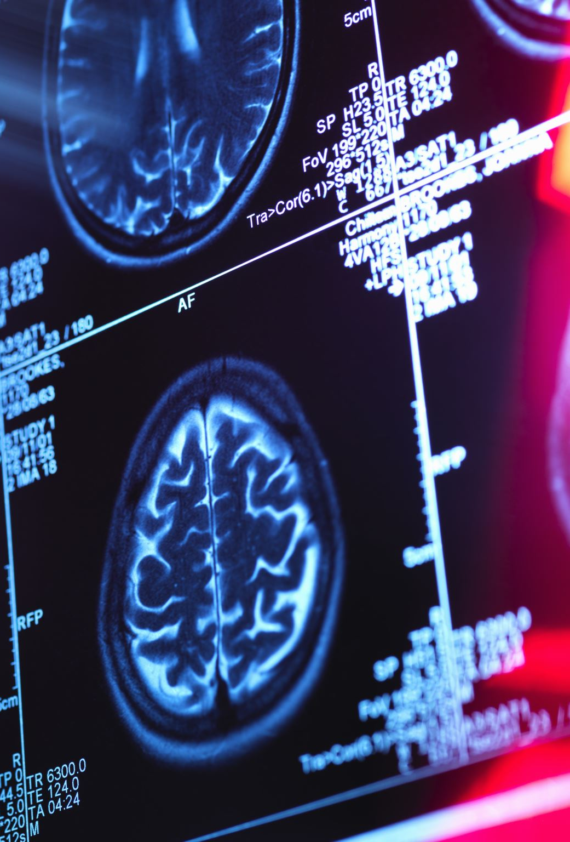
Study Questions
Do lipidome changes contribute to Hippocampal atrophy? Which lipid species have a significant impact?
Will it be possible to combine the use of machine learning methods with, MRI, and lipidomics data to accurately predict the progression of AD in a patient over a certain time interval?

Slide 4
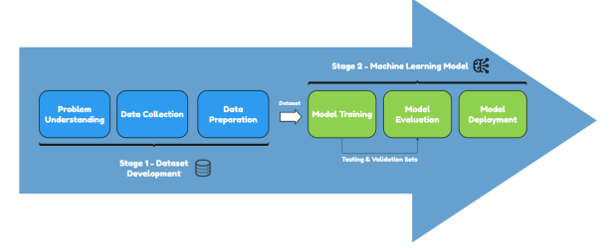
Thesis Timeline

Slide 5
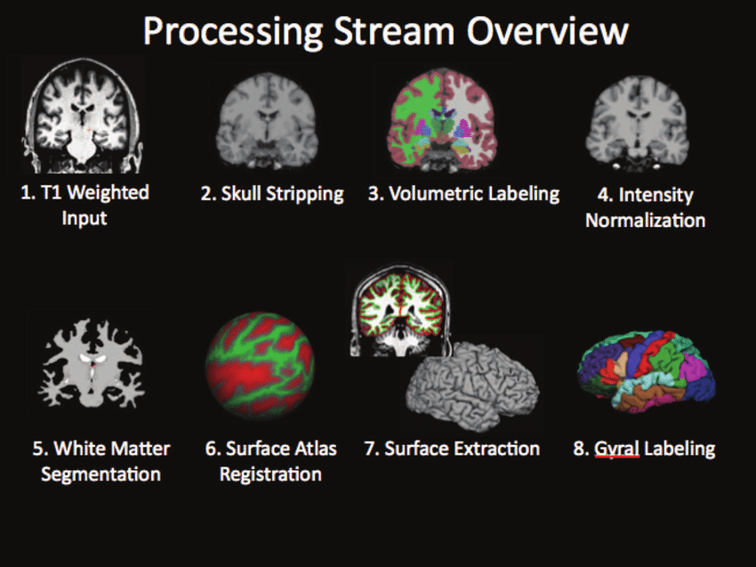
Data Collection
Data collected from the Alzheimer’s Disease Neuroimaging Initiative (ADNI)
MRI features extracted with Freesurfer

Slide 6

Dataset Stats
2754 rows
Number of Subjects: 1146 extracted from the ADNI database, ages 55 upwards
Lipid Species: 781
Total MRI Features Extracted: 129
CN: 809
AD: 401
MCI: 1544
*MCI Subjects include MCI, LMCI, EMCI, and SMC groups

Slide 7
Diagnosis Comparison using Volcano Plots

Slide 8
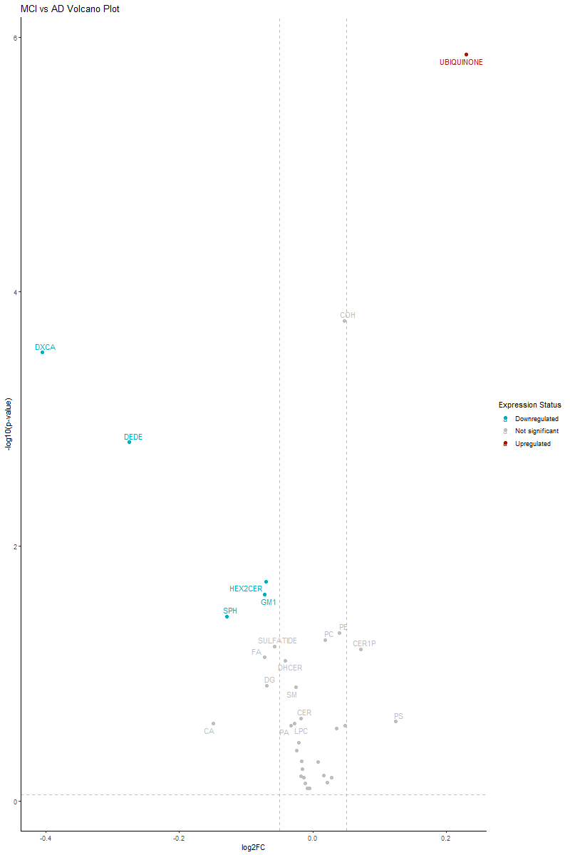
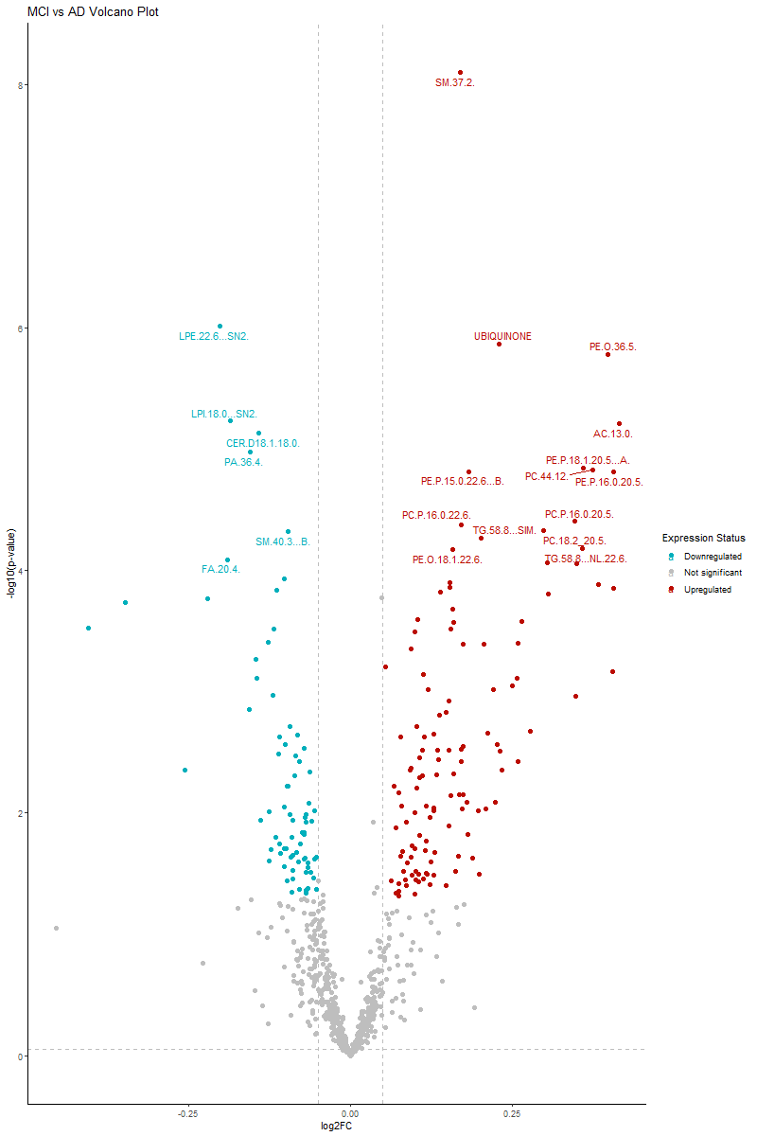
MCI vs AD

Slide 9
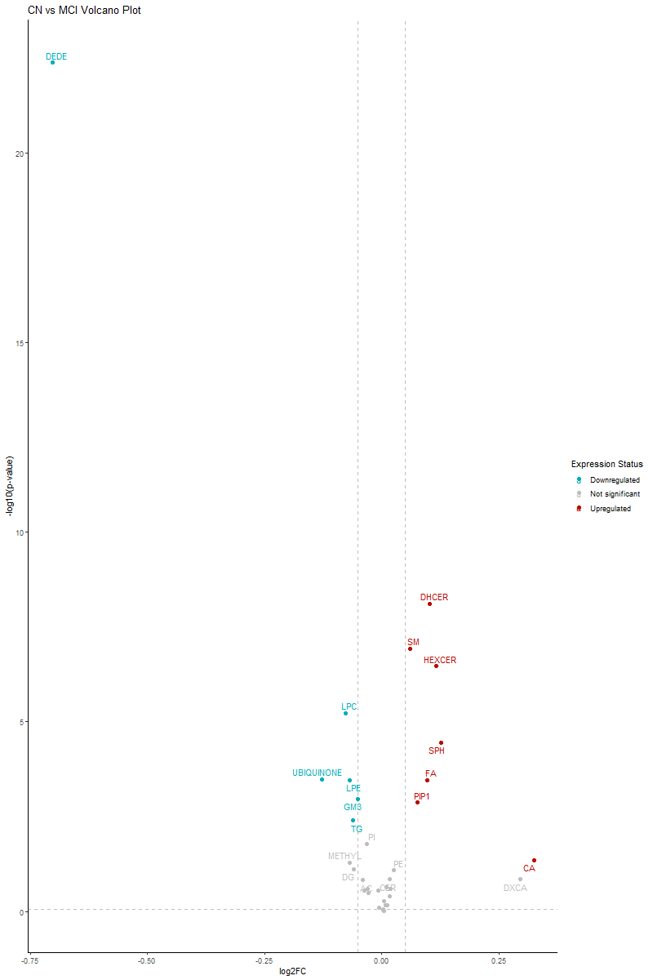
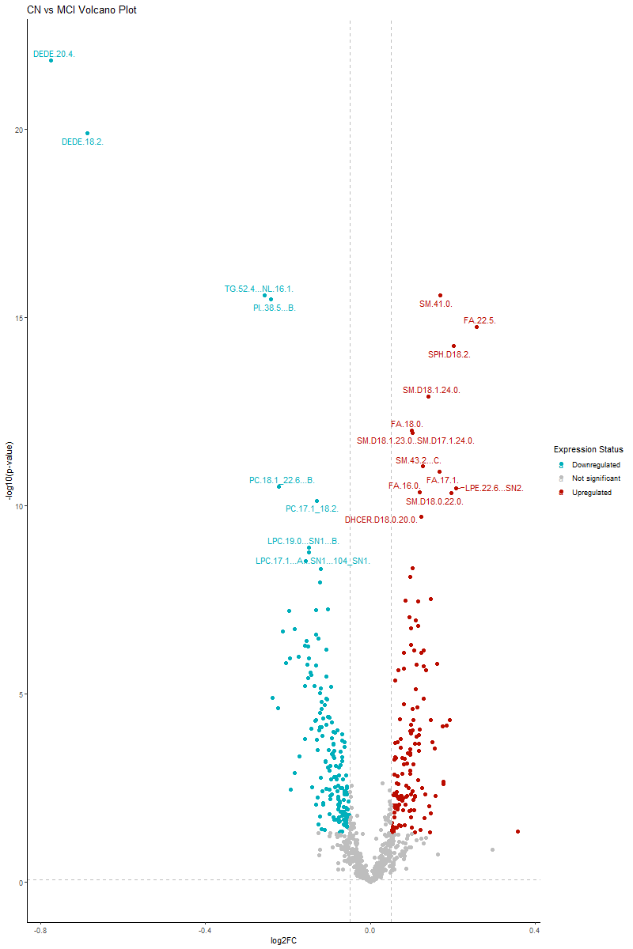
CN vs MCI

Slide 10
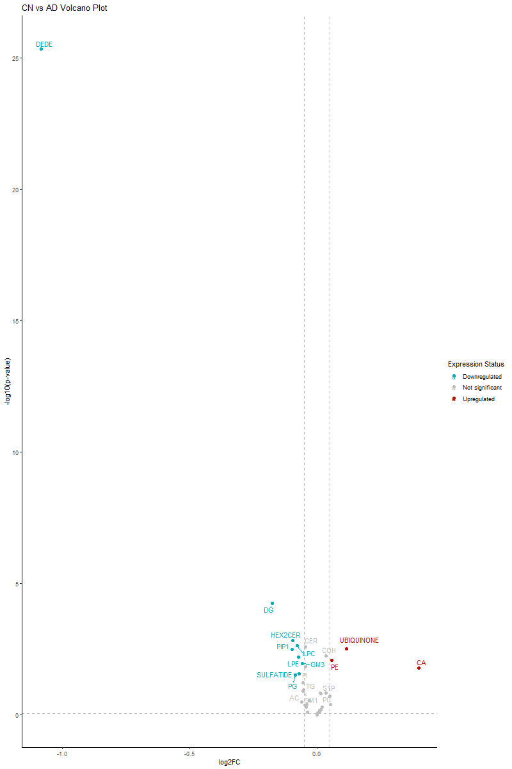
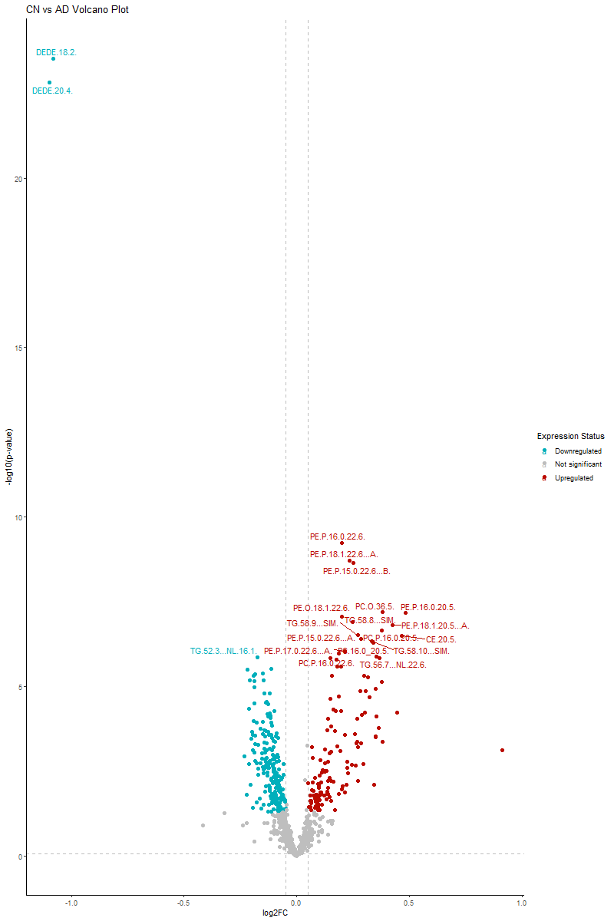
CN vs AD

Slide 11
Correlations between Lipid Classes and Brain Regions

Slide 12
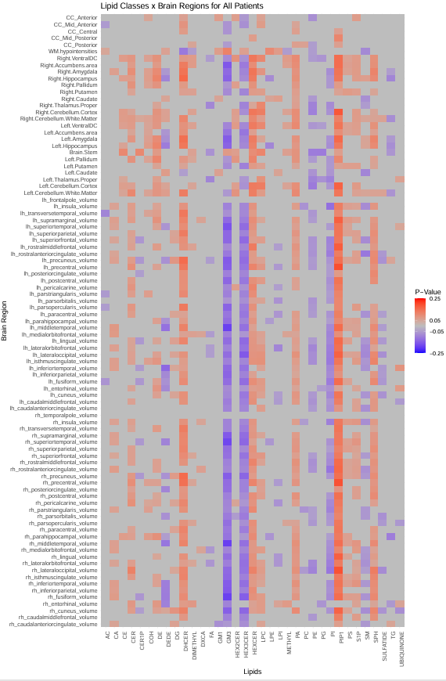
AD x CN x MCI

Slide 13
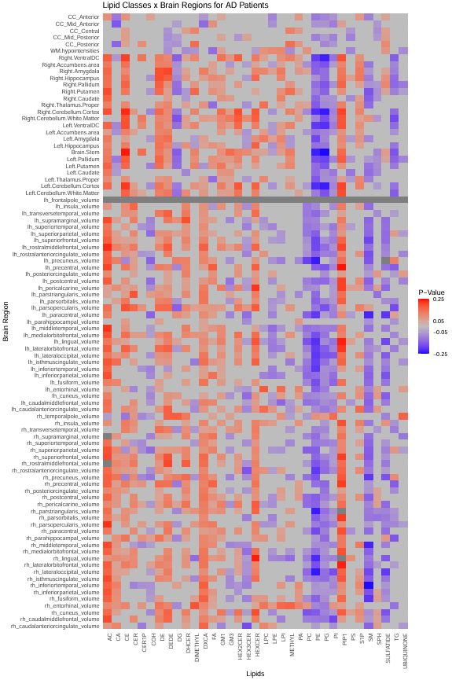
AD Patients Only

Slide 14
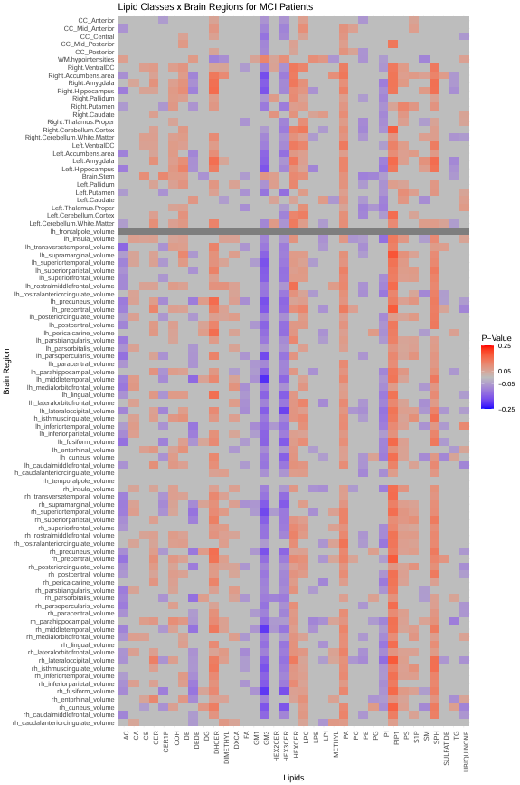
MCI Patients Only

Slide 15
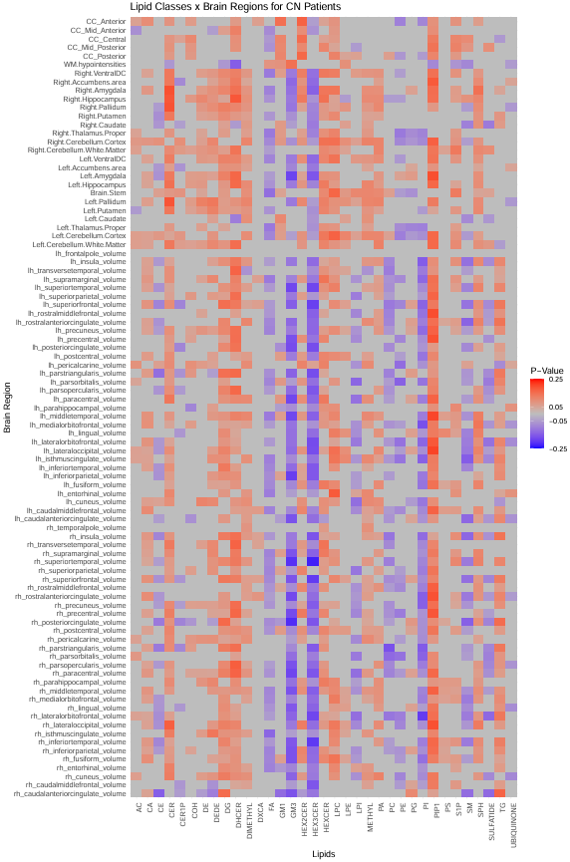
CN Patients Only

Slide 16
Principal Component Analysis

Slide 17
All Patients

Slide 18
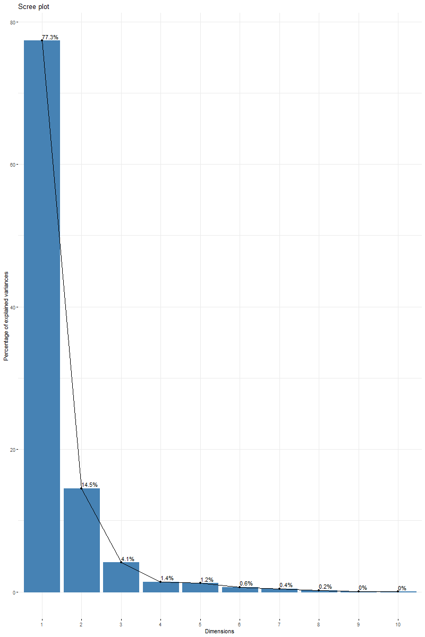
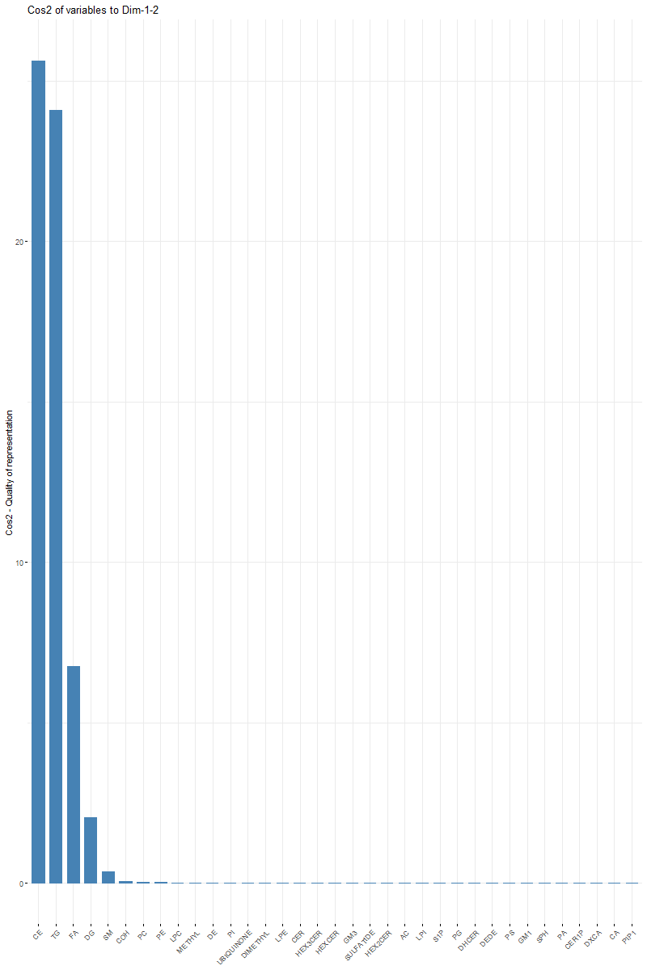
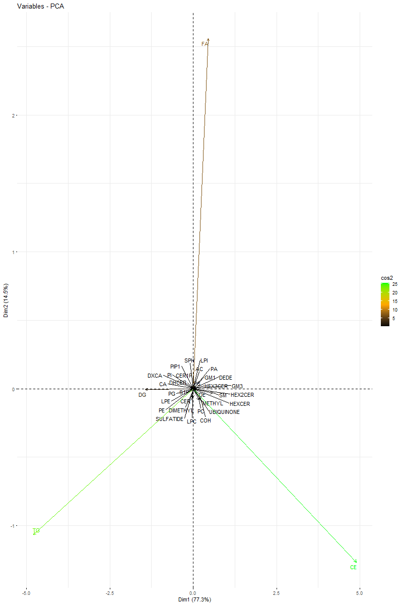

Slide 19
Patients with AD

Slide 20
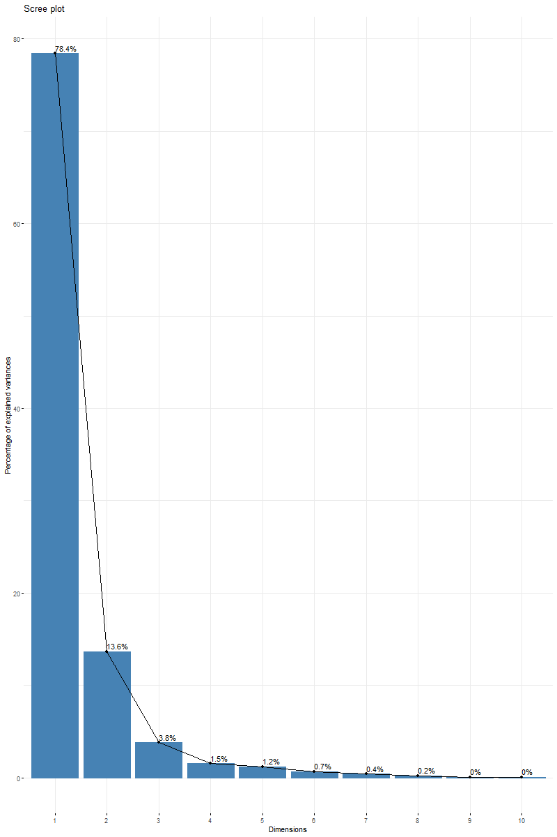

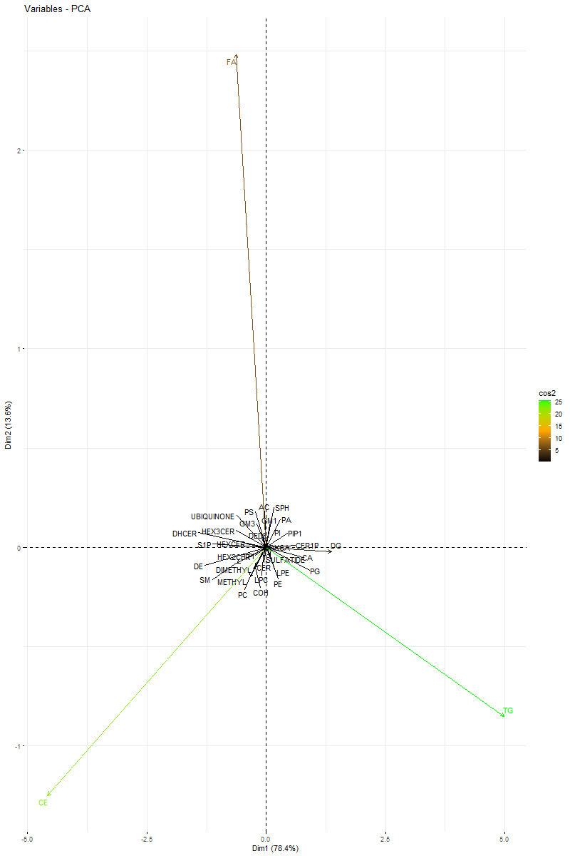

Slide 21
Patients with MCI

Slide 22


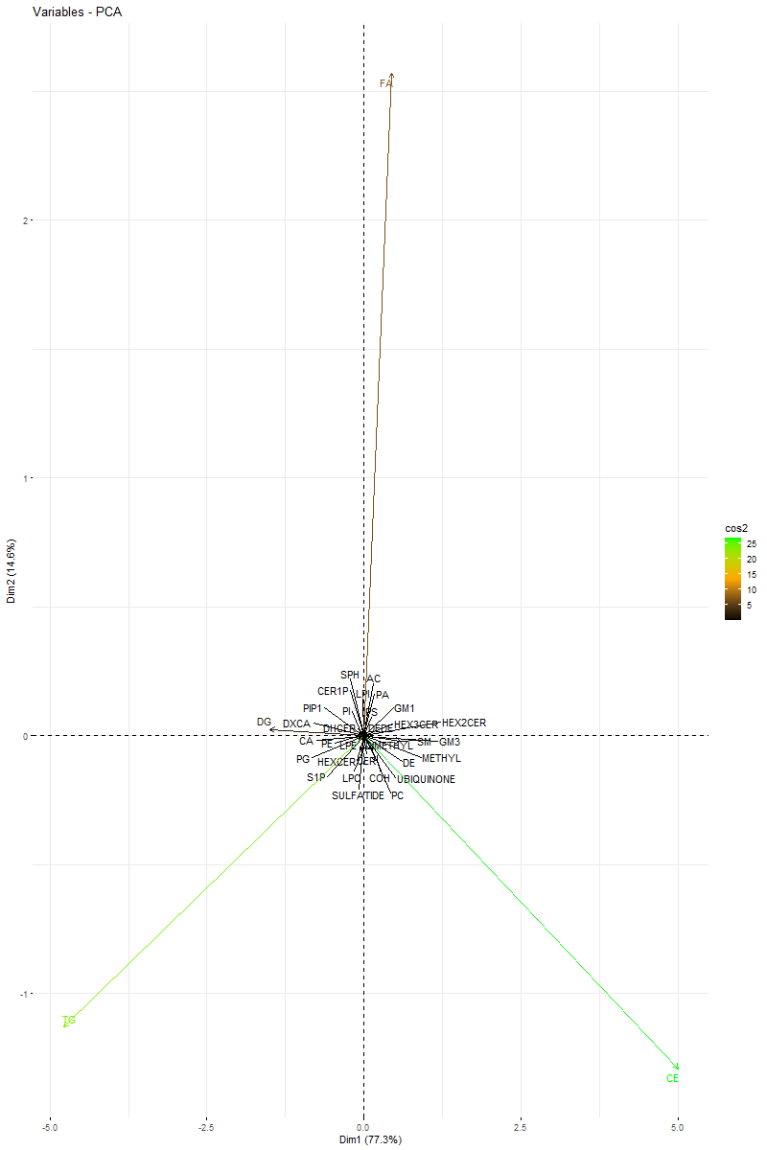

Slide 23
CN Patients

Slide 24


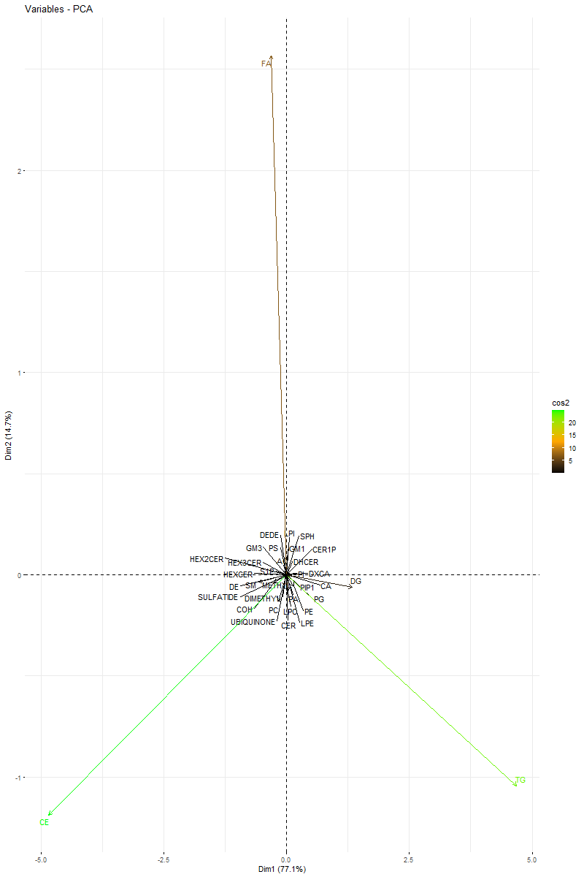

Slide 25
PCA Diagnosis Group Definition

Slide 26
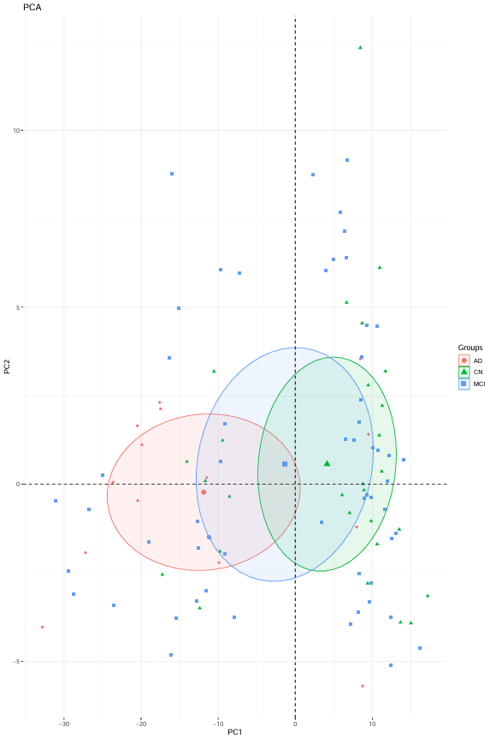

Slide 27
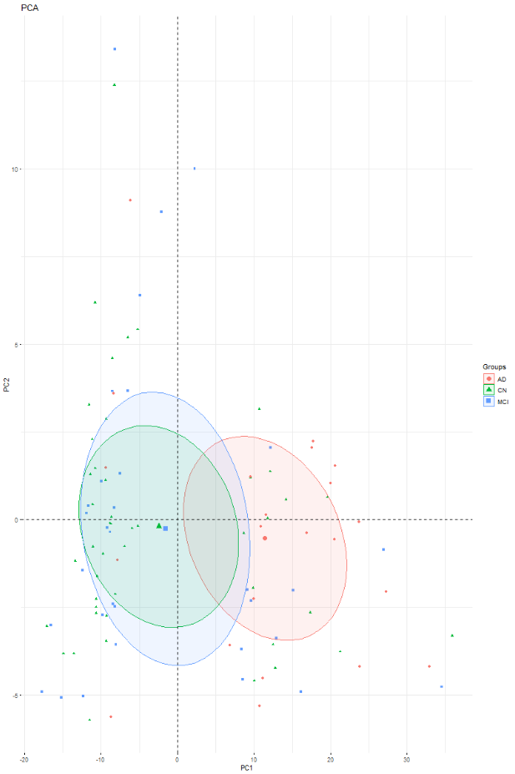

Slide 28
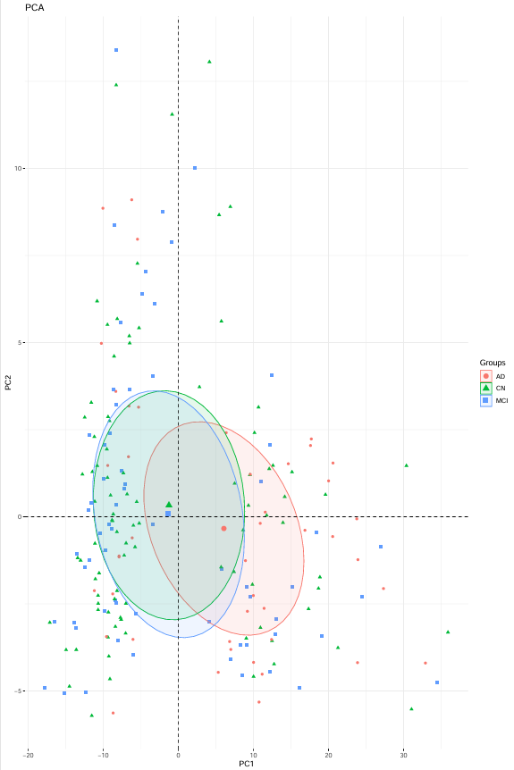
*removidos pacientes com MCI e uma idade superior a 70
Eclipse nível 0.30
Top 200

Slide 29
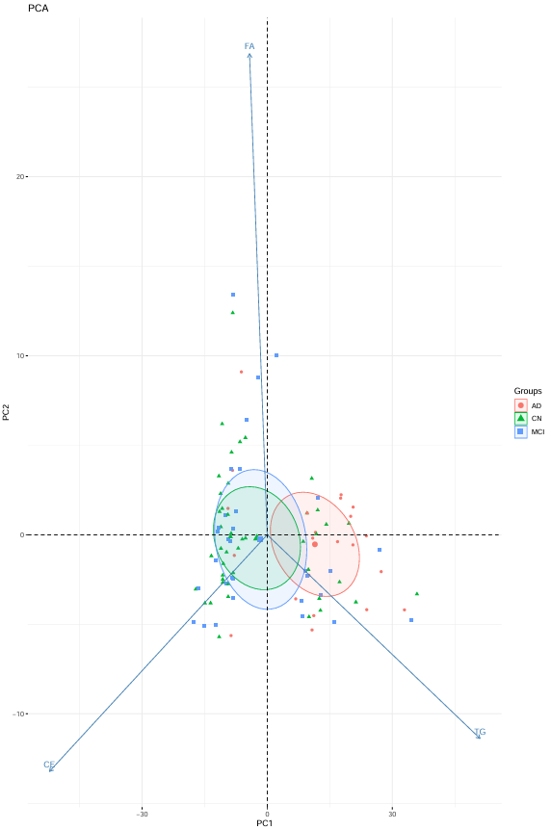
*removidos pacientes com MCI e uma idade superior a 70
Eclipse nível 0.30
Top 100
Biplot

Slide 30
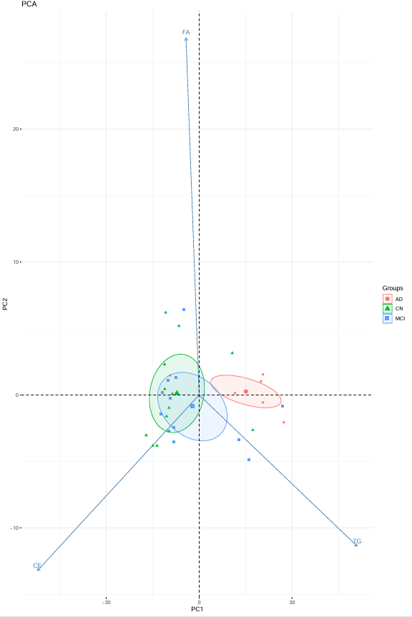
*removidos pacientes com MCI e uma idade superior a 70
Eclipse nível 0.30
Top 30 contribuições
Biplot

Slide 31
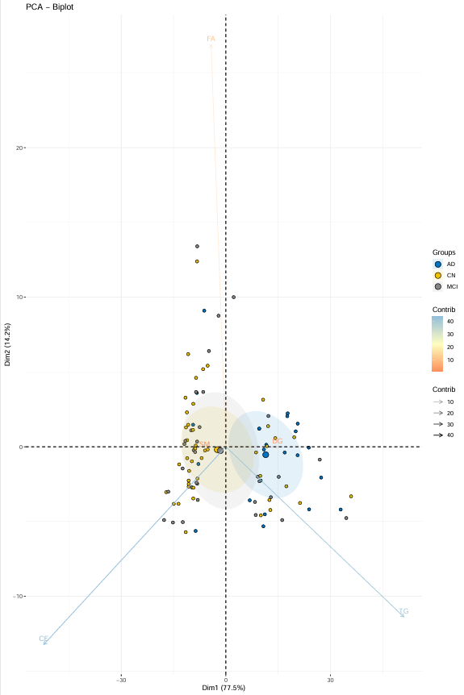
*removidos pacientes com MCI e uma idade superior a 70
Eclipse nível 0.30
Top 100 contribuições
Biplot

Slide 32

Prediction of the evolution of Alzheimer’s Disease A study with a multimodal approach
Ciarán McEvoy, A87240
Dissertation supervised by
Vitor Alves
Tiago Gil Oliveira

