Slide 1
Event Request Unit (ERU)
Embedded systems assignment 2

Slide 2
What is an eru?
An ERU is an Event Request Unit is found in XMC1100 microcontrollers produced by Infineon.
An ERU can select, combine, detect and memorize peripheral events, and then trigger a pulse that the system will accept as a request for hardware actions.
An event occurring on the dedicated input(s), having undertook any specified operations, will trigger the relevant output in real-time, which is suitable for the time-critical systems common for all Embedded Systems.

Slide 3
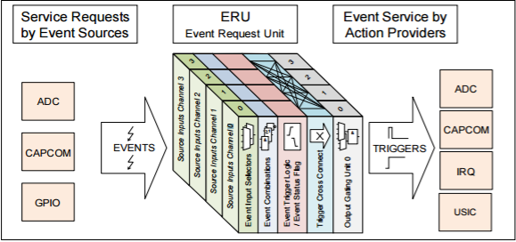
Basic function visual overview

Slide 4
Useful Features
Flexible processing of service requests
Multiple inputs from per channel
Input and Output Gating Functionality
Can be used for level or edge triggered events
Triggers combinable from multiple inputs

Slide 5
ERU Blocks
Connected to each input channel.
Allows for the transition to be defined (edge or level triggered, and what consists of a trigger input (High/Low).
The selected signals’ input levels are translated into the corresponding events.
Event Trigger Logic (ETL)
Event Input Selectors inspect two inputs on the microcontroller. They allow the selection of one of these inputs, for which there are 4 possible signals available.
The Event Combinations at this stage may perform a logical combination of any two of the configured inputs, to act as a single input for a trigger.
Event Request Select (ERS) Unit

Slide 6
ERU Blocks
Distributes the events and status flags to the Output Channels.
Also receives peripheral trigger signals which can be combined (OR logic) with other trigger signals.
Trigger Cross Connect Matrix
Combines trigger events and status information.
Gates the output depending on a gating signal.
Trigger Combo: trigger event and pattern change event are OR-combined.
Pattern Detection: Pattern match can be detected when enabled status flags set.
Output Gating Unit (OGU)

Slide 7
ERU Initialization
Service Requests must be enabled at source and destination.
Write to register bit fields to determine functions and initialise ERU.
Peripheral Outputs
Must be selectively enabled, but the procedure to do so depends on the individual peripheral.
The ERU0 can be programmed to process and route the request (Optional)
External Requests
The selected ports must be programmed for input.
ERU0 must be programmed to process and route the external request.

Slide 8
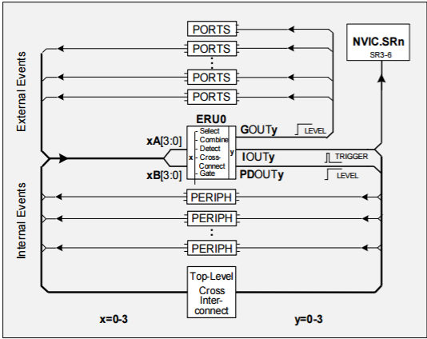
Physical Structure
5 x External Input Control Selection Registers
4 x Output Control Registers
ERU connectivity with XMC1100 chip →
Certain Input/Outputs for the ERU are programmed onto certain ports of the chip, e.g. ERU0.GOUT2 on P0.2, P2.1

Slide 9
Example configuration
Description of Example: ERU0 used to trigger an external interrupt request upon detection of two input signals being logically ANDed together. Both inputs must be high to trigger the event.
Two Digital inputs must be configured on ERU accepted ports (P2.6, P2.10) and connected to signals A and B on the event detector. ( eg button inputs)
The trigger out signal must be connected to the trigger in of the event generator.
The iout output signal of the event generator must be connected to an interrupt sr_irq, which will have an IRQ handler method which produces the required output ( flash LED etc) .

Slide 10
Benefits to embedded systems
This unit reduces software usage for interactions between certain inputs (e.g. Analog and Digital inputs) and the corresponding triggered output event.
Real Time Systems as triggers/events are hardware handled, software usage increases time delays.
Reduction in software handlers as interrupt controllers are not needed. For hardware actions/events.
Allows for a combination of inputs to be used easily for triggering output signals.
ERU usage expands the P-to-P connections of the device :
- ports-to-peripherals
- peripherals-to-peripherals
- ports-to-ports

